Slide 1
SMS
SCHOOL MANAGEMENT SYSTEM
By : Rakesh

Slide 2
Content
Introduction
Technical Requirements
Use Case Diagram
Implementation
Output Screens
Future Enhancements

Slide 3
Introduction
Welcome to School Management System, Our platform offers an integrated approach to managing student information, academic records, attendance tracking, and resource allocation.
Experience the future of education administration with our School Management System.

Slide 4
Technical Requirements
Software Requirements
Bootstrap, Angular, Node.js
Code Editor ,Web Browser & Font awesome
Dependencies :@angular/forms, @angular/router, rxjs, typescript, @angular/cli
Hardware Requirements
4/8 Gb RAM
Minimum 256 Gb SSD
I3 or above processor

Slide 5
CASE DIAGRAM
SCHOOL MANAGEMENT SYSTEM
Admin
End User
LOGIN
Employee Details
Add Student Details
Manage Student Details
Student Details

Slide 6
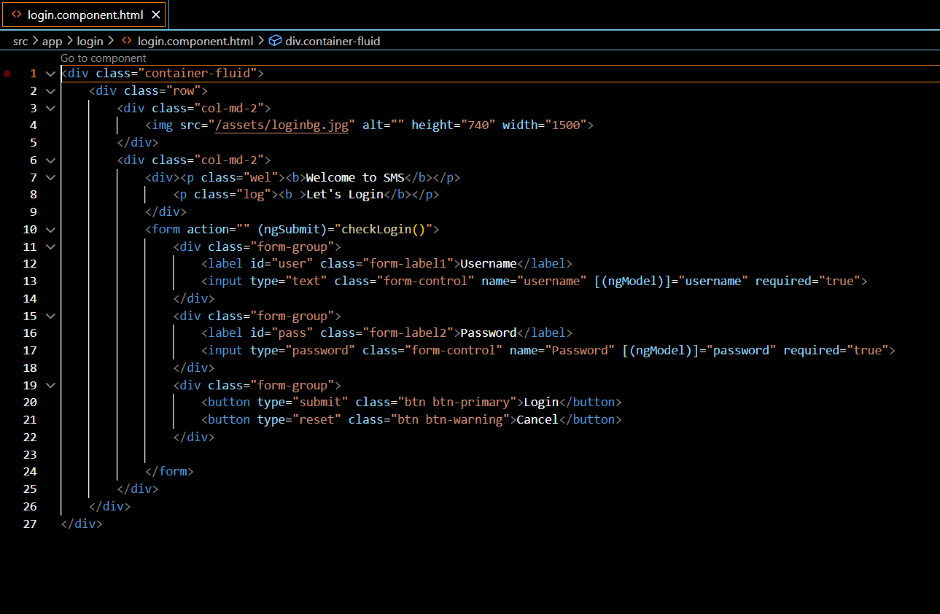
Implementation
LOGIN
METHOD

Slide 7

OUTPUT

Slide 8
Future Enhancement
We will add Back End (graphic Interface) to the project and add more security to the project.

Slide 9

THANK YOU SO MUCH FOR YOUR ATTENTION
Feedback ?

