Slide 1
Lab: Data Visualization and Analysis
Topic: Transport of Goods
Chandan Acharya
Devendra Hupri
Nagesh Taverekere Ramamoorthy
Rakesh Lagare

Slide 2
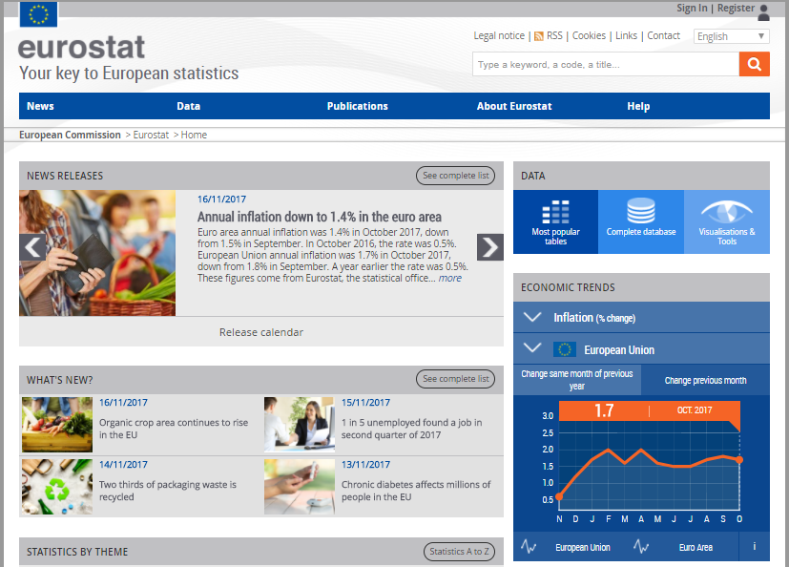
Source of data
Eurostat is the statistical office of the European Union situated in Luxembourg. Eurostat's main role is to process and publish comparable statistical information at European level.
Link:http://ec.europa.eu/eurostat/web/main/home

Slide 3
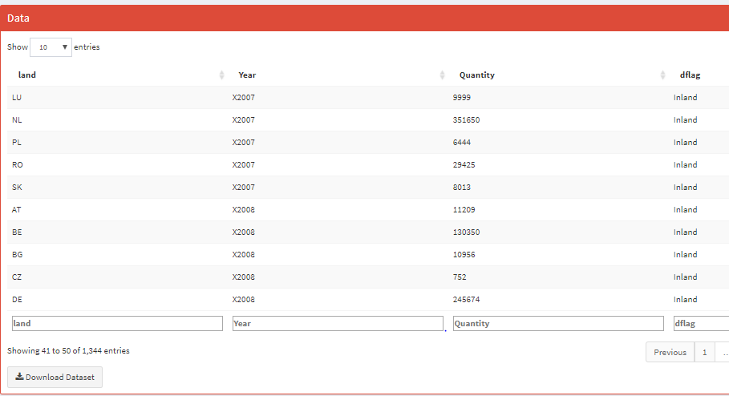
Visualization Variables:
Region/Land : EU Countries
Year : 2005-2016
Quantity : Thousand tonnes
Type/Flag : Inland, Rail, Sea, Road.

Slide 4
Usability of data
Can be used to produce statistics on the transport of goods on different modes.
Statistics can answer many questions:
Which mode of transport is opted more frequently?
How many tonnes of goods get transported in a year in multiple regions?
Which is the region with highest quantity of goods transported?

Slide 5
Visualization Demo

Slide 6


