Slide 1


Introduction to Linux
Rakesh Raghavaraju
User Support Analyst
Centre for Advanced Computing
Queen’s University
rs211@queensu.ca
March 18, 2024

Slide 2
Introduction to Linux Command Line
Rakesh Raghavaraju
User Support Analyst
Centre for Advanced Computing
Queen’s University
rs211@queensu.ca
March 18, 2024

Slide 3
About CAC
Centre for Advanced Computing (CAC) at Queen's University supports the research community by providing access to innovative digital research infrastructure (DRI)
The CAC delivers high performance and highly secure computing, supporting hundreds of Canadian research groups, comprising thousands of researchers working in a variety of fields
https://cac.queensu.ca/

Slide 4
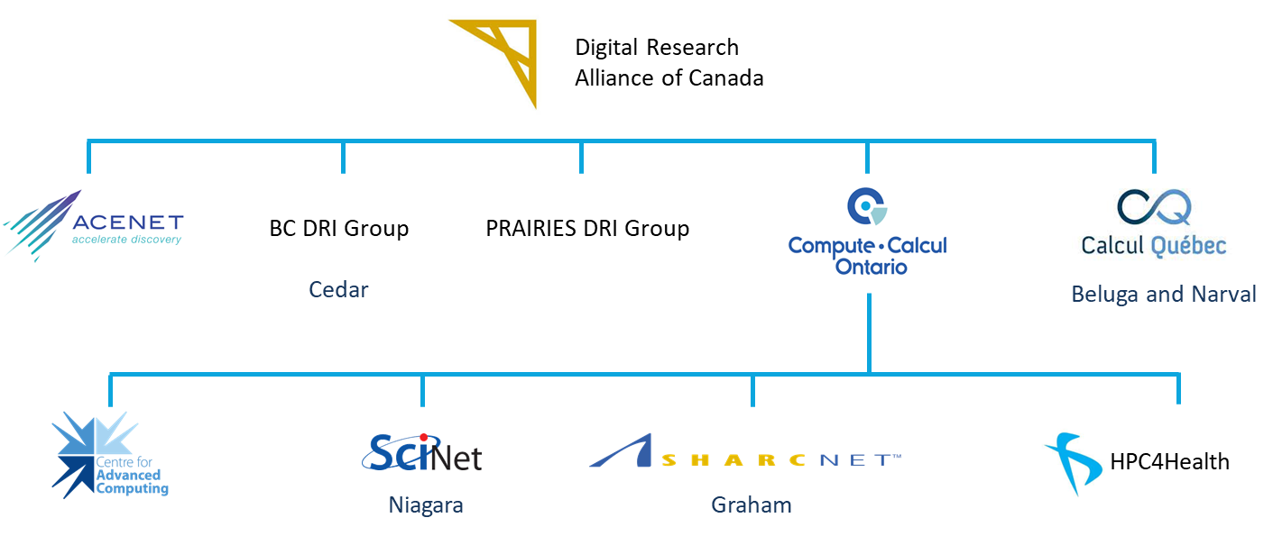
Digital Research Infrastructure(DRI)

Slide 5
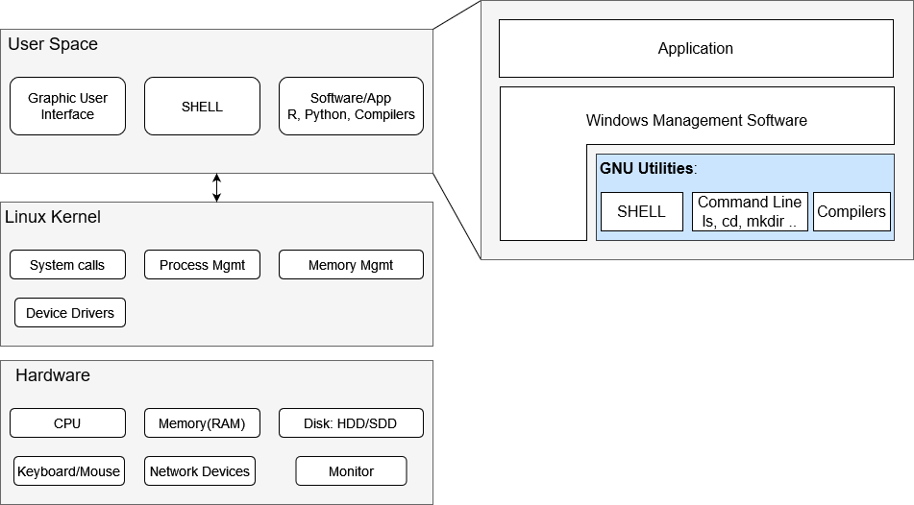
Overview of Linux Operating System

Slide 6
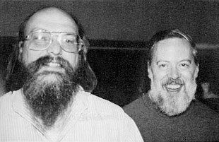
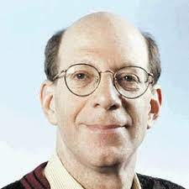
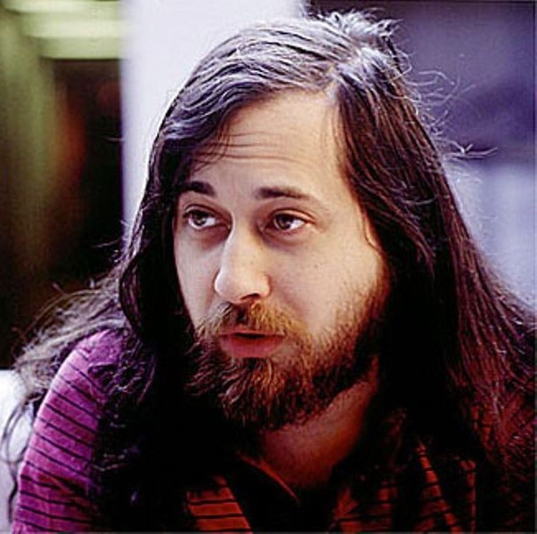
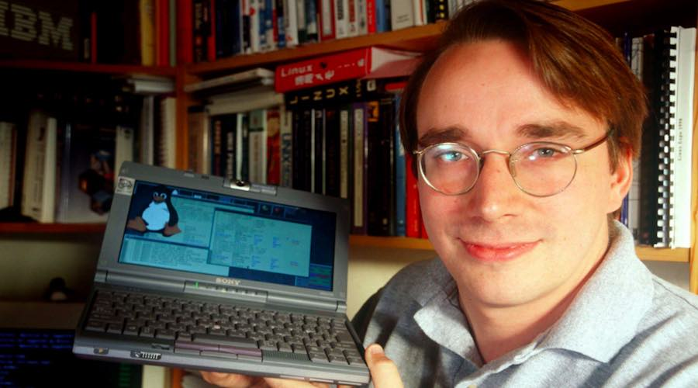
History
1970’s : Unix OS was developed by Denis Ritchie and Ken Thompson at AT&T Bell Labs
1983 : Richard Stallman started the GNU Project to create a free and open-source version of UNIX
1987: Andrew S. Tanenbaum released MINIX, a UNIX-like system for academic use
1991 : Linus Torvald started working on project that later became the Linux Kernel using MINIX with GNU C compiler. Released in 1992 under GNU GP License
1993 on : Kernel was adapted to GNU environment and several distros were developed using GNU/Linux
“I'm doing a (free) operating system (just a hobby, won't be big and professional like gnu) for 386(486) AT clones. This has been brewing since april, and is starting to get ready. I'd like any feedback on things people like/dislike in minix, as my OS resembles it somewhat (same physical layout of the file-system (due to practical reasons) among other things). “

Slide 7
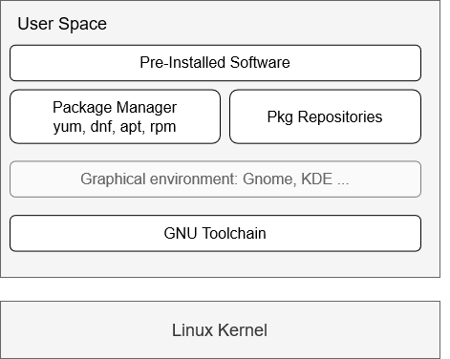
Linux Distributions(distros)
A Linux OS that includes the Linux kernel, system libraries, utilities, a selection of pre-installed software, a package manager and in most case a graphic environment
Debian-based: Ubuntu, Linux Mint, Raspbian
RHEL-based: RedHat, CentOS, Rocky Linux, Fedora
SUSE: OpenSUSE
Android: based on the BusyBox (not GNU)
“Linux” distributions are distributions of GNU/Linux customized to a particular userbase

Slide 8
GUI vs Command Line
Graphical User Interface
Ease to get started, familiar interface
Several pre-installed desktop application e.g., Libre Suite, Firefox
Good at using existing functionality
Flexibility: Less control and hard to do large and/or repetitive tasks
Not ideal for accessing a remote server; rendering is quite slow with a high overhead; higher bandwidth usage
Command Line
Hard to learn, you are given a blank canvas, and it can be overwhelming to navigate at first
Commands that are efficient at doing that one thing
Helpful in creating reproducible and repetitive workflows
Commands can be saved(in a script) and can be used later
Low overhead
For the most part, only way to use HPC

Slide 9
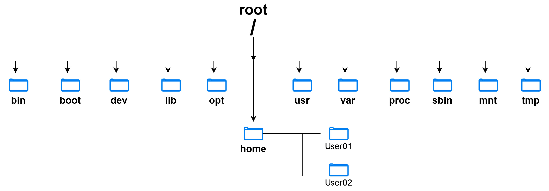
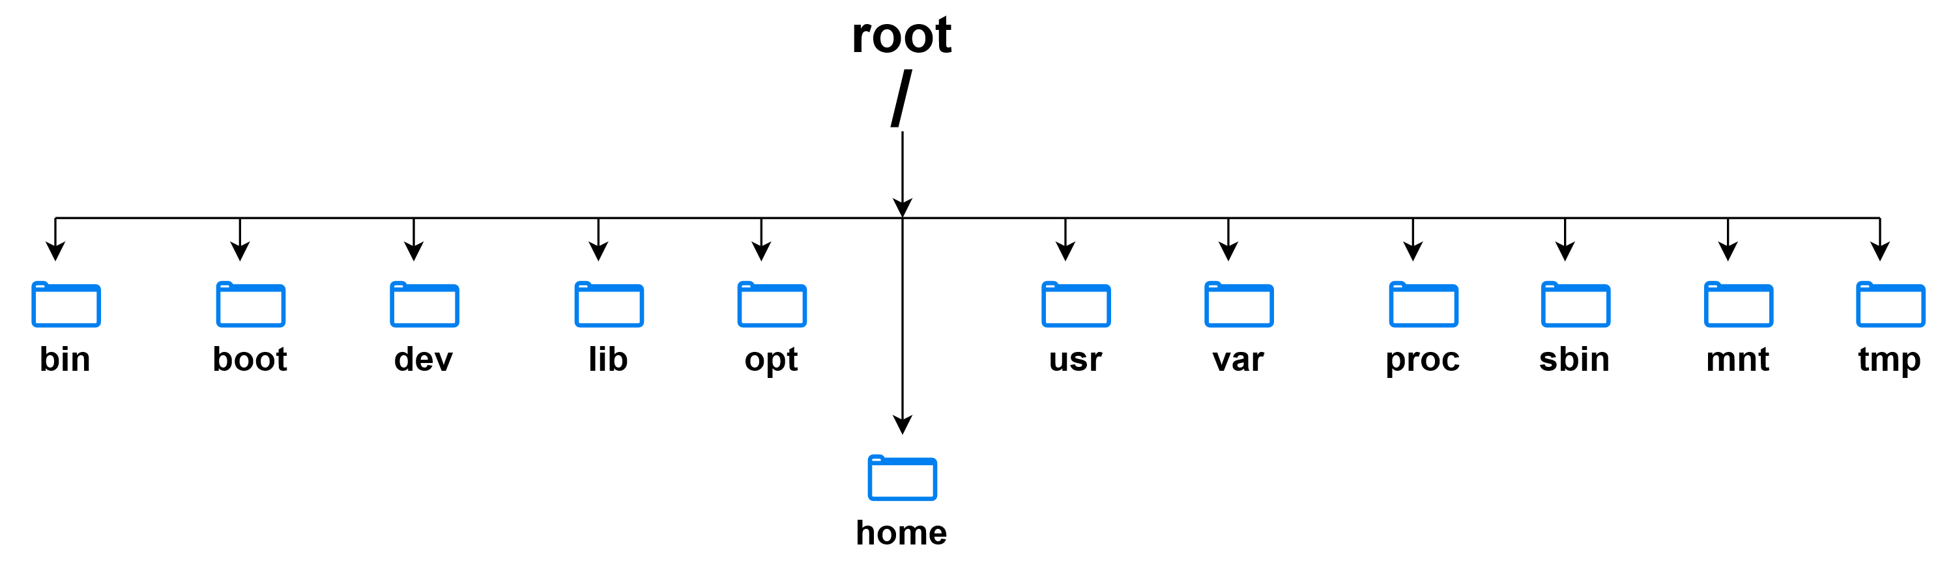
Filesystem

Slide 10
Filesystem
bin: Contains binaries(GNU Toolchain) which are program/app we can run
etc: System-wide configuration files
boot: Files required during the boot process. Should NOT be modified/touched
dev: Device files; enable interface between device and operating system
Sys: Virtual directory like /dev and contains info about connected devices
lib: Contains library files that user application and executables can use.
opt: For compile software and script that can be used system-wide
usr: Contains lib and bin directories and user applications are installed in this directory
var: Stands for ‘variable’ and contains files that vary with time, e.g., log files, cache and backup
proc: Contains system information such as info about CPU, Memory …
sbin: Similar to /bin, but contains application that can only be used by ‘root’ (superuser) user
mnt: Mount storage devices
tmp: Temporary files
home: This is the directory for user’s personal files; Typically, each users has a directory in this folder e.g., /home/rakeshr or /home/sa105060

Slide 11


Overview Linux Operating System

Slide 12
SHELL
Shell is a super program
It is an interface between the user and the operating system
Almost all computers including Microsoft(Powershell) has a Shell program
User can launch or run application using a Shell
Terminal or Terminal Emulator(MobaXterm) to open a Shell program
Linux shell: Bourne Shell (sh), Bourne Again Shell (bash), csh (C shell), ksh, ..
Bash is most common shell, its default shell in most GNU based distros

Slide 13
Accessing Linux Shell
MobaXterm
Terminal: MacOS, Linux
Windows Subsystem Linux(WSL)
Oracle VM VirtualBox
Google Cloud Shell: https://console.cloud.google.com/
HPC Cluster: Frontenac
Locally installed Linux Distro: Single board computer, Old laptop

Slide 14
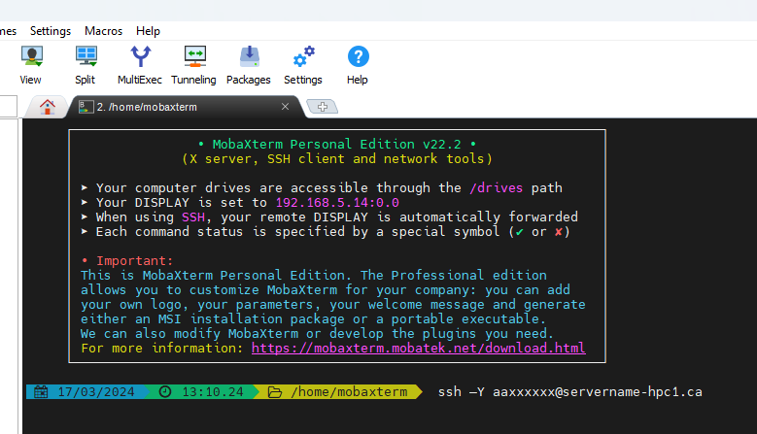
Accessing the Frontenac cluster
Requirements: SSH-Client to login
MobaXterm, PuTTY for Windows
Terminal on MacOS and Linux
ssh –Y sa130xxx@login.cac.queensu.ca
SSH stands for secure shell and enables a secure way to communicate between two hosts.
MobaXterm: https://mobaxterm.mobatek.net/download.html
PuTTY : https://www.putty.org/
Username
Graphical output
Server Name
Notes:
sl

Slide 15
Exercise 0: Login to the cluster (15 mins)
Download or open a Terminal or Terminal emulator (MobaXterm)
Login to the Frontenac cluster

Slide 16
Navigating the filesystem
Learn how to move around the filesystem through command line and explore the files
Commands used
pwd Present Working Directory
ls list the files in the directory
cd change directory
man <command> Manual file for the command
[sa105060@caclogin03 ~]$ pwd
/global/home/sa105060
[sa105060@caclogin03 ~]$ ls
CAC_files.txt jobname-5334773.out
jobname-%e.err mpiinit-5345223.err submitJob1.sh
large_submitJob.sh mpiinit-5345223.out submitJob.sh
[sa105060@caclogin03 ~]$ cd /
[sa105060@caclogin03 ~]$ ls
…
[sa105060@caclogin03 ~]$ cd ~

Slide 17
Navigating the filesystem
cd command options ‘cd – ‘ : Previous folder ‘cd ..’ : Change to parent directory ‘cd ../..’ : Two directories up to parent directory ‘cd ~’: Change current working directory to ‘home’
[GDB_Valgrind]$ ls -a
. .. 00_HelloWorld 01_readArg 02_Divisors 03_Factorial 04_CalcPi 05_InfiniteLoop 06_IllegalMemAccess Debugging_PDO_March2023.pdf

Slide 18
Exercise 1: Exploring the filesystem on your local terminal
Open a terminal on your local computer(or on Frontenac) and change to $HOME directory and identify all the files in the folder

Slide 19
Exercise 1: Exploring the filesystem on your local terminal (10 mins)
Open a terminal on your local computer(or on Frontenac) and change to $HOME directory and identify all the files in the folder Note: Explore various flags for ‘ls’ command using ‘man’ or ‘- -help’ and find the option to print all the files including hidden file(has a ‘.’ prefix in the file name)
On Frontenac, change the directory to ‘/global’ and list all the sub-folders

Slide 20
A few tips
‘tab’ will auto-complete the command
Use ←,→ arrows to navigate within the command
You can get previous commands using ↑ ↓ arrows
‘history’ to get a list of previous(~1000) commands used in the shell
Run multiple commands in a single line
command_1; command_2;
command_1 && command_2 # command_2 will only run after the command_1 is successful

Slide 21
Creating files
Create files and learn how to read and write to the file/folder
Commands that we will use
mkdir Creates a new file in the
touch Create an empty file
echo Display text to screen/stdout
nano Text editor
cat Display the content of the file
[IntroLinux]$ mkdir Example01
[IntroLinux]$ cd Example01/
[Example01]$ touch file01.txt
[Example01]$ ls
file01.txt
[Example01]$ echo "First line of the file"
First line of the file
[Example01]$ echo "First line of the file" > file01.txt
[Example01]$ cat file01.txt
First line of the file
[Example01]$ nano file01.txt

Slide 22
Moving files
[Example01]$ ls
file01.txt
[Example01]$ cp file01.txt file01.bak.txt
[Example01]$ ls
file01.bak.txt file01.txt
[Example01]$ rm file01.bak.txt
[Example01]$ mv file01.txt file01_renamed.txt
[Example01]$ mkdir backup_dir
[Example01]$ cp file01_renamed.txt file01.txt
[Example01]$ mv file01.txt ./backup_dir/
[Example01]$ ls
backup_dir file01_renamed.txt
[Example01]$ ls backup_dir/
file01.txt
Here, we learn on how move, copy, delete and create links to existing file
Commands used
mv move or rename a file
cp copying files
rm remove files
ln create a link to a file

Slide 23
Exercise 2: Create files and folders (10-15 mins)
Change directory to ‘/global/project/Workshop2023/IntroLinux’ and create a folder with your username ‘sa130xxx’
Create a file in this folder and enter your first line(‘This is the first line’) into this file
Now copy the file to a new file
And add a second line to the folder ‘This is a second line’
(Optional) Examine the difference between the first file and second file using ‘diff’. Use ‘man’ command to find the syntax for diff command.

Slide 24
View file content
Commands used
more View file content
less View file content
head First few lines of the file
tail Last few lines of the file
[IntroLinux] $ cd grep_Tut
[grep_Tut] $ more NameList_200.txt
…
[grepTut]$ head -n 6 NameList_200.txt
FNAME, LNAME, City, Province
Arwen, Kirk, Ottawa, ON
Thor, Lannister, Kingston, ON
Trinity, Smith, Waterloo, ON
Athena, Gandalf, Winnepeg, MB
Juliet, Smith, Halifax, NS
[grepTut]$ tail -n 5 NameList_200.txt
Bilbo, Gandalf, Vancouver, BC
Trinity, Smith, Vancouver, BC
Shrek, Baratheon, Calgary, AB
Bruce, Loki, Halifax, NS
Athena, Bane, Toronto, ON

Slide 25
Examine file content
Commands used
grep search for a key word
wc word count
Wildcards
Regular expressions (regex) special character
[IntroLinux] $ cd grep_Tut
[grep_Tut] $ grep ‘Toronto’ NameList_200.txt
[grep_Tut] $ wc NameList_200.txt
[test0]$ wc -l example3.fastq
400 example3.fastq
[grep_Tut] $ ls ./Nek5000/bin/nekb*
nekb nekbb nekbmpi
[grep_Tut] $ ls ./Nek5000/bin/nek[1-9]*
nekb nekbb nekbmpi
[grep_Tut] $ grep ‘[tT]oronto’ NameList.txt
[grep_Tut] $ grep ‘Toronto|Ottawa’ NameList.txt
. | Match any single character
* | Any character must appear zero or more times
? | Preceding character must appear once
^ | Pattern at the begin of the line
$ | Pattern at the end of the line
\ | Escape the special character
[] | Should contain any of the character
| | In pattern matching you can specify two or more patter

Slide 26
Piping
We can pipe(or re-direct) output from one command to another command using ‘|’
You can find ‘|’ just about the enter key on most keyboards
[IntroLinux] $ cd grep_Tut
[grep_Tut] $ cat NameList_200.txt |grep ON| wc –l
89
[grep_Tut] $ grep 'ON' NameList_200.txt | grep -v 'Toronto' |wc –l
76

Slide 27
Exercise 3: Examine the content of the file (10 mins)
Copy ‘1_control_trnL_2019_minq7.fastq’ from ‘IntroLinux/CourseMaterial/grepTut’ to your folder in ‘IntroLinux /sausers/’
And count the number of lines in the file
(Optional) Find the number of lines with the sequence A,C,T,G
Download NEK5000 tar file from github and untar the file. You can find the commands in ‘IntroLinux/CourseMaterial/grepTut DownloadCommands’

Slide 28
Searching for files
Commands that we will learn
find Find files and directories in a hierarchy tree
~ $ module load qt/5.9.6
~ $ cd EBROOTQT5
[5.9.6] $ find . -type d -name ^Qt
…
[5.9.6] $ find . -type d -name ^qt

Slide 29
Copying and Downloading files
wget to download file from the weblink
‘git clone’ to download file from github
tar and gunzip to decompress the files
scp, sftp commands to copy file to and from remote servers
[IntroLinux] $ cd grep_Tut
[grep_Tut] $ wget https://github.com/Nek5000/Nek5000/.../v19.0.tar.gz
…
[grepTut]$ ls -la v19.0.tar.gz
-rw-r----- 1 rakeshr wheel 4224008 Oct 9 22:48 v19.0.tar.gz
[grepTut]$ git clone https://github.com/Nek5000/Nek5000.git
[grepTut]$ ls -lad Nek*
drwxr-x--- 11 rakeshr wheel 4096 Oct 9 22:51 Nek5000

Slide 30
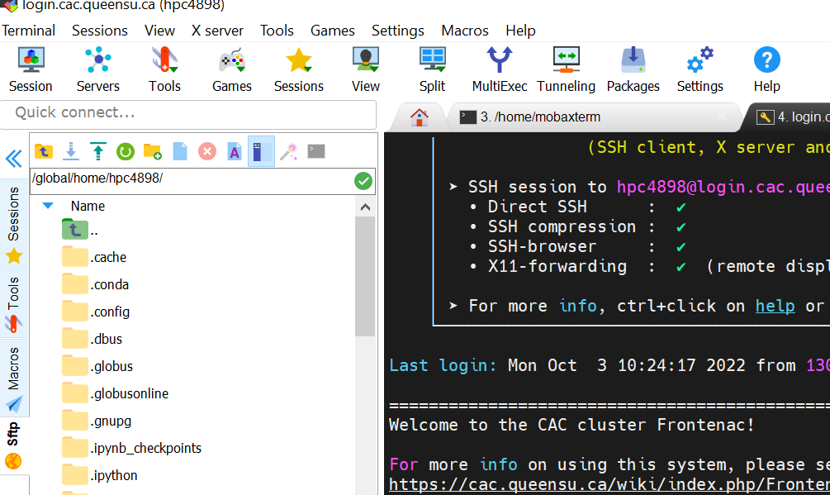
Copying files to the cluster
Command line: rsync, scp $ scp –R ./myfile.txt sa105060@login.cac.queensu.ca:/global/home/sa105060/Myfolder/
Filezilla; SFTP session(MobaXterm): GUI interface
Globus: For transferring large datasets
References https://cac.queensu.ca/wiki/index.php/UploadingFiles:Frontenac https://docs.alliancecan.ca/wiki/Transferring_data Globus: https://docs.alliancecan.ca/wiki/Globus
Recursive
Source path
Username:Server Addresss
Destination path

Slide 31
Exercise 4: Upload a file (10 mins)
Create a file called ‘Local_file.txt’. Add a few lines to this file and upload it to Frontenac cluster

Slide 32
Redirecting input and output
Output from the command is printed to screen; Input is streamed from the keyboard
Redirecting stdin, stdout, stderr using ‘>’ and ‘<‘
[04_CalcPi]$ ./calcPi
No arguments were entered defaulting to N=10000
The value of PI is: 3.1416
[04_CalcPi]$ ./calcPi > out.txt
[04_CalcPi]$ cat out.txt
The value of PI is: 3.1416
[04_CalcPi]$ ./calcPi 1>out.txt 2>/dev/null
[04_CalcPi]$ cat out.txt
The value of PI is: 3.1416
[04_CalcPi]$ ./calcPi 1>out.txt 2>&1
[04_CalcPi]$ cat out.txt
The value of PI is: 3.1416
[04_CalcPi]$ wc –l < calcPi.c
23
> | to redirect the output to a file or device
< | to redirect input from a file or device to a command application
1> | stdout to a file or device
2> | stderr to a file or device

Slide 33
File permissions
d: directory
-: file
l: symbolic link
drwx rwx rwx
r: read
w: write
x: execute
u:user
g:group
o:other
Linux is a multi-user system and multiple users can use it, simultaneously. File permission are set to grant access to the user on the file system.
chmod: change file permission $ chmod g+w Makefile $ chmod u+x Makefile $ chmod ugo+x Makefile $ chmod 754 Makefile
4: read (r); 2: write (w); 1: execute (x)
chown: change ownership of the file $ chown username:grpname filename
[simpleZeroCopy]$ pwd
/global/home/hpc4898/cuda-sample/0_Simple/simpleZeroCopy
[simpleZeroCopy]$ ls -la
total 515
drwxr-x--- 3 hpc4898 hpcgtest 4096 Aug 31 2021 .
drwxr-x--- 41 hpc4898 hpcgtest 4096 Aug 31 2021 ..
drwxr-x--- 2 hpc4898 hpcgtest 4096 Aug 31 2021 doc
-rw-r----- 1 hpc4898 hpcgtest 8236 Aug 31 2021 Makefile
-rw-r----- 1 hpc4898 hpcgtest 2111 Aug 31 2021 NsightEclipse.xml
-rw-r----- 1 hpc4898 hpcgtest 236 Aug 31 2021 readme.txt
-rw-r----- 1 hpc4898 hpcgtest 8731 Aug 31 2021 simpleZeroCopy.cu

Slide 34
Exercise 5: File permissions (10 mins)
Copy the folder from ‘/global/project/Workshop2023/IntroLinux/CourseMaterial/Example01’ and troubleshoot if you face any issue Note: All sa130XXX accounts are part of sg130000 group
Notes:
Take out write permissions

Slide 35
Environment variables
System variables: $PATH, $LD_LIBRARY_PATH, $LIBRARY_PATH
User-defined variables export INSTALLPATH=~/bin
Programs and Scripts can use env variable to obtain information about the system
$ env
..
LIBRARY_PATH=/cvmfs/.../R/lib:/cvmfs/.../r/4.3.1/lib:...:/cvmfs/.../lib/intel64
OLDPWD=/global/project/rakeshr/IntroLinux/RedirectingOutput/04_CalcPi
SHELL=/bin/bash
USER=rakeshr
$

Slide 36
Exercise-6
Load a module called dealii using the following commands and check how the path variable changes with each command
module --force purge
module load StdEnv/2020 gcc/9.3.0
module load dealii
On Frontenac we use Slurm as our job scheduler. Running the following to ask for interactive node through scheduler. salloc --nodes=1 --ntasks=1 --mem=1g --time=15:00 Once the job is allocated find all the environment variable that start with ‘SLURM’. Use ‘grep’ command to search for the variables.

Slide 37
Useful Linux commands
cd | Change directory
ls | List files in the directory
mkdir | Make directory
cat | Display the content
mv | Move/Rename a file
rm | Remove file/directory
history | List the past commands used
clear | Clear the terminal
cp | Copy files
echo | Print to screen
wc | Word count
file filename | Information about the file
which command | Location of the executable
diff file1 file2 | Compare two files
wget | Download files from urls
sort file | Sort the lines
source file | Execute the command in the file
grep key file | Search for the ‘key’ in file
cmd1 | cmd2 | ‘|’: Pipes the output one cmd1 as input for cmd2
tar | Untar/ tar files; similar to ‘zip’
head –n 100 file | Prints first 100 lines
tail –n 100 file | Prints last 100 lines

Slide 38
Closing Exercise-7
Copy this tar file to your local machine ‘/global/project/Workshop2023/IntroLinux/CourseMaterial.tar.gz’
Unpack the files on your local machine.

Slide 39
Shell scripting
Shell script is a set of commands stored in a file and can be re-used
Command line is useful when you run 1 or 2 commands. But scripting become necessary for complex workflows
Each shell script must start with ‘#!’ line that specified the shell. Here we are using bash shell #!/bin/bash
Commands in following lines are executed in sequence
We can use conditional statement(if-else) and for loops in the script

Slide 40
Shell scripting
Variable
Passing arguments to the script
Conditional statement
For and while loop

Slide 41
Advanced commands
SED
AWK
Notes:
Change .lua file: sed
Sacctmgr for AWK

Slide 42
References
Blum R and Breshnan C., 2015, Linux Command Line and Shell Scripting, 3rd Edition
Linux Foundation: https://training.linuxfoundation.org/training/introduction-to-linux/ https://www.youtube.com/watch?v=sWbUDq4S6Y8&t=4552s
Brian Ward, How Linux Works: What every superuser should know
Wikipage: https://docs.alliancecan.ca/wiki/Linux_introduction

Slide 43
Thank you

Slide 44
DEMO: Exploring Linux Filesystem with GUI
Filesystem: What happened to my C:\ drive?

