Slide 1
HEALTH CARE FACILITIES IN RURAL AREAS
Team members:
20761A05A5
20761A05A6
20761A05A7
20761A05A8
20761A05A9

Slide 2
Contents
Abstract
Introduction
Objectives
Survey Area
Analysis and Interpretation
Pictures of the survey
Conclusion

Slide 3
Abstract
The main objective of this project is to acquire an understanding of medical and health. Facilities in rural areas.
In rural communities, the health care facilities are not in a well-developed state.
In some cases, the rural individuals do not have access to these facilities and are required to travel to urban areas.

Slide 4
Introduction
Although these surveys all have the health facility surveys as their focus, they vary along at least four important dimensions.
First, they have different motivations. Some aim to understand better how health facility characteristics influence health-seeking behaviour and health outcomes, while others make the facility the focus of analysis, emphasizing issues such as cost, efficiency, and quality.
We seek to provide an introduction to health facility surveys, and to the methodological approaches that underpin them.
We discuss what has motivated different health facility surveys and approaches to measurement and outlines how facility data have been used.

Slide 5
Objectives
To understand how the community health care center works.
To understand about CHC (Community Health Centre) in patients and workers perspective.
To measure satisfaction of patients in C.H.Center.
To study the challenges faced by patients in rural areas.
To analyse and provide some solutions for the observed problems.

Slide 6
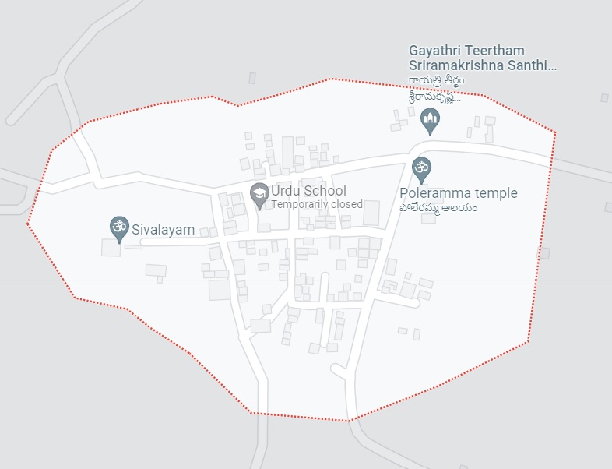
Survey Area
The survey was carried out in prime locations that come under the vicinity of Pondugula near temple, panchayat and rice mill bazaar few prominent places visited during the survey are as follows:
Rice mill Bazar
Temple, Panchayat
Sc colony

Slide 7
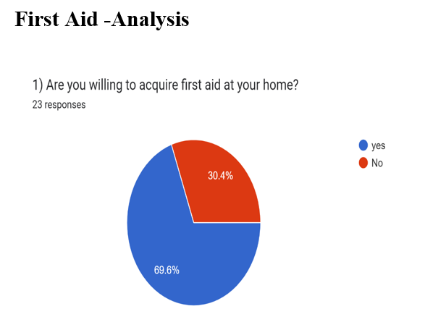
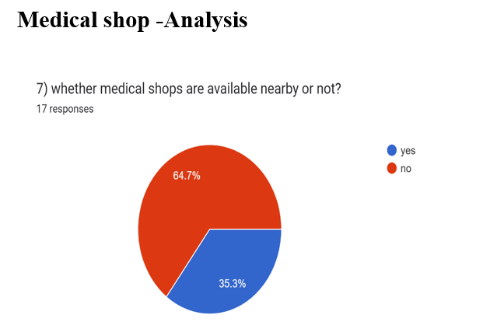
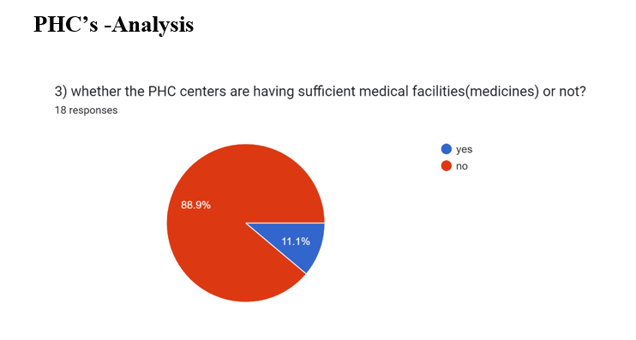
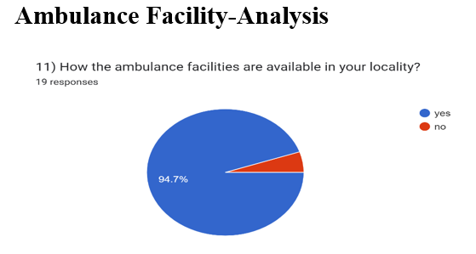
Analysis and Interpretation

Slide 8
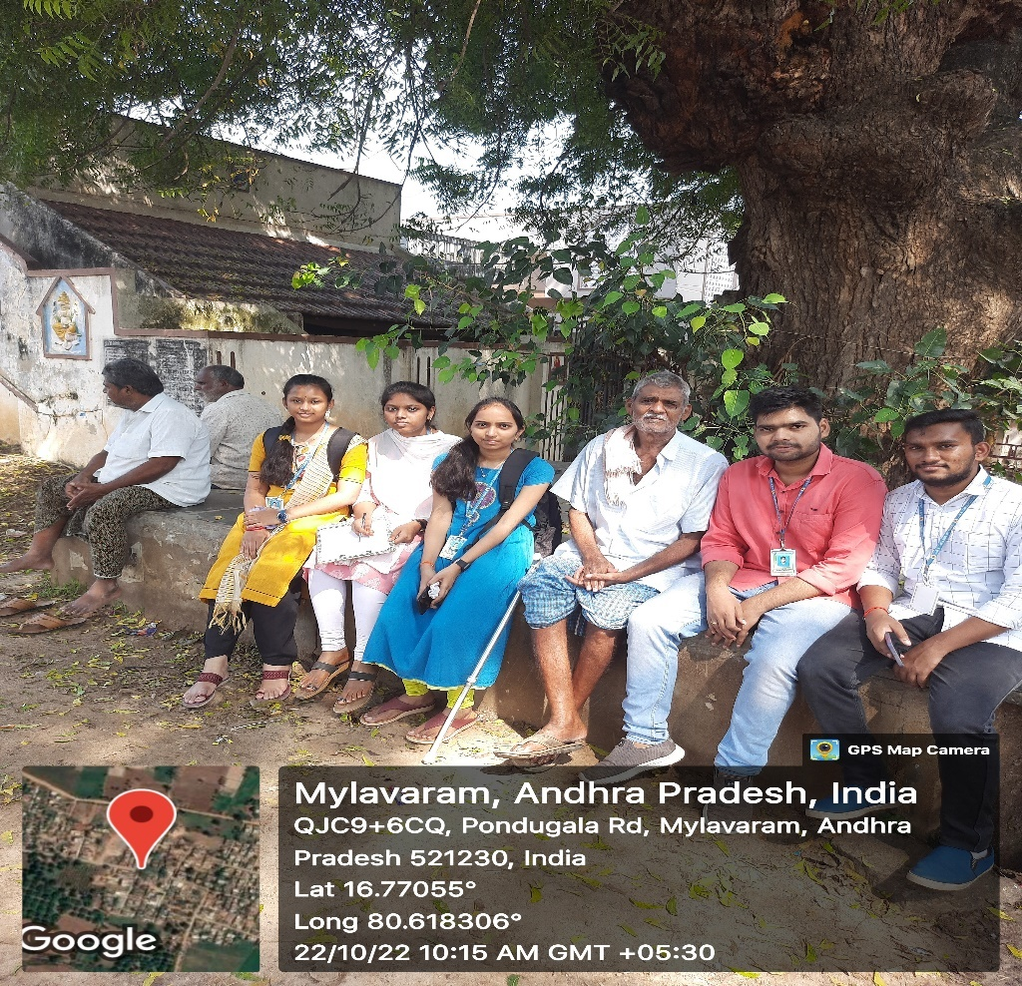
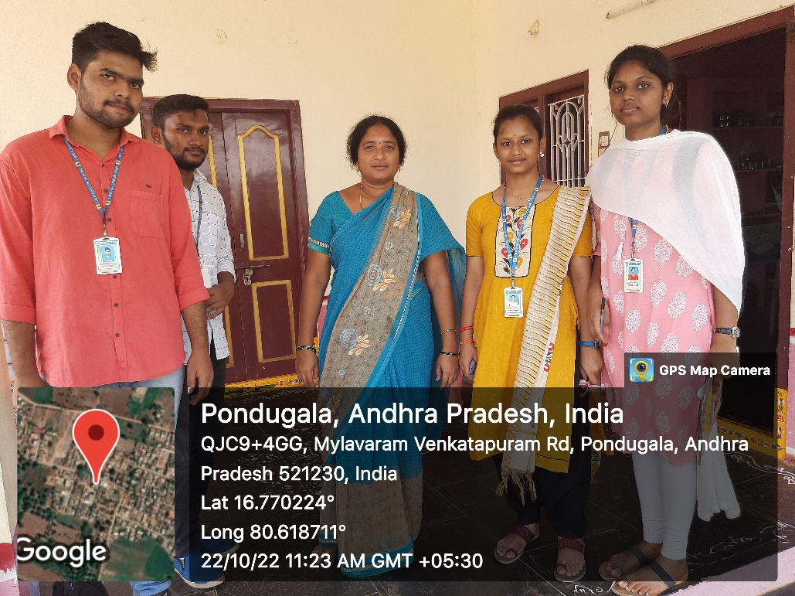
Pictures of the survey

Slide 9
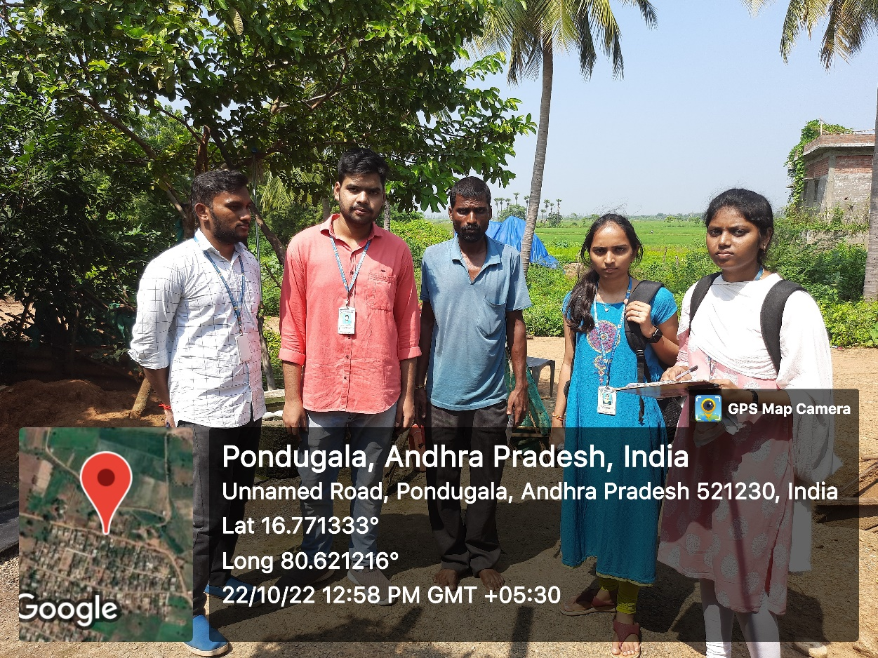
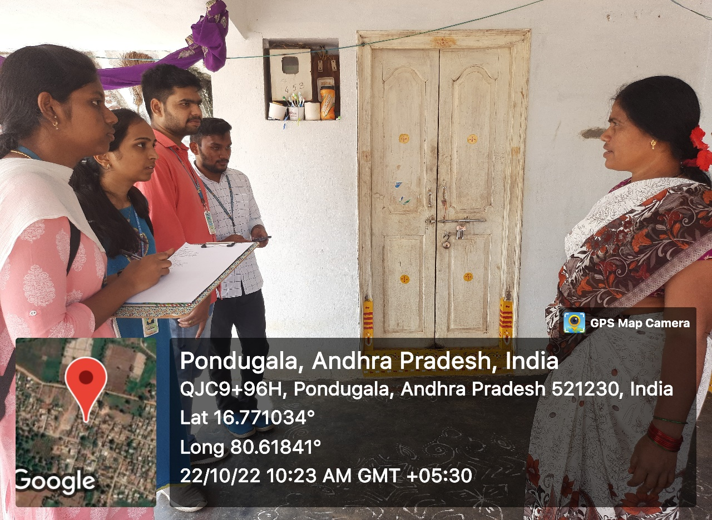
Pictures of the survey

Slide 10
Conclusion
Health care is regarded as one of the important aspect that is a major requirement of the individuals, belonging to various castes, creeds, races, ethnicities gender, age groups and socio-economic background.
In rural communities, the health care and medical facilities are not in a much developed state.
In some cases, when rural individuals experience severe health problems and illnesses, they are required to migrate to urban communities.
When the origin and evolution of primary health care in India takes place, the main programs and scheme.

Slide 11


