Slide 1

Community service project
LAKIREDDY BALI REDDY COLLEGE OF ENGINEERING (AUTONOMOUS) Accredited by NAAC & NBA (Under Tier - I), ISO 9001:2015 Certified Institution Approved by AICTE, New Delhi and Affiliated to JNTUK, Kakinada L.B. REDDY NAGAR, MYLAVARAM, NTR., A.P.-521 230.
DEPARTMENT OF COMPUTER SCIENCE & ENGINEERING
HEALTH AND MEDICAL FACILITIES
Project Guide: Team members:
Ms.CH.Nagamani T.Venkata Manikanta Rakesh
T.Murali krishna
Head of the department: T.Sujith Reddy
Dr.Veeraiah, HOD, Professor Vellanki Vijaya Lakshmi
Yarasani Saida Reddy

Slide 2
CONTENTS
Introduction
Objectives
Health and its’s benefits
Survey area
Analysis and interpretation
Problems identified
Survey pictures

Slide 3
INTRODUCTION

Slide 4
India is having limelight at global front not only in terms of its health scenario also.
Even after Independence, its population is still brewing under the scourge of degraded health system.
There are nearly 8.46 crore rural people who are constantly battling for basics healthcare services in their habitat.
This condition has been aggravated by worsening living condition of rural habitats.
The unsafe and unhygienic conditions of households , drinking water, environmental causes, poor nutrition , poverty , smoking and alcoholism living areas promotes expansion of several diseases in rural areas.
And also, some rural areas are not having proper medical facilities like medical shops ,hospitals ….etc. causes more effect for rural people.

Slide 5
OBJECTIVES

Slide 6
To study the challenges faced by the people in rural areas.
To understand why rural residents, prefer urban health care services.
To understand the working conditions of government hospitals
To measure satisfaction of patients in Community Health centers.
To study the challenges faced by the animals in a veterinary hospital.
To know how the government workers making clean the roads and drainage system in rural areas.
To know every people in rural are maintaining proper nutrition for health.
To know about whether government is taking any action regarding to conducting meetings for “who to be health and who to keep our surrounding clean” and conducting any “check-up” camp for rural people .
To know the timings of government hospitals and veterinary hospitals.
Doctor’s action on any emergency cases in the area and their take over.

Slide 7
Health and it’s benefits

Slide 8
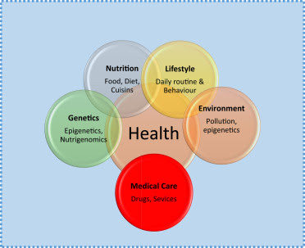
Health is a state of complete physical, mental and social well-being and not merely the absence of diseases or infirmity. Preamble to the constitution of the world health organization (WHO). Health is a multifaceted concept. It is not simply the condition of being well or unwell.
Factors influencing health are age, gender, environment, family history or heredity , genetics, temperatures/weather status,
nutrition, psychological well being, social well being , socio economic condition of the family Assistant

Slide 9
BENFITS OF HEALTH:
• More life force energy
• Increases happiness, less depression
• Save money
• Increases feeling of self-worth.
• Protect you from serious health problems
• Boots immunity
• Strengthens bones.
• Improve Brain health and mood
• Reduces stress
• Optimizes performances like focus, creativity, concentration.
• Healthy guts and organs
• Maintain healthy weight or lose it
Build confidence
.

Slide 10
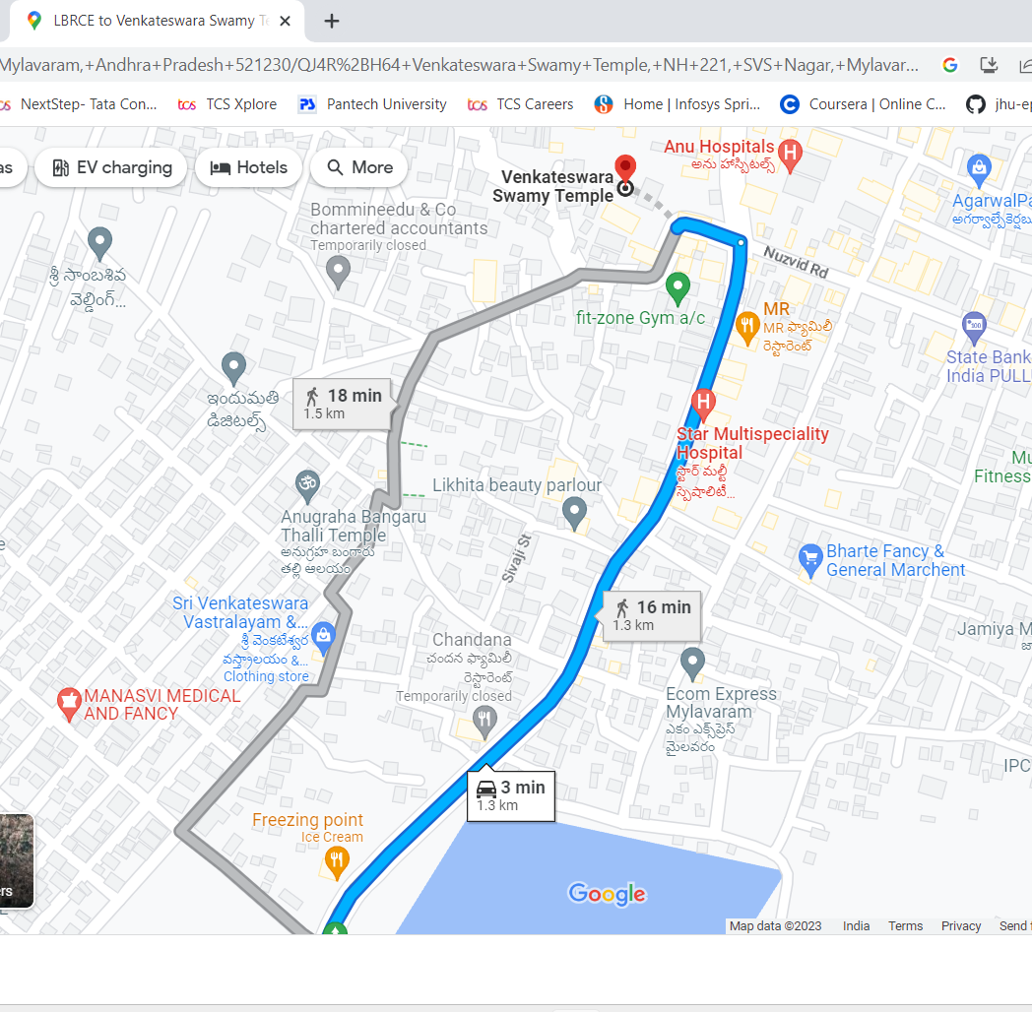
Survey Area
The survey is carried out in the place which is known as Mylavaram with the help of guide we have chosen the area for over survey.
We have chosen few areas in the rural area they are near
→Venkateswara swamy temple
→Nuzvid road
→And ,up to Bommmineedu & CO chartered accountants.
As a part of that we have visited more than 40 houses or family for the survey in these area for a part of 3 days.

Slide 11
Analysis and interpretation

Slide 12
This is regrading to services of ambulance in their areas.
First aid is available or not People are habituated to any drugs

Slide 13
This is about how many item people usually This shows about the drainage system wash their hands per day. satisfaction by people
veterinary doctors are coming on time or not

Slide 14
As the above graph says that the facilities in the veterinary hospital
We have observed that there is worst cases in the veterinary hospital .
The doctors are not coming to hospitals on time and no proper medical facilities for animals in the veterinary hospitals.

Slide 15
Problems identified

Slide 16
→The major problem is there is no proper drainage system in the village resulting in an overflow of drainages in case of heavy rain and stagnation of drainage water that may lead to water borne diseases. →Another major problem is there is no proper of veterinary hospital that means irregularly of doctors and no sufficient care regarding to animals like buffalos and so on. By our survey we sawed that so many people are suffering from that, and some buffalos are died due to insufficient medicines and doctors’ irresponsibility. →There was no emergency kits that means first aid in many of the houses →There are no public dustbins in the village.

Slide 17
SURVEY PICTURES

Slide 18
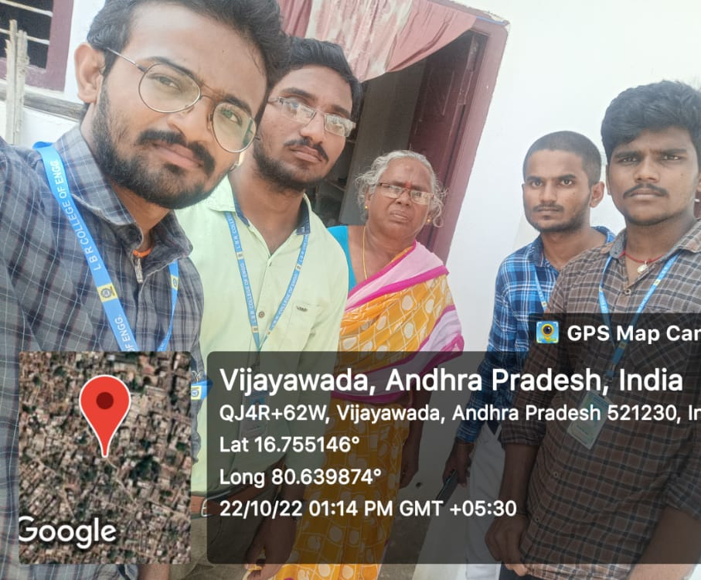
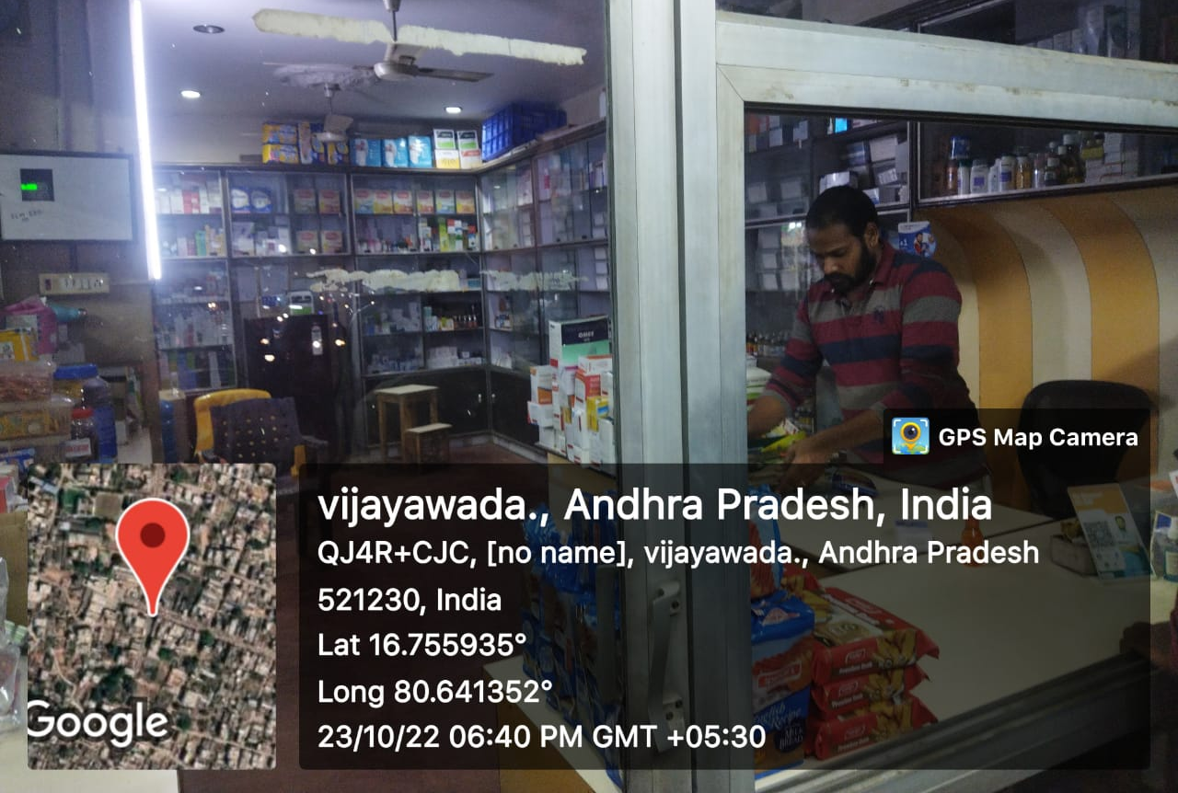
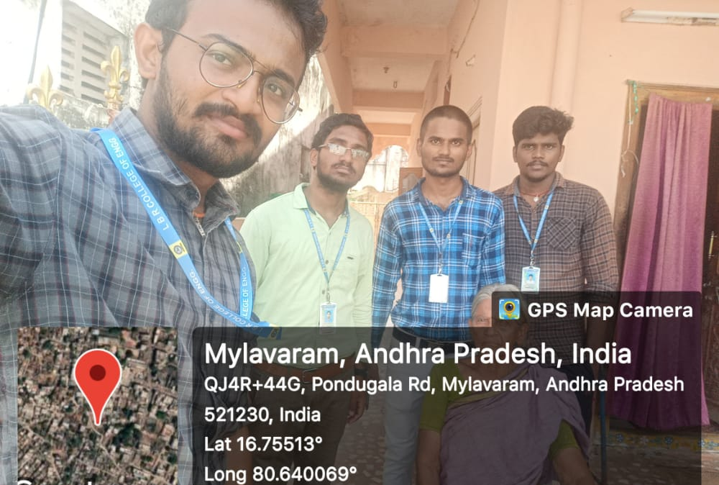

Slide 19
