Slide 1


Mini Project (CSE7102)
REVIEW-1
29-08-2026
Presidency
School of Computer Science and Engineering

Slide 2
Development of a Software Application for Analysis and Processing of DVB-S2 Receiver Output Stream
CSS7102- Mini Project Review-1
Project ID:PRJ_111
Panel No:23
Group members details:
Under the Supervision of,
Mr. Irfan Rajab Bhat
Assistant Professor
School of Computer Science and Engineering
Presidency University
Sl.No | Student Name | Roll Number
1 | Y Vengala Rao | 20231COM0001
2 | Sk Samad | 20231COM0031
3 | C Rakeshwar | 20231COM0008
Name of the Program(s): Computer Engineering(AI&ML)
Name of the HoD (Team Leader’s): Dr. Gopal K Shyam
Name of the Program Project Coordinator (Team Leader’s):Ms. Sumita Guddin
Name of the School Project Coordinators: Mr. Muthuraju V

Slide 3
INDEX
Problem Statement
Git Hub Link
Introduction
Literature Review
Architecture Diagram
Analysis of Problem Statement/Output Expected
Timeline of the Project(Gantt Chart)
References

Slide 4
Problem Statement Number: PRJ_111
Category : Software
Problem Description:
DVB-S2 receivers generate output in different formats such as BB Frames, GSE and MPEG Transport Stream (TS). There is a need for a unified software application that can parse, process and analyze these outputs to determine stream health, detect unusual behaviour and present the results in an understandable form.
Difficulty Level: High

Slide 5
Github Link
https://github.com/rakesh0709/PRJ_111_DVB-S2_Analysis.git

Slide 6
Introduction
About the project
DVB-S2 (Digital Video Broadcasting – Satellite – Second Generation) is widely used for satellite broadcasting and data transmission.
Receiver systems can produce output in different formats, including BB Frames, GSE and MPEG Transport Stream (TS).
Analyzing these outputs helps identify stream health issues, transmission behaviour and unusual patterns.
Our project aims to develop a unified software application for parsing, processing and analyzing these receiver outputs.
The system is designed to provide stream health analysis, anomaly detection, pattern detection, visualization, comparison and automated reporting.

Slide 7
Literature Review
Summary of Key Literature and Contributions
DVB-S2 Standard: Morello & Mignone (2006) presented the DVB-S2 architecture, framing, coding and modulation, establishing the technical foundation for our stream analysis [1].
Adaptive DVB-S2: Albertazzi et al. (2005) studied adaptive coding/modulation and physical-layer performance under varying channel conditions [2].
DVB-S2 Modem: Casini et al. (2004) analyzed modem algorithms and performance over typical satellite channels, supporting receiver-processing understanding [3].
GSE Encapsulation: Cantillo et al. (2008) investigated efficient GSE encapsulation for IP over DVB-S2 generic streams [4].
GSE Design: Cantillo et al. (2007) examined GSE design and IP datagram encapsulation over DVB-S2 [5].
Receiver Test-bed: Savvopoulos et al. (2008) developed a software-radio test-bed for DVB-S2 receiver measurement and diagnostic analysis [6].
LSTM Anomaly Detection: Arbon et al. (2018) applied LSTM networks to identify anomalies in satellite communication systems [7].
Bi-LSTM Detection: Pan et al. (2020) used Bi-LSTM prediction to detect anomalies in satellite telemetry sequences [8].
Explainable Detection: Zeng et al. (2022) combined causal networks and feature-attention LSTM for satellite telemetry anomaly detection [9].
Co-Attention LSTM: Wang et al. (2023) used multiple factors and co-attention LSTM for improved satellite telemetry anomaly detection [10].

Slide 8
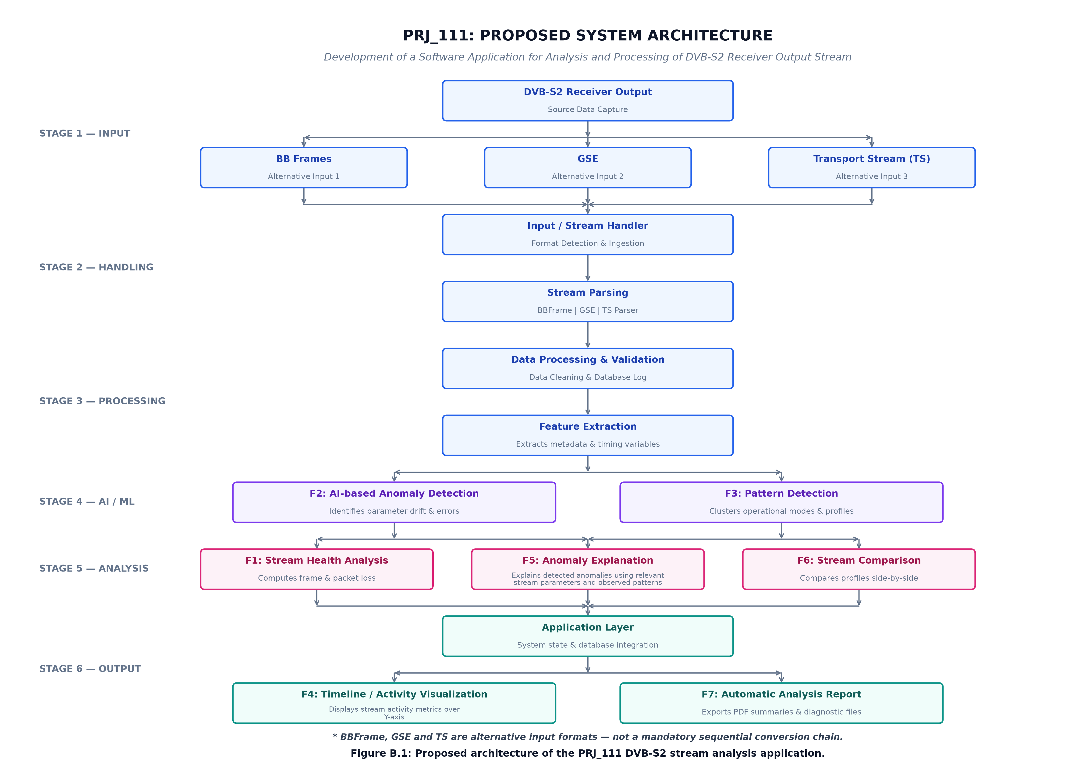
Architecture Diagram

Slide 9
Output Expected
1. Stream Health Analysis Frame/packet loss Stream integrity Basic stream health metrics 2. AI-based Anomaly Detection Detect unusual parameter behaviour Identify abnormal stream conditions 3. Pattern Detection Identify recurring operational patterns Group similar stream behaviour | 4. Timeline Display stream activity over time 5. Anomaly Explanation Provide possible reasons/context for detected anomalies 6. Stream Comparison Compare different stream profiles 7. Automatic Analysis Report Generate summaries and diagnostic information
The proposed application is expected to provide

Slide 10
Analysis of Problem Statement (contd...)
Software Requirements Python 3.x VS Code Git & GitHub Required Python libraries Database system Frontend / UI framework AI/ML libraries | Hardware Requirements Laptop / Desktop Multi-core processor Minimum 8 GB RAM Sufficient storage for datasets and stream files Internet connection for development/repository access

Slide 11
Analysis of Problem Statement (contd...)
Functional Requirements Accept BB Frame, GSE and TS input Detect input format Parse the selected stream format Validate and clean stream data Extract relevant features Analyze stream health Detect anomalies/patterns Visualize analysis results Generate reports | Non-Functional Requirements Accuracy Reliability Usability Scalability Maintainability Reasonable processing performance

Slide 12
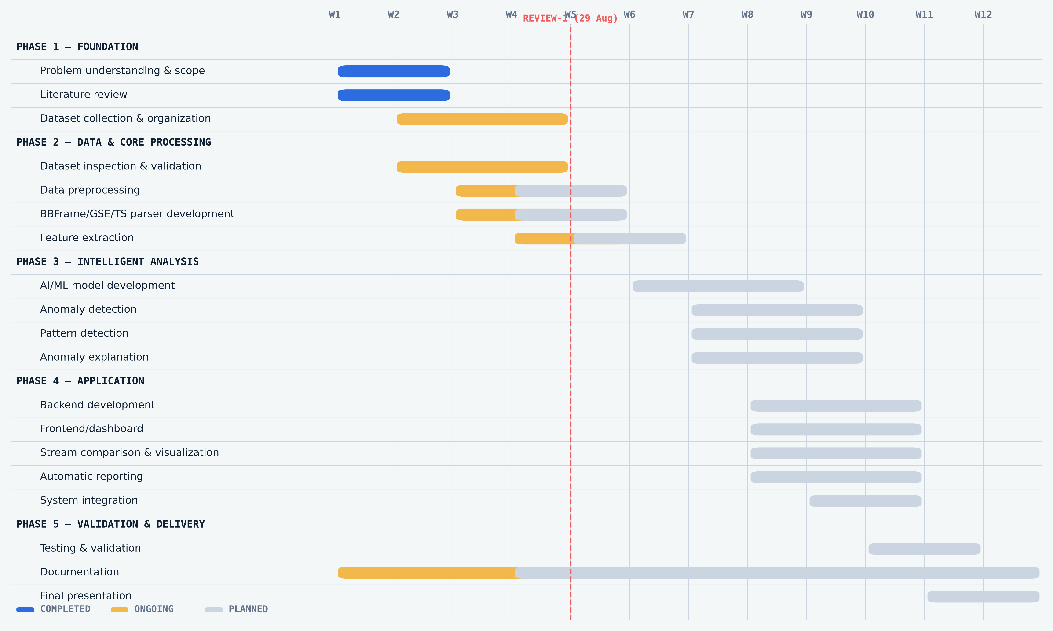
Timeline of the Project (Gantt Chart)

Slide 13
References (IEEE Paper format)
References (IEEE / APA Format):
[1] A. Morello and V. Mignone, “DVB-S2: The Second Generation Standard for Satellite Broad-Band Services,” Proc. IEEE, vol. 94, no. 1, pp. 210–227, 2006, doi: 10.1109/JPROC.2005.861013.
[2] G. Albertazzi et al., “On the Adaptive DVB-S2 Physical Layer: Design and Performance,” IEEE Wireless Communications, vol. 12, no. 6, pp. 62–68, 2005, doi: 10.1109/MWC.2005.1561946.
[3] E. Casini, R. De Gaudenzi, and A. Ginesi, “DVB-S2 Modem Algorithms Design and Performance over Typical Satellite Channels,” Int. J. Satell. Commun. Network., vol. 22, no. 3, pp. 281–318, 2004, doi: 10.1002/sat.791.
[4] J. Cantillo et al., “GSE: A Flexible, Yet Efficient, Encapsulation for IP over DVB-S2 Continuous Generic Streams,” Int. J. Satell. Commun. Network., vol. 26, pp. 231–250, 2008, doi: 10.1002/sat.915.
[5] J. Cantillo, J. Lacan, I. Buret, and F. Arnal, “Design Issues for the Generic Stream Encapsulation (GSE) of IP Datagrams over DVB-S2,” in Proc. IWSSC, pp. 276–280, 2007, doi: 10.1109/IWSSC.2007.4409430.
[6] P. Th. Savvopoulos, N. Papandreou, and T. Antonakopoulos, “A Software-Radio Test-bed for Measuring the Performance of DVB-S2 Receiver Circuits,” in Proc. SPSC, 2008, doi: 10.1109/SPSC.2008.4686729.
[7] E. Arbon, P. Smet, L. Gunn, and M. McDonnell, “Anomaly Detection in Satellite Communications Systems using LSTM Networks,” in Proc. MilCIS, IEEE, 2018, Art. no. 8574109, doi: 10.1109/MilCIS.2018.8574109.
[8] D. Pan et al., “Satellite Telemetry Data Anomaly Detection Using Bi-LSTM Prediction Based Model,” in Proc. IEEE I2MTC, 2020, doi: 10.1109/I2MTC43012.2020.9129010.
[9] Z. Zeng et al., “Satellite Telemetry Data Anomaly Detection Using Causal Network and Feature-Attention-Based LSTM,” IEEE Trans. Instrum. Meas., vol. 71, 2022, doi: 10.1109/TIM.2022.3151930.
[10] J. Wang, H. Li, L. Wang, and Z. Xu, “Satellite Telemetry Data Anomaly Detection using Multiple Factors and Co-Attention based LSTM,” in Proc. IEEE WCNC, 2023, doi: 10.1109/WCNC55385.2023.10118903.

Slide 14


