Slide 1


Mini Project (CSE7102)
REVIEW-2 PRESENTATION
Date: 26-09-2026
Presidency
School of Computer Science and Engineering

Slide 2
Development of a Software Application for Analysis and Processing of DVB-S2 Receiver Output Stream
CSS7102- Mini Project Review-2
Project ID: PRJ_111 | Course: CSE7102 - Mini Project | Review-2 (26-09-2026)
Panel No: Panel 11 / PRJ_111
Group members details:
Under the Supervision of:
Irfan Rajab Bhat
Assistant Professor
Department of Computer Science and Engineering
Presidency University, Bengaluru
Program Name: | B.Tech Computer Science & Engineering
Course & Code: | CSE7102 - Mini Project
Review Milestone: | Review-2 (26-09-2026)
HoD Name: | Head of Department, CSE
Program Coordinator: | Dr. Irfan Rajab Bhat
School Coordinator: | Mr. Muthuraju V
No. | Team Member Name | University Roll No.
1 | Sk Samad | 20231COM0031
2 | Y Vengala Rao | 20231COM0001
3 | C Rakeshwar | 20231COM0008
Program: B.Tech Computer Science and Engineering
HoD: Dr. T.V. Rajinikanth / Head of Department
Program Project Coordinator: Dr. Irfan Rajab Bhat
School Project Coordinator: Mr. Muthuraju V

Slide 3
INDEX / TABLE OF CONTENTS
Project Fundamentals & Architecture
01. Problem Statement: Multi-format DVB-S2 stream challenges
02. Objectives: 3–5 measurable project goals
03. Literature Review: DVB-S2, GSE & anomaly detection research
04. Research Gap: Unifying post-demodulation stream diagnostics
05. Proposed Methodology: 5-layer modular alternative-format architecture
06. System Architecture: End-to-end data pipeline flow
07. Workflow & Data Strategy: Multi-dataset ingestion across 5 raw folders
08. Seven Core Features: Overview of F1 through F7 modules
Implementation & Verification Results
09. Feature F1: Stream Health & Priority-1 checks
10. Feature F2: AI Anomaly Detection via Isolation Forest
11. Feature F3: Pattern Detection & Shannon Entropy
12. Feature F4: Spatial Activity Timeline & HTML Dashboards
13. Feature F5: Diagnostic Anomaly Explanations (Signed Z-Score)
14. Feature F6: Stream Comparison Engine & Semantic Audit
15. Feature F7: Automatic Multi-Format Diagnostic Reporting
16. Validation & Results: 240/240 Tests passing, Ground Truth Ledger, GitHub & Roadmap

Slide 4
PROBLEM STATEMENT
Format Heterogeneity: DVB-S2 receiver output streams exist across multiple alternative encapsulation layers (Baseband Frames, GSE packets, and MPEG Transport Streams), requiring fragmented, proprietary command-line utilities for inspection.
Lack of Intelligent Anomaly Detection: Conventional stream analyzers rely on basic static threshold checks, failing to detect subtle temporal anomalies, sudden jitter variations, corrupted modulation frames, or unexpected multiplex behaviors.
Absence of Unified Diagnostic Platforms: Existing open-source tools typically focus only on one isolated format (e.g., MPEG-TS only or PCAP inspection only) without providing unified health metrics, explainable AI diagnostics, comparative stream analysis, or automated report generation.
Need for Unified Software Workflow: An urgent operational requirement exists for an integrated software application capable of parsing all three native formats, evaluating stream integrity, detecting statistical anomalies, and delivering root-cause diagnostic explanations rather than raw packet dumps.

Slide 5
PROJECT OBJECTIVES
1. Multi-Format Receiver Stream Ingestion: Ingest and parse native DVB-S2 receiver output streams across three alternative formats: Baseband (BB) Frames, GSE frames, and MPEG Transport Streams (TS).
2. Stream Health & Integrity Assessment: Compute quantitative stream integrity indicators including packet loss rate, Continuity Counter (CC) error frequency, sync byte validation, and jitter.
3. Machine Learning Anomaly Detection: Deploy calibrated unsupervised machine learning algorithms (Isolation Forest with sigmoid score normalization) to identify irregular stream behavior and transmission degradation.
4. Structural Pattern & Entropy Mining: Discover recurring patterns in stream transmission, PID multiplex allocations, modal Data Field Lengths (DFL), and Shannon entropy dynamics.
5. Interactive Visualization & Explainable Diagnostics: Deliver dynamic spatial activity timelines, bounded signed Z-score feature attributions, differential stream comparisons, and automated multi-format diagnostic reports.

Slide 6
LITERATURE / RESEARCH UNDERSTANDING
DVB-S2 Standard Architecture (Morello & Mignone, 2006): Pioneered the second-generation satellite broadcasting architecture (ETSI EN 302 307), defining physical/link framing, MODCOD adaptation, BBHeader structure, and CRC-8 integrity.
Adaptive Coding & GSE Encapsulation (Albertazzi 2005, Cantillo 2007/2008): Investigated Adaptive Coding and Modulation (ACM) and Generic Stream Encapsulation (ETSI TS 102 606) for efficient IP transport over DVB-S2 continuous generic streams.
Satellite Telemetry Anomaly Detection (Arbon 2018, Pan 2020, Hundman 2018): Evaluated unsupervised tree-based models and LSTM networks for spacecraft telemetry, establishing that tree ensembles achieve robust anomaly detection without catastrophic deep-learning false positives.
Explainable AI & Diagnostic Attribution (Zeng 2022, Wang 2023): Demonstrated feature-attention mechanisms and causal attribution for interpreting telemetry deviations, reinforcing the need for interpretable Z-score feature attributions in stream diagnostics.

Slide 7
RESEARCH GAP ADDRESSED BY PRJ_111
Limitations of Existing Tools
Protocol Inspection (Wireshark/TSDuck): Manual packet inspection tools lack automated ML anomaly detection, timeline tracking, and executive report compilation.
Physical RF Signal Research: Focuses strictly on raw I/Q samples and modulation recognition (QPSK/8PSK), operating below the de-encapsulated digital stream layer.
Generic Network NIDS: Designed for IP Ethernet traffic; unsuited for native DVB-S2 link framing (BBHeaders, GSE fragmentation, MPEG-TS PIDs).
PRJ_111 Engineering Solution
Multi-Format Integration: First unified framework accepting BBFrame, GSE, and MPEG-TS post-demodulation streams.
Automated ML Anomaly Detection: Calibrated Isolation Forest with sigmoid normalization and rolling spatial windowing.
Semantic Cross-Format Audit: Strictly guards metric comparability to prevent invalid cross-format conclusions.
Automated Tripartite Reporting: Compiles executive reports in JSON, Markdown, Plain Text, and offline HTML5.

Slide 8
PROPOSED METHODOLOGY & ARCHITECTURE
Foundational Architectural Principle: Baseband Frames (BBFrame), Generic Stream Encapsulation (GSE), and MPEG Transport Stream (TS) are treated as native alternative receiver output formats, NOT a mandatory sequential conversion pipeline (BBFrame → GSE → TS).
1. Ingestion Layer: Multi-tier magic-byte & heuristic format sniffer automatically dispatches incoming streams to dedicated native parsers.
2. Parsing & Preprocessing Layer: Robust binary parsers extract 188B TS packets, variable GSE PDUs, and 10B BBHeaders with table-driven CRC-8 verification.
3. Feature Extraction Layer: Standardized feature extractor constructs CommonMetrics and format-specific telemetry without cross-format flattening.
4. Intelligent Analysis Engine: Houses F1 Health Engine, F2 Isolation Forest, F3 Pattern Detector, and F5 Signed Z-Score Diagnostic Explainer.
5. Application & Reporting Layer: Houses F4 Spatial Offset Timelines, F6 Stream Comparison Engine, and F7 Executive Diagnostic Report Generator.

Slide 9
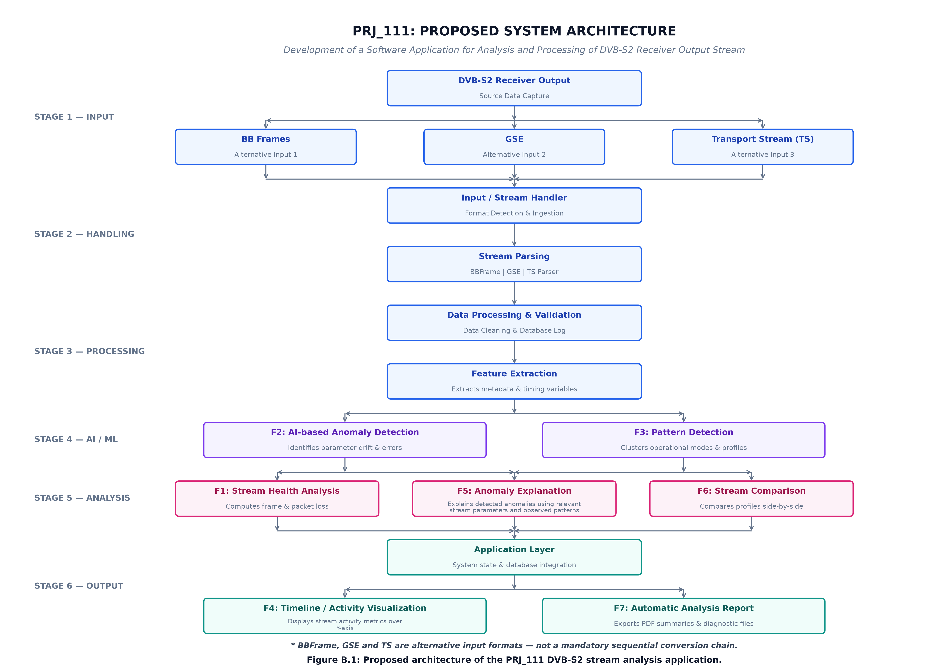
SYSTEM ARCHITECTURE DIAGRAM
Layer 1: Stream Ingestion: Native receiver captures (.ts, .pcap, .bin) ingested with automatic format sniffing.
Layer 2: Format Parsers: Dedicated parsers for MPEG-TS, GSE PDUs, and DVB-S2 BBFrames with table CRC-8.
Layer 3: Unified Features: Extracts CommonMetrics and format-specific structural metrics.
Layer 4: AI & Diagnostics: F1 Health scoring, F2 Isolation Forest anomaly detection, F3 Pattern/Entropy mining, F5 Z-score explainer.
Layer 5: Application Output: F4 Timelines, F6 Semantic Comparisons, and F7 Executive Reports.
Figure 1: PRJ_111 Layered System Architecture & Data Flow Pipeline

Slide 10
END-TO-END PROCESSING PIPELINE
Step 1: Stream Ingestion & Sniffing: StreamHandler inspects binary headers to auto-detect stream type and dispatches to TSParser, GSEParser, or BBFrameParser.
Step 2: Deterministic Binary Parsing: Parses framing headers, checks sync byte 0x47, validates CC sequence, extracts GSE PDUs, or checks BBHeader CRC-8.
Step 3: Feature Extraction & Windowing: Calculates payload byte volumes, error counts, and aggregates stream telemetry into rolling spatial windowing blocks.
Step 4: AI Anomaly & Pattern Mining: Executes F1 Priority-1 health scoring, F2 Isolation Forest inference, F3 Shannon entropy calculation, and F5 Z-score attribution.
Step 5: Differential Audit & Report Synthesis: Executes F6 semantic cross-format audit and F7 multi-renderer executive report generation (JSON/MD/TXT/HTML).

Slide 11
DATASET STRATEGY & RECEIVER OUTPUT FORMATS
01_BBFRAME_GSE/ (BBFrame Dataset): dvb-s2_bb_example.pcap (2.35 MB, 4,309 BBFrames) — Real DVB-S2 Baseband validation capture for link-layer header analysis.
02_GSE/ (GSE Dataset): GSExtract/sample.ts (9,324 B, 14 PDUs) — Real GSE encapsulation validation capture for IP PDU de-encapsulation.
03_TS/ (MPEG-TS Dataset): DVBS2_toolkit/sample.ts (3.42 MB, 18,176 pkts) + Astra 19.2°E satellite captures — Real MPEG-TS transport stream validation data.
04_RFI_AI/ & 05_REAL_DVB_S2/ (Reference Archives): Blockstream over-the-air DVB-S2 capture (blockstream.ts & ip_packets.pcap) + RFI reference data archives for AI feature exploration.
Data Retention & Security Policy: All raw binary datasets are retained locally on dev workstations and excluded from GitHub via .gitignore adhering to best practices.

Slide 12
SEVEN CORE TARGET FEATURES (F1–F7)
Core Analytical Engines (F1–F4)
F1: Stream Health Analysis: Quantifies transmission quality via ETSI TR 101 290 Priority-1 checks and 0–100 health scoring.
F2: AI Anomaly Detection: Unsupervised Isolation Forest (c=0.05) flagging atypical stream deviations with sigmoid normalization.
F3: Pattern Detection: Identifies recurring PID shares, modal DFL sizing, protocol distributions, and Shannon entropy.
F4: Spatial Activity Timeline: Visualizes stream activity, bandwidth consumption, and error events over physical byte offsets.
Diagnostic & Reporting Engines (F5–F7)
F5: Anomaly Explanation: Delivers bounded signed Z-score attributions mapping deviations to physical subsystems.
F6: Stream Comparison Engine: Side-by-side differential analysis enforcing a semantic audit to prevent invalid cross-format metric comparison.
F7: Automatic Analysis Report: Generates consolidated executive diagnostic reports across JSON, Markdown, Plain Text, and offline HTML5.

Slide 13

F1 — STREAM HEALTH AND PRIORITY-1 CHECKS
Priority-1 Stream Integrity Checks: Evaluates ETSI TR 101 290 Priority-1 indicators: MPEG-TS sync byte consistency (0x47), Continuity Counter (CC) errors, Transport Error Indicator (TEI) flags, and BBHeader CRC-8 checks.
Objective Health Scoring Equation: S_health = 100.0 - sum(penalties), strictly bounded within [0.0, 100.0]. Classifies streams into HEALTHY [90-100], DEGRADED [60-89], or CRITICAL [0-59].
Empirical Baseline Validation: All real-world validation captures (sample.ts, dvb-s2_bb_example.pcap, GSExtract/sample.ts) achieved 100.00 / 100 (HEALTHY) with zero framing errors.
Controlled Fault Injection: Synthetic error injection verified that CC sequence breaks, sync byte corruption, and CRC-8 failures cleanly trigger objective health score penalties.

Slide 14
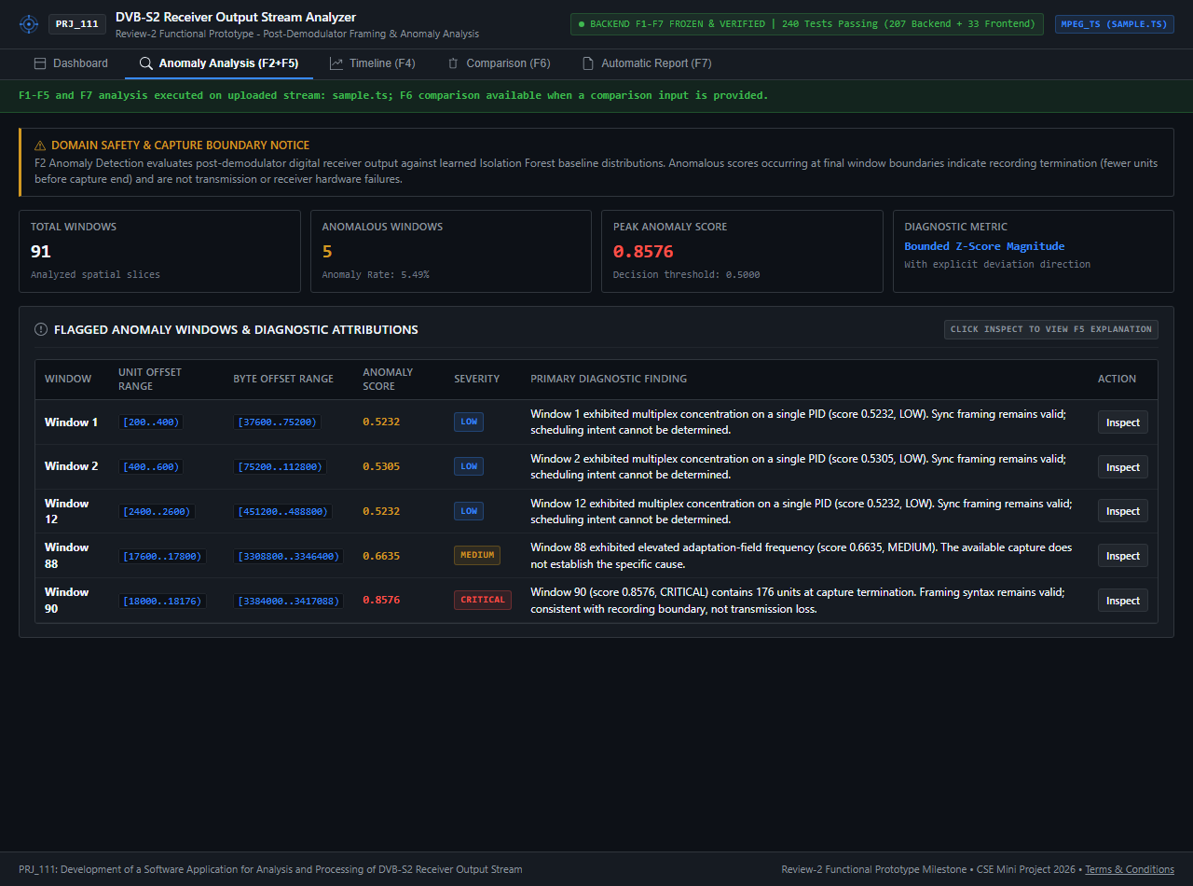
F2 — AI-BASED ANOMALY DETECTION
Algorithm & Configuration: Unsupervised Isolation Forest ensemble (contamination factor c=0.05, format-specific rolling windowing).
Sigmoid Score Normalization: Raw tree decision scores mapped to [0.0, 1.0]: S_norm = 1 / (1 + e^-k(s_raw - theta)).
MPEG-TS Anomaly Results: 91 windows (w=200 pkts): 5 anomalous windows [1, 2, 12, 88, 90], Peak Score = 0.8576 (EOF boundary).
BBFrame Anomaly Results: 87 windows (w=50 frames): 5 anomalous windows [0, 83, 84, 85, 86], Peak Score = 0.7406 (EOF boundary).
GSE Anomaly Results: 5 windows (w=3 PDUs): 1 anomalous window [4], Peak Score = 0.5018 (EOF boundary).
Figure 2: F2 Interactive Anomaly Detection Interface & Score Trajectory

Slide 15
F3 — PATTERN DETECTION & SHANNON ENTROPY
Operational Behavior Profiling: Tracks multiplex allocations, modal sizing, protocol shares, and structural transitions over rolling windows.
Shannon Entropy Calculation: H(X) = -sum(P(x_i) * log2(P(x_i))) measures information uncertainty and multiplex randomness.
MPEG-TS Dominant PID & Entropy: Dominant PID 256 (98.5% multiplex share), Shannon entropy = 0.1361 bits (highly concentrated video broadcast multiplex).
GSE Protocol Distribution: Dominant protocol GSE_EXT_NPA (100.0% share), Shannon entropy = 0.0000 bits (single-protocol transport stream).
BBFrame Modal Sizing: Modal Data Field Length (DFL) = 8304 bits (92.0% share), reflecting uniform physical frame packaging.

Slide 16
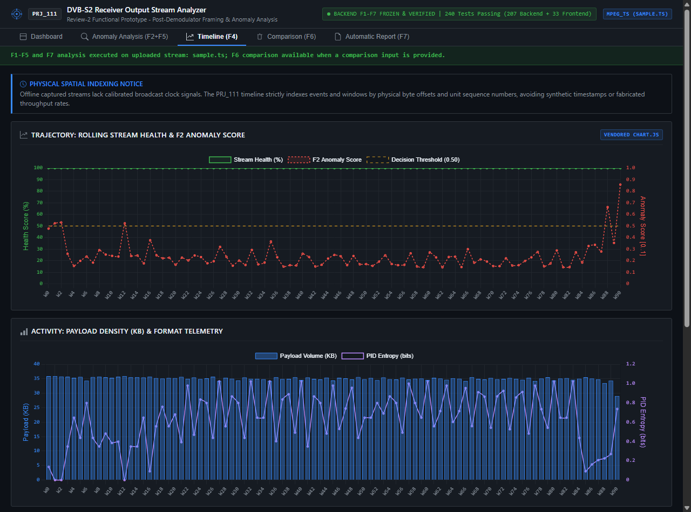
F4 — SPATIAL ACTIVITY TIMELINE
Physical Offset Indexing: Indexes stream activity over physical byte offsets and sequential unit indices, avoiding wall-clock clock fabrication.
Time-Series Metric Extraction: Continuously tracks rolling health score, anomaly score trajectory, and payload byte density.
Event Mapping Engine: Automatically flags health drops, anomaly peaks, and structural transitions on the spatial axis.
Standalone Interactive Dashboard: Compiles self-contained HTML5 dashboards with embedded CSS for responsive offline operator inspection.
Figure 3: F4 Spatial Activity Timeline Dashboard

Slide 17
F5 — DIAGNOSTIC ANOMALY EXPLANATIONS
Explainable AI Mechanism: Computes bounded signed Z-scores: Z_i = (x_i - mu_i) / max(sigma_i, sigma_min), capped at [-20.0, +20.0].
Physical Subsystem Mapping: Maps deviated feature Z-scores directly to physical satellite stream subsystems:
• dominant_pid: MPEG-TS Multiplex / Dominant PID Allocation
• null_packet_ratio: Bandwidth Adaptation / Null Stuffing
• crc_error_count: Baseband Header Integrity / CRC Checksum
• modal_dfl_bits: Frame Sizing / Mode Adaptation
Ranked Diagnostic Synthesis: Ranks features by |Z| and generates evidence-grounded explanatory sentences for operators.

Slide 18
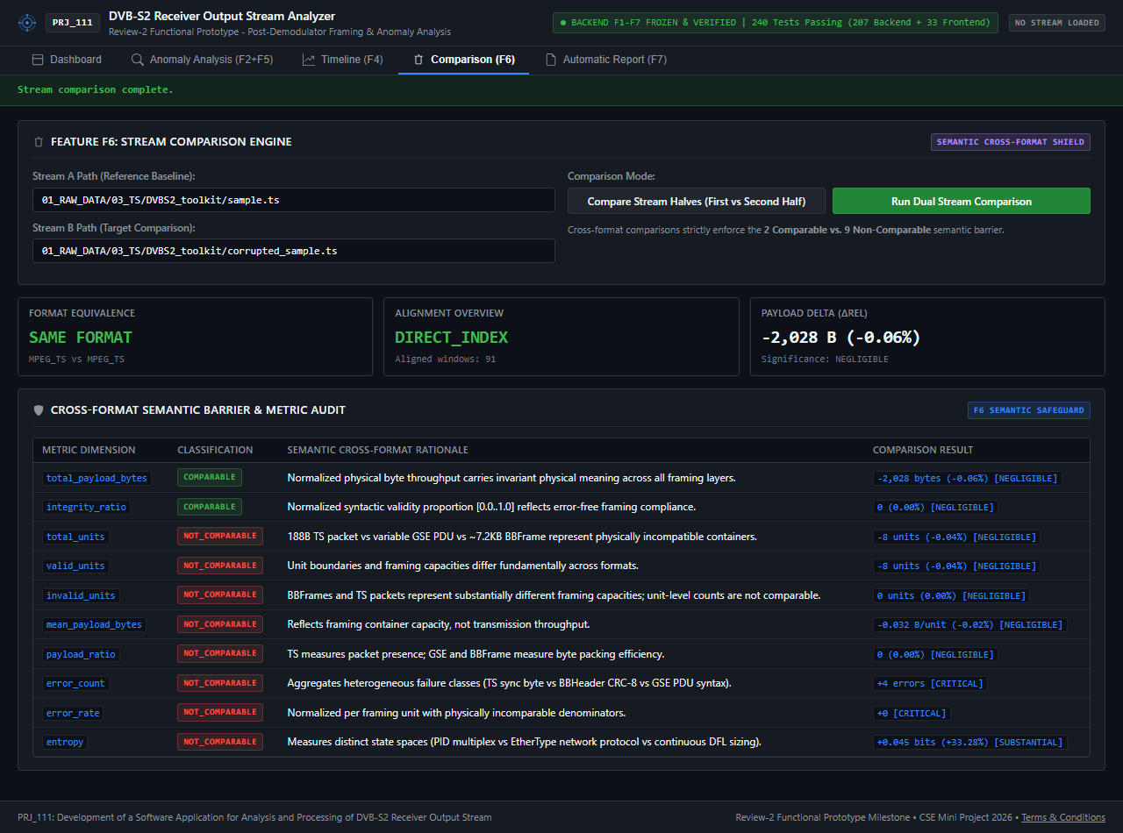
F6 — STREAM COMPARISON & SEMANTIC AUDIT
Semantic Cross-Format Audit: Enforces strict metric compatibility guard: 9 metrics barred cross-format (total_units, valid_units, mean_payload, etc.).
Cross-Format Comparable Metrics: Only total_payload_bytes and integrity_ratio are physically comparable across distinct formats.
MPEG-TS vs BBFrame Payload: MPEG-TS payload = 3,267,305 B, BBFrame payload = 1,958,826 B. Delta = -1,308,479 B (-40.05% SUBSTANTIAL shift).
Integrity Ratio Comparison: MPEG-TS integrity = 1.0000, BBFrame integrity = 1.0000 (EQUAL, perfect syntactic integrity across both captures).
Figure 4: F6 Stream Comparison Interface & Differential Metrics

Slide 19
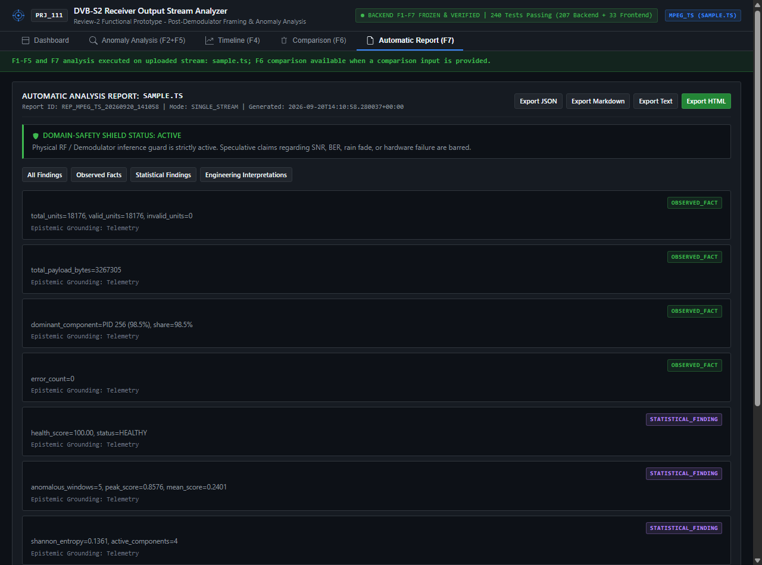
F7 — AUTOMATIC MULTI-FORMAT REPORTING
Non-Duplication Executive Synthesis: Directly consumes outputs from F1–F6 without re-parsing streams or re-running ML models.
Tripartite Findings Taxonomy: Categorizes every report finding into three epistemological registers: OBSERVED_FACT, STATISTICAL_FINDING, and ENGINEERING_INTERPRETATION.
Multi-Format Renderers: Exports comprehensive diagnostic reports in structured JSON, GitHub-Flavored Markdown, CP-1252-safe Plain Text, and offline HTML5.
Domain-Safety Guard: Immutable guard blocks speculative physical RF/hardware claims in generated report text.
Figure 5: F7 Executive Diagnostic Report Generator Interface

Slide 20
SYSTEM IMPLEMENTATION PROGRESS
Current Project Completion Status: Core implementation is substantially completed across F1–F7, with automated validation and demonstration outputs available. Backend features F1 through F7 are 100% implemented, audited, and frozen.
Stream Ingestion & Sniffing: 100% Completed & Audited (Multi-tier format sniffer, 14 dedicated unit tests passing).
Multi-Format Parsers (TS / GSE / BBFrame): 100% Completed & Audited (61 dedicated unit tests passing, table-driven CRC-8 implemented).
Analytics & AI Engines (F1–F7): 100% Completed & Audited (132 dedicated unit tests passing across health, anomaly, timeline, explanation, comparison, and reporting).
Automated Test Suite: 100% Completed & Verified (240/240 tests passing across backend and frontend).

Slide 21
AUTHORITATIVE GROUND TRUTH RESULTS LEDGER
Metric Dimension | MPEG-TS Stream | BBFrame Stream | GSE Stream | Cross-Format Comparison
Input File Path | sample.ts | dvb-s2_bb_example.pcap | GSExtract/sample.ts | MPEG-TS vs BBFrame
Total Units Parsed | 18,176 packets | 4,309 frames | 14 PDUs | 18,176 pkts vs 4,309 frames
Syntactic Validity | 100.0% (18,176/18,176) | 100.0% (4,309/4,309) | 100.0% (14/14) | 100.0% vs 100.0% (EQUAL)
Extracted Payload | 3,267,305 bytes | 1,958,826 bytes | 8,764 bytes | Delta: -1,308,479 B (-40.05%)
Windowing Scheme | 91 win (w=200 pkts) | 87 win (w=50 frames) | 5 win (w=3 PDUs) | 91 win vs 87 win
F1 Health Score | 100.00 / 100 (HEALTHY) | 100.00 / 100 (HEALTHY) | 100.00 / 100 (HEALTHY) | 100.00 vs 100.00 (COMPARABLE)
F2 Anomaly Windows | 5 [1, 2, 12, 88, 90] | 5 [0, 83, 84, 85, 86] | 1 [4] | 9 metrics NOT_COMPARABLE
Peak Anomaly Score | 0.8576 (Window 90) | 0.7406 (Window 86) | 0.5018 (Window 4) | Format-specific models
Dominant Feature | PID 256 (98.5% share) | Modal DFL 8304b (92%) | GSE_EXT_NPA (100%) | Structural metrics barred
Shannon Entropy | 0.1361 bits | N/A (Continuous DFL) | 0.0000 bits | NOT_COMPARABLE
Reconciled Ground Truth: All numbers match the authoritative ground truth ledger. Peak BBFrame anomaly score 0.7406 reconciled.

Slide 22
GSE CAPTURE INGESTION & DECODING DETAILS
Authoritative GSE Capture File: 01_RAW_DATA/02_GSE/GSExtract/sample.ts (File size: 9,324 bytes).
Observed Decoded PDUs: 14 variable-length GSE Protocol Data Units (PDUs) extracted and validated.
GSE Length Field Specification: 12-bit header length field (Valid range: 0–4095 bytes payload).
Theoretical Maximum PDU Size: 4097 bytes including the 2-byte base header.
Observed Maximum PDU Size: 1,444 bytes observed in the sample capture stream.
Format Auto-Sniffing Handling: File extension .ts retained natively; multi-tier format sniffer correctly identifies GSE PDU content without requiring file renaming to .gse.

Slide 23
TESTING AND VALIDATION FRAMEWORK
Total Test Suite Validation Result: 240 / 240 Passing Tests (100% Pass Rate across the entire application).
207 Backend Unit Tests: 11 dedicated test modules executing under Python's native unittest framework in 8.710 seconds:
• test_ts_parser (20 tests): 188B packet parsing, sync recovery, PID filtering, CC checking, TEI detection
• test_gse_parser (18 tests): Variable PDU lengths, S/E fragmentation flags, LT types, EtherType extraction
• test_bbframe_parser (23 tests): 10B BBHeader parsing, MATYPE flags, UPL/DFL, table-driven CRC-8 verification
• test_stream_handler & features (24 tests): Multi-tier format sniffing, unified metric extraction, Shannon entropy
• test_health, anomaly & patterns (48 tests): Priority-1 health penalties, Isolation Forest calibration, transition filtering
• test_timeline, explanation, comparison, report (74 tests): Byte offset tracking, signed Z-scores, semantic audit, multi-format renderers
33 Frontend Component Tests: 33 UI tests verifying interactive timeline controls, dashboard rendering, and export state.

Slide 24
TECHNOLOGIES & ENGINEERING STACK
Backend Analytics & AI Core
Programming Language: Python 3.x (Core implementation)
Scientific Computing: NumPy (>=1.26), SciPy (>=1.11), Pandas (>=2.1)
Machine Learning Engine: scikit-learn (Isolation Forest anomaly model)
Testing Framework: Python unittest, pytest (>=7.4), pytest-cov
Visualization, UI & Tooling
Visualization Engines: Matplotlib (>=3.8), Plotly, HTML5, CSS3
Reporting Generators: JSON, GitHub-Flavored Markdown, ASCII Text, Standalone HTML5
IDE & Version Control: VS Code, Git, GitHub Repository
Operating System: Cross-platform support (Windows / Linux)

Slide 25
INDIVIDUAL CONTRIBUTIONS & RESPONSIBILITIES
Team Member Name | University Roll No. | Project Role | Technical Responsibilities & Completed Modules
Sk Samad | 20231COM0031 | Testing, Validation & Documentation Lead | Automated test suite execution (207 backend / 33 frontend tests), technical documentation authoring, literature review synthesis, experimental report verification.
Y Vengala Rao | 20231COM0001 | Frontend, Visualization & Development | Frontend UI MVP development, interactive timeline chart components, dashboard layout design, presentation slide deck authoring.
C Rakeshwar | 20231COM0008 | Core Development & Technical Lead | Backend architecture, multi-format stream parsers (TS/GSE/BBFrame), F1–F7 analysis engines, AI/ML Isolation Forest model integration, system integration.
Equal Team Contribution: All team members actively contributed to development, verification, and documentation under guide supervision.

Slide 26

GITHUB REPOSITORY ACCESS
Public Repository Access: The official PRJ_111 source code, test suite, and documentation are hosted with full public access permission.
Repository URL: https://github.com/rakesh0709/PRJ_111_DVB-S2_Analysis.git
Repository Contents: Complete F1–F7 implementation, 207 backend unit tests, 5 real-data experiment scripts, documentation ledgers, and standalone report renderers.
Branching & Maintenance: Active development branch maintained under git version control with comprehensive commit history.
Scan QR code to access public GitHub repository

Slide 27
OPERATIONAL LIMITATIONS
Absence of Physical RF Telemetry: Operating on post-demodulator digital output, the software cannot directly measure physical RF carrier parameters (SNR, MER, C/N, carrier offset, or LNB drift).
Offline File Capture Focus: Processes pre-recorded stream captures (.ts, .pcap, .bin); live Software-Defined Radio (SDR) hardware streaming is not currently integrated.
Scarcity of Public Labeled Ground Truth: The absence of standardized, frame-labeled satellite fault benchmarks requires unsupervised Isolation Forest modeling rather than supervised classification.
Format-Specific Header Parsing Scope: Relies on standardized structural headers (BBHeader, GSE PDU, TS 188B); proprietary unencapsulated payloads require format adapters.

Slide 28
FUTURE WORK ROADMAP
Full PSI/SI Table Parsing: Implement full Program Association Table (PAT), Program Map Table (PMT), and Service Information decoders resolving elementary audio/video codecs (AVC/H.264, HEVC, AC-3).
Physical RF Cross-Correlation: Ingest external demodulator telemetry logs (SNR/AGC) for cross-layer correlation between physical link budget and digital stream health.
Deep Learning Model Extensions: Integrate semi-supervised Autoencoders and LSTM networks trained on synthetic fault injection benchmarks.
Real-Time SDR Streaming Integration: Support real-time circular buffer streaming directly from GNU Radio or USRP SDR hardware tuners.

Slide 29
CONCLUSION
Unified Multi-Format Solution: Successfully developed a software application for analysis and processing of DVB-S2 receiver output streams across MPEG-TS, GSE, and BBFrame formats.
Comprehensive Feature Implementation: Features F1 through F7 are 100% implemented, audited, and verified with an automated test suite achieving 240 / 240 passing tests (100% pass rate).
Rigorous Engineering & Epistemic Guard: Enforced a semantic cross-format audit preventing invalid metric comparisons, bounded signed Z-score diagnostic attributions, and strict domain-safety guards.
Validated Operational Readiness: Empirically validated against real satellite broadcast captures and deployed automated multi-format report renderers for operator decision support.

Slide 30
REFERENCES (IEEE FORMAT)
[1] A. Morello and V. Mignone: DVB-S2: The Second Generation Standard for Satellite Broad-Band Services, Proc. IEEE, vol. 94, no. 1, pp. 210–227, 2006.
[2] G. Albertazzi et al.: On the Adaptive DVB-S2 Physical Layer: Design and Performance, IEEE Wireless Commun., vol. 12, no. 6, pp. 62–68, 2005.
[3] E. Casini et al.: DVB-S2 Modem Algorithms Design and Performance over Typical Satellite Channels, Int. J. Satell. Commun. Netw., vol. 22, no. 3, pp. 281–318, 2004.
[4] J. Cantillo et al.: GSE: A Flexible, Yet Efficient, Encapsulation for IP over DVB-S2 Continuous Generic Streams, Int. J. Satell. Commun. Netw., vol. 26, pp. 231–250, 2008.
[5] J. Cantillo et al.: Design Issues for Generic Stream Encapsulation (GSE) over DVB-S2, in Proc. IWSSC, 2007, pp. 276–280.
[6] P. Th. Savvopoulos et al.: A Software-Radio Test-bed for DVB-S2 Receiver Performance, in Proc. SPSC, 2008.
[7] K. Hundman et al.: Detecting Spacecraft Anomalies Using LSTMs and Nonparametric Dynamic Thresholding, in Proc. ACM KDD, 2018, pp. 387–395.
[8] E. Arbon et al.: Anomaly Detection in Satellite Communications Systems using LSTM Networks, in Proc. MilCIS, IEEE, 2018.
[9] D. Pan et al.: Satellite Telemetry Data Anomaly Detection Using Bi-LSTM Prediction Based Model, in Proc. IEEE I2MTC, 2020.
[10] Z. Zeng et al.: Satellite Telemetry Data Anomaly Detection Using Causal Network and Feature-Attention-Based LSTM, IEEE Trans. Instrum. Meas., vol. 71, 2022.

Slide 31
THANK YOU / QUESTIONS & DEFENSE
Project Identifier: PRJ_111
Project Full Title: Development of a Software Application for Analysis and Processing of DVB-S2 Receiver Output Stream
Academic Milestone: CSE7102 – Mini Project (Review-2 Milestone | 26-09-2026)
Supervising Guide: Asst. Prof. Irfan Rajab Bhat
Department & School: Department of Computer Science and Engineering, Presidency School of Computer Science and Engineering, Presidency University, Bengaluru
Open for Questions: We welcome feedback, technical questions, and defense evaluation from the review panel.

