Slide 1

First Draft V 0.1
Prepared by : Vishal Titre
Date : 02-AUG-2016

Slide 2
Table of Contents
1
Version Control System and Git Basic
2
Git Installation & Configuration
3
Git Command Line operation
4
Branching & Merging
5
Working with GIT GUI
6
Working with GitHub
7
Appendix

Slide 3

Version Control System and Git Basic
Topics Covered
1 | What is Version Control
2 | Central Version control system (CVCS)
3 | Distributed Version control system (DVCS)
4 | What is GIT
5 | GIT work flow
6 | How Git stores Data into Database

Slide 4
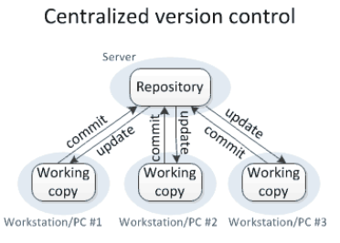
What is Version Control
Version control is a system that records changes so that you can recall specific versions later.
Version control enables multiple people to simultaneously work on a single project. Each person edits his or her own copy of the files and chooses when to share those changes with the rest of the team. Thus, temporary or partial edits by one person do not interfere with another person's work.
Version control software keeps track of every modification to the code in a special kind of database. If a mistake is made, developers can turn back and compare earlier versions of the code to help fix the mistake while minimizing disruption to all team members.
Version control integrates work done simultaneously by different team members. In most cases, edits to different files or even the same file can be combined without losing any work. In rare cases, when two people make conflicting edits to the same line of a file, then the version control system requests human assistance in deciding what to do.
Version Control software allows you to revert files back to a previous state, revert the entire project back to a previous state, compare changes over time, see who last modified something that might be causing a problem, who introduced an issue and when, and more.
Centralized Version Control System Vs Distributed Version control system
Centralized Version Control System:
All the versioned files are stored at centralized server. Users perform check-in and check-out of code from central place.
This system give clear views to developers on what others are doing on the code .
It is easy to admin and control .
If the main server goes down the developers can’t save versioned changes (single point of failure).
If the hard disk of the central database becomes corrupted the entire history could be lost.
In centralized version control, each user gets his or her own working copy, but there is just one central repository. As soon as you commit, it is possible for your co-workers to update and to see your changes. For others to see your changes, 2 things must happen:
You commit
They update

Slide 5
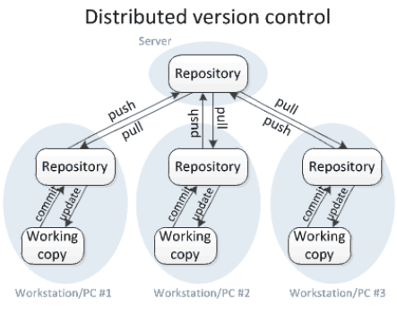
Distributed Version control system:
Distributed Version Control Systems (DVCSs) don’t rely on a central server.
In DVCS Instead of a working copy, each developer gets their own local repository, complete with a full history of commits.
If the sever goes down, then the repository from any client can be copied back to the server to restore it.
Every checkout is a full backup of the Server repository.
Require network connection only to publish (Push) your changes and take the latest changes (Pull).
Performing actions other than pushing and pulling changesets is extremely fast because the tool only needs to access the hard drive, not a remote server.
You can commit changes, create branches, view logs, and perform other operations when you are offline.
Performing actions other than pushing and pulling changesets is extremely fast because the tool only needs to access the hard drive, not a remote server.
In distributed version control, each user gets his or her own repository and working copy. After you commit, others have no access to your changes until you push your changes to the central repository. When you update, you do not get others' changes unless you have first pulled those changes into your repository. For others to see your changes, 4 things must happen:
You add
You commit
You push
They pull
They update
In DVCS commit and update commands only move changes between the working copy and the local repository, without affecting any other repository. By contrast, the push and pull commands move changes between the local repository and the central repository, without affecting your working copy.

Slide 6
What is Git
Git is a mature, actively maintained open source project originally developed in 2005 by Linus Torvalds.
Git is an example of a DVCS (Distributed Version Control System). Rather than have only one single place for the full version history, in Git, every developer's working copy of the code is also a repository that can contain the full history of all changes.
In addition to being distributed, Git has been designed with performance, security and flexibility in mind.
Git uses a common cryptographic hash function called secure hash function (SHA1) to store the data in to Git Database.
Having a full local history makes Git fast, you don’t need a network connection to create commits, inspect previous versions of a file, or perform diffs between commits.
Git use blob, tree, commit and tag objects to store the details of data.
Default Git configuration file location is .git/config.
Advantages of Git:
Free and open source : You can use Git to manage propriety projects without paying a single penny. As it is an open source, you can download its source code and also perform changes according to your requirements.
Fast and small : The core part of Git is written in C, which avoids runtime overheads associated with other high-level languages. Though Git mirrors entire repository, the size of the data on the client side is small. This illustrates the efficiency of Git at compressing and storing data on the client side.
Implicit backup : Data present on any client side mirrors the repository, hence it can be used in the event of a crash or disk corruption.
Security : Git uses a common cryptographic hash function called secure hash function (SHA1), to name and identify objects within its database. it is impossible to change file, date, and commit message and any other data from the Git database without knowing Git.
No need of powerful hardware: In GIT, developers don’t interact with the server unless they need to push or pull changes. All the heavy lifting happens on the client side, so the server hardware can be very simple indeed.
Easier branching : management with Git is very simple. It takes only a few seconds to create, delete, and merge branches.

Slide 7
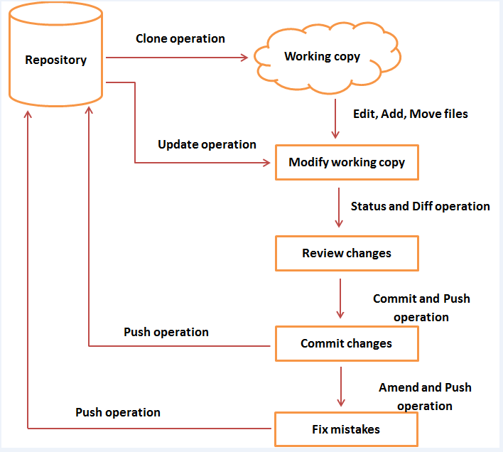
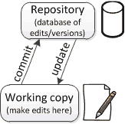
Git Workflow
General workflow of Git is as follows:
You clone the Git repository as a working copy.
You modify the working copy by adding/editing files.
If necessary, you also update the working copy by taking other developer's changes.
You review the changes before commit.
You commit changes. If everything is fine, then you push the changes to the repository.
After committing, if you realize something is wrong, then you correct the last commit and push the changes to the repository.
Git Repository is a database of all the historical versions (snapshots) of your project. It is possible for the repository to contain edits that have not yet been applied to your working copy. You can update your working copy to incorporate any new edits or versions that have been added to the repository since the last time you updated.
working copy is your personal copy of all the files in the project. You make arbitrary edits to this copy, without affecting your teammates. When you are happy with your edits, you commit your changes to a repository

Slide 8
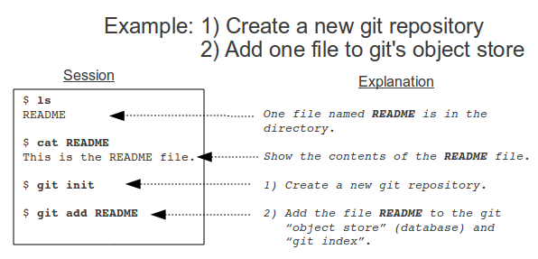
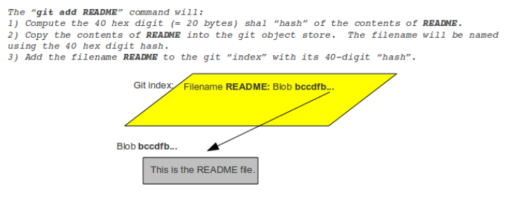
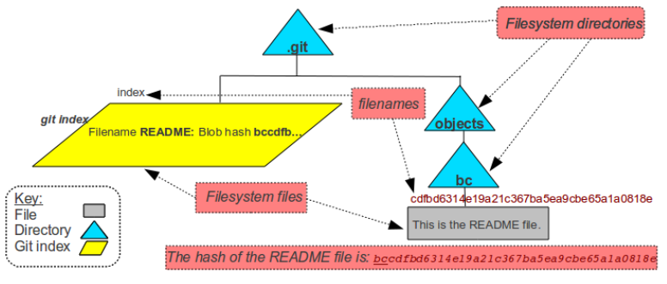
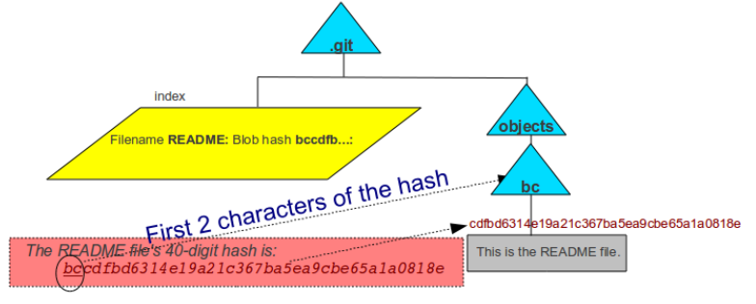
How Git Store Data into Database (git add operation)
Below are the action performed in background when you execute git add README command :
Compute the 40 digit hex code of the content of README
Copy the contents of README into the git database.
The filename will be named using the 40 hex digit hash
Add the filename README to the git "index" with tits 40-digit hash.
Git stores the contents of user files in .git/objects.
The first two digits of the hash of the README file is XX so a directory was created by the name XX. The rest of the hash is used as the filename in the XX directory.
Two files with identical contents will have the same hash value. Two files with different contents will have different hash values.
Git stores compressed versions of files and can also “pack” files to save disk space.
For referring to particular file no need to type complete 40- character has value , we can use first 6 digit of the hash value.
Index is the staging area where files are added (e.g. “git add”) and removed (e.g. “git rm”) before they are committed to a repository. Files start in the user’s working directory before moving to the index.

Slide 9
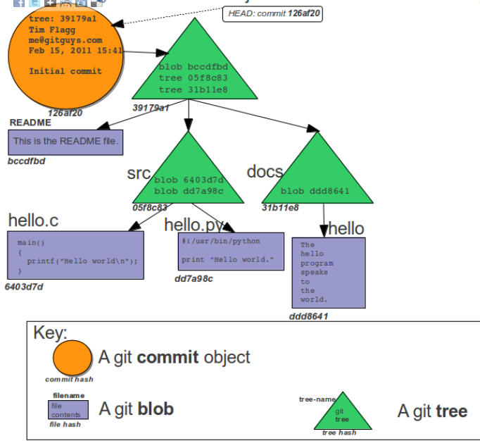
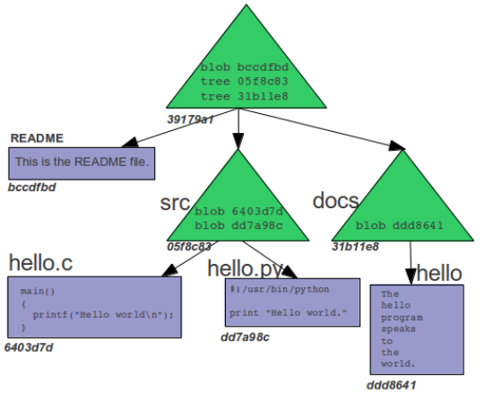
How Git Store Data into Database (git commit operation)
Once you create new file or done with editing the existing file in working copy you need to coming or check-in the code to update the repository .
When you use git commit to update the repository, git creates a new commit object, which is also saved to the git repository.
Commit object includes:
The hash of the Git tree that represents the state of the index at the time of the commit.
Commiter: The name and email address of who did the git commit, along with a date/time.
Comment: A text comment that summarizes the reason for the commit.
Since commit objects are part of the object database, they not only have a hash value, but are referred to by their hash.
After every git commit, git has a complete record of the contents of every file and directory that was in the index to be committed at the time of the commit.
The HEAD pointer, points to the most recent commit on the current branch.

Slide 10
Git Installation & Configuration
Topics Covered
1 | Installation of GIT on Windows Server
2 | Installation of GIT on Ubuntu Server
3 | Creating SSH keys for authentication

Slide 11
Git Installation and Configuration on Ubuntu Linux
Add new user into server to admin git environment.
As Root user create new folder (Git home directory) under git admin user home directory . Change the ownership of that folder to git admin User .
Provide sudo permission to newly added git admin user.
To Install Git Version Control System on Ubuntu Server Run below command with Sudo Permission. $ Sudo apt-get install git
Generate the Public /Private key pairs using ssh-keygen command for user authentication
Once Git installation is complete execute below command to configure the Git Environment . Git use these details to embeds into each commit we do.
$ git config --global user.name "Your Name" # Configure you name to embed into each commit we do.
$ git config --global user.email "youremail@domain.com" # Configure you email ID to embed into each commit we do.
$ git config --global core.editor vim # Set default editor
$ git config –list # to see all the configuration details.
Git Installation and Configuration on Windows Machine
Refer Below links for step by step instruction with screenshots to install Git on Windows Machine and Generating SSH Keys:
Instruction URL : https://blog.assembla.com/AssemblaBlog/tabid/12618/bid/77264/Setting-Up-Git-on-Windows-in-Four-Easy-Steps.aspx

Slide 12
Git Command line Operations
Topics Covered
1 | GIT Shared Remote Repository
2 | GIT local Repository
3 | Creating , Indexing and Committing file
4 | Pushing files to Remote Repository
5 | Cloning Remote Repository to Local working directory
6 | Reviewing the changes
7 | GIT Branching & Stashing
8 | GIT Merging

Slide 13
Git Repository
Shared Remote Repository Vs Local Repository
Shared Remote Repository:
When creating a central repository that will be shared by other users, the bare repositories should be created with the –bare option
When you create a git repository with the –bare option:
There is no working directory created.
There is no .git directory created and contents of .git directory are present directly inside it.
bare git repositories should end in .git. The .git ending of a directory signals to others that the git repository is bare.
Syntax : git init -- bare <Repository name>.git
Local Repository :
When you create the local repository for your own use which you don’t want to share with other in the team, you can create non-bare directory.
Normal non bare repository basically made up of 2 components :
Working directory : In simple terms it is the place where all checked out files reside and file available in this location can be added to git repository by “ git add FILE_NAME” command.
.git Directory : In simple terms this directory contains all the administrative related files and data that are required by GIT to support all the commands like git commit, git status , git pull, git push. This directory is always present in the root of your project directory.
Syntax : git init <Repository name>
Local Repository
Remote Repository
Git clone
Copies the whole remote repository to local repository.
Git Pull
Retrieve any updates from the remote repository that aren’t yet in the local repository and merges them into the local repository
Git push
Publish updates from local repository to the remote repository
Branch : master
Branch : master

Slide 14
Git command line operations
If you want to participate in a project using git, you can follow this standard workflow:
git clone URL: After you have done a git clone, you have a copy of the complete repository.
Make some changes to the local version of the repository, then git add and git commit the changes to the local repository.
git push to publish the changes (“commits”) to the remote repository
Periodically git pull to retrieve any new updates from the remote repository.
For better understanding of git commands we will use below setup:
Remote server 192.168.0.1 and created new admin user “gitadmin”
Remote Repository directory name “repo.git”
Remote Repository URL: gitadmin@192.168.0.1:repo.git
It is assumed that git client is installed on all workstations.
It is assumed that ssh authentication is already setup for passwordless transaction between Remote repository server and workstations.
Create local repository onto workstation and add file into it:
$ mkdir /home/user1/gitrepo
$ cd /home/user1/gitrepo
$ git init # it will initialized the empty git Repository in /home/user1/gitrepo/.git
$ echo “Hi All, Welcome to fist steps towards learning the Git operations” > README # Add the README file with some contents
Add newly created file into Index (Staging area): $ cd /home/user1/gitrepo $ git add REAMDE # Added README file into Index (staging area) and are ready to perform the commit into local repository.
Git Operation

Slide 15
Git command line operations Continued ….
View the status of your files in the working directory and staging area :
$ git status -s # give status of your staging area compared to the code in your working directory # -s option will give you short output. # A : file is newly added , AM : file is modified on disk since we last added it, # D : files that were deleted since your last commit, M : files that were modified or staged since your last commit.
After indexing the changes , Record/Update the changes into local repository using “git commit” command: $ git commit –m ‘This is my initial commit’ # This will update the changes into local master repository
# Post this commit now you can push data to Remote Repository. # If you leave off the -m option, Git will open a text editor to write commit message.
Copy the Git Remote repository from Remote Server to Workstation into local repository:
$ cd /home/user1/gitrepo # Change current working directory to Local Repository directory.
$ git clone gitadmin@192.168.0.1:repo.git # Copy complete Repository from remote server to local Repository.
Working with Remotes:
$ git remote –v # Shows the remote servers you have configured
# -v option show the URL that git has stored for shortname to be used when reading and writing to that remote.
$ git remote add <shortname> <url> # To add shortname to new Remote Git Repository for easily reference
Example : $ Git remote add gitadmin gitadmin@192.168.0.1:repo.git # Added shortname “gitadmin” for Remote Git Repository gitadmin@192.168.0.1:repo.git
$ git remote show <remote-name> # It will show more information about particular remote.
$ git remote rm <Remote Shortname> # It will remove the Remote details
$ git remote set-url <shortname> <new URL> # It will use to update the remote location for particular Shortname

Slide 16
Git command line operations Continued ….
To update a remote repository with the changes you've made locally use “git push” command:
$ git push <shortname> <branch>
Note :You can push any branch to any remote repository that you have write access to in this way. If your branch is already on the server, it will try to update it, if it is not, Git will add it. Git push command will take what your [branch] looks like and push it to be [branch] on the remote, if possible. If someone else has pushed since you last fetched and merged, the Git server will deny your push until you are up to date.
To see the log details using “git log” command:
$ git log
To Pull the data from Remote repository that you don’t have yet on Local Repository use “git fetch ” and “git merge” command: $ git fetch <remote repository short name> # Pull all data from Remote repository that you don’t have in local repository. $ git merge <remote repository short name> / <branch> # To merge into your current branch anything new you see on the server.
To see the changes between any two commit use “git diff” command . Note : This is largely used in two main situations - seeing how two branches differ from one another and seeing what has changed since a release or some other older point in history. Let's look at both of these situations.
$ git diff <branch A > < branch B> # To inspect branch B relative to branch A.
$ git diff <version> # To see what has changed since the last release.

Slide 17
Git Branching & Stashing
When you first create a git repository (with a command such as git init), one branch is created. It’s your main (and only) branch. The branch, by default, is named master.
When you make that first addition to the repository, the first addition is usually made to that one branch, The master branch.
Using Git branch command list all the branches in the repository . The asterisk that is placed to the left of branch name is git branch command output indicates the current branch in the repository. $ git branch.
HEAD is used by git to refer to the current commit you are working on. HEAD config file (.git/HEAD).
$ git branch <new branch name> # Use below command to create new Branch.
$ git branch # List all branches in the repository, current branch is indicated by *
$ git checkout <branch name> # Switch to new branch.
$ git ls-files # Display all files on current branch.
$ git branch –d <branch name> # Delete the branch.
$ git checkout –m <branch name> # Tells git to merge in any conflicts, before switching branches.
$ git show-branch # Shows the branches and the commit history.
Stashing your work:
If you are in situation that you modifying files in the working directory and/or index and you find out you need to fix a bug on a different branch. You can’t just switch to a different branch and lose all your work. In such situation you can use “git stash” command.
Git stash command perform below action:
Saves your working directory and index to a safe place.
Restores your working directory and index to the most recent commit.
Once you are done with the work on other branches, make commits, etc. and when you’re ready to get back to where you were, you type “git stash pop” and you’re back.
Note : “git stash” will not stash (save) files in the working directory unless the files are being tracked (some version of the file has been added to the index).
Syntax : $ git stash # Saved the uncommitted but indexed files details into safe area.
$ git stash pop # To retrieve the saved files details into working directory.

Slide 18
Git Merging

Slide 19
Appendix
Topics Covered
1 | Reference links
2
3

Slide 20
Reference Site
https://www.atlassian.com/git/tutorials/why-git
http://www.tutorialspoint.com/git/git_life_cycle.htm
http://maxivak.com/setting-up-and-using-git-on-windows-and-ubuntu/
https://git-scm.com/book/en/v2/Getting-Started-About-Version-Control
https://www.appfusions.com/display/StashSCMImporter/CVCS+vs.+DVCS+In+a+Nutshell
https://betterexplained.com/articles/a-visual-guide-to-version-control/
https://homes.cs.washington.edu/~mernst/advice/version-control.html
https://www.appfusions.com/display/StashSCMImporter/Why+DVCS+and+git
http://matthew-brett.github.io/pydagogue/git_gui_windows.html
https://nathanj.github.io/gitguide/tour.html
http://www.gitguys.com/topics/the-git-object-model-starting-with-the-blob/ --------- ******
http://techidiocy.com/bare-and-non-bare-repositories-git-directory-and-working-tree/
http://www.vogella.com/tutorials/Git/article.html#workingtree
http://gitref.org/basic/

