Slide 1

Efficiency Analysis of Counting Operations in Nested Loops
Course: Design and Analysis of Algorithms (DAA)
Presented by:
M. Rakesh
B.Tech Information Technology
SIMATS

Slide 2
Problem Statement
Many algorithms use nested loops to process arrays, matrices, or collections of data.
The objective is to:
Determine the total number of operations performed.
Analyze how the execution time grows with input size.
Express efficiency using asymptotic notation.
Analyze a two-level nested loop and derive its time complexity.

Slide 3
Algorithm Overview
Input: Array of size n
Outer loop executes n times.
Inner loop executes n times for every outer iteration.
Each inner iteration performs one counting operation.

Slide 4
Pseudocode
count ← 0
for i ← 1 to n
for j ← 1 to n
count ← count + 1
print(count)

Slide 5
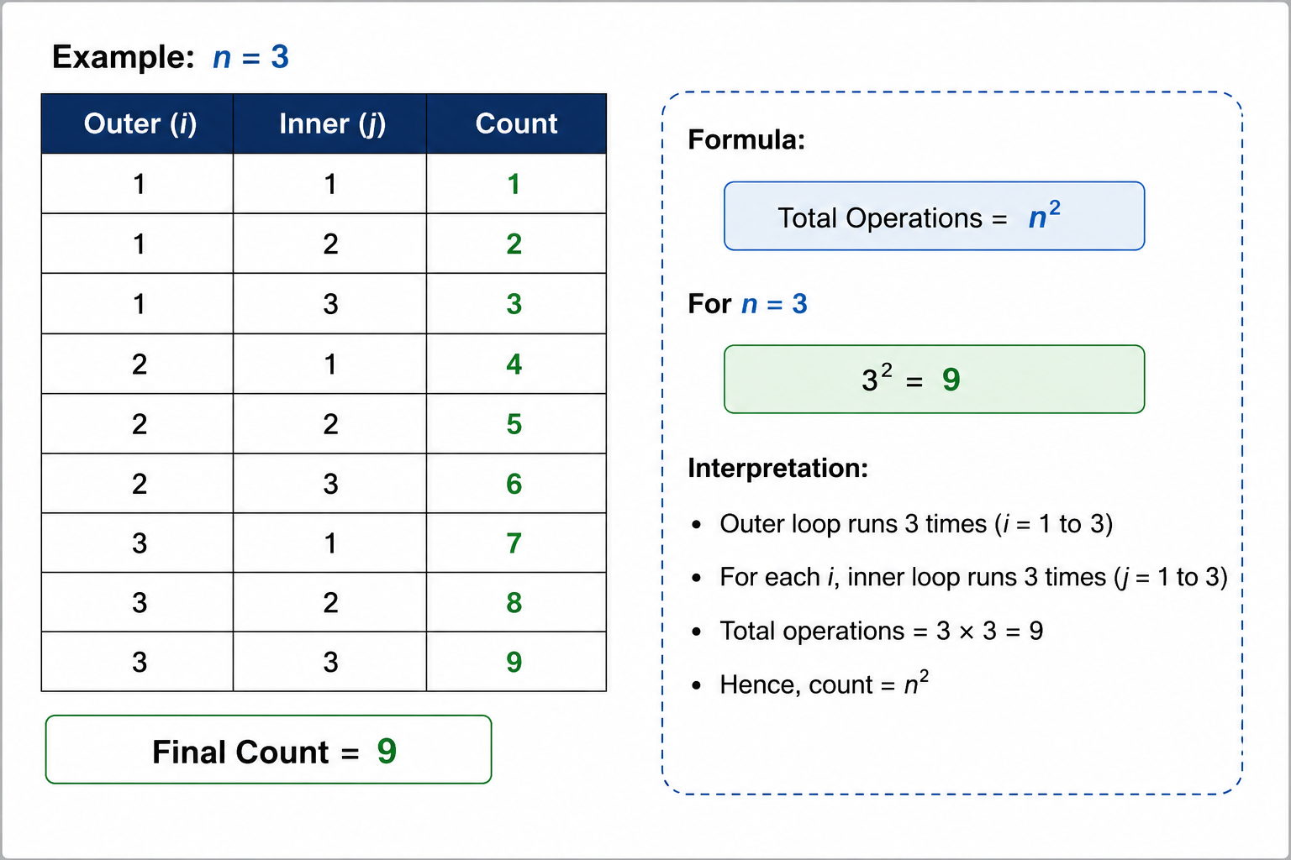
Working Example

Slide 6
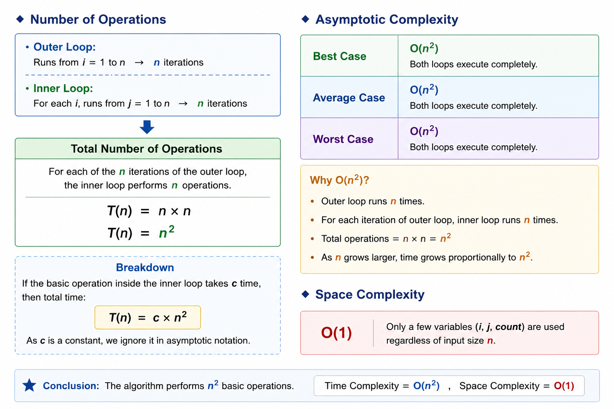
Complexity Analysis

Slide 7
Applications
Matrix Multiplication
Image Processing
Pattern Searching
Bubble Sort
Selection Sort
Graph Algorithms (Adjacency Matrix)
Distance Calculations

Slide 8
Results & Discussion
Results
Operation Count
Discussion
Operations increase quadratically.
Doubling input size nearly quadruples the work.
Efficient for small datasets.
Less suitable for very large inputs.
Complexity analysis helps choose scalable algorithms.
n | Operations (n²)
5 | 25
10 | 100
20 | 400
50 | 2500
100 | 10000

Slide 9
Conclusion
Nested loops perform n² operations.
Time Complexity = O(n²).
Space Complexity = O(1).
Operation counting helps estimate algorithm efficiency.
Asymptotic analysis predicts scalability for larger inputs.

