Slide 1

MSBA 6330 Big Data Analytics
Recommender Systems for Team Assignment
Arnav Sivaram | Ashwin Assysh Sharma | Mainak Roy | Sameeksha Aithal | Sampada Sathe
December 11, 2019
Team 11 - GGWP

Slide 2
Big Picture - Motivation
Challenges with globalization
Clients getting more demanding
Markets getting more competitive
Expertise getting more specialized
Big companies are getting bigger
Increased interdependence
Role shift of managers in the collaboration economy
Need for high-performance teams with diverse skillsets
Notes:
Increasingly complex project requirements require diversity in skillset

Slide 3
Our Solution - Scenarios
Scenario 1:
Team manager is looking for new roles for an employee
Wants to assess what roles the employee could be good at
Solution: Recommends roles employee could be good at, based on other employees identified as similar to given employee
Scenario 2:
Team manager has a team profile (list of roles) he wants to fill
Wants to know which individuals to recruit, for what roles
Solution: Recommends employees and roles that the manager consider in forming the team
Notes:
Increasingly complex project requirements require diversity in skillset

Slide 4
Big Picture - Benefits
Mathematically-grounded method for team assignment
Selection process is less prone to bias
Manager intervention at later stage, until then allows focus on higher-involvement decisions
Assessing role-fit of team members not limited to own past experience
Enabling employees to experiment with other roles may also improve motivation and job satisfaction
Notes:
Increasingly complex project requirements require diversity in skillset

Slide 5
Why Kubeflow?
ML libraries images can be deployed easily
Deploying and managing loosely-coupled microservices
Scaling based on demand
Gives an easy to use ML stack with self configuration properties

Slide 6
Approach

Slide 7
Data – Motivation for Dota2
Sports an excellent setting to examine teams, but comparison fails in contemporary organizations
A more persuasive alternative – multiplayer online battle arenas (MOBAs) such as Dota2
Models most team characteristics
Models individual member expertise
Models team dynamics and cohesion
Readily and easily available data, unlike that of a firm’s employees

Slide 8
Data – Dota2 Context
Two team, 5v5 player game, objective is to destroy opposition base
Players choose heroes, each hero can play multiple roles
Player can improve hero capability by collecting items and resources through course of game

Slide 9
Data – Description
Random sample of players selected between April 2019 and today
Use pro-match game data from OpenData, sourced through API calls
Each request can contain up to 1,000 matches per player
In total, 10 million matches
JSON format, has 25+ fields per player per match
Demo – only a cleaned sample of this data frame will be used

Slide 10
Kubeflow Setup and Operation
Set up a GCP project
Set up OAuth for Cloud IAP using OAuth client
Install Docker, kubectl, kustomize
Setup Environment Variables
Use UI/CLI to deploy Kubeflow on GCP
Create a Cloud Storage bucket
Train the model on GKE
Deploy the web UI to the cluster
Access the web UI in the browser
https://kubeflow.endpoints.trendsmarketplace.cloud.goog/

Slide 11
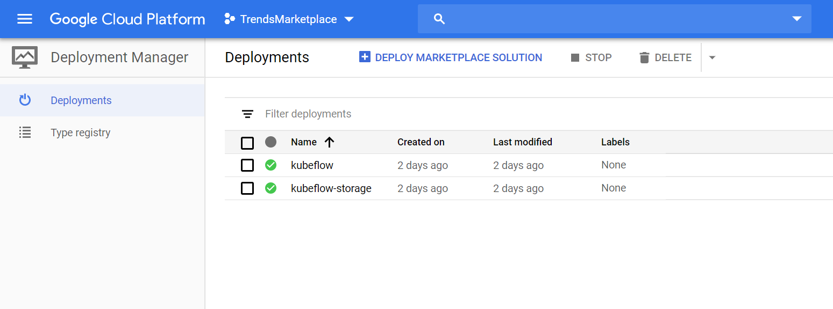
Kubeflow Setup and Operation

Slide 12
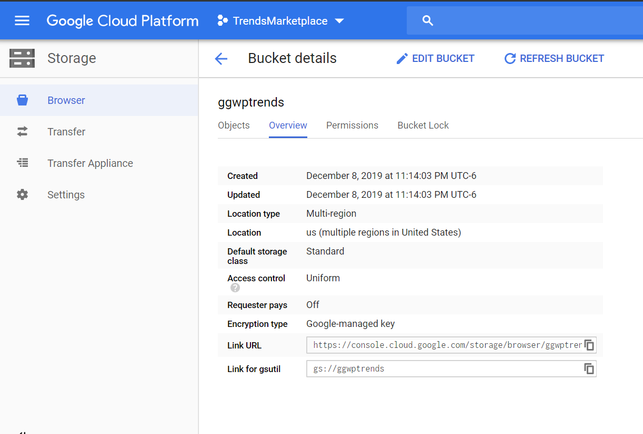
Kubeflow Setup and Operation

Slide 13
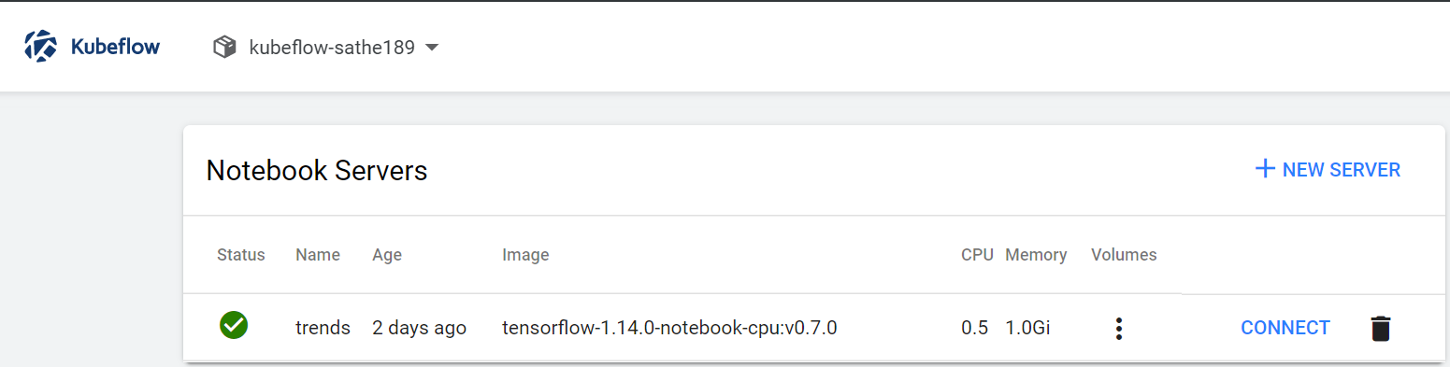
Kubeflow Setup and Operation

Slide 14
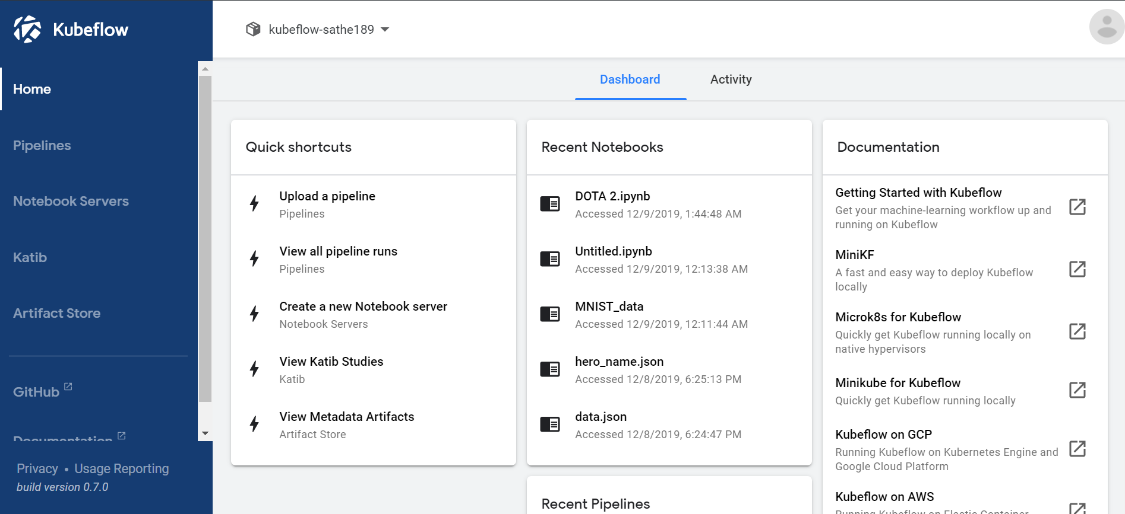
Kubeflow Setup and Operation

Slide 15
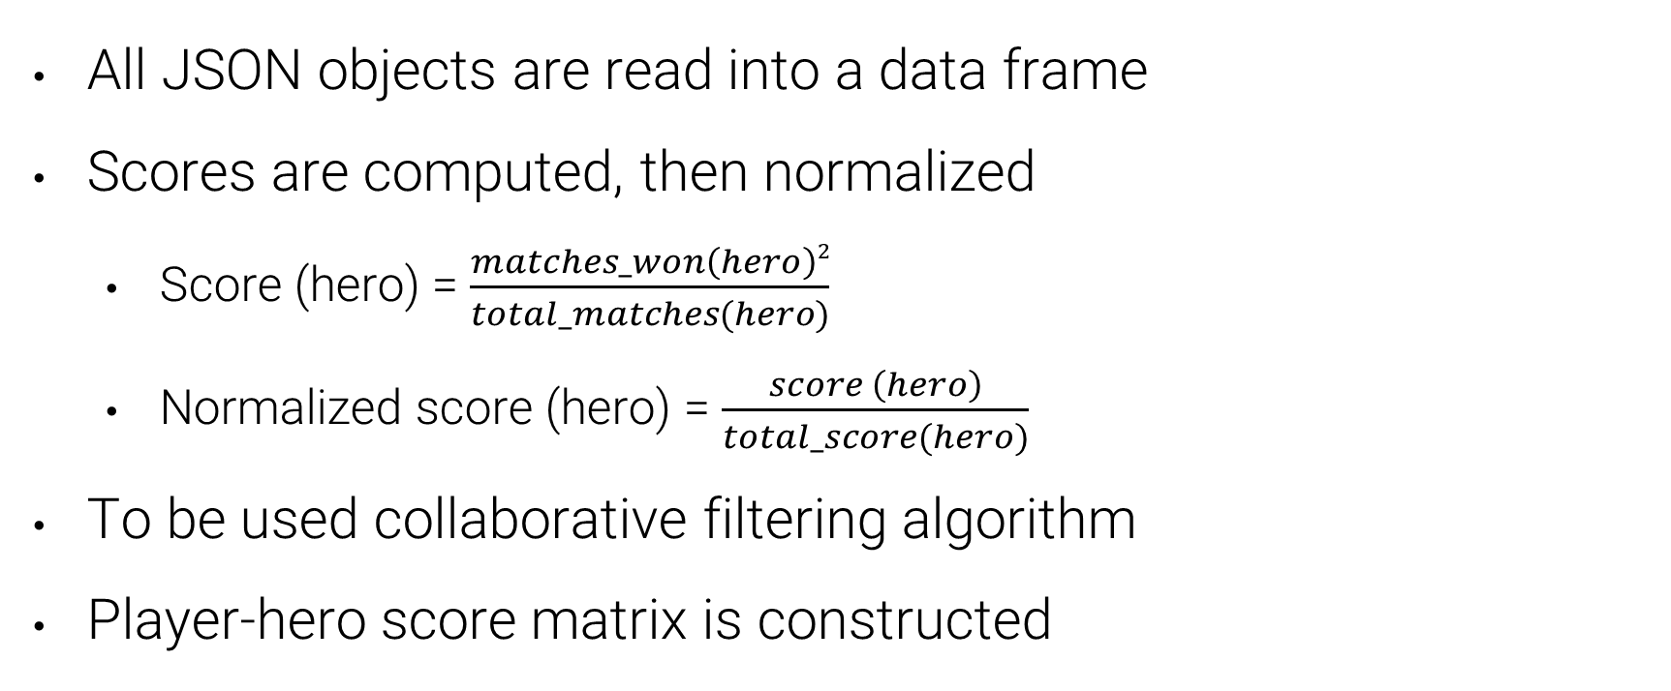
Data –Transformations and Analysis

Slide 16
Data –Transformations and Analysis
‘Pearson Correlation’ used as a similarity measure between heroes played by two users
Similarity takes into account general game characteristics like lanes, statistics such as kill-deaths-assists, strategy such as roles and items
Accounts for rank using weights

Slide 17
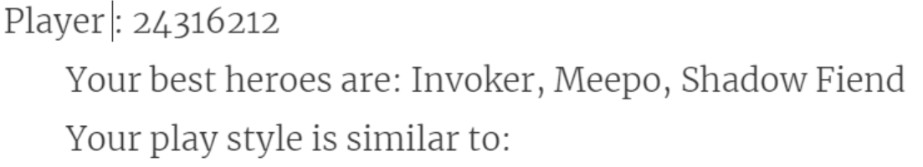
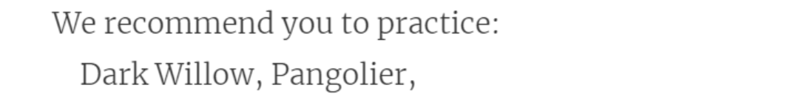
Data - Output
Scenario 1: Role recommendation for individual player
https://www.dotabuff.com/players/5390881
https://www.dotabuff.com/players/145875
https://www.dotabuff.com/players/125191873

Slide 18
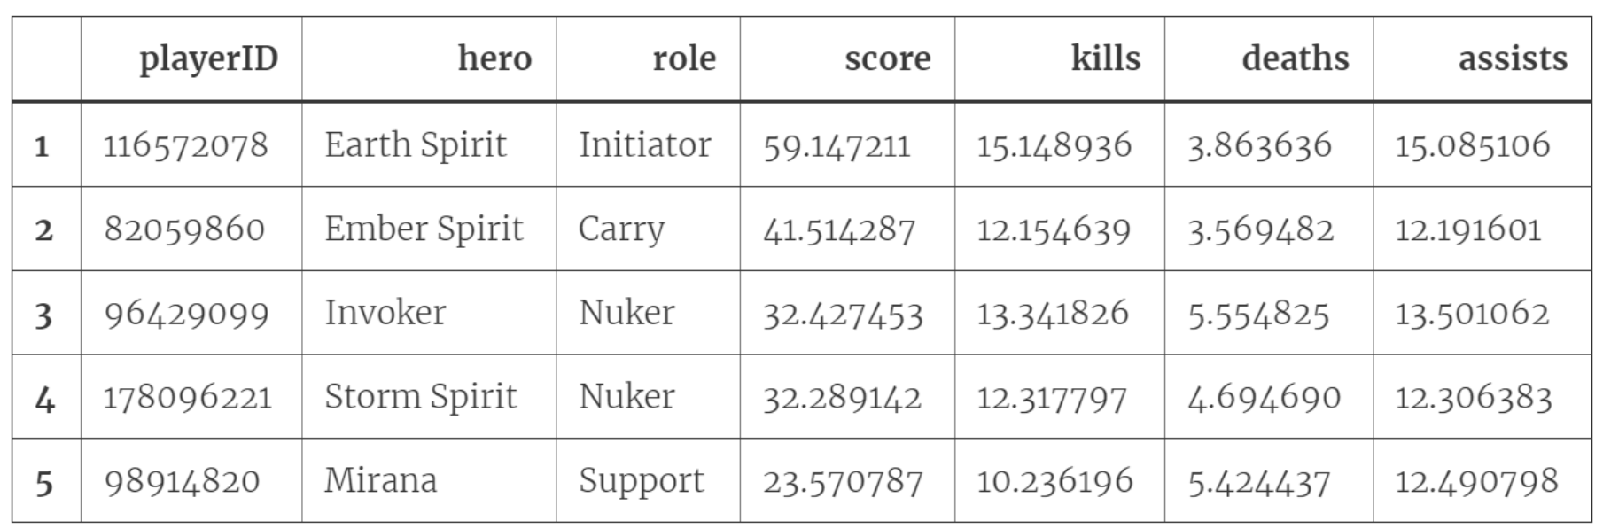
Data - Output
Scenario 2: Role recommendation given team profile
Input (Team Profile)
Output (Recommendations)
Sr. No. | Role
1 | Nuker
2 | Nuker
3 | Carry
4 | Initiator
5 | Support

Slide 19
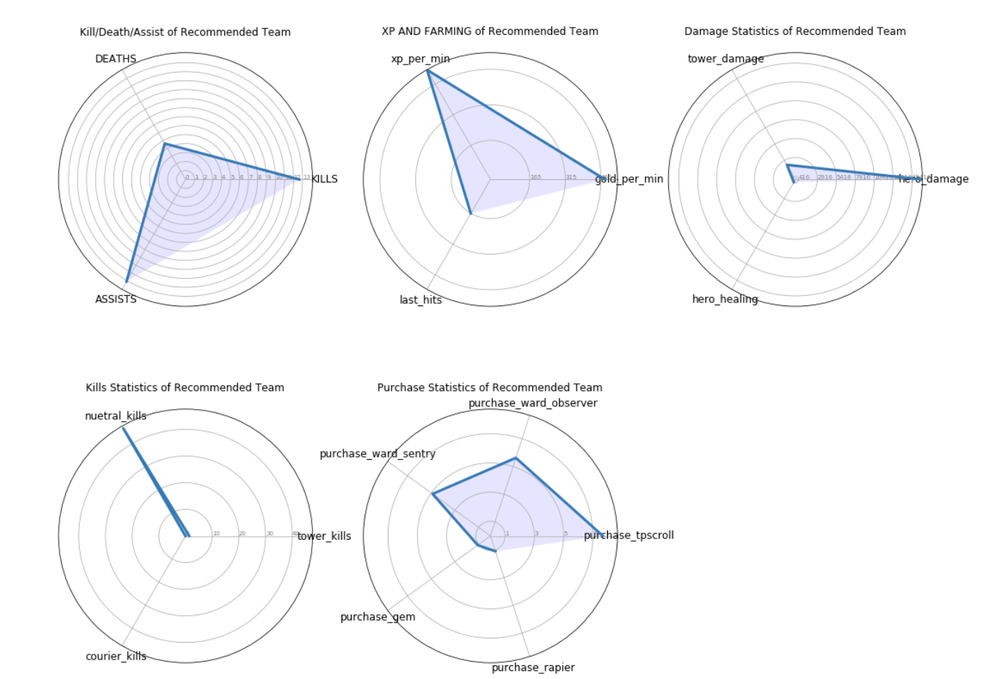

Slide 20
Data – Contextualizing
Identify relevant roles employees are to be assessed on
Assign performance scores across roles
Can use appraisal information, NPS scores, textual feedback
Construct an employee-role matrix
Identify employees similar to the employee being considered for the team, using Pearson’s correlation
Assess roles the similar employee has performed well, likely employee being considered performs well too

Slide 21
Conclusions - Learnings
Understanding complexities of modelling team organizational behavior
Intricacies of Multiplayer Online Battle Arena (MOBAs)
Implementation of collaborative filtering-based recommendation systems
Familiarity with Google Cloud Platform (GCP) and Kubeflow for building scalable machine learning algorithms
Conceptual understanding of containerization and container orchestration

Slide 22
Limitations
Doesn’t take into account costs of different team members
Defining roles in organizations is not as straightforward as that in Multiplayer Online Battle Arena (MOBAs)
Underlying assumption that employees found similar based on certain attributes will perform similarly in new roles
Unlike Dota2, team outcomes in an organization are not binary

Slide 23
Next Steps
Explore algorithms such as (kNN, DBSCAN, etc.) for similarity that are more robust compared to Pearson’s Correlation
Incorporate ranking into our recommendation system output
Validate team recommendations through qualitative discussions with peers, past managers

Slide 24
Appendix

Slide 25
References
Jooyeon Kim, Brian C. Keegan, Sungjoon Park, and Alice Oh. 2015. The Proficiency-Congruency Dilemma: Virtual Team Design and Performance in Multiplayer Online Games. Search Results. Association for Computing Machinery
Zhengxing Chen, Truong-Huy D Nguyen, Yuyu Xu, Christopher Amato, Seth Cooper, Yizhou Sun, and Magy Seif El-Nasr. 2018. The Art of Drafting: A Team-Oriented Hero Recommendation System for Multiplayer Online Battle Arena Games. In Proceedings of ACM Conference (Conference’17). ACM, New York, NY, USA, 9 pages. https://doi.org/10.1145/nnnnnnn.nnnnnnn
Leigh L. Thompson. Making the Team: A Guide for Managers
Dang Le Dang Khoa. Dota2-Hero-Recommendation. 2018. https://github.com/dangkhoadl/Dota2-Hero-Recommendation/
Ekaba Bisong. Kubeflow for Poets - A Guide to Containerization of the Machine Learning Production Pipeline. 2019. https://towardsdatascience.com/kubeflow-for-poets-a05a5d4158ce

Slide 26
References
https://www.kubeflow.org/docs/gke/gcp-e2e/
https://www.kubeflow.org/docs/gke/deploy/project-setup/
https://conferences.oreilly.com/strata/strata-ny-2018/public/schedule/detail/69041
https://www.kubeflow.org/docs/notebooks/why-use-jupyter-notebook/

