Slide 1
Digital Portfolio
STUDENT NAME: RAKESH S
REGISTER NO : 24132161802521073
NMID: 0717C22A3EE1A1CAEE3454C9E33E1A43
DEPARTMENT: BSC . COMPUTER SCIENCE
COLLEGE: GOVERNMENT ARTS AND SCIENCE COLLEGE THIRUVENAINALLUR / ANNAMALAI UNIVERSITY

Slide 2
PROJECT TITLE
Digital Notepad:
An efficient and convenient digital notepad developed with core web technologies, providing essential note-taking features accessible from any device.

Slide 3


AGENDA
Problem Statement
Project Overview
End Users
Tools and Technologies
Portfolio design and Layout
Features and Functionality
Results and Screenshots
Conclusion
Github Link
3/21/2024 Annual Review

Slide 4

PROBLEM STATEMENT
There is a need for a basic, user-friendly digital notepad that allows quick note-taking without technical barriers or software installation.
Many existing solutions are cluttered or require sign-ins, making it difficult for students to jot down information instantly.
The project aims to address these gaps by offering an accessible, lightweight solution for all users.

Slide 5

PROJECT OVERVIEW
The project is a web-based Notepad application built using HTML, CSS, and JavaScript, designed for simplicity and practicality.
It provides essential features like creating, editing, and saving notes directly in the web browser, making it highly portable.
All notes are stored locally using browser storage, ensuring privacy and persistence without server-side components.

Slide 6

WHO ARE THE END USERS?
Specifically designed for college students who need a fast way to record and review notes for assignments and lectures.
Teachers can use it to prepare short class notes or instructions, which can be accessed anytime.
General users who want a free, convenient, and secure online notepad for personal or professional use

Slide 7

TOOLS AND TECHNIQUES
HTML is used to create the structure of the notepad, defining sections like title, note area, and buttons.
CSS styles the layout, ensuring a visually appealing and mobile-responsive interface.
JavaScript adds all interactive features such as adding, modifying, and saving notes, utilizing local storage for data persistence.
Project is developed using popular editors like Visual Studio Code or Notepad++, which support efficient coding workflows.

Slide 8
POTFOLIO DESIGN AND LAYOUT
The application features a clean, single-page portfolio layout with a prominent header and easy navigation.
The main interface consists of a large text area for note writing, supported by functional buttons for saving and clearing notes.
Design is fully responsive, ensuring usability on desktop computers and mobile devices alike.
‹#›

Slide 9
FEATURES AND FUNCTIONALITY
Users can create new notes with a dedicated button, edit existing notes, and delete notes they no longer need.
Notes are automatically saved to local storage, so users don't lose their work when refreshing or closing the browser.
Option to download or export notes, providing greater flexibility and control for end users.
Intuitive interface focuses on ease of use, with prominent action icons and clear instructions for common tasks

Slide 10
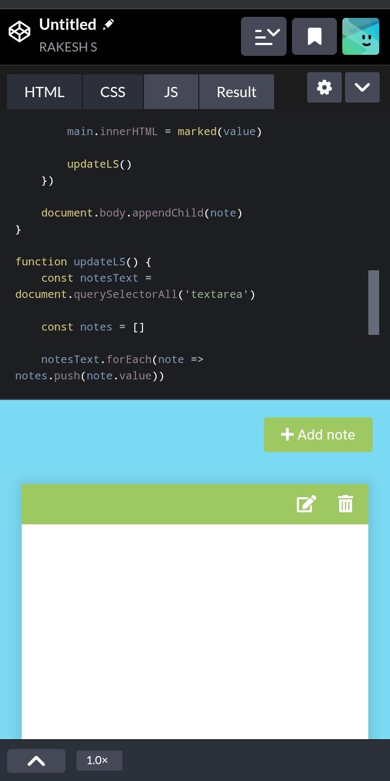

RESULTS AND SCREENSHOTS
The completed web notepad delivers efficient note management, allowing for easy creation and retrieval of notes.
Testing confirms reliability across popular browsers, including Chrome and Firefox.
Screenshots on this slide depict the main application view, feature buttons, and sample user interaction.
3/21/2024 Annual Review
‹#›

Slide 11
CONCLUSION
This project fills a vital gap by providing a simple online notepad that prioritizes privacy and convenience for everyday users.
Demonstrates the power of basic web technologies for practical problem solving and enhances digital productivity for students and professionals.
The notepad’s portability, ease of use, and secure local storage make it a valuable tool for all note-takers.
‹#›

