Slide 1

Jenkins
By
Rakesh Kumar
Satya
Malika arjun

Slide 2
Agenda

Slide 3

What is Jenkins?
An open-source automation server which enables developers around the world to reliably build, test, and deploy their software

Slide 4
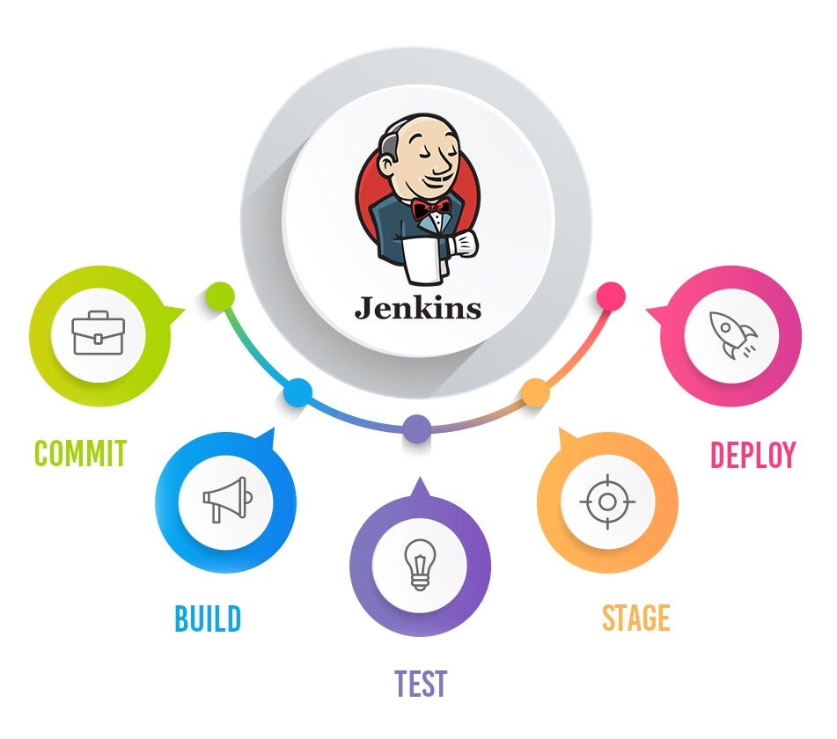
What is Jenkins?

Slide 5
Why we need to learn Jenkins?
Problem?
Developers keep merging code to VCS several times a day. All the code collected from different developers would have generated conflicts and bugs.
Code Merged from a long time when built throws Conflicts, Bugs, and errors. All these conflicts, bugs & errors need to be resolved, which takes a very long time and halts development.

Slide 6

Why we need to learn Jenkins?
Runs Automated Test Suites
Run your Web, Mobile Automation SUITE
API Monitoring
Report and Email Notification
Trends and detailed failures that can be shared.
You can use slave to make build and run fast.

Slide 7
Jenkins Architecture
Developers commit changes to the source code, found in the repository.
The Jenkins CI server checks the repository at regular intervals and pulls any newly available code.
The Build Server builds the code into an executable file. In case the build fails, feedback is sent to the developers.
Jenkins deploys the build application to the test server. If the test fails, the developers are alerted.
If the code is error-free, the tested application is deployed on the production server.

Slide 8
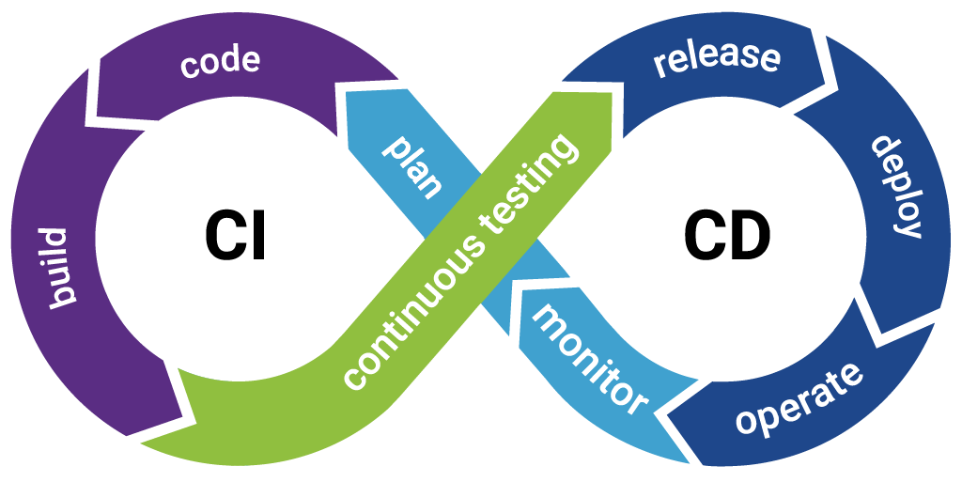
CI/CD with Jenkins

Slide 9
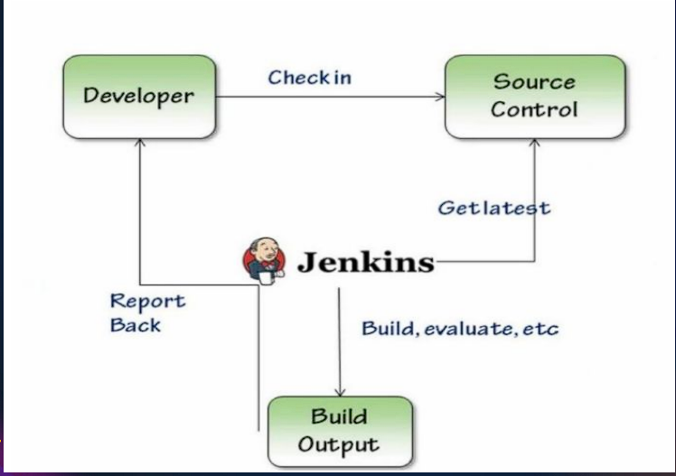
CI with Jenkins

Slide 10
Jenkins Features
Easy Installation
Easy Configuration
Available Plugins
Extensible
Easy Distribution
Free Open Source

Slide 11

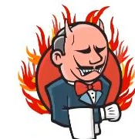

Using Jenkins
Advantages
Disadvantages
Free to Use
Rich Plugin Ecosystem
Easy Integration
Developer Centric
Setting Change Issues

Slide 12
Jenkins Installation
Java- JRE, JDK – Java 8
Any OS – Window, Linux, MacOS

Slide 13
Jenkins Installation

