Slide 1


Facial Emotion and Sleep Detection With Audio Feedback: A Dual-Purpose AI System
M JAYESH - CB.SC.U4AIE24128
M RAKESH - CB.SC.U4AIE24134
CH VIRINCHI SAI - CB.SC.U4AIE24158
K JATIN CHANDRA GUPTA - CB.SC.U4AIE24162

Slide 2
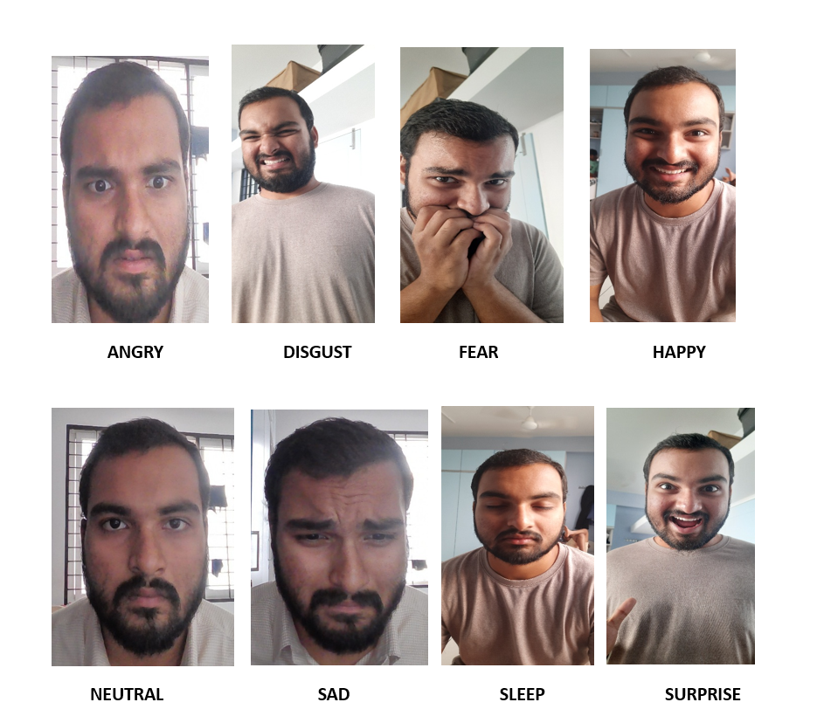
INTRODUCTION
Facial Emotion Recognition (FER) is a deep learning-based computer vision technique that detects human emotions from facial expressions. This project builds a real-time CNN-based model that classifies 8 emotions, including “Sleep.” It helps blind people through audio feedback and alerts drivers when drowsiness is detected, improving both accessibility and safety.

Slide 3
OBJECTIVES
  To develop a real-time system for detecting facial emotions and sleepiness.
  To train a CNN model capable of recognizing 8 emotions including "Sleep".
  To provide audio feedback using Text-to-Speech for blind users.
  To detect drowsiness and alert drivers in real-time.
  To implement face detection and classification using computer vision and deep learning techniques.

Slide 4

DATA SET
The dataset is based on FER-2013 from Kaggle, containing 35,887 grayscale images (48×48 pixels) labeled with seven emotions. A custom “Sleep” class was added to introduce sleep detection. After preprocessing and augmentation, the final dataset was split into training (80%, 33,467 images), validation (10%, 4,180 images), and testing (10%, 4,192 images), maintaining class balance for improved recognition of both emotions and the newly added sleep category.

Slide 5
METHODOLOGY
Dataset Preparation
  Used FER-2013 dataset as the base (48x48 grayscale images).
  Added a new class called “Sleep” with 4,388 images collected manually.
  Augmented Disgust class due to low image count.
  Applied preprocessing: grayscale normalization, histogram equalization, resizing.
Data Augmentation
  Performed data augmentation to improve model accuracy:
    Rotation (±15°)
    Brightness adjustment (±20%)
    Horizontal flips & cropping
  Goal: balance all classes and reduce overfitting.
  Ensured all images were consistent in size and format.

Slide 6
METHODOLOGY
Model Architecture
  Built a CNN (Convolutional Neural Network) using Keras.
  Layers:
    Convolution + ReLU
    Batch Normalization
    Max Pooling
    Dropout
  Final output layer: Softmax with 8 emotion classes.
Training Strategy
  Used Adam Optimizer for fast and stable learning.
  Training features:
    60 epochs
    EarlyStopping and ModelCheckpoint
  Split dataset: 80% Train, 10% Validation, 10% Test

Slide 7
IMPLEMENTATION
Emotion Detection Pipeline
  Face detected using Haar Cascade Classifier (OpenCV).
  Detected face is preprocessed and resized to 48x48.
  Image passed to CNN model for emotion classification.
  Prediction converted to label (e.g., Happy, Sleep).
Real-Time Video & Audio Feedback
  Live webcam used for real-time emotion detection.
  If emotion changes → speak it out loud using gTTS.
  Audio played using Pygame.
  Threading used for smooth speech without freezing video.

Slide 8
IMPLEMENTATION
Smart Feedback System
  System speaks only when emotion changes → avoids repetition.
  Deletes old audio files before creating new ones.
  Feedback is quick, clear, and hands-free.
  Example: If emotion = Sleep, system says “You are feeling Sleepy”
Dual Application Design
  Mode 1: Assistive Tech for Blind
    Announces emotions using speech.
  Mode 2: Driver Alertness System
    Detects "Sleepy" and alerts the driver.
  Both modes use same core CNN model with different use cases.

Slide 9
RESULT AND ANALYSIS
  Final Test Accuracy: 60.81%
  Final Test Loss: 1.065
  Best performing classes:
    Sleep (F1-score: 0.91)
    Happy (F1-score: 0.81)
  Validation accuracy closely follows training → good generalization
  Accuracy plotted for Training, Validation, and Testing.

Slide 10
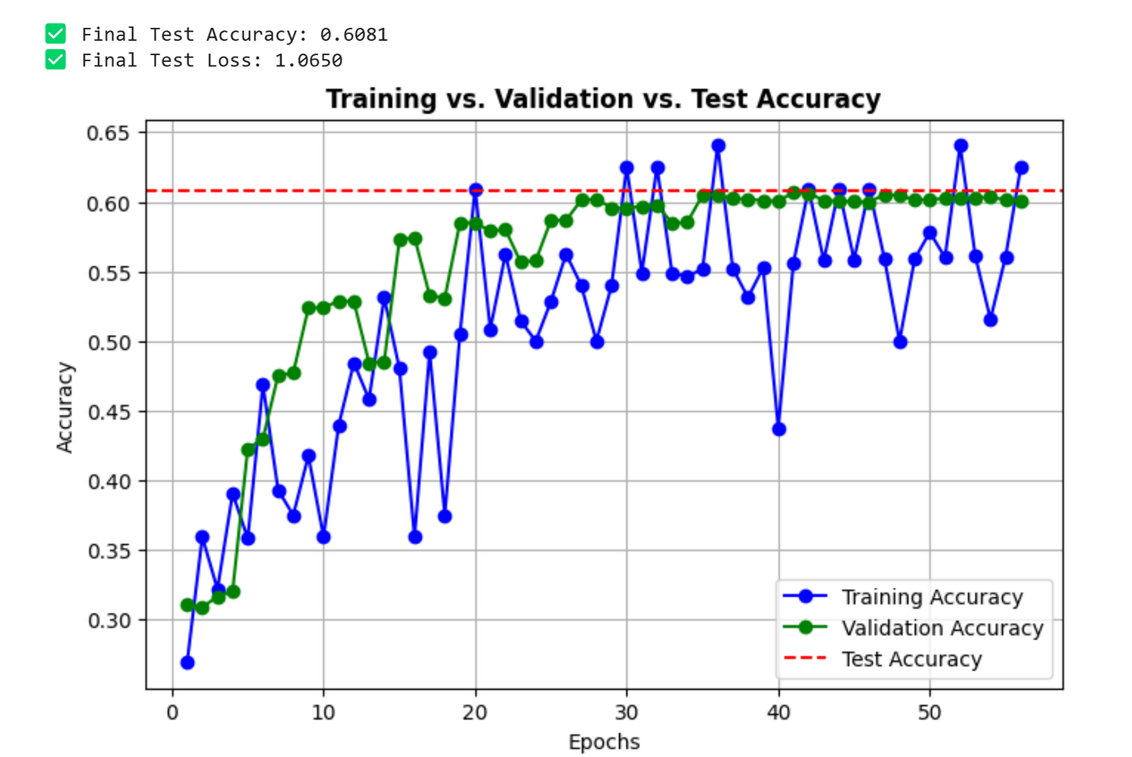
Training and validation accuracy and loss curves depicting model learning progress and convergence trends.

Slide 11
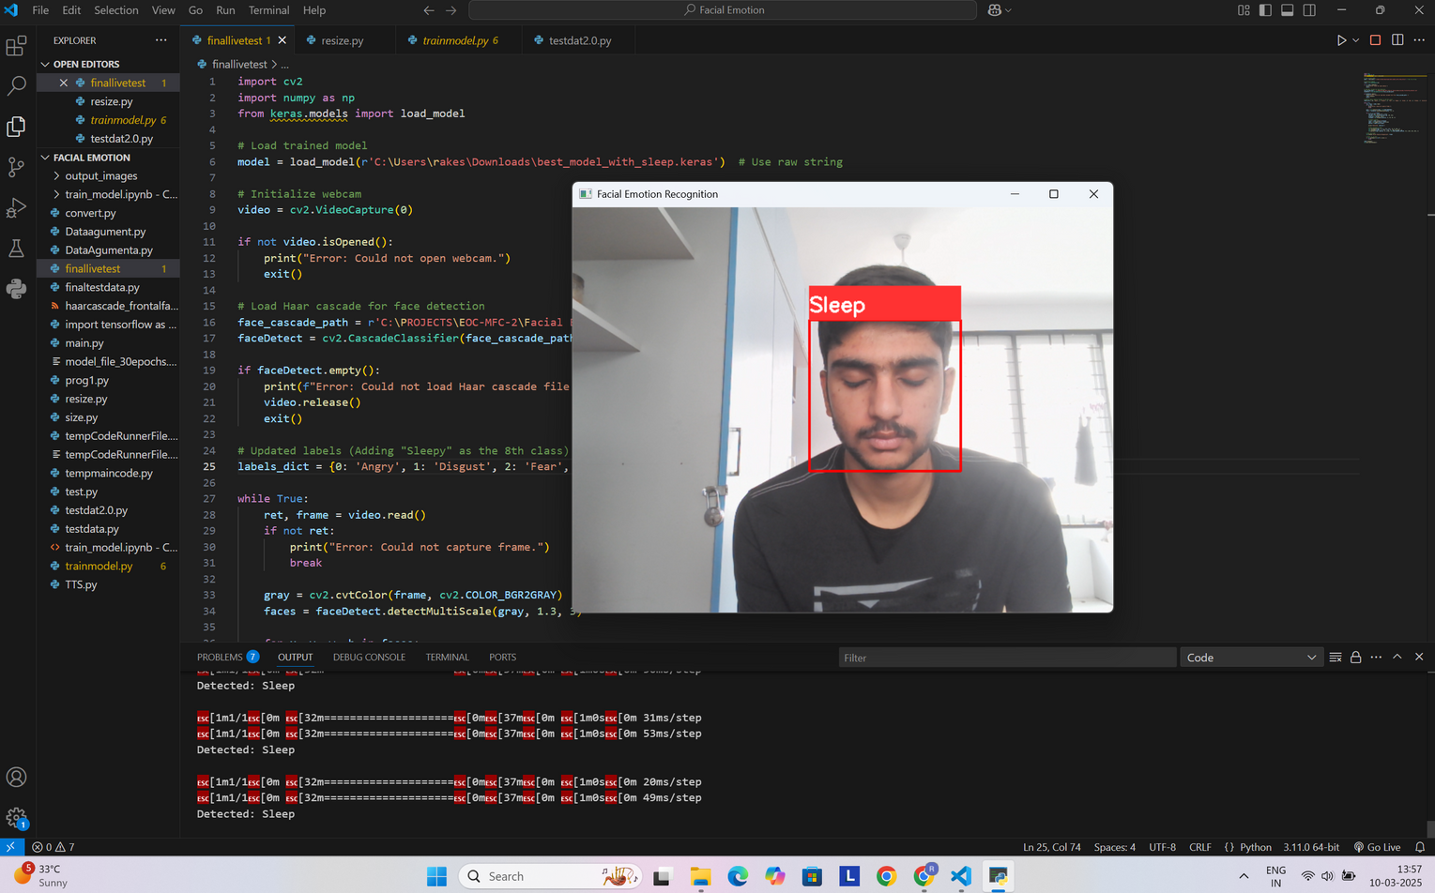
Real-time system output showing facial region detection and classification result. In this instance, the model has identified the “Sleep” state, which is overlaid on the video stream and simultaneously converted into speech feedback.

Slide 12
DISCUSSION
  Model performs well on dominant classes.
  Struggles with emotions like Fear due to fewer samples.
  Real-time performance is smooth with low delay.
  Data imbalance still affects performance — can be improved.
  Sleep detection works reliably in live scenarios

Slide 13
CONCLUSION
  Successfully built a real-time dual-purpose AI system.
  Helps blind people understand emotions using speech.
  Alerts drivers when they look sleepy.
  Achieved balanced performance across classes using CNN and augmentation.
  Future Work:
    Add more data for weak classes
    Use transfer learning for better accuracy
    Add multi-language audio feedback

Slide 14
REFERENCE PAPERS
    EMOTION RECOGNITION BASED ON CONVOLUTIONAL NEURAL NETWORK (CNN)-2021
    HUMAN EMOTION DETECTION USING OPEN CV - 2022
    ARTIFICIAL INTELLIGENCE AND FACE EMOTION PREDICTION BASED TRAINING FOR AUTISM KIDS -2022
    EMOTION RECOGNITION IN IMAGES AND VIDEO WITH PYTHON FOR AUTISM ASSESSMENT-2024
    REAL TIME EMOTION RECOGNITION USING IMAGE CLASSIFICATION - 2023
    OPENCV AND PYTHON FOR EMOTION ANALYSIS OF FACE EXPRESSIONS-2023
    AI AND FACE EMOTION PREDICTION BASED TRAINING FOR AUTISM KIDS-2020
    MACHINE LEARNING AND DEEP LEARNING TECHNIQUES FOR EXPRESSION BASED FACIAL RECOGNITION-2023
    IMPROVED OPTIMIZER WITH DL MODEL FOR EMOTION DETECTION-2024
    EXPLORING DIFFERENT TECHNIQUES FOR EMOTION DETECTION THROUGH FACE RECOGNITION-2023

Slide 15
THANK YOU!

