Slide 1
Security in Computing, Fifth Edition
Chapter 3: Programs and Programming

Slide 2
Objectives for Chapter 3
Learn about memory organization, buffer overflows, and relevant countermeasures
Common programming bugs, such as off-by-one errors, race conditions, and incomplete mediation
Survey of past malware and malware capabilities
Virus detection
Tips for programmers on writing code for security

Slide 3
IEEE Standard 729 defines quality-related terms:
Error: A human mistake in performing some software-related activity, such as specification or coding.
Fault: An incorrect step, command, process or data
definition in a piece of software.
Failure: A departure from the system’s desired behaviour.

Slide 4
A program security flaw is an undesired program behaviour caused by a program vulnerability.
Work on program security considers two questions:  How do we keep programs free from flaws?  How do we protect computing resources against programs with flaws?
Early idea was to attack the finished program to reveal faults, and then to patch the corresp. errors.
Experience shows that this is not effective, and just tends to introduce new faults (and errors)!
More modern approach is to use careful specification and compare behaviour with the expected.

Slide 5
Program security flaws Fall into two groups:
1 Non-malicious flaws. Introduced by the programmer overlooking something: 
Buffer overflow 
Incomplete mediation
Time-of-check to Time-of-use (TOCTTU) errors
2. Malicious flaws. Introduced deliberately (possibly by exploiting a non-malicious vulnerability):
Virus, worm, rabbit
Trojan horse, trapdoor
Logic bomb, time bomb

Slide 6
Memory Allocation
Notes:
Much of this chapter requires basic knowledge of how memory is organized, and this is a nice, simple diagram to refresh students on how it works. The key takeaways: code and data separated, with the heap growing up toward high addresses and the stack growing down from the high addresses.

Slide 7
Data vs. Instructions
Notes:
The same hex value in the same spot in memory can either be a meaningful data value or a meaningful instruction depending on whether the computer treats it as code or data. This will be the basis of the attacks in the following slides.

Slide 8
Buffer Overflows
Occur when data is written beyond the space allocated for it, such as a 10th byte in a 9-byte array
In a typical exploitable buffer overflow, an attacker’s inputs are expected to go into regions of memory allocated for data, but those inputs are instead allowed to overwrite memory holding executable code
The trick for an attacker is finding buffer overflow opportunities that lead to overwritten memory being executed, and finding the right code to input

Slide 9
How Buffer Overflows Happen
char sample[10];
int i;
for (i=0; i<=9; i++)
sample[i] = ‘A’;
sample[10] = ‘B’;
Notes:
This is a very simple buffer overflow. Character B is placed in memory that wasn’t allocated by or for this procedure.

Slide 10
Memory Organization
Notes:
Similar to the earlier picture on memory organization, only this one shows where the system data/code reside vs. where the program code and its local data reside. This context is important for understanding how an attack that takes place inside a given program can affect that program vs. how it can affect the rest of the system.

Slide 11
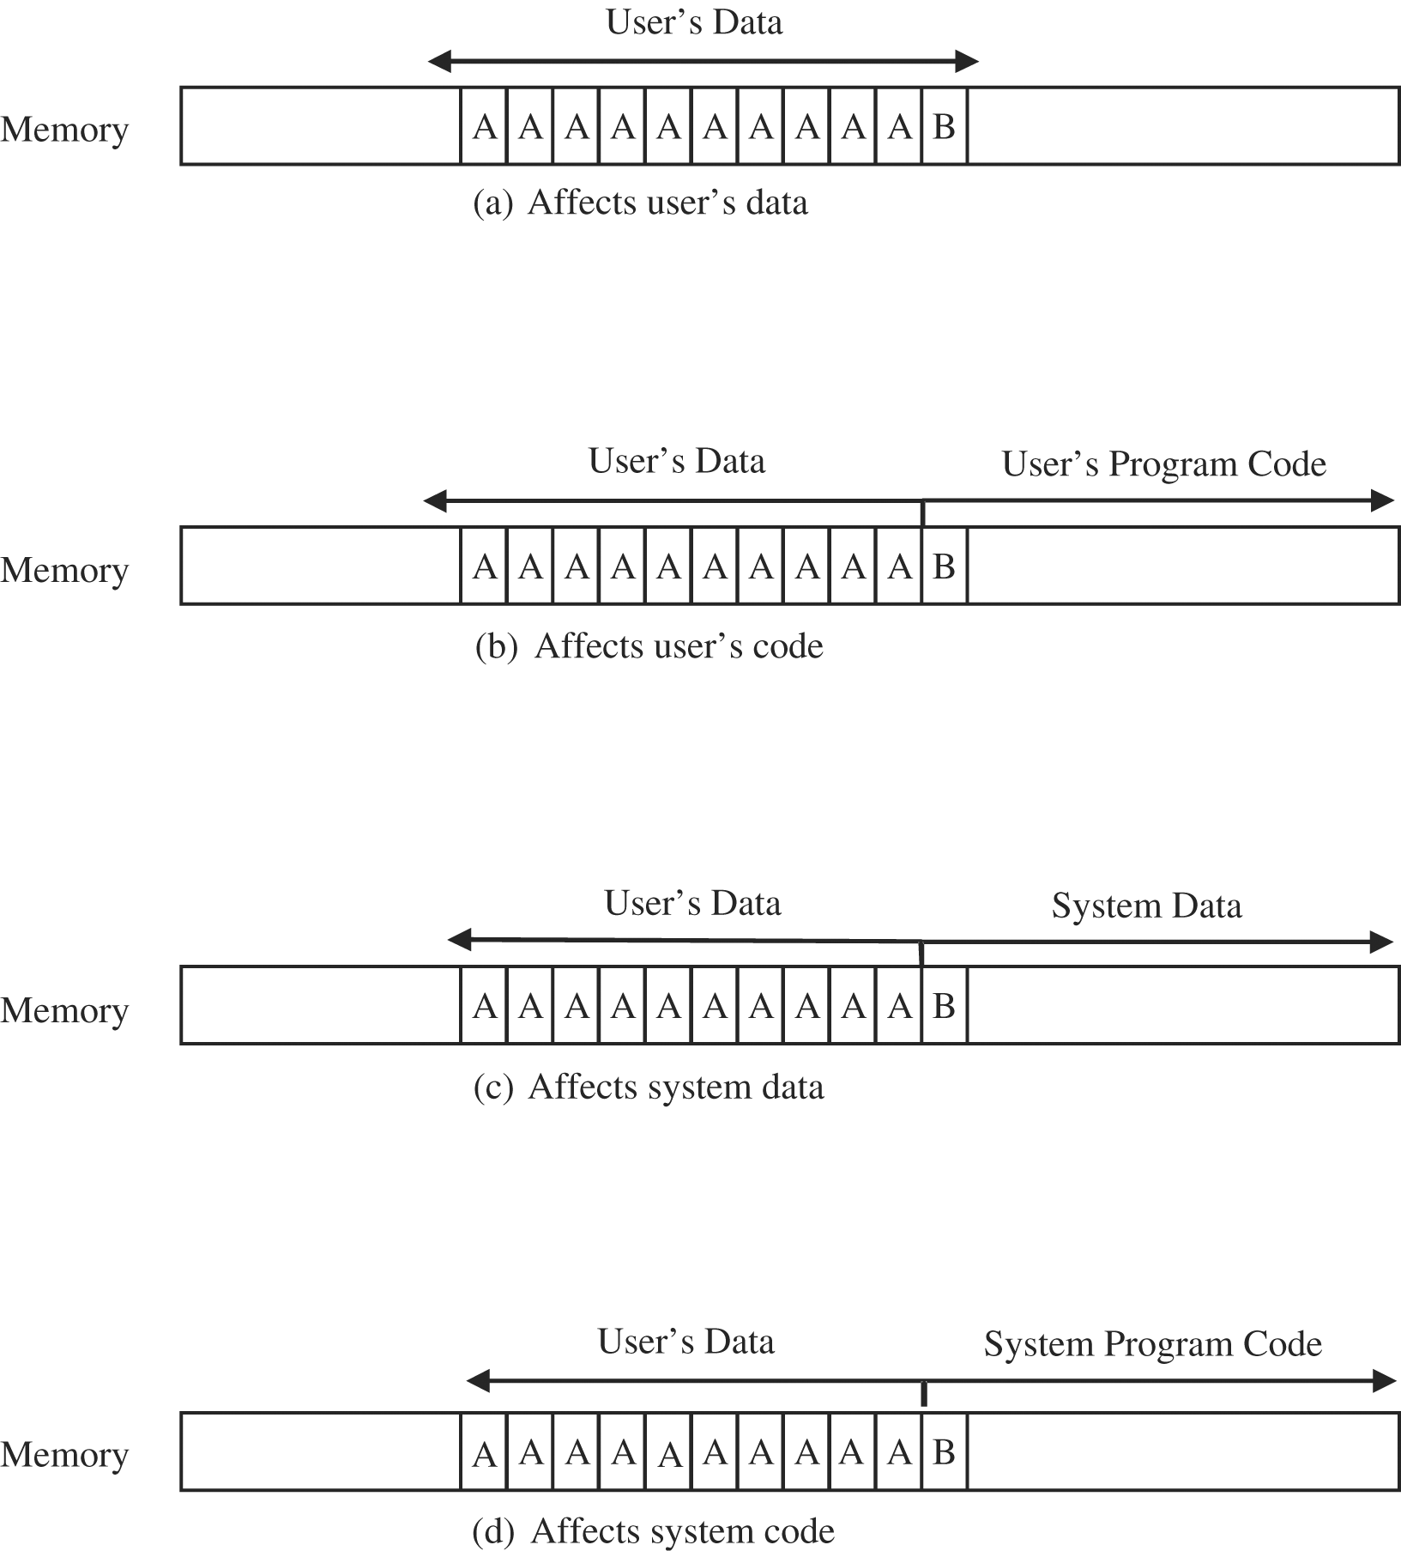
Where a Buffer Can Overflow
Notes:
Examples of buffer overflow effects in the context of the earlier AAAAAAAAAAB example. The memory that’s overwritten depends on where the buffer resides.

Slide 12
The Stack

Slide 13
The Stack after Procedure Calls
Notes:
When procedure A calls procedure B, procedure B gets added to the stack along with a pointer back to procedure A. In this way, when procedure B is finished running, it can get popped off the stack, and procedure A will just continue executing where it left off.

Slide 14
Compromised Stack
Notes:
Instead of pointing at procedure B in this case, the program counter is pointing at code that’s been placed on the stack as a result of an overflow.

Slide 15
Overwriting Memory for Execution
Overwrite the program counter stored in the stack
Overwrite part of the code in low memory, substituting new instructions
Overwrite the program counter and data in the stack so that the program counter points to the stack

Slide 16
Harm from Buffer Overflows
Overwrite:
Another piece of your program’s data
An instruction in your program
Data or code belonging to another program
Data or code belonging to the operating system
Overwriting a program’s instructions gives attackers, that program’s execution privileges
Overwriting operating system instructions gives attackers the operating system’s execution privileges

Slide 17
Overflow Countermeasures
Staying within bounds
Check lengths before writing
Confirm that array subscripts are within limits
Double-check boundary condition code for off-by-one errors
Limit input to the number of acceptable characters
Limit programs’ privileges to reduce potential harm
Many languages have overflow protections
Code analyzers can identify many overflow vulnerabilities
Canary values in stack to signal modification

Slide 18
Incomplete Mediation
Mediation: Verifying that the subject is authorized to perform the operation on an object
Sensitive data (namely, the parameter values) are in an exposed, uncontrolled condition.
Preventing incomplete mediation:
Validate all input
Limit users’ access to sensitive data and functions
Complete mediation using a reference monitor
Notes:
The three properties of a reference monitor are (1) small and simple enough to give confidence of correctness, (2) unbypassable, and (3) always invoked. These three properties combine to give us solid, complete mediation.

Slide 19
Time-of-Check to Time-of-Use
Mediation performed with a “bait and switch” in the middle

Slide 20
Race Conditions
Notes:
Example 1 (no race condition): A booker books the last seat on the plane, and thereafter the system shows no seat available. See next slide to continue.

Slide 21
Race Conditions
Notes:
Example 2 (race condition): Before the first booker can complete the booking for the last available seat, a second booker looks for available seats. This system has a race condition, where the overlap in timing of the requests causes errant behavior.

Slide 22
Other Programming Oversights
Undocumented access points (backdoors)
Off-by-one errors
Integer overflows
Unterminated null-terminated string
Parameter length, type, or number errors
Unsafe utility libraries

Slide 23
Malware
Programs planted by an agent with malicious intent to cause unanticipated or undesired effects
Virus
A program that can replicate itself and pass on malicious code to other nonmalicious programs by modifying them
Worm
A program that spreads copies of itself through a network
Trojan horse
Code that, in addition to its stated effect, has a second, nonobvious, malicious effect

Slide 24
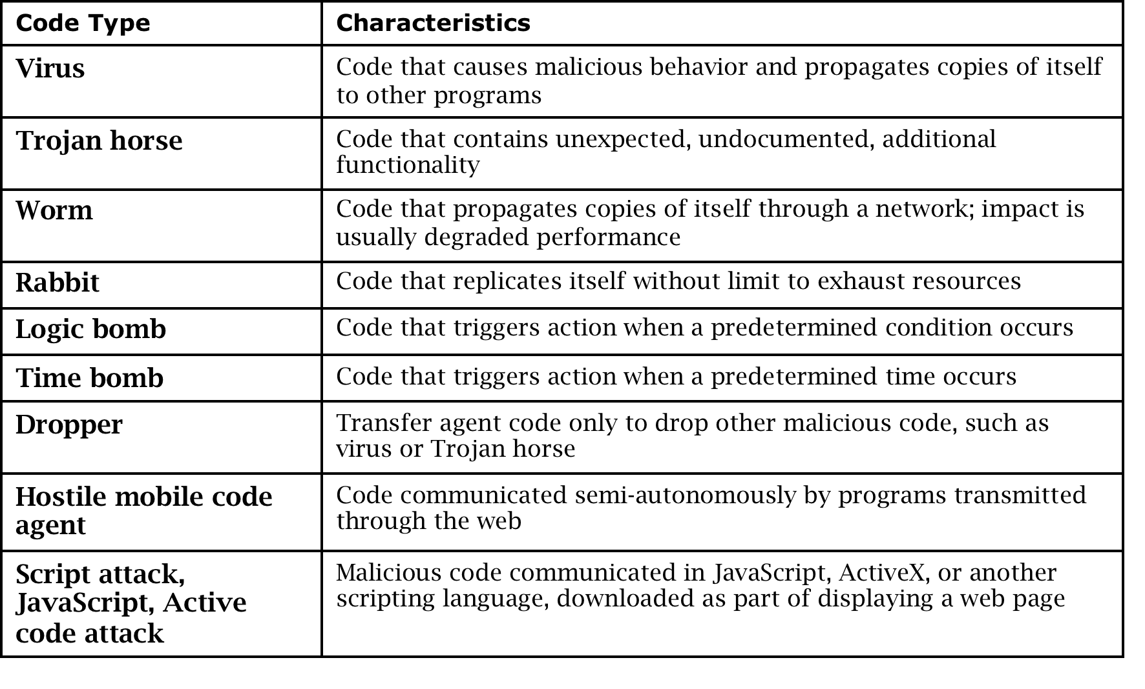
Types of Malware

Slide 25
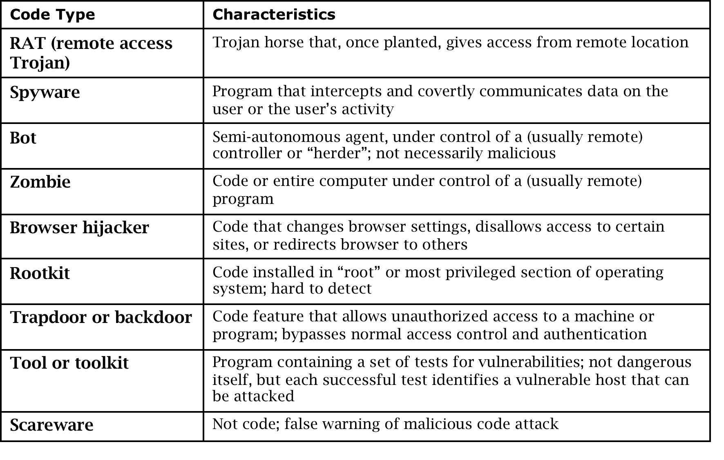
Types of Malware (cont.)

Slide 26
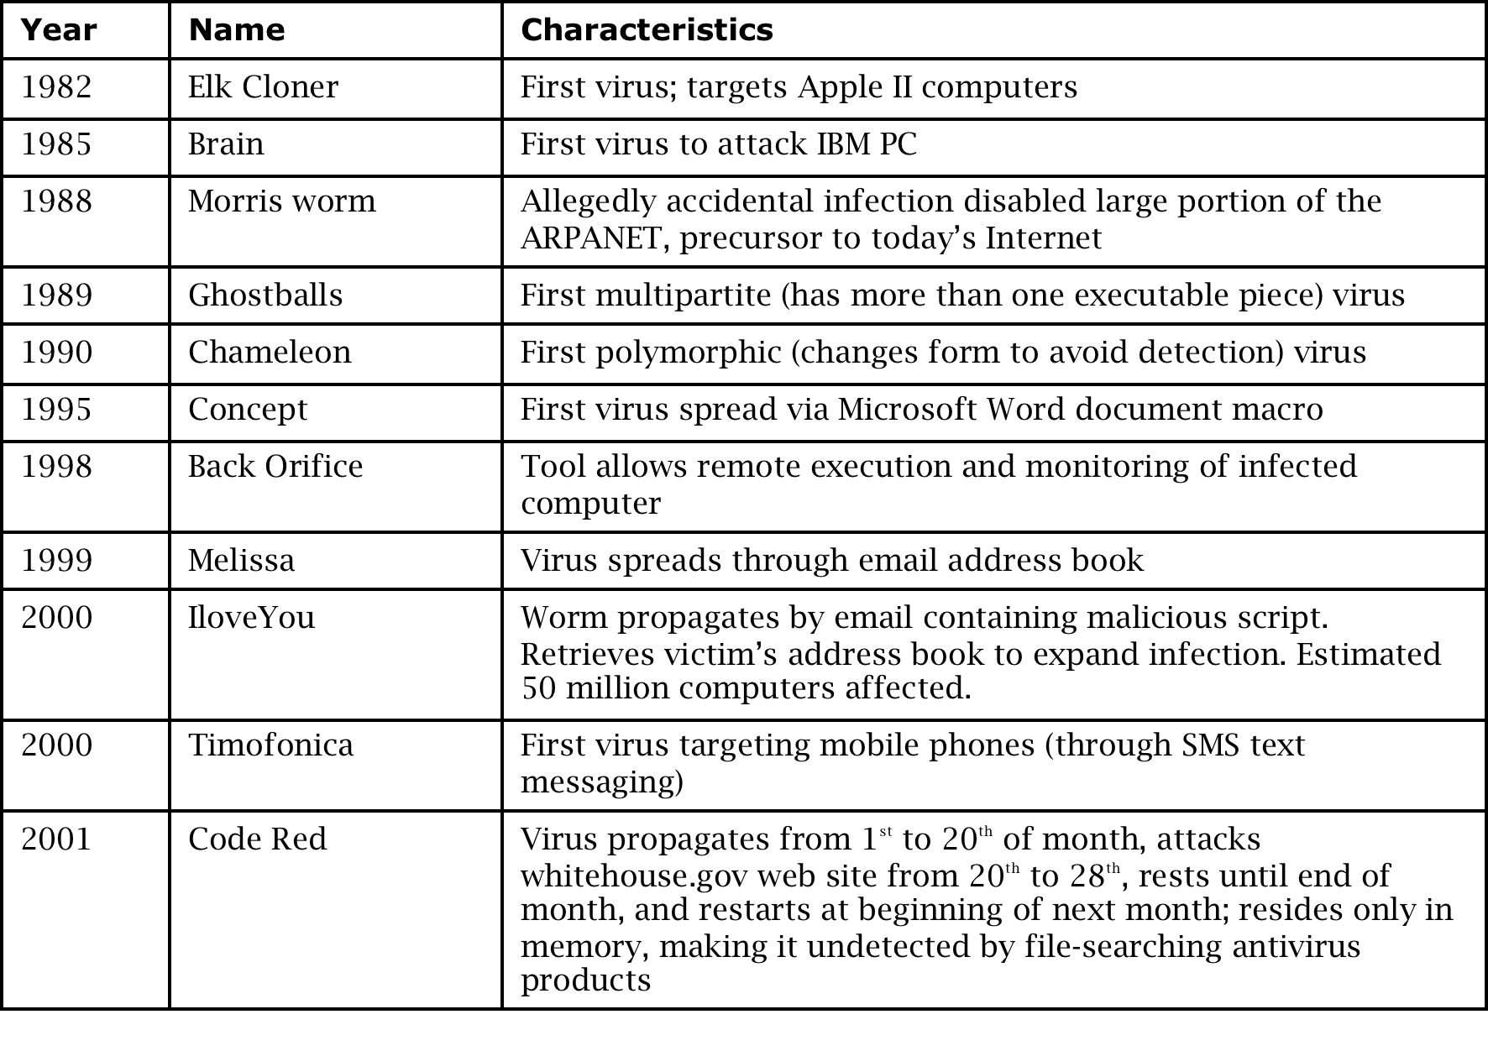
History of Malware

Slide 27
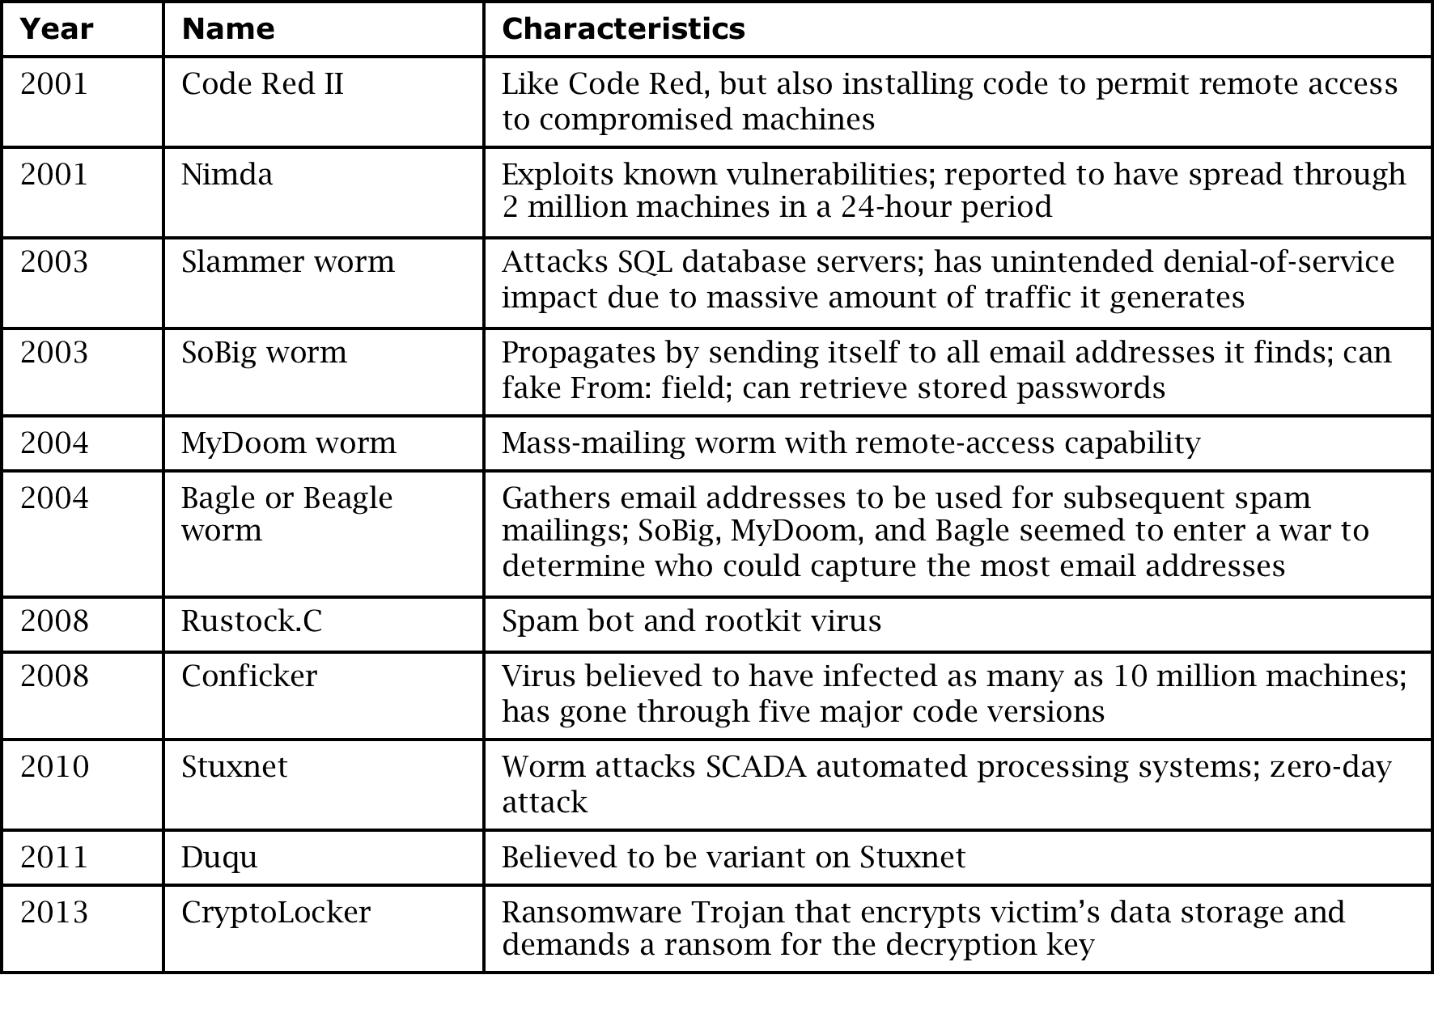
History of Malware (cont.)

Slide 28
Harm from Malicious Code
Harm to users and systems:
Sending email to user contacts
Deleting or encrypting files
Modifying system information, such as the Windows registry
Stealing sensitive information, such as passwords
Attaching to critical system files
Hide copies of malware in multiple complementary locations
Harm to the world:
Some malware has been known to infect millions of systems, growing at a geometric rate
Infected systems often become staging areas for new infections

Slide 29
Transmission and Propagation
Setup and installer program
Attached file
Document viruses
Autorun
Using nonmalicious programs:
Appended viruses
Viruses that surround a program
Integrated viruses and replacements

Slide 30
Malware Activation
One-time execution (implanting)
Boot sector viruses
Memory-resident viruses
Application files
Code libraries

Slide 31
Virus Effects

Slide 32
Countermeasures for Users
Use software acquired from reliable sources
Test software in an isolated environment
Only open attachments when you know them to be safe
Treat every website as potentially harmful
Create and maintain backups

Slide 33
Virus Detection
Virus scanners look for signs of malicious code infection using signatures in program files and memory
Traditional virus scanners have trouble keeping up with new malware—detect about 45% of infections
Detection mechanisms:
Known string patterns in files or memory
Execution patterns
Storage patterns

Slide 34
Virus Signatures

Slide 35
Countermeasures for Developers
Modular code: Each code module should be
Single-purpose
Small
Simple
Independent
Encapsulation
Information hiding
Mutual Suspicion
Confinement
Genetic diversity

Slide 36
Code Testing
Unit testing
Integration testing
Function testing
Performance testing
Acceptance testing
Installation testing
Regression testing
Penetration testing

Slide 37
Design Principles for Security
Least privilege
Economy of mechanism
Open design
Complete mediation
Permission based
Separation of privilege
Least common mechanism
Ease of use

Slide 38
Other Countermeasures
Good
Proofs of program correctness—where possible
Defensive programming
Design by contract
Bad
Penetrate-and-patch
Security by obscurity

Slide 39
Summary
Buffer overflow attacks can take advantage of the fact that code and data are stored in the same memory in order to maliciously modify executing programs
Programs can have a number of other types of vulnerabilities, including off-by-one errors, incomplete mediation, and race conditions
Malware can have a variety of harmful effects depending on its characteristics, including resource usage, infection vector, and payload
Developers can use a variety of techniques for writing and testing code for security

