Slide 1
Big Data Job Analysis
CS5530 – Principles of Data Science
Saiteja Thalluri - 16342709
Rakesh Naini - 16341798
Prateek Dhall -16344965
Sravya Ryakam - 16344249

Slide 2
Abstract
This project proposes a comprehensive Big Data analytics framework to address the escalating demand for skilled professionals in Big Data technologies. Utilizing advanced techniques such as machine learning algorithms like logistic regression, Random forest and Decision Tree, the framework analyzes extensive dataset from Kaggle. The primary objectives include identifying distinct Big Data job families, uncovering homogeneous skill groups, and characterizing job families based on competency levels for each skill set. The nuanced approach aims to empower HR departments to tailor recruitment strategies, providing actionable insights beyond traditional methods. By navigating the evolving landscape of technology-driven industries, this data-driven approach ensures organizations can secure the right talent to drive innovation and success in the realm of Big Data.

Slide 3
Objectives
Conduct a thorough analysis of the dataset derived from real-world job postings in the field of Big Data.
Identify and categorize distinct Big Data job families within the dataset based on job descriptions, requirements, and responsibilities.
Characterize each identified Big Data job family based on the level of competence required for specific skill sets, offering a nuanced understanding of skill landscapes.
Utilize machine learning algorithms to extract meaningful insights, patterns, and associations among the demanded Big Data skills from the analysed datasets.
Assist HR professionals in making informed decisions by offering a detailed understanding of the evolving skill landscape and job market for Big Data roles.
Contribute to the success of organizations in technology-driven industries by ensuring they secure the right talent for innovation and success in the realm of Big Data.

Slide 4
Introduction
In today's tech-driven world, companies really need people who know their way around Big Data – that's handling and making sense of large amounts of information. Finding the right people for these jobs is a big challenge for the HR (Human Resources) folks.
This project is like a guide for HR teams, using lots of data from real job ads online. Our goal is to help them understand the Big Data job market better. We want to find out what kinds of Big Data jobs are out there, what skills companies really value, and how good someone needs to be at those skills for different jobs.
In the next parts, we'll talk about what exactly we're trying to do, how we're going to do it, and what we hope to achieve. The idea is to make hiring for Big Data roles easier for HR teams and make sure companies get the right people to make the most of their data.

Slide 5
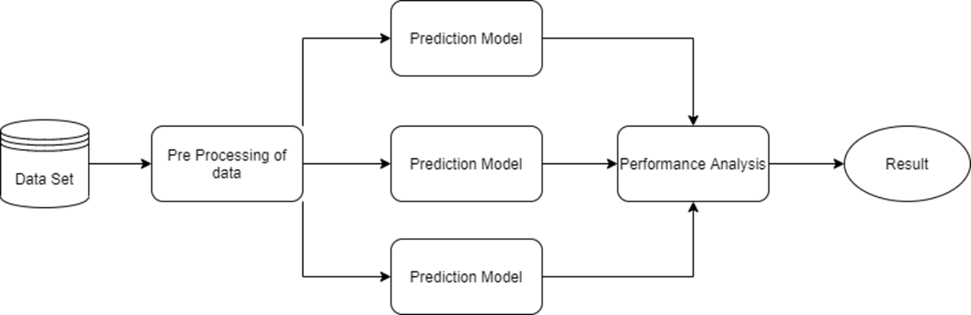
Architectural Design

Slide 6
Source Dataset
https://www.kaggle.com/code/rohitsahoo/data-analyst-job-analysis/input
This dataset is taken from Kaggle which contains different attributes
Job title
Salary Estimate
Job Description
Company Name
Location
Rating etc.

Slide 7
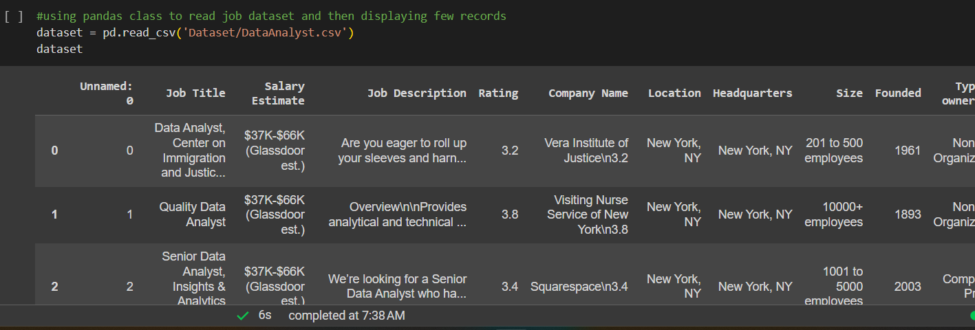
Data Processing
Importing the dataset and displaying the values.

Slide 8
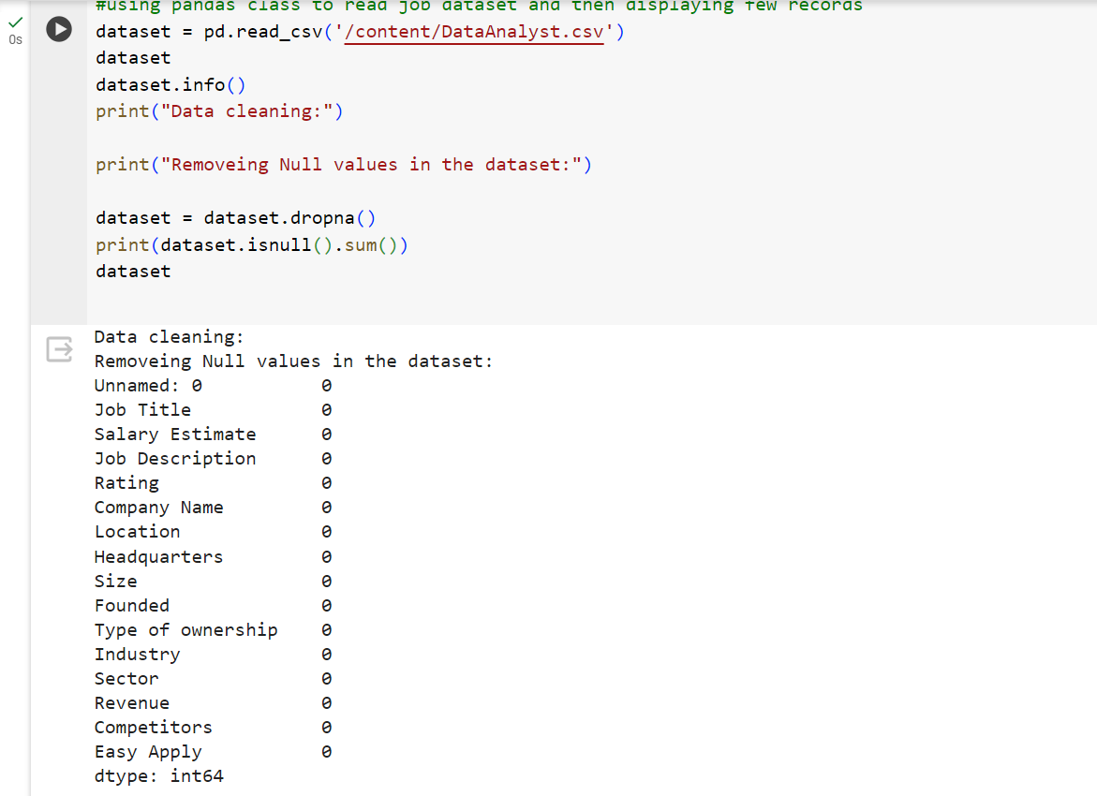
DATA Pre-processing
Here we are pre-processing the data

Slide 9
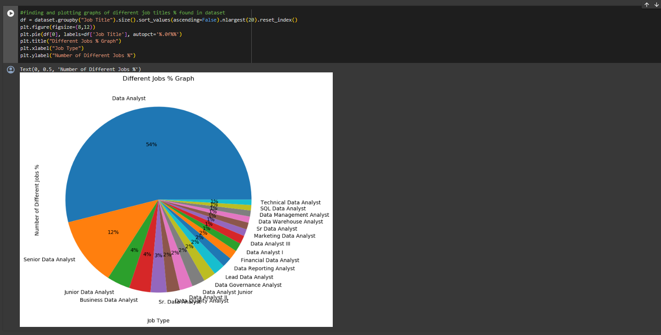
Data Analysis
2. Analyzing the job title which is in demand.

Slide 10
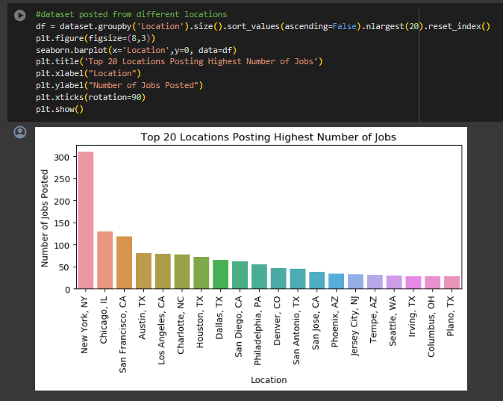
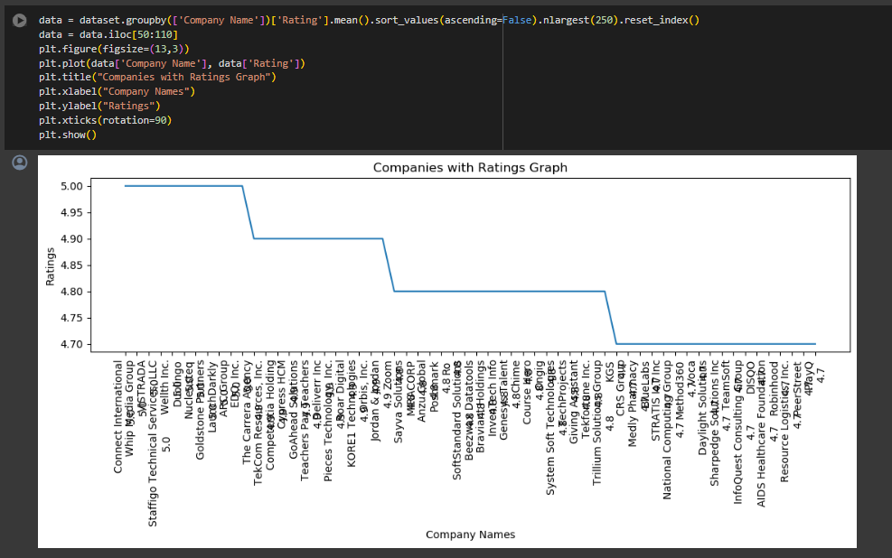
Data Analysis
Figures displaying the company ratings and the top 20 locations posting highest number of jobs.

Slide 11
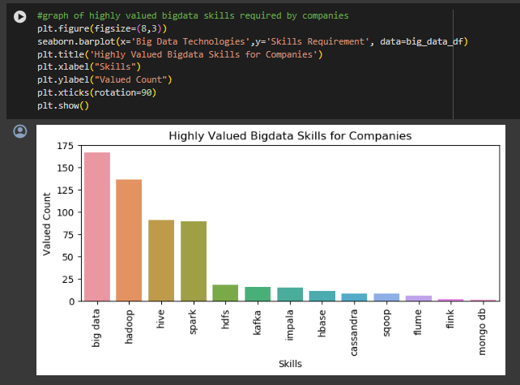
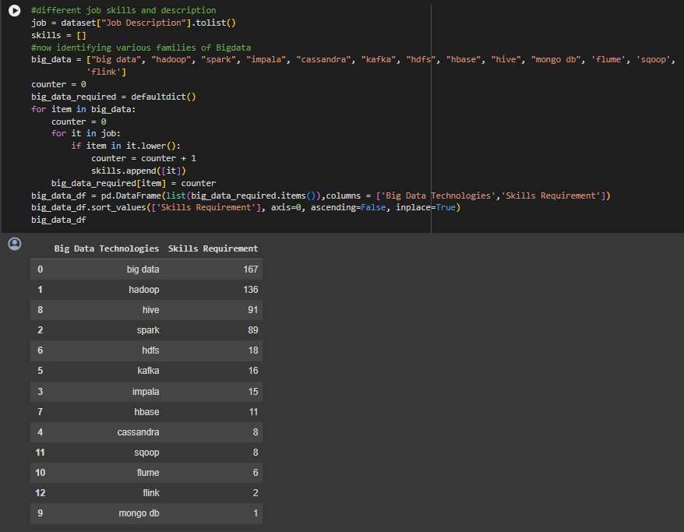
Data Analysis
Big data family technologies which are in more demand.

Slide 12
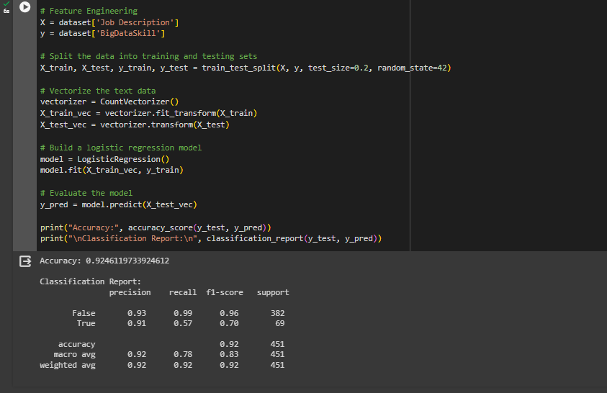
Machine Learning Algorithms
Logistic Regression Based on the job description and Big data skills this ML algorithm show 92% accuracy.

Slide 13
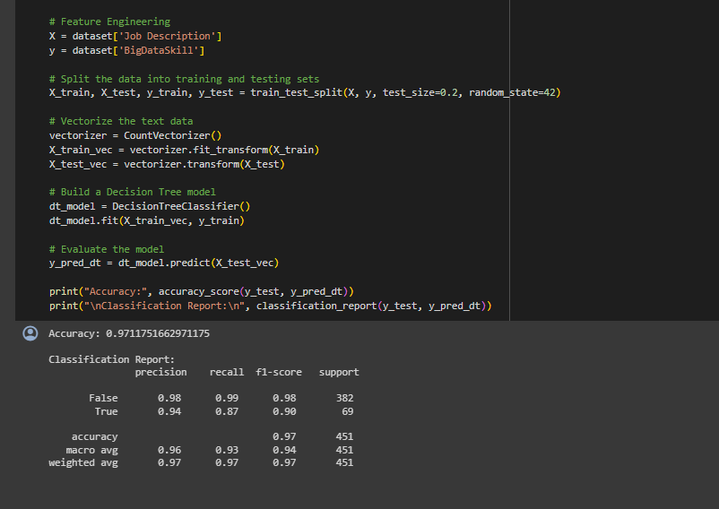
Machine Learning Algorithms
Decision Tree Based on the job description and Big data skills this ML algorithm show 97% accuracy.

Slide 14
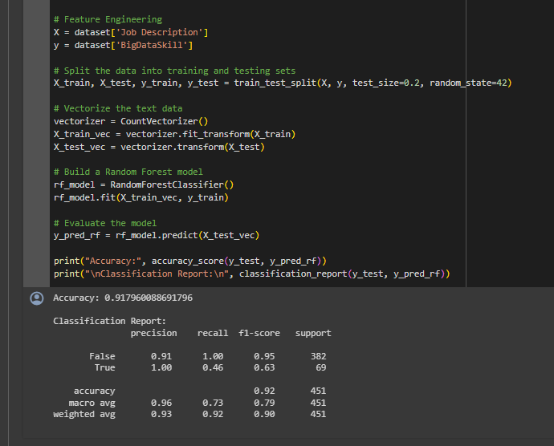
Machine Learning Algorithms
Random Forest Based on the job description and Big data skills this ML algorithm show 91% accuracy.

Slide 15
Conclusion
After comparing three different machine learning algorithms, we found that the decision tree algorithm stood out with the highest accuracy, reaching an impressive 97%. This means it did a great job in understanding patterns.
By utilizing these It makes easier for HR to find and hire the best candidates for Big Data roles and making informed decisions. It's a step towards smarter and more effective hiring practices in the world of technology.
By leveraging the insights and recommendations provided by the project, the HR department can enhance its recruitment process. It can focus on candidates with higher competence levels in critical Big Data skills, leading to more successful and efficient hiring processes.
It helps to offer a data-driven approach for talent acquisition.
Empower organizations to secure the right talent to drive innovation and success in the realm of Big Data.

Slide 16
References
Provost, F., & Fawcett, T. (2013). "Data Science for Business." O'Reilly Media.
Isson, J. P., & Harriott, J. S. (2015). "People Analytics in the Era of Big Data: Changing the Way You Attract, Acquire, Develop, and Retain Talent." John Wiley & Sons.
Si"Beyond Data Scientists: A Review of Big Data Skills and Job Families" by Giuseppe Sannino, Leonardo Albino, and Alessandra D'Angelo (2016)
"Human Resources for Big Data Professions: A Systematic Classification of Job Roles and Required Skill Sets" by Christian Sterly, Michael Lindner, and Bernd Eberspacher (2019)
"Job Family Matrix" by Harvard Human Resources (2020)
"A Systematic Review of Big Data Job Roles and Required Skill Sets" by Muhammad Usman, Muhammad Asif, and Muhammad Younus (2020)
"Big Data Job Roles and Skills Classification: A Review and Research Agenda" by Muhammad Usman and Muhammad Asif (2021)
Murphy, M. (2011). "Hiring for Attitude: A Revolutionary Approach to Recruiting and Selecting People with Both Tremendous Skills and Superb Attitude." McGraw-Hill Education.

Slide 17
Thank You!

