Slide 1
Autoscaling
Using the Autoscaling service

Slide 2
Roadmap
Autoscaling

Slide 3

Scaling Options
CF allows horizontal scaling
  Controlling the # of instances of an application running
  All behind a common router (load balancer)
  Controllable via the manifest, cf command line, or App Manager console
All options require manual intervention
Notes:
To review and set the stage, all of the scaling options we know about are MANUAL.

Slide 4
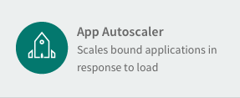
AutoScaling
CF can allow applications to be automatically scaled
  “AutoScaling”
System load can be used as a trigger in place of manual interaction.
Autoscaling Service
  Must be installed by administrator
Notes:
Only available as a Pivotal CF service, not in PWS

Slide 5
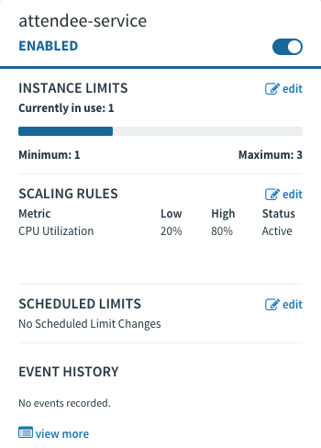
AutoScaling Service – Steps
Create the service
Bind to Application
Set desired scaling parameters
  Instance Limits
  Scaling Rules
    CPU Utilization
    HTTP Througput
    HTTP Latency
  Scheduled Limits
Notes:
At present, minimum instances is 2, maximum is 20.
Defaults of 80% and 20% are shown.

Slide 6

AutoScaling – Moving Average
Scaling activity based on moving averages
  Softens effect of temporary spikes
Manual scaling disables AutoScaling
    Re-enable:
Spikes do not
trigger auto-scaling
Moving average exceeds
threshold, add instances
80%
Moving average drops
remove instances
20%
Notes:
The previous slide may prompt question of what exactly is meant by 80% or 20%. This is a moving average of all application instances. One instance with a spike in activity usually won't cause scaling to occur.
When the moving average of all instances exceeds the threshold, a new instance is added. When the moving average of all instances is lower than the minimum threshold, then instances are removed until minimum # of instances reached. NOTE: the new instance is not necessarily the last one started as this illustration may imply.
If you manually scale, then you disable the autoscaling feature, so you need to remember to re-enable it.
The interesting footnote here is the stopping of a perfectly healthy instance by CF. Re-enforce that apps should be stateless and should handle a 'crash' at any time.

Slide 7
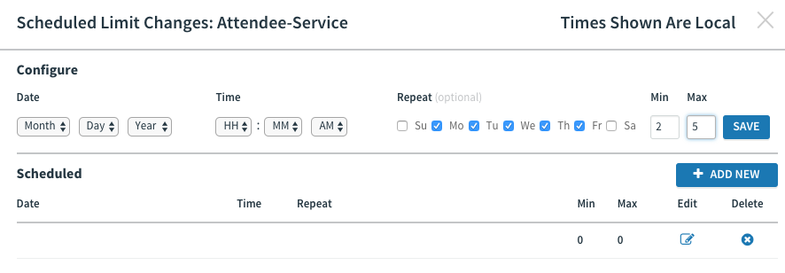
AutoScaling – Scheduling
Autoscaling events can be scheduled
Changes autoscaling behavior on the given date / time.
May be single event or recurring
2
5
Notes:
When you set up an autoscaling event, essentially the min/max settings described take over from that point forward, until the next scaling event happens.
All scaling events are single events UNLESS you have checked one of the day checkboxes, then they recur every week.
So if a movie reservation business wanted to, they could scale up at the beginning of the weekend, then scale down on mondays. The date / time would affect when the schedule would take effect.

Slide 8
Lab
Autoscaler

