Slide 1
Pivotal Cloud Foundry Developer
A three-day workshop on using PCF to develop and deploy enterprise applications
Course Overview

Slide 2
Introductions
Name
Role / title
Background in Software Development
Experience with command-line or “shell”
What you would like to get out of this course

Slide 3

Logistics
Instructor introduction
Course registration (if needed)
Courseware
Internet access
Phones on silent
Working hours
Lunch and breaks
Toilets/Restrooms
Fire alarms
Emergency exits
Any other questions?

Slide 4

How You will Benefit
Gain a solid understanding of Pivotal Cloud Foundry ...
… from the point of view of a developer
Learn to use Pivotal Cloud Foundry to develop, test and deploy web and other applications
Gain hands-on experience
  Generous mixture of presentation and labs
Access to experienced, certified instructors
Notes:
Note that this is a course about deploying to Cloud Foundry. It is not about developing the applications themselves. Therefore, it does not assume or require attendees know any particular programming language.

Slide 5
Covered in this section
Agenda
About Pivotal
Notes:
Don't get too hung up the actual days, different groups will go at their own pace.

Slide 6

Course Agenda: Day 1
Introduction to Cloud Foundry and PCF
Concepts
Getting Started with cf CLI
Logging, Scaling and High Availability
Services
Notes:
Logging/Scaling and HA section is long and an excuse to discuss the PCF architecture.

Slide 7

Course Agenda: Day 2
Environment Variables
Manifests
Application Security Groups
Log Draining
Blue-Green (Rolling) Deployments
Introduction to Microservices
Application Autoscaler
Application Performance Monitoring
Metrics
Notes:
Not as bad as it looks – many of these are short (not many slides) and the labs are typically 30 minutes or less. Microsevices is longer and just an overview (no lab) – you could present it at almost any point.

Slide 8

Course Agenda: Day 3
Buildpacks
Service Brokers
Continuous Delivery
Route Services
Advanced Features
  Tasks, TCP routing, Volume Services
  Container to Container routing
Notes:
The Service Broker lab is one of the most interesting but takes time. The CD lab is also time consuming -

Slide 9
Covered in this section
Agenda
Getting the Most from this Course
About Pivotal
Notes:
Ask these questions:
Who has heard of Pivotal?
Why was Spring bought by Vmware?
Not many developers seem to be aware of the new company or our fit in the Cloud and Big Data Strategies.

Slide 10
Approach & Methodology
Course is designed to challenge you
  You will learn by doing, as well as from the presentations
To get through the labs, you will have to:
  Ask questions
  Collaborate with colleagues
  Follow links to, and read official product documentation,
  Use “cf help” and “ cf help <command>”
  Experiment

Slide 11
Tips for Working Through a Lab Exercise
Take the time to read the referenced documentation
For every new cf command
  Check out the cf help for that command.
Example:
  Look up “services” in the online documentation
  You need to use cf create-service for the first time
    Run cf help create-service to see how it works

Slide 12
Covered in this section
Agenda
Getting the Most from this Course
About Pivotal
Notes:
Ask these questions:
Who has heard of Pivotal?
Why was Spring bought by Vmware?
Not many developers seem to be aware of the new company or our fit in the Cloud and Big Data Strategies.

Slide 13



About Pivotal
Pivotal Software
  Joint venture by EMC, VMware and General Electric
  Formed in 2013, privately held
Several products supporting cloud deployment
  Cloud Foundry itself
  Spring Projects
  Gemfire Distributed Data Grid
  RabbitMQ Messaging (AMQP)
Notes:
Why virtualise, why big data, why Spring?
Virtualizing Java applications saves money, pure and simple. Moving to tcServer saves even more money because the annual licensing is cheaper (compared to Websphere/Weblogic). It also requires less resources so you get more for your money. Most users typically do not use most of the JEE stack – but they pay for it anyway. Compare a full-service, full-cost airline versus the budget airline approach – you pay just for what you use. If you don't want check-in baggage, or the terrible food, you don't pay for them. 80% of Spring users run on Tomcat server(s).
Once you move to a Cloud environment you gain two more advantages,
Firstly you can start charging users (internal departments) for the compute resources they use – chargeback. Managing IT as a service (ITSM) means the IT department can commit to guaranteed service levels and in return, the different departments in the company pay for what they actually use. So marketing and sales pay more for email because they use and rely on it more. This is especially true for Intranet services.
Secondly, at peak periods, a cloud based system can overflow onto public clouds if necessary to accommodate the extra load. Or IT can provision extra resources temporarily. Again the owner of the application pays for what they use. They pay extra during the peak, but not the rest of the time. Once the peak is over, the resources can be reclaimed and given to a different application. IT can better handle peaks and troughs and the application owners can be made to pay for the extra resources they need. If marketing run a special offer, they pay for the extra traffic it generates.
IT becomes and enabler not an overhead.
We are swapped with data (especially tracking users online, on the phone, wherever they interact with computer systems). Petabytes of data that can be mined to spot trends, what customers like, hate, might do/buy/like if offered. Spotting trends in (near) real-time you can see trouble coming and rectify it before it happens (possible outages, stock about to run out, runs on certain products, dropped calls o the network, too many customers giving up when shopping online, scamming, fraud-detection, online bullying and abuse … The Hadoop platform is increasingly the way to store such huge amounts of data, but it is complex to install, configure and maintain. Raw Map/Reduce code is frustratingly low-level. Spring to the rescue once again!

Slide 14
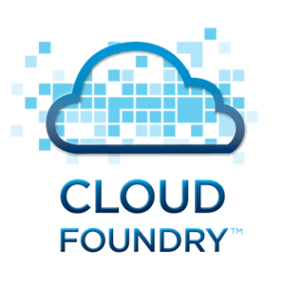






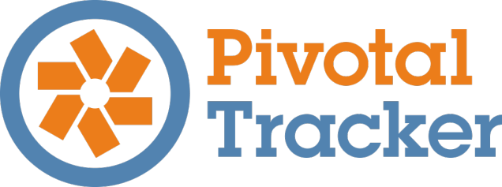


The Pivotal World
Cloud Foundry
Cloud Independence
Microservices
Continuous Delivery
Dev Ops
Development
Frameworks
Services
Analytics
Big Data Suite
High Capacity
Real-time Ingest
SQL Query
Scale-out Storage
Working with clients to build better apps more quickly
Notes:
Quick overview of Pivotal.
Essentially three divisions:
1. Our Open PaaS, Cloud Foundry
2. Our Big Data Suite – featuring both Big Data (Hadoop, HAWQ and Greenplum) and Fast Data (Gemfire)
3. Application Development – open-source products like Spring and Rabbit/MQ and our project tracking tool Pivotal Tracker.
Pivotal Labs intersects all three providing mentoring in agile application development including fast-data analytics.

Slide 15

Covered in this section
Agenda
About Pivotal
Let's get on with the course..!
Notes:
Enough marketing .. let's get going ..

