Slide 1

Collision Prediction Based On Semantic Relations
30220 - Master Thesis Presentation
Rakesh Allampally, Chemnitz, February 2021

Slide 2
Contents:
SUMO
Semantic Entity Relational (Approach-1)
Goals
Basic Overview of Approach
Recurrent Neural Networks
Long Short Term Memory Network (LSTM)
1) Recursive Forecast & Results
2) Encoder-Decoder & Results
Entity Relation for Single Vehicle (Approach-2)
Collision Test Scenarios & Results
Conclusion & Future Work

Slide 3

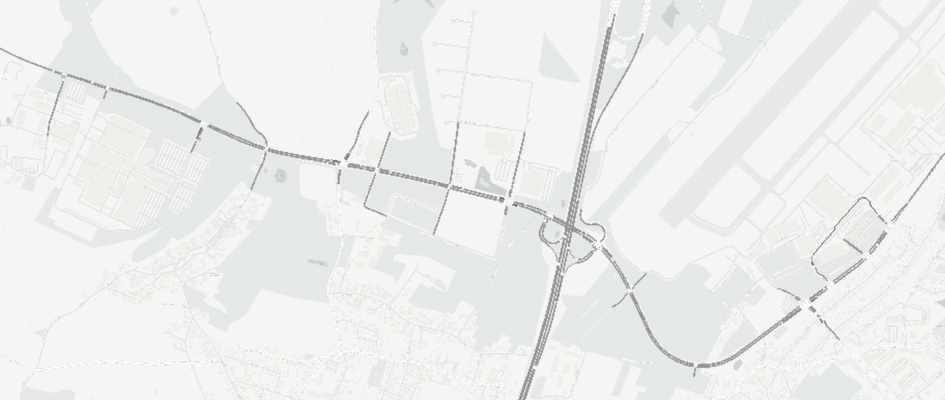
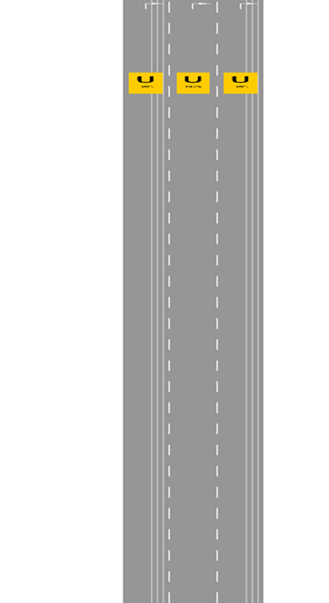
SUMO
Highway Scenario in SUMO
IAV 12/2020 IAV TI-F21

Slide 4
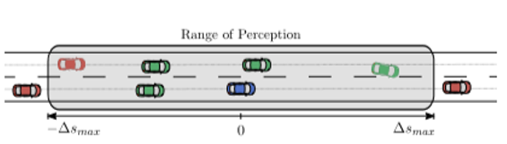
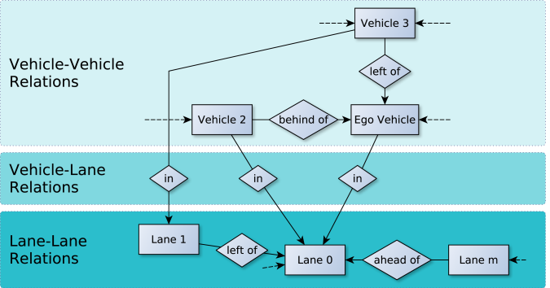
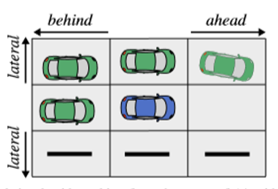
Semantic Entity Relation (Approach-1)
Relational Grid Model [1]
At each time step we get the information of all the objects in the scene and their relations
[1] https://www.groundai.com/project/adaptive-behavior-generation-for-autonomous-driving-using-deep-reinforcement-learning-with-compact-semantic-states/1
IAV 12/2020 IAV TI-F21

Slide 5
Goals
Use semantic entity relationship model to get complete overview of the scene.
Use RNN to predict trajectory of all the vehicles in the scene by using the past trajectory.
Finally, developed model test on various collision probable scenarios.
IAV 12/2020 IAV TI-F21

Slide 6
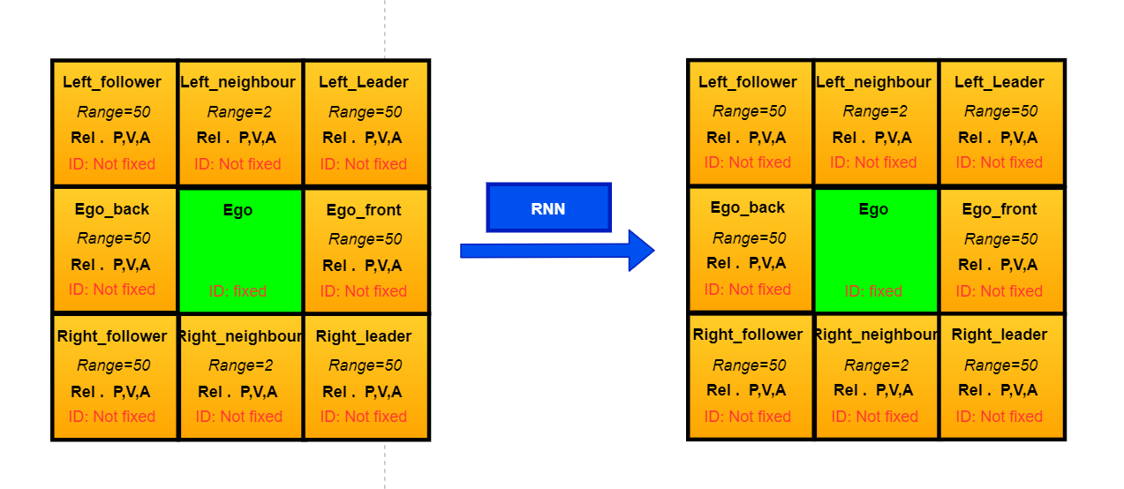
Basic Overview of Approach
For each time stamp, the Ego vehicle and its surroundings are considered.
The surroundings are in the range of 50 meters.
ID of the Ego vehicle is fixed but remaining vehicles IDs keeps changing.
Rel. P, V, A = Relative position, velocity, acceleration with respect to Ego.
Relational Grid Model
IAV 12/2020 IAV TI-F21

Slide 7
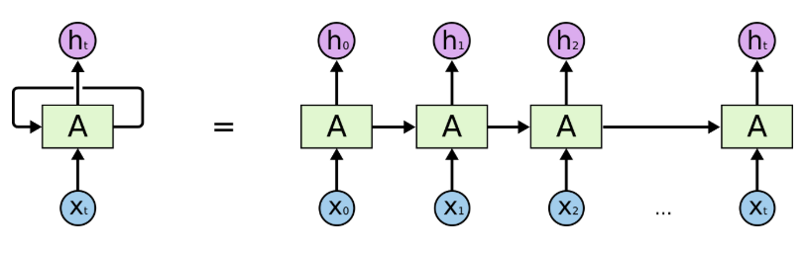
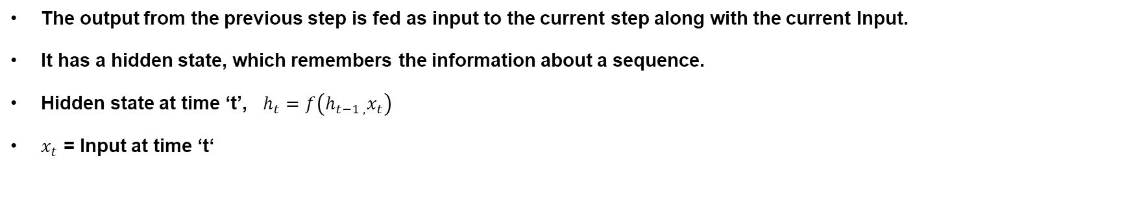
Recurrent Neural Networks
The output from the previous step is fed as input to the current step along with the current Input.
It has a hidden state, which remembers the information about a sequence.
Hidden state at time ‘t’, $h_{t}=f\left(h_{t−1 , }x_{t}\right)$
$x_{t}$ = Input at time ‘t‘
Recurrent Neural Networks [2]
[2] https://colah.github.io/posts/2015-08-Understanding-LSTMs/
IAV 12/2020 IAV TI-F21

Slide 8
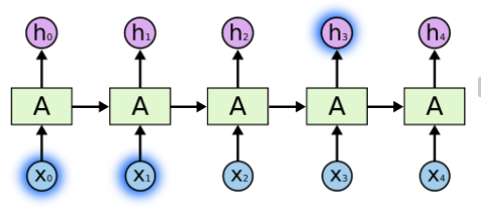
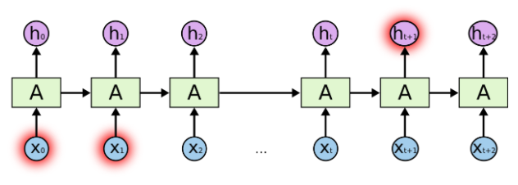
Problem with RNN
The main problem of RNN is long term dependency.
Less Time Steps [2]
More Time Steps [2]
[2] https://colah.github.io/posts/2015-08-Understanding-LSTMs/
IAV 12/2020 IAV TI-F21

Slide 9
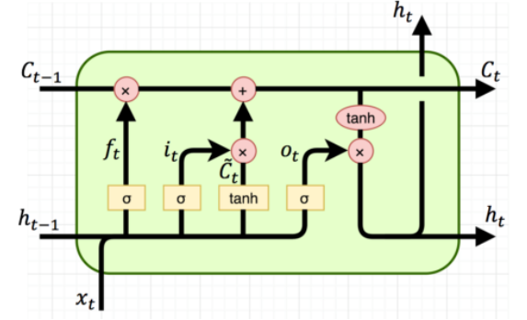
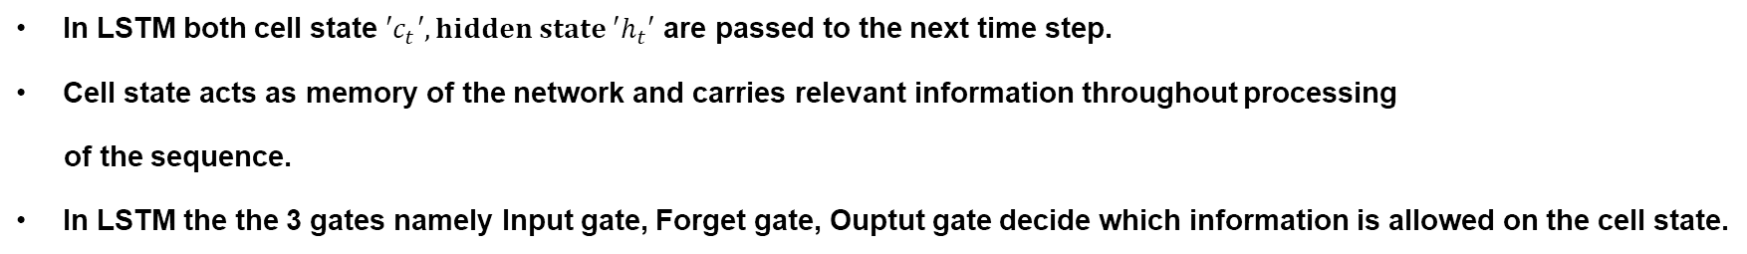
Long Short Term Memory Network (LSTM)
In LSTM both cell state ${′c}_{t}′, hidden state ′h_{t}′$ are passed to the next time step.
Cell state acts as memory of the network and carries relevant information throughout processing
of the sequence.
In LSTM the the 3 gates namely Input gate, Forget gate, Ouptut gate decide which information is allowed on the cell state.
LSTM [2]
[2] https://colah.github.io/posts/2015-08-Understanding-LSTMs/
IAV 12/2020 IAV TI-F21

Slide 10
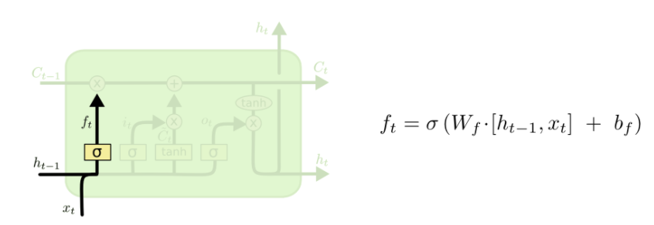
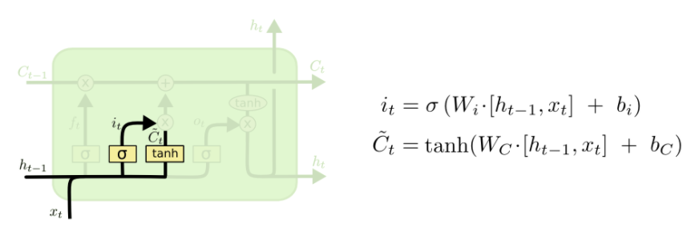
Long Short Term Memory Network (LSTM)
Forget Gate
Input Gate
IAV 12/2020 IAV TI-F21

Slide 11
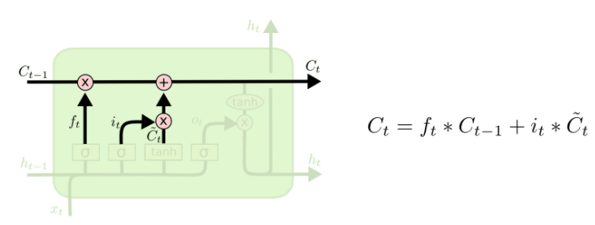
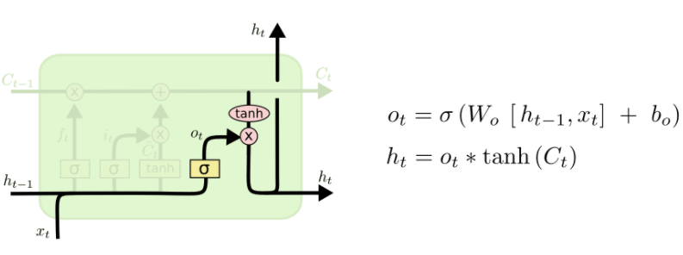
Long Short Term Memory Network (LSTM)
Updated Cell State
Output Gate
IAV 12/2020 IAV TI-F21

Slide 12
Time Series Data:
Input data: t-39, t-39, t-38, ………., t-1, t [40 time-steps]
For current models we get only single step prediction ahead.
Predicted data : t+1 [1 time-step]
Multi-step prediction:
To predict more than one step ahead, we should use multistep prediction.
Some of the multi-step prediction models are:
1) Recursive Forecast
2) Encoder-Decoder
IAV 12/2020 IAV TI-F21

Slide 13
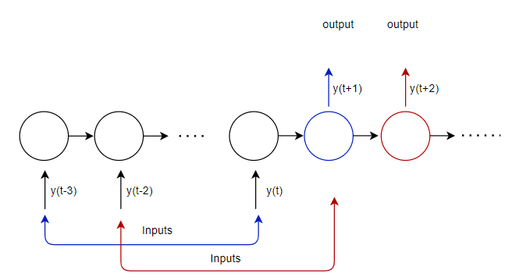
1) Recursive Forecast (Approach-1)
Input data: t-39, t-39, t-38, ………., t-1, t [40 time-steps]
Predicted data : t+1 [1 time-step]
First iteration:
Input: t-38, ………., t-1, t, t+1 [40 time-steps]
Predicted data : t+2 [1 time-step]
Second iteration:
Input: t-37, ………., t-1, t, t+1, t+2 [40 time-steps]
Predicted data : t+3 [1 time-step]
Repeat these for 20 iterations
Predicted data : t+1, t+2, t+3, ………., t+20 [20 time-step]
Recursive Forecast [3]
[3] A. Sorjamaa and A. Lendasse, “Time series prediction using dirrec strategy.,”inEsann, vol. 6, pp. 143–148, 2006.
IAV 12/2020 IAV TI-F21

Slide 14
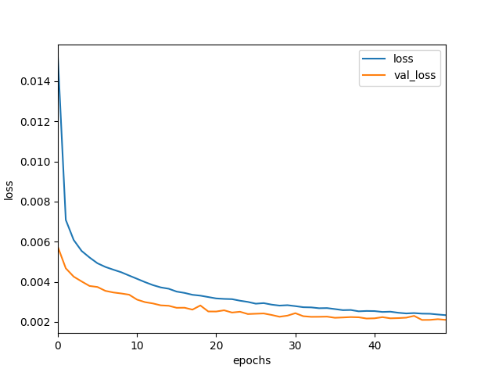
Recursive Forecast
Number of lstm layers = 2
Number of neurons = 56
Number of epochs = 50
Time taken for each epoch = 32 seconds
Trained scenes - 50
Tested scenes - 15
Training loss vs Validation loss
IAV 12/2020 IAV TI-F21

Slide 15
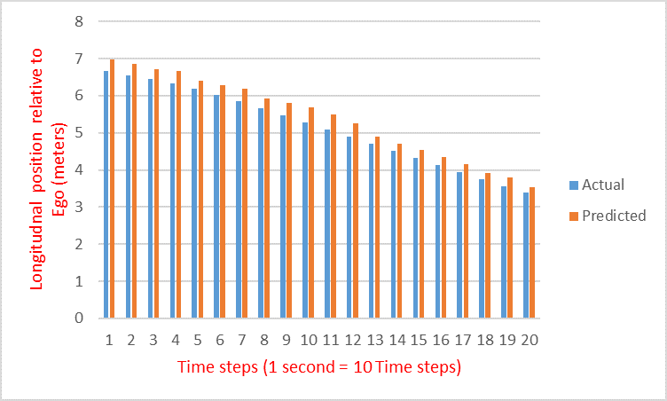
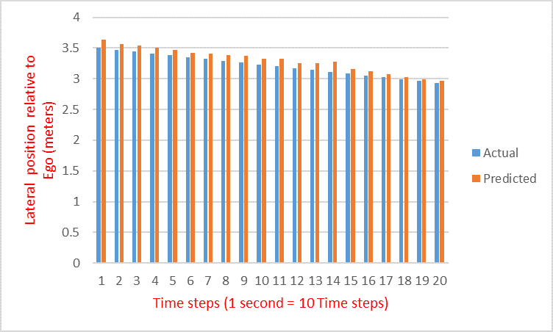
Prediction Result of Right-leader
Longitudinal Position Prediction
Lateral Position Prediction
The longitudinal mean absolute error, e = 1.95 meters.
The lateral mean absolute error, e = 0.45 meters.
IAV 12/2020 IAV TI-F21

Slide 16
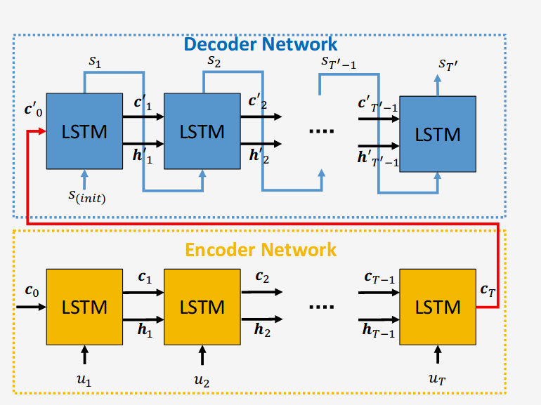
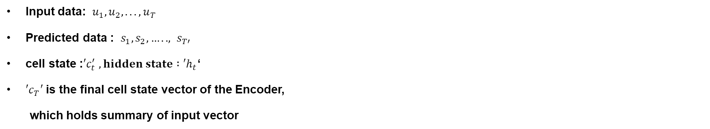
2) Encoder-Decoder (Approach-1)
Input data: $u_{1},u_{2},... ,u_{T}$
Predicted data : $s_{1},s_{2},….., s_{T′}$
cell state :${′c}_{t}^{′} , hidden state :′h_{t}$‘
$′c_{T}′$is the final cell state vector of the Encoder,
which holds summary of input vector
Encoder-Decoder LSTM [4]
[4] https://www.semanticscholar.org/paper/Sequence-to-Sequence-Prediction-of-Vehicle-via-LSTM-Park-Kim/528f6933d246ff9d0918f2e936d7bfa79aa7fea9
IAV 12/2020 IAV TI-F21

Slide 17
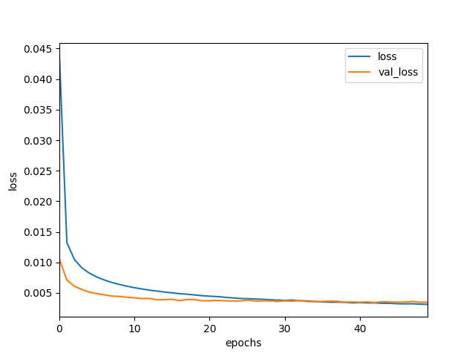
Encoder-Decoder
Number of LSTM Encoder-Decoder layer = 1
Number of neurons = 256
Number of epochs = 50
Time taken for each epoch = 120 seconds
Trained scenes - 50
Tested scenes - 15
Training loss vs Validation loss
IAV 12/2020 IAV TI-F21

Slide 18
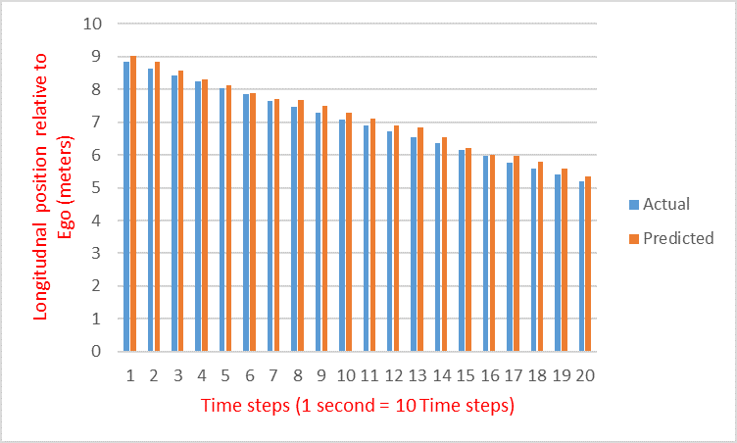
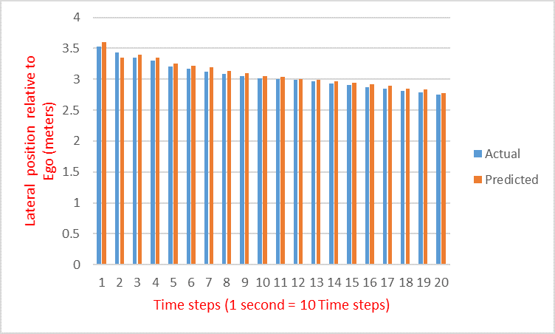
Prediction Result of Right-leader
Longitudinal Position Prediction
Lateral Position Prediction
The longitudinal mean absolute error, e = 1.4 meters.
The lateral mean absolute error, e = 0.3 meters.
IAV 12/2020 IAV TI-F21

Slide 19
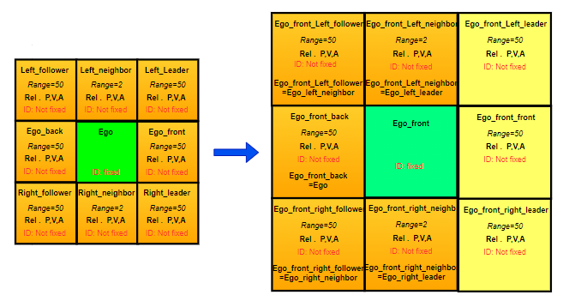
Entity Relation for Single Vehicle (Approach-2)
Approach-2 Overview
IAV 12/2020 IAV TI-F21

Slide 20
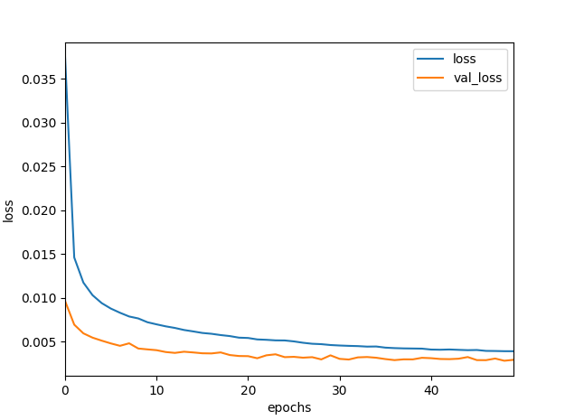
Encoder-Decoder
Number of LSTM Encoder-Decoder layer = 1
Number of neurons = 512
Number of epochs = 50
Time taken for each epoch = 50 seconds
Trained scenes - 50
Tested scenes - 15
Training loss vs Validation loss
IAV 12/2020 IAV TI-F21

Slide 21
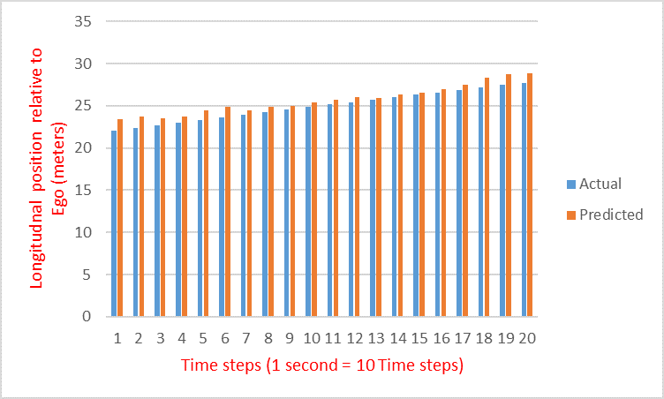
Prediction Result of Ego-front
Longitudinal Position Prediction
The longitudinal mean absolute error, e = 1.6 meters.
IAV 12/2020 IAV TI-F21

Slide 22
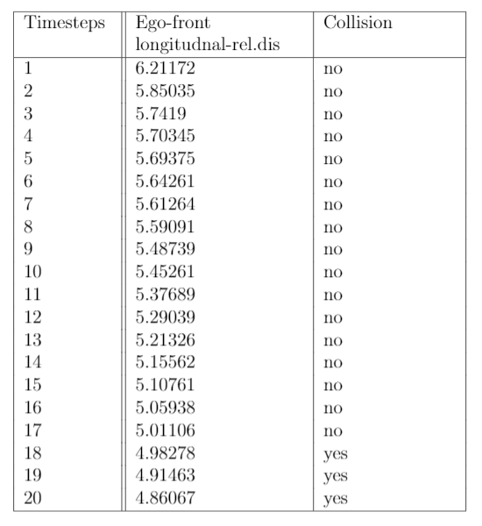
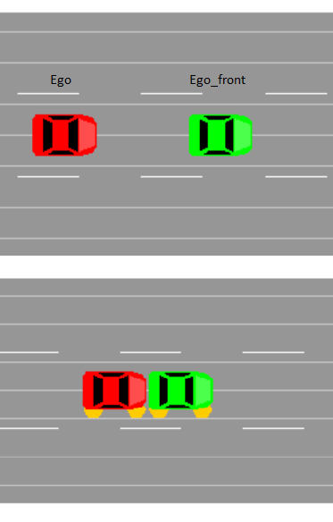
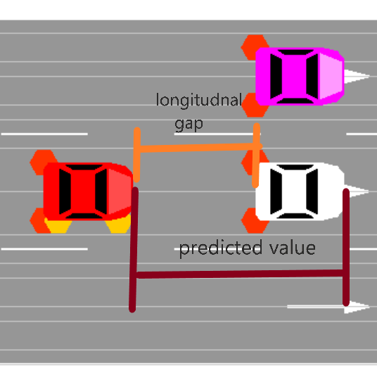
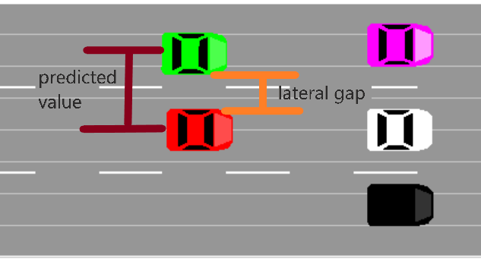
Test Scene 1
Ego-front collision
Threshold = 2 meters (longitudnal)
Threshold = 1 meter (lateral)
IAV 12/2020 IAV TI-F21

Slide 23
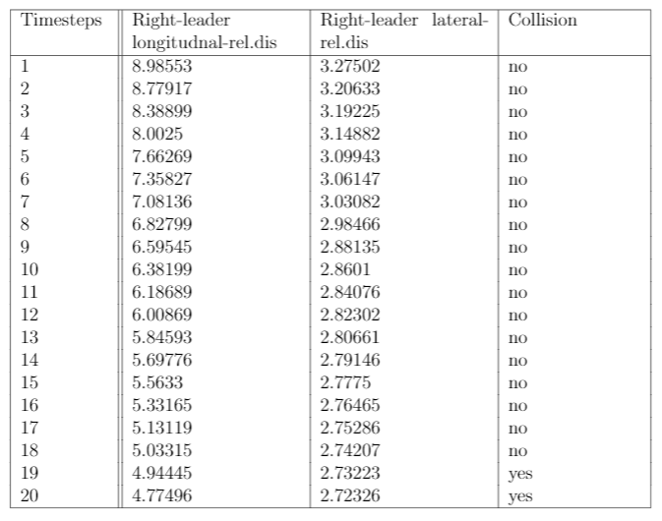
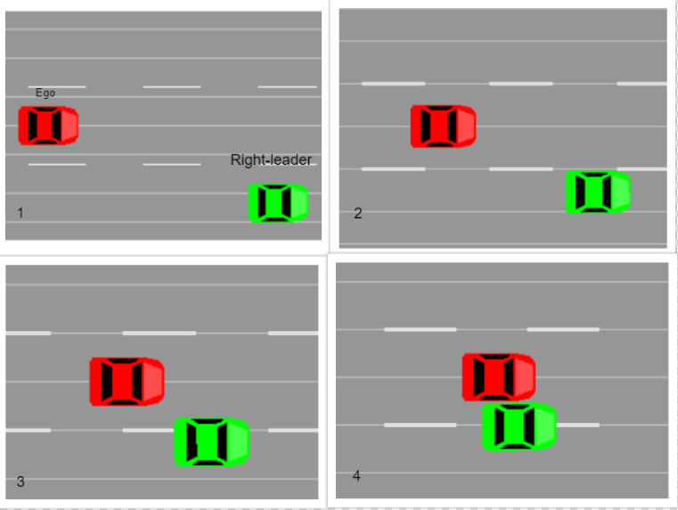
Test Scene 2
Right-leader collision
IAV 12/2020 IAV TI-F21

Slide 24
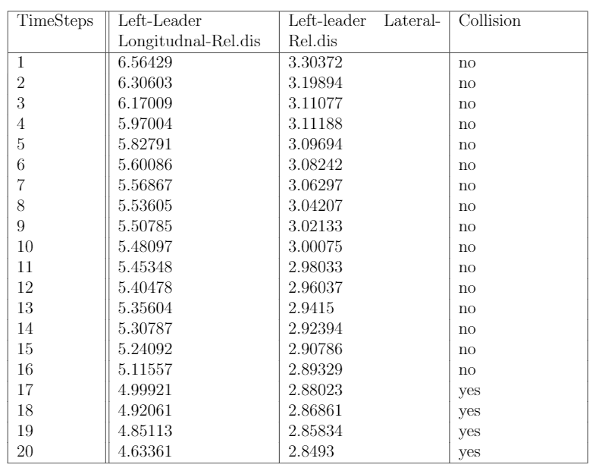
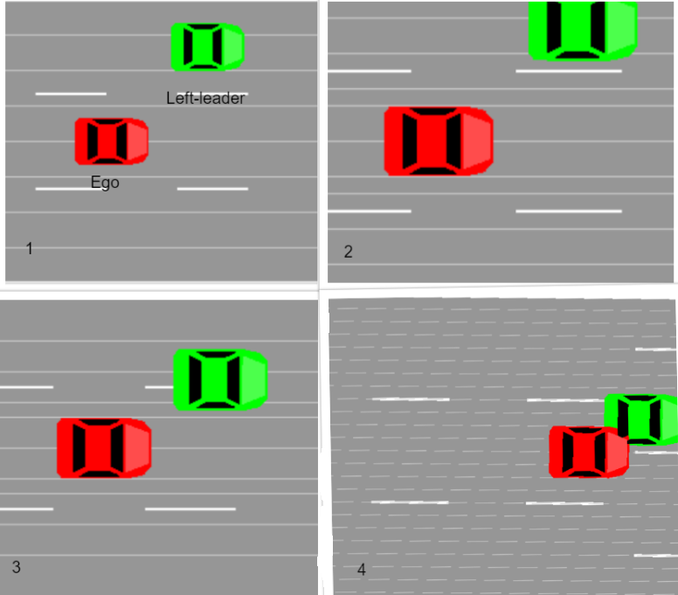
Test Scene 3
Left-leader collision
IAV 12/2020 IAV TI-F21

Slide 25
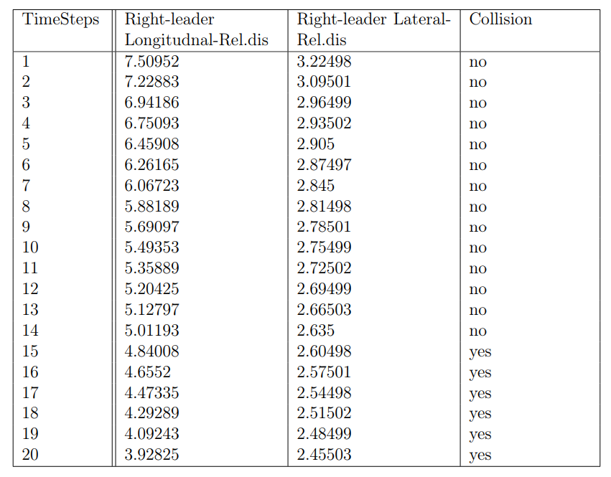
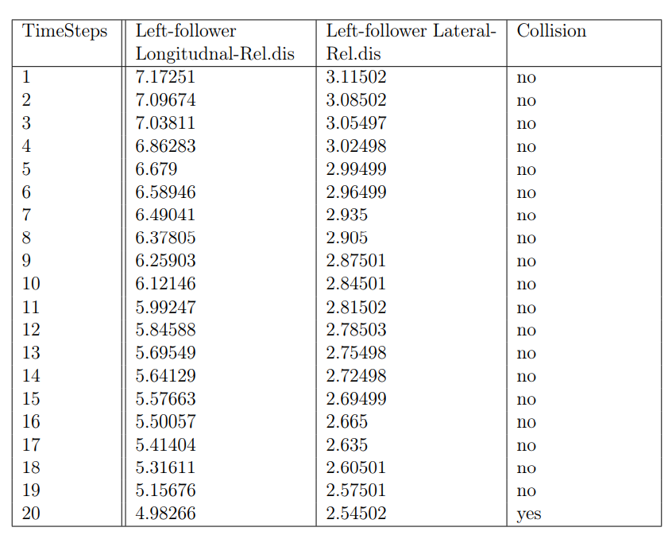
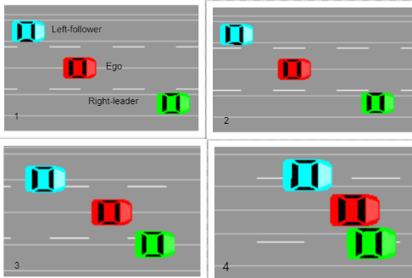
Test Scene 4
Right-leader & Left-follower collision
IAV 12/2020 IAV TI-F21

Slide 26
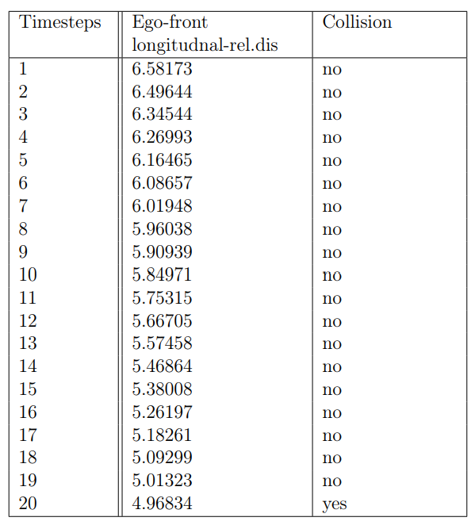
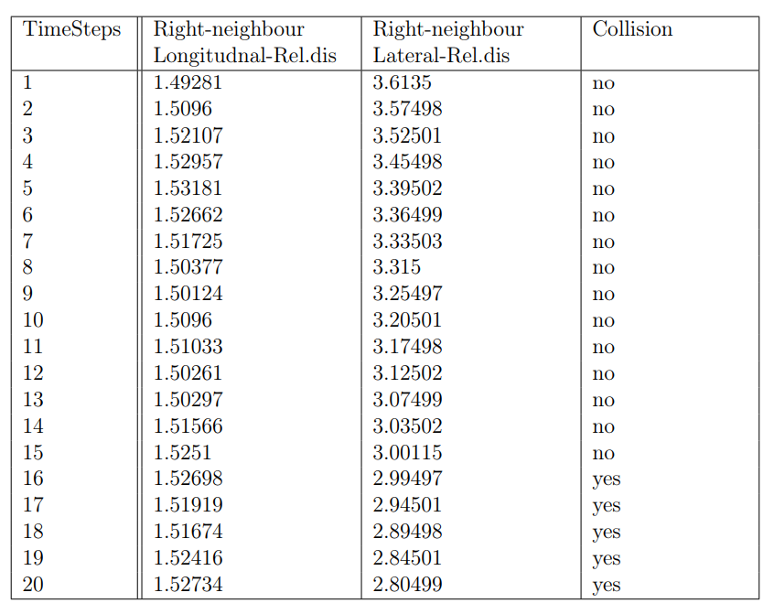
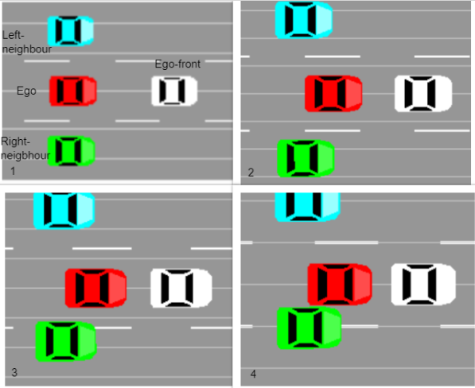
Test Scene 5
Right-neighbour & Ego-front collision
IAV 12/2020 IAV TI-F21

Slide 27
Conclusion & Future Work
The mean absolute error is minimal for semantic entity relationship’s based encoder-decoder model.
This can be deployed in real-world autonomous driving cars, by predicting the collision in advance can help to minimize the accidents.
IAV 12/2020 IAV TI-F21

Slide 28
Rakesh Allampally (TIF 21)
IAV GmbH
Kauffahrtei 25, 09120 Chemnitz Telefon 015258540248
www.iav.com

