Slide 1
Report 3
Ammonia Positive Cycles

Slide 2
Walkers Class
Objects that move in the stoichiometric space
Ammonia +
Hydrogen +
Nitrogen - Nitrogen +
Hydrogen -
Ammonia -

Slide 3
Breadth First Cycle Search
Starts at (0,0)
Not Allowed to return to any visited point except (0,0)
Topologically equivalent to a circle

Slide 4
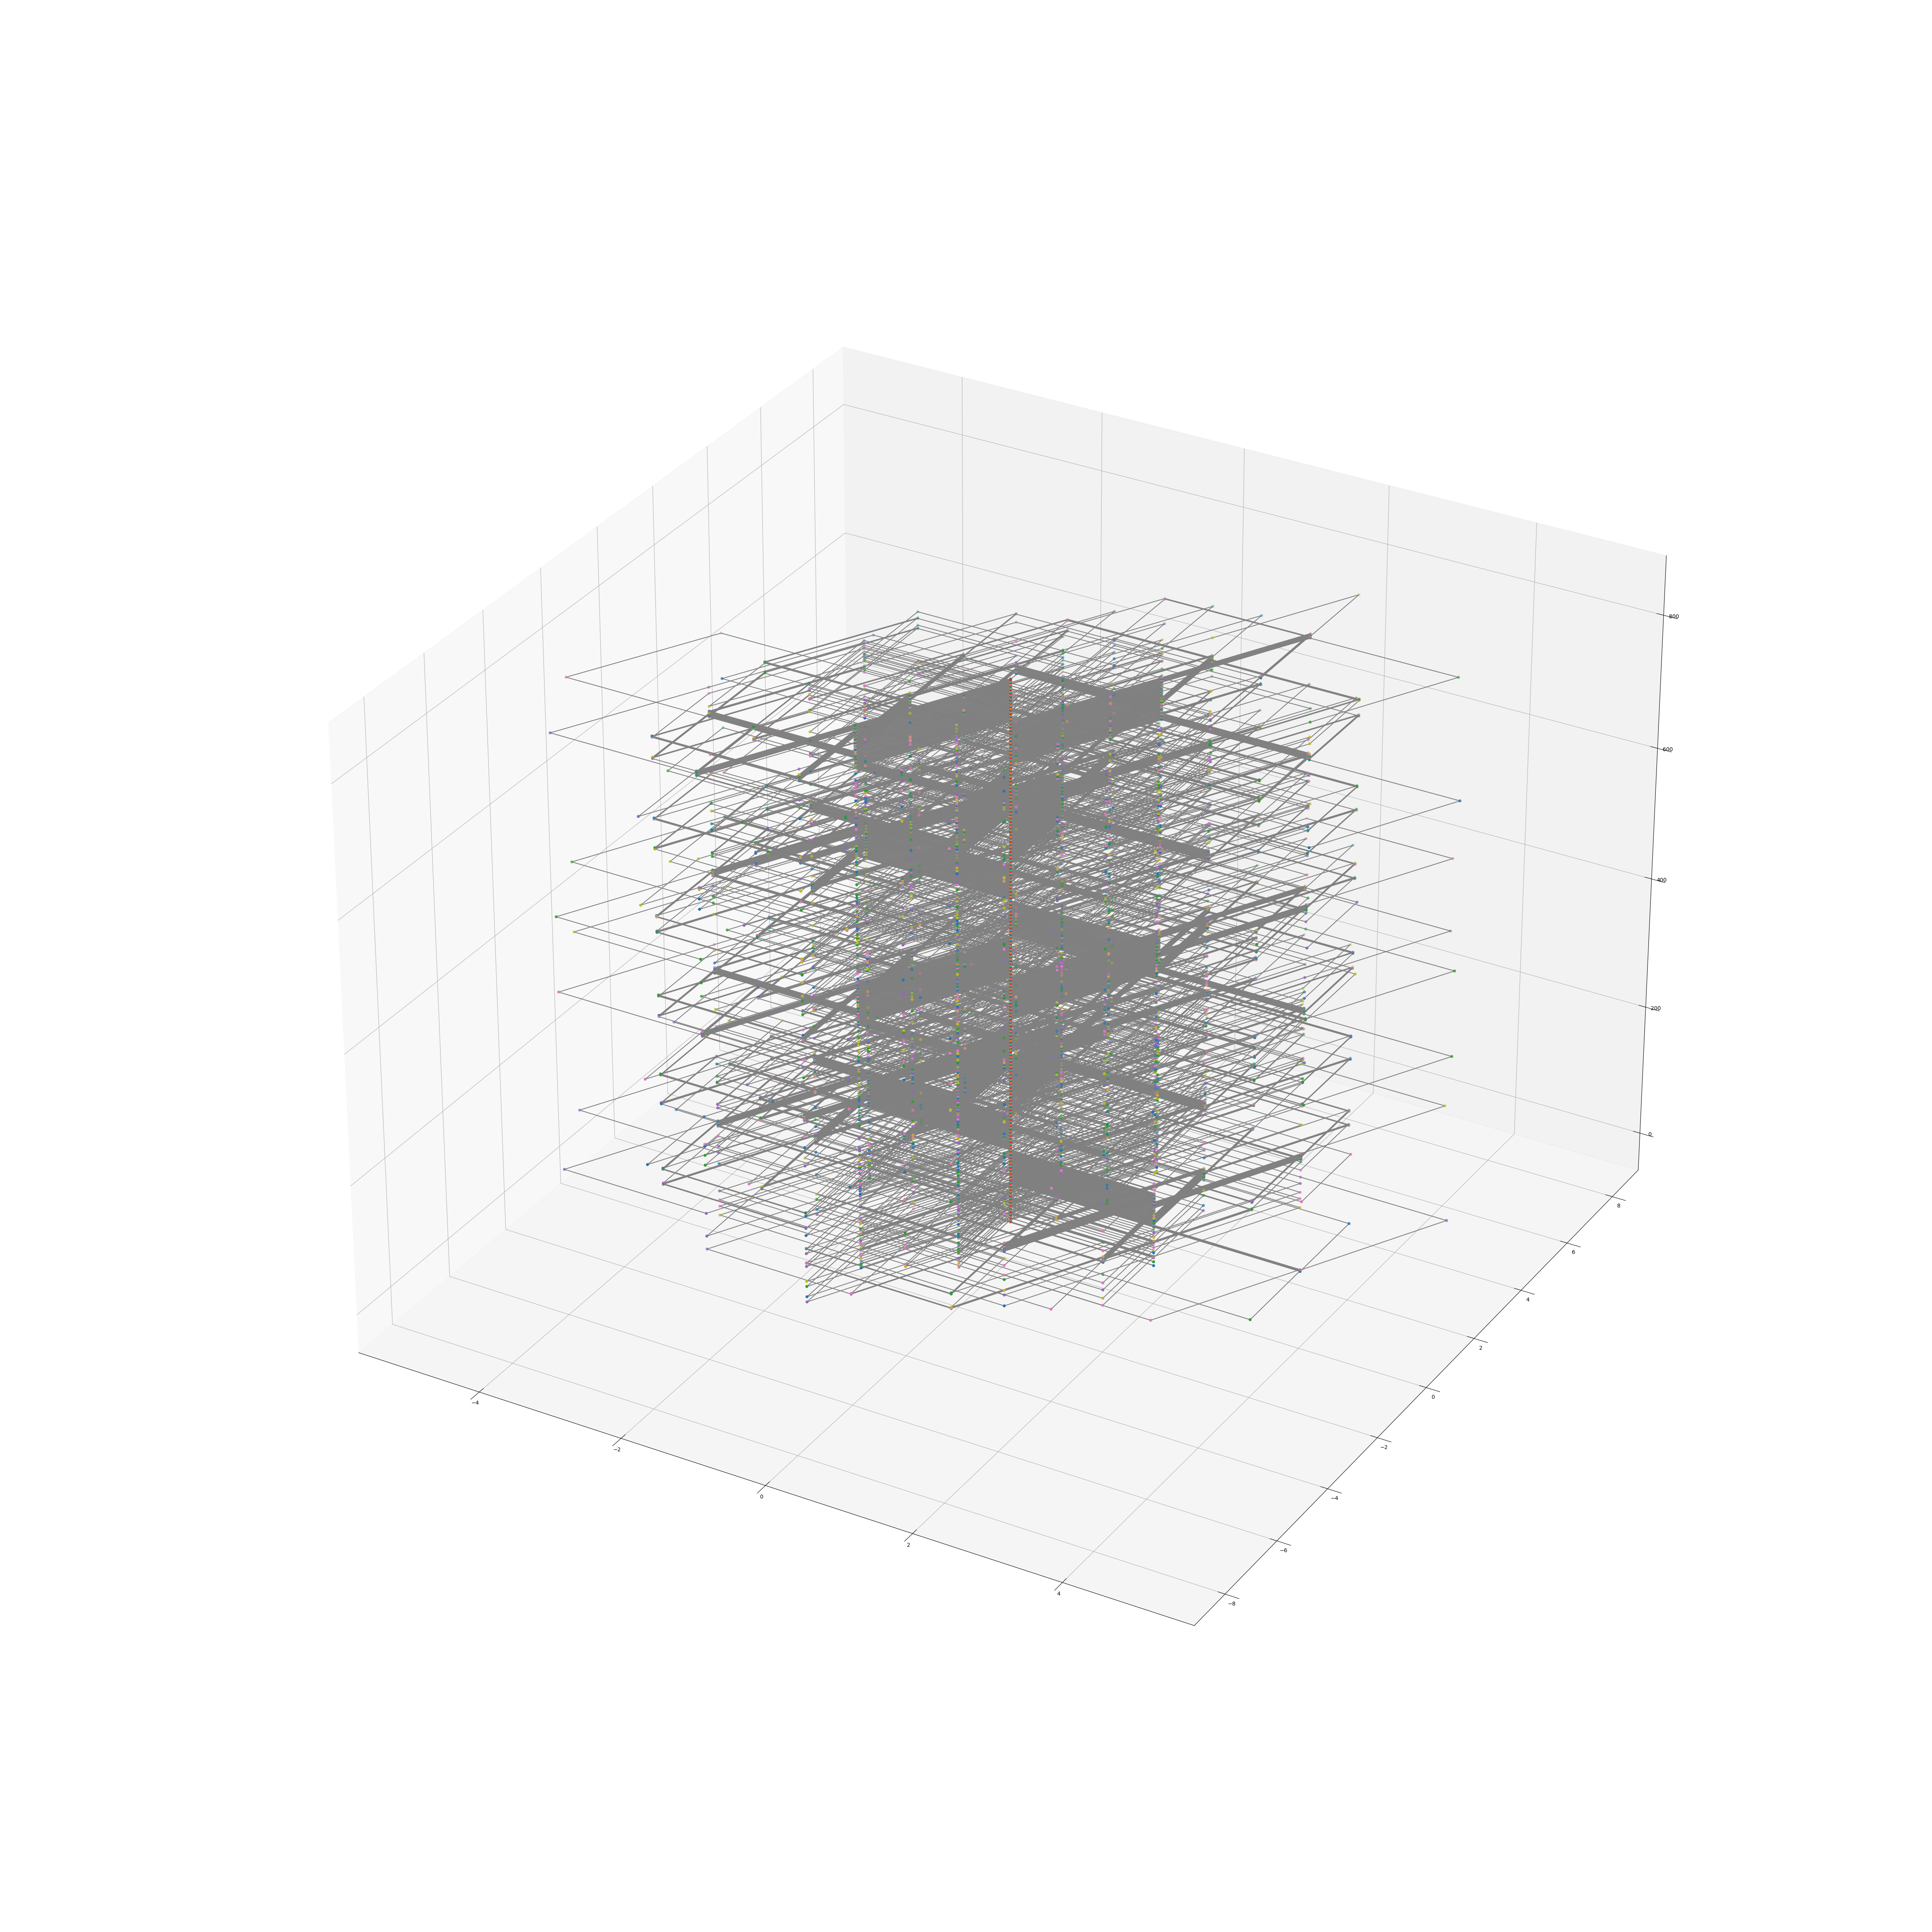
Cycles

Slide 5
Maximum Steps (6)
Minimum steps to get an ammonia producing cycle

Slide 6
Remarks about code
One nested loop
RAM data maybe transfered to ROM
Noticed that windows has GPU excess but Linux doesn’t

Slide 7
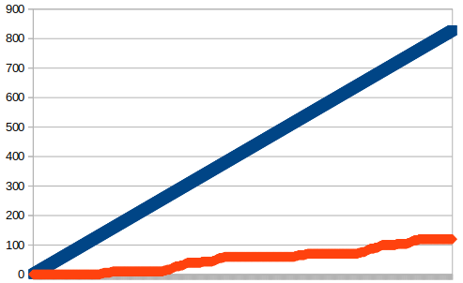
Enumerative Results
Total Cycles (TC, Blue)
Ammonia Producing Cycles (APC, Orange)

Slide 8
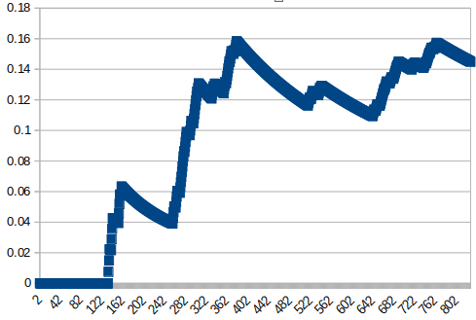
Enumerative Results
Y-axis: #APC/#TC (ratio)
X-axid: #TC

Slide 9
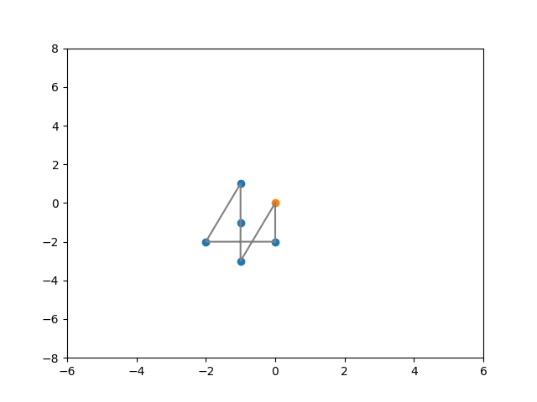
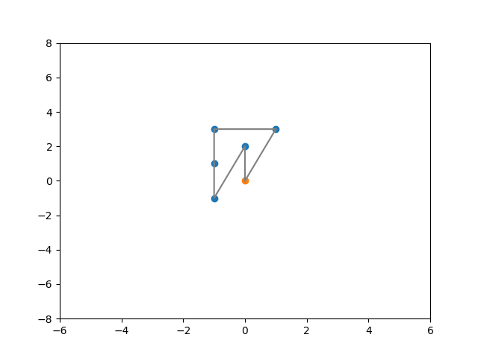
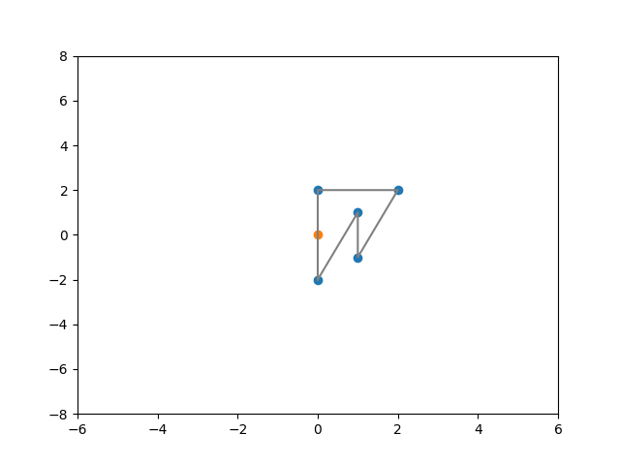
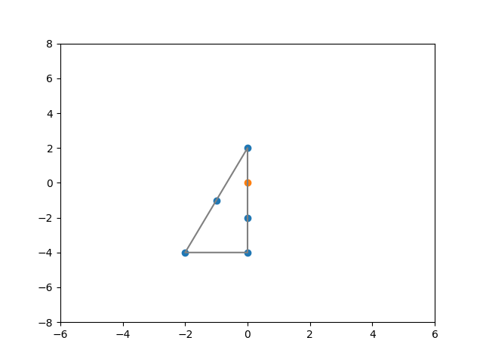
Few APCs

