Slide 1
BLUESTOCK MUTUAL FUND ANALYTICS CAPSTONE
Prepared By
Banoth Rakesh
June 2026

Slide 2
Problem Statement & Objectives
Problem Statement
Investors face challenges in selecting mutual funds due to the large number of schemes and varying performance metrics.
Objectives
Build ETL pipeline
Clean data
Perform EDA
Analyze performance
Calculate Sharpe Ratio
Calculate VaR & CVaR
Build recommendation engine
Create Power BI dashboard

Slide 3
Data Sources
• Mutual Fund Master Data
• NAV History Data
• Benchmark Data
• Investor Data
Key Fields
• Fund Name
• Category
• NAV
• Returns
• Risk Metrics

Slide 4
ETL Architecture
Raw Data
|
Data Cleaning
|
Data Transformation
|
SQLite Database
|
Analytics
|
Power BI Dashboard

Slide 5
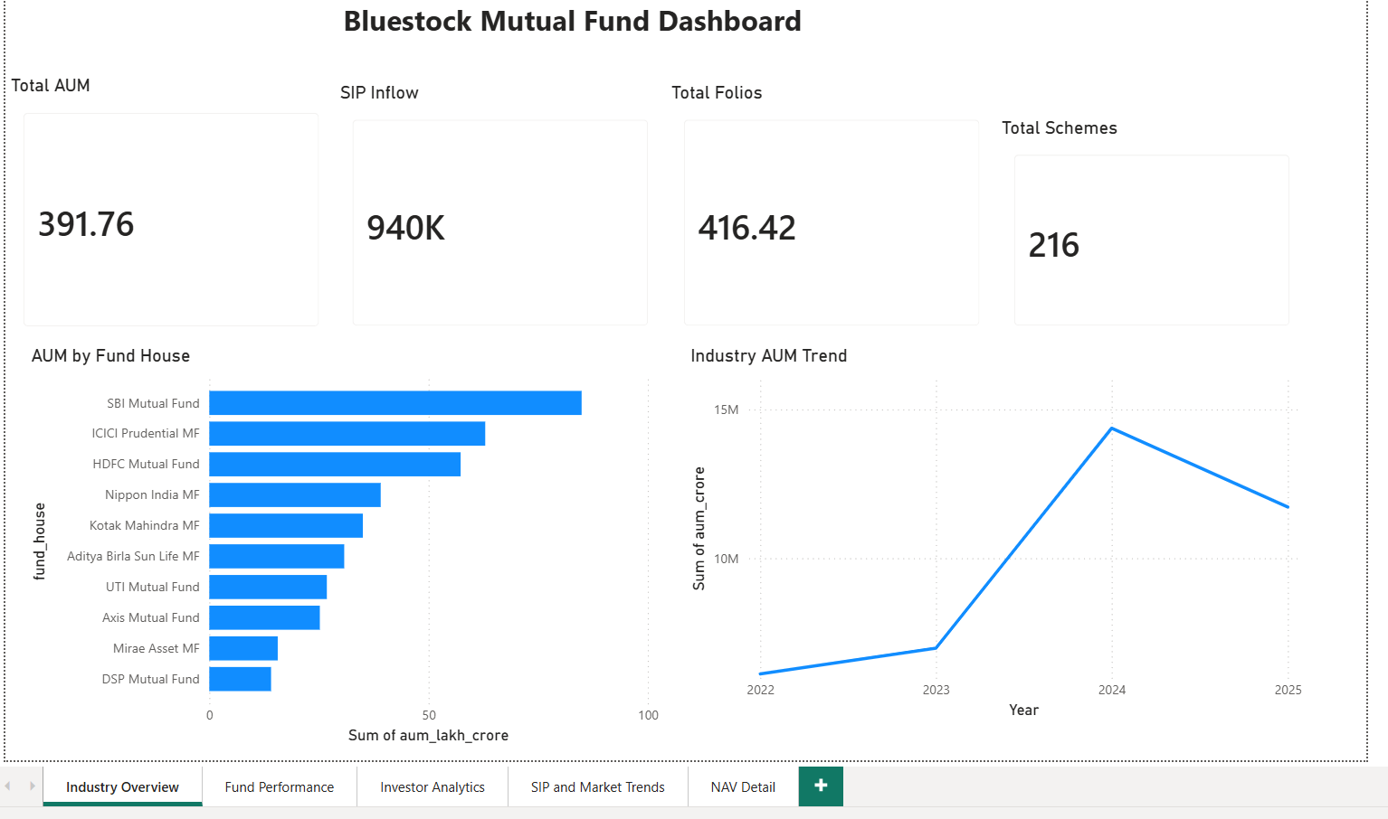
EDA Highlights - Industry Overview

Slide 6
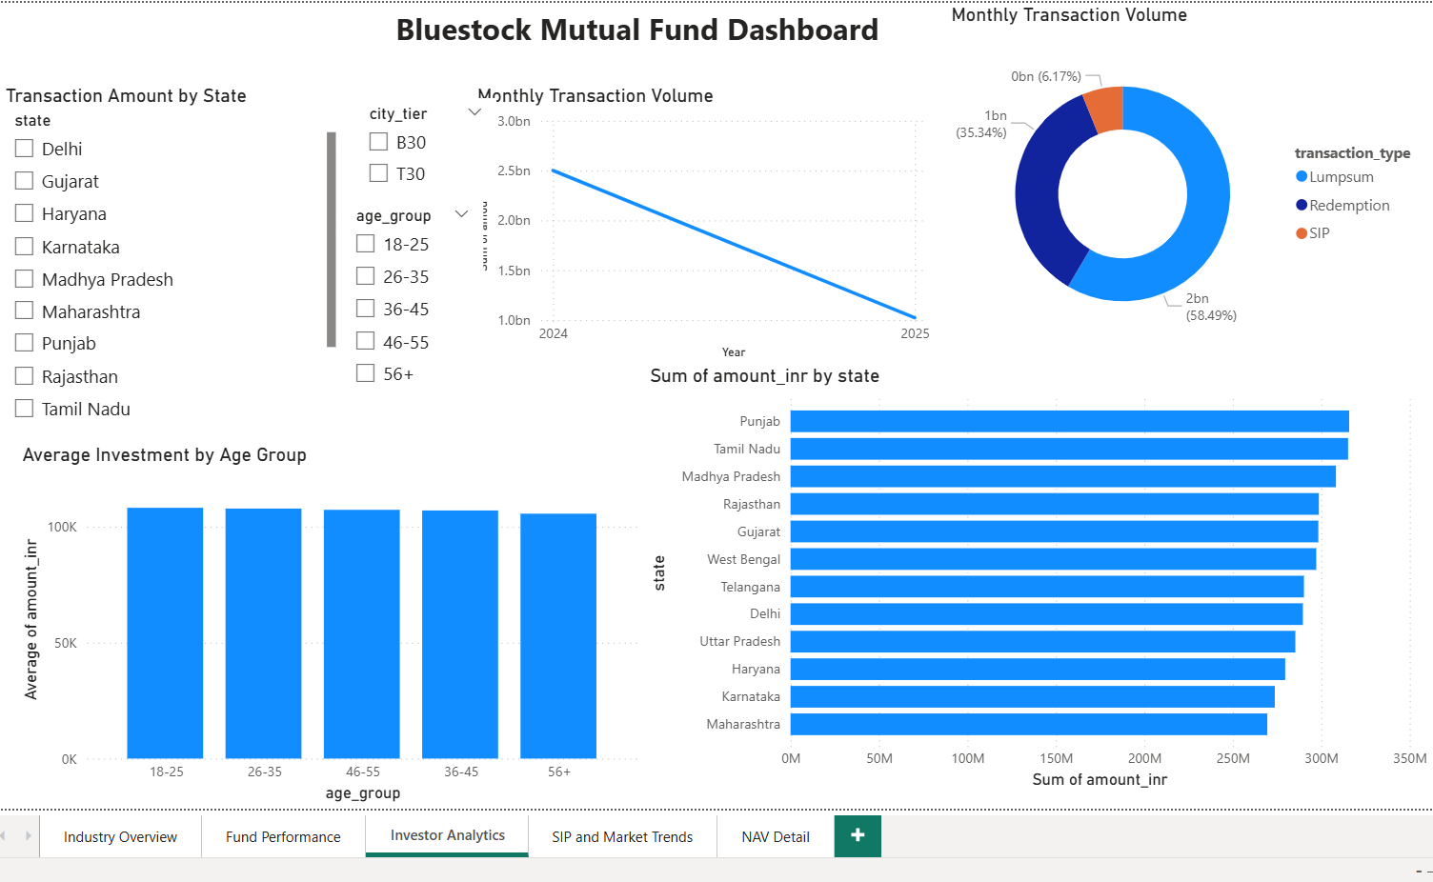
EDA Highlights - Investor Analytics

Slide 7
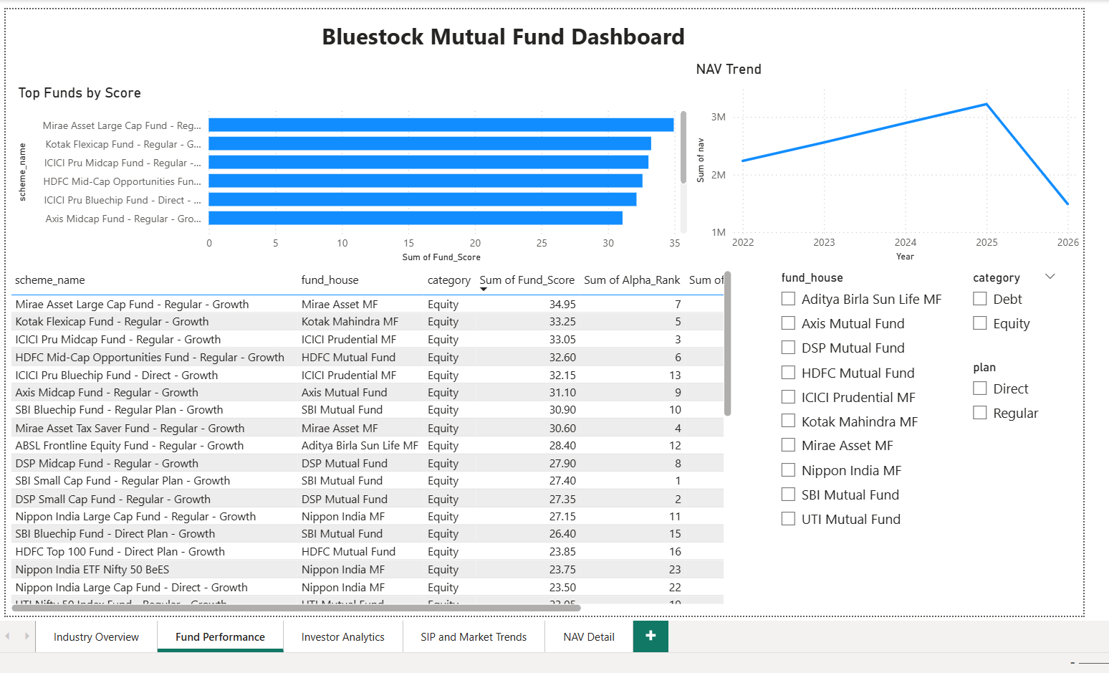
Performance Analysis

Slide 8
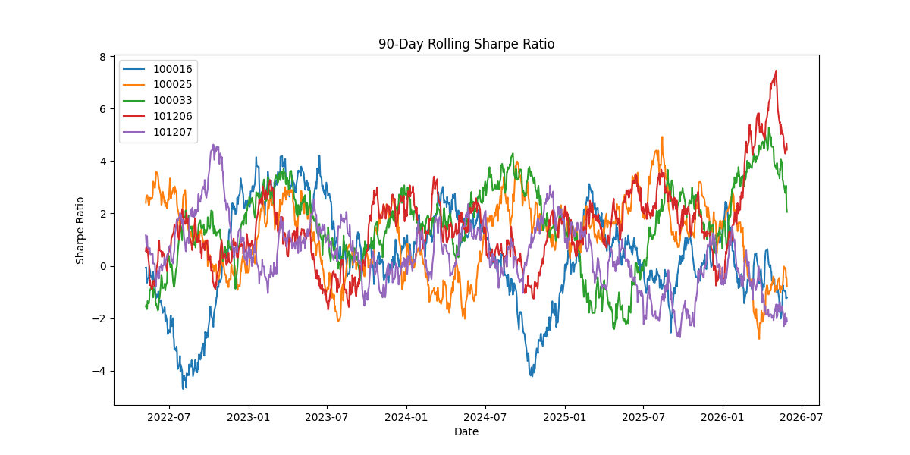
Risk Analysis - Sharpe Ratio, VaR & CVaR

Slide 9
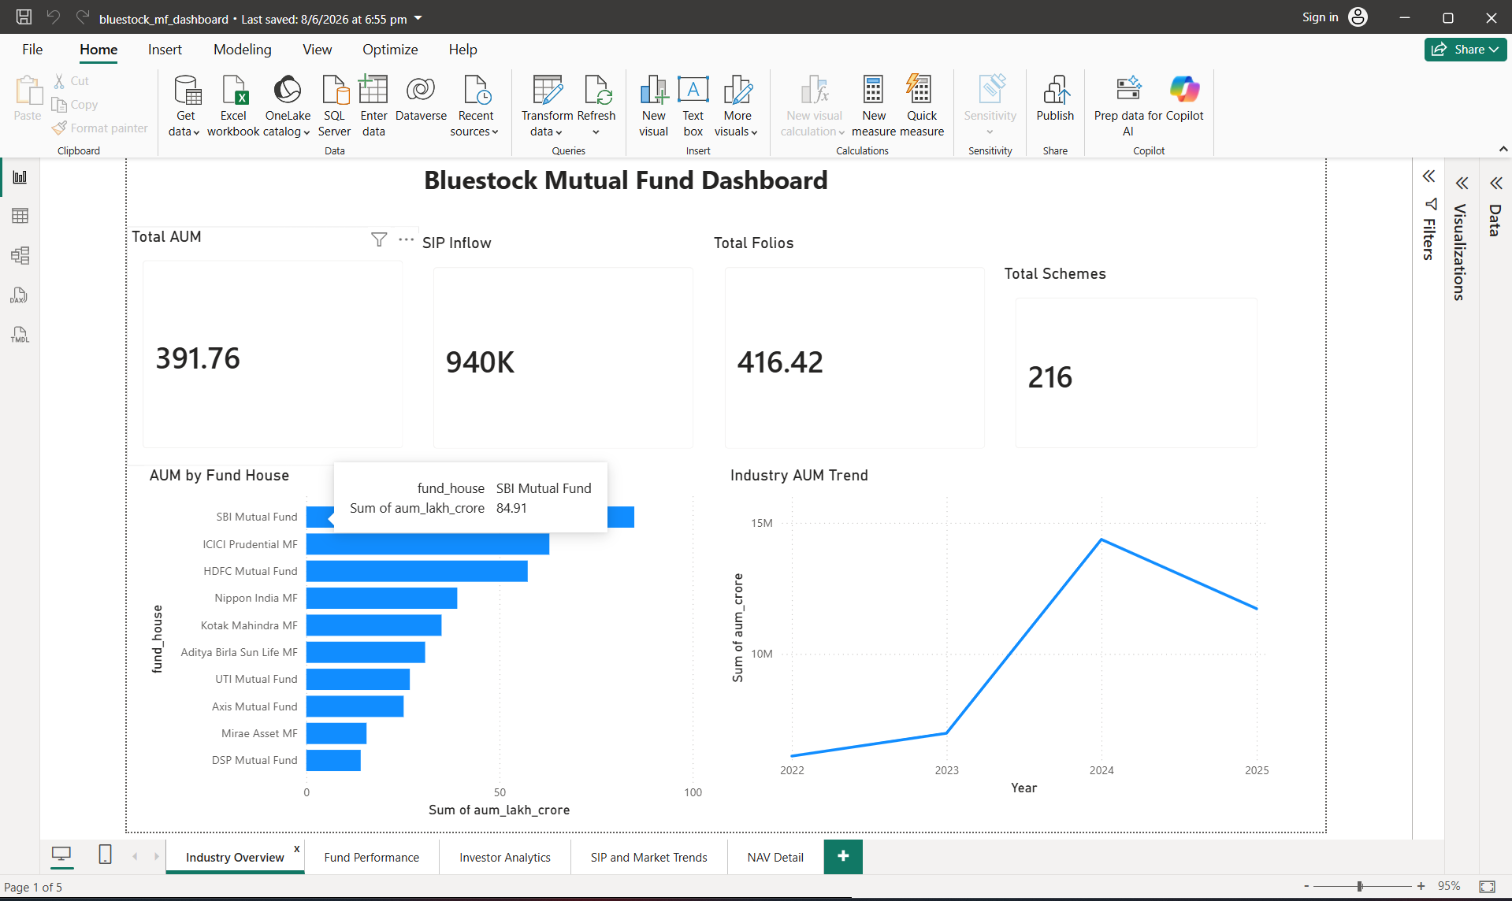
Power BI Dashboard Overview

Slide 10
Dashboard Analytics

Slide 11
Key Findings
• Equity funds generated higher returns.
• Debt funds provided stable performance.
• SIP investments showed consistent growth.
• Several funds outperformed benchmarks.
• Dashboard visualizations simplified analysis.

Slide 12
Thank You
Rakesh Banoth
Bluestock Mutual Fund Analytics Capstone

