Slide 1
Supervised Learning Capstone
Rakesh Bhatia

Slide 2

Project Overview
For this capstone, we used the Ames Housing Dataset, provided by Kaggle.
This dataset consists of 81 total variables, and ~1500 rows of data for home listings in Ames, Iowa
Our target variable for this dataset was SalePrice

Slide 3
Dropping Outliers
The accompanying documentation for this dataset indicated that there were four outliers that should be removed prior to using the data
These outliers are visible by plotting SalePrice vs. GrLivArea
GrLivArea – above ground living area in square feet

Slide 4
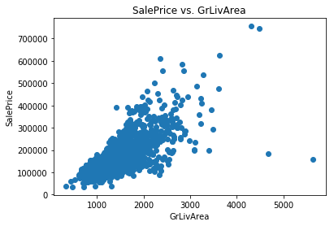
Scatter Plot - SalePrice vs. GrLivArea

Slide 5
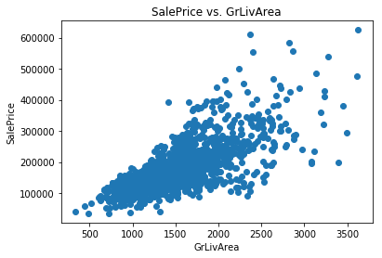
SalePrice vs. GrLivArea – Outliers Removed

Slide 6
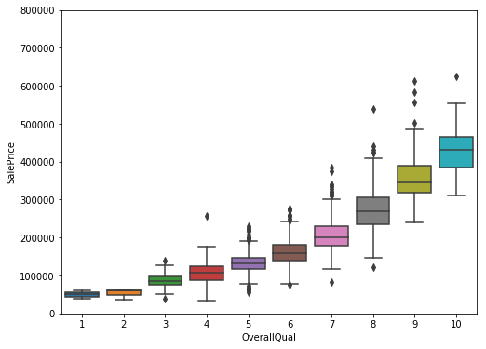
Box Plot - SalePrice vs. OverallQual

Slide 7
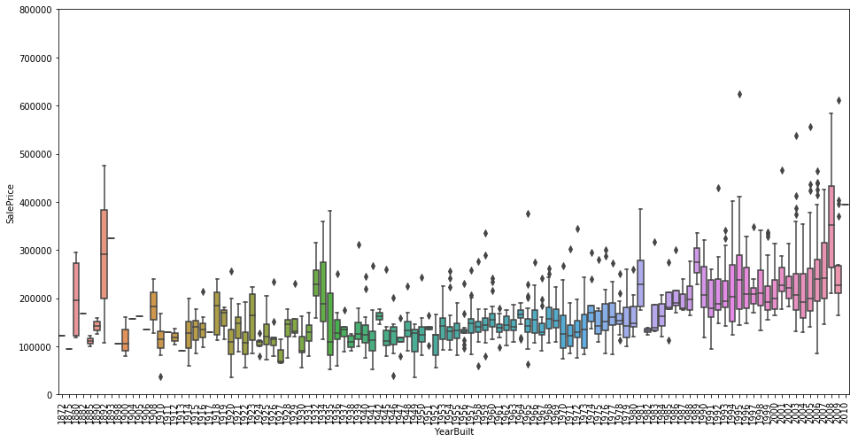
Box Plot - SalePrice vs. YearBuilt

Slide 8
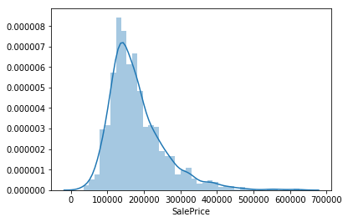
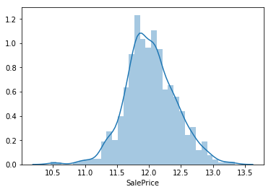
SalePrice Distribution
The SalePrice distribution is not normal; it is heavily right-skewed
For this reason, we transformed SalePrice using a log transformation prior to using it in our model

Slide 9
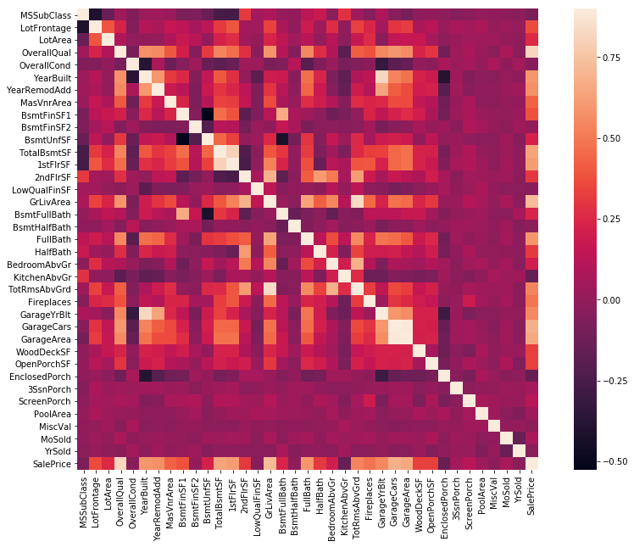
Correlation Heatmap

Slide 10
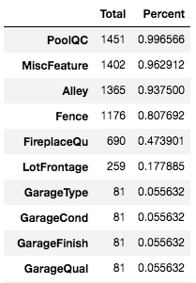
Handling Missing Values
There are several features that contain many missing values
We determined the number of missing values for each feature and listed them in descending order
For features that contain >40% missing values, we dropped them
For those features with <40% missing values, we imputed the missing values as appropriate

Slide 11
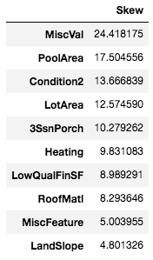
Transforming Skewed Values
We determined the skewness of each feature using the skew() method
For features with a skewness > 0.75, we transformed them using a box-cox transformation
The box-cox transformation is a special version of a log transformation

Slide 12
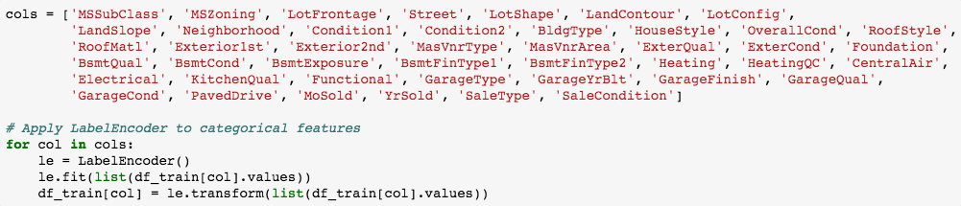
Label Encoding Categorical Features

Slide 13
Add New Feature and Generate Dummies
TotalSF = TotalBsmtSF + 1stFlrSF + 2ndFlrSF
Create dummy variables out of categorical features using the pd.get_dummies() method
The pd.get_dummies() method converts categorical features into a larger set of binary features which only have a 1 or 0 value
This enables the categorical features to be interpreted easily by any of our regression models

Slide 14
Modeling
We used a total of five different models:
  Linear Regression
  KNN Regression
  Random Forest Regression
  Ridge Regression
  Lasso Regression

Slide 15
Modeling – Iteration 1
Full feature set
Best model: Ridge Regression
    Accuracy: 90.06%
    RMSE: 0.30621

Slide 16
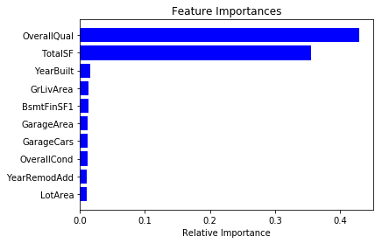
Modeling Iteration 2 – Feature Importances
Used 20 most important features
Best model: Linear Regression
  Accuracy: 91.45%
  RMSE: 0.30119

Slide 17
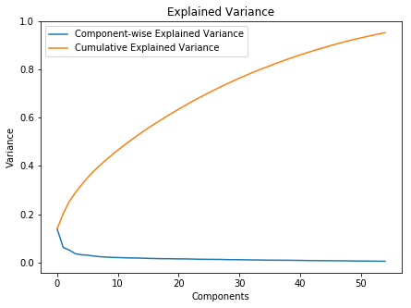
Modeling Iteration 3 - PCA
Created a PCA that retains 95% of the variance
Best model: Lasso Regression
  Accuracy: 72.66%
  RMSE: 0.45645

Slide 18
Conclusion
Overall, the first two iterations appeared to provide the best results
There was a slight improvement in some of the models from iteration 1 to iteration 2, when we limited the feature set to the 20 most important features
However, there was a significant drop-off when we used a PCA that retained 95% of the variance
Thus, utilizing feature importances and feature selection appears to be an optimal way to model this dataset

