Slide 1

APPLIED AGENTIC AI FOR TPMs
Capstone Project 2
CalendarMate
An Orchestrator-Led Agentic AI Assistant for Time, Meetings & Inbox Intelligence
COMPANY
ROLE
PLATFORM
PREPARED BY
ServionIQ Solutions
AI Technical Program Manager
n8n · Google Gemini · Google Workspace
Rakesh Ranjan Yadav

Slide 2


CONTEXT
ServionIQ Solutions — Company & Role
Company Profile
My Role: AI Technical Program Manager
SaaS platform for professional-services firms — consulting, legal, accounting, architecture and marketing agencies.
End-to-end suite: project management, time tracking, CRM, billing, workforce planning and knowledge management.
Modular, cloud-native architecture built for easy deployment, configuration and third-party integration.
Serves both boutique practices and global enterprise clients with the same platform core.
Hired by the CTO to lead delivery of AI-powered solutions, with emphasis on emerging Agentic AI capability.
Translate complex business needs into technically feasible product strategy alongside ML engineers, data scientists and designers.
Own ML model lifecycle, data infrastructure and experimentation/deployment pipelines while upholding governance, security and performance standards.
CalendarMate · Capstone Project 2
02

Slide 3




THE PROBLEM
Too Many Calendars, Too Little Visibility
As a TPM, coordinating stakeholders across projects means juggling many calendars before a single meeting can be booked — and when meetings collide, the fallback is manual reliance on minutes and AI-generated notes after the fact.
Multi-Calendar Scheduling Overhead
Conflicting Meetings
Missed Meetings
Manual Reconstruction
Every meeting request needs visibility across several stakeholder calendars before a slot can be confirmed, consuming hours each week.
Overlapping commitments are common; something is always double-booked, forcing trade-off decisions on the fly.
Conflicts and volume lead to missed sessions, leaving the TPM without direct context on decisions made.
Recovering context means chasing minutes or AI-generated notes after the fact — reactive, slow and easy to lose track of.
CalendarMate · Capstone Project 2
03

Slide 4

WHY IT MATTERS
The Hidden Cost of Manual Calendar Ops
5–8 hrs
1 in 4
45+ min
0
lost weekly per TPM to manual scheduling back-and-forth
meetings affected by an undetected conflict before a fix
spent daily reconstructing context from minutes & notes
single view of the day’s calendar, inbox and meeting outputs today
Illustrative estimates — used to frame the business case, not measured production data.
These are not isolated annoyances — they compound across every stakeholder meeting a TPM runs, directly reducing the time available for actual program delivery.
Framing the ask
Build an Agentic AI Assistant — CalendarMate — that consolidates meeting notes, schedules against real availability, summarizes the day’s email, and gives a single quick view of daily activity.
CalendarMate · Capstone Project 2
04

Slide 5






ASSIGNMENT Q1
Business Benefits of Agentic AI for Employee Productivity
Time Reclaimed
Consistent Execution
Orchestrated, Not Siloed
Autonomous scheduling and triage remove the manual back-and-forth of coordinating calendars, returning hours per week to high-value program work.
Agents apply the same rules and checks every time — no missed conflict, no forgotten follow-up — unlike ad-hoc manual handling.
A single orchestrator can call specialised sub-agents (email, notes, calendar), giving one coherent assistant instead of disconnected point tools.
Always-On Visibility
Scales Without Headcount
Governable by Design
A daily digest of meetings, notes and email gives employees a single pane of glass instead of hunting across five apps.
The same agent pattern extends to more employees or use cases without proportional increases in support or admin staff.
Human-in-the-loop and audit trails keep AI-driven actions transparent and reviewable — critical for enterprise adoption.
CalendarMate · Capstone Project 2
05

Slide 6




ASSIGNMENT Q2 — THE SOLUTION
Introducing CalendarMate
A single conversational Agentic AI Assistant, built in n8n, that acts on the TPM’s behalf across calendar, email and meeting notes — directly answering the problem statement’s four asks.
Consolidated Meeting Notes
Availability-Aware Scheduling
Daily Email Summarization
Quick Daily Activity View
Pulls together notes from multiple meetings held during the day into one consolidated summary, on request.
Checks real calendar availability before drafting, updating or cancelling a meeting — no more blind invites.
Summarizes the day’s inbox activity so nothing important is missed between meetings.
Gives an on-demand snapshot of the day’s meetings, tasks and messages in one conversational reply.
Delivered as a 12-node AI Agent + tools architecture in n8n — an orchestrator agent, two callable sub-agents, and five deterministic calendar/data tools, detailed over the next slides.
CalendarMate · Capstone Project 2
06

Slide 7









ARCHITECTURE
Orchestrator-Led Multi-Agent Design
CalendarMate Orchestrator Agent
check_availability
Email Summarizer Agent
Chat Trigger
Google Gemini reasoning · routes each request to the right tool or sub-agent
get_calendar_events
Sub-agent · Gmail tool
draft_calendar_event
Meeting Notes Consolidator Agent
Gemini Chat Model
Simple Memory
delete_calendar_event
Sub-agent · Drive/Docs tool
update_calendar_event
How to read this diagram
The user chats with CalendarMate in natural language. The Orchestrator (Google Gemini + short-term memory) interprets intent and calls a deterministic calendar tool directly, or hands off to a sub-agent for email / meeting-notes work — then returns one consolidated answer.
CalendarMate · Capstone Project 2
07

Slide 8
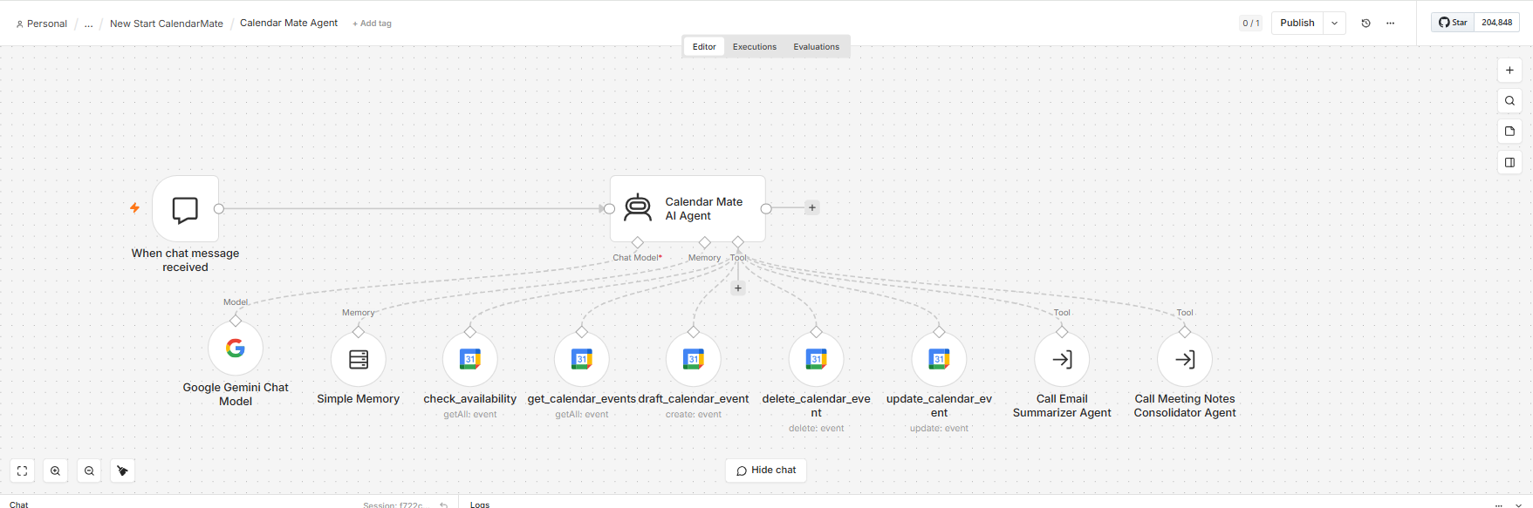
Calendar Mate - n8n Workflow Snapshot
CalendarMate · Capstone Project 2
08

Slide 9
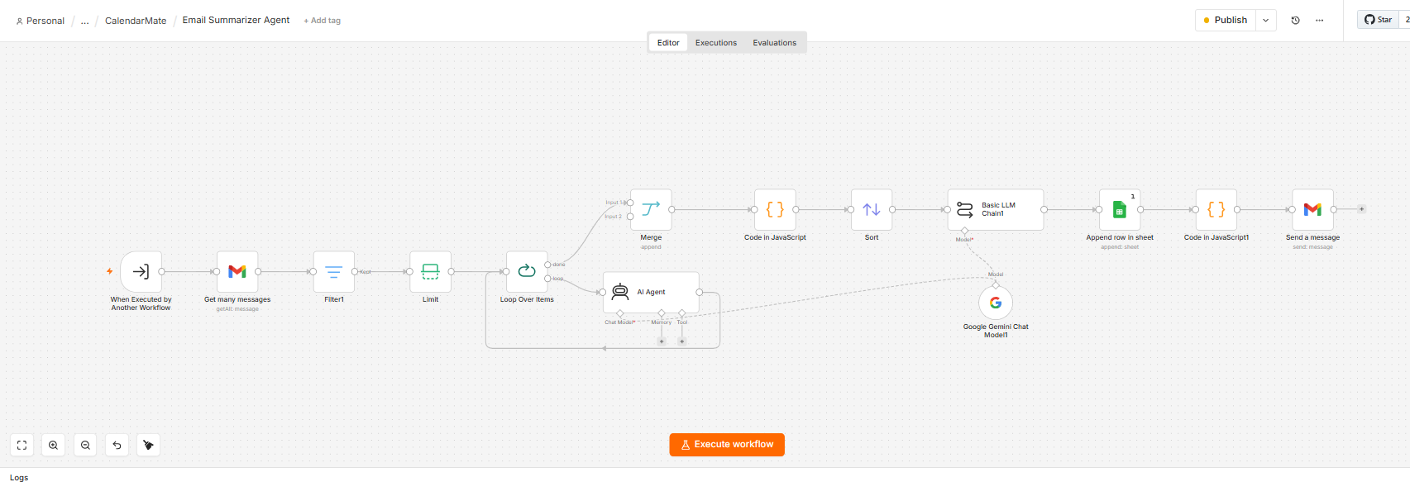
Email Summarizer Agent - n8n Workflow Snapshot
CalendarMate · Capstone Project 2
09

Slide 10
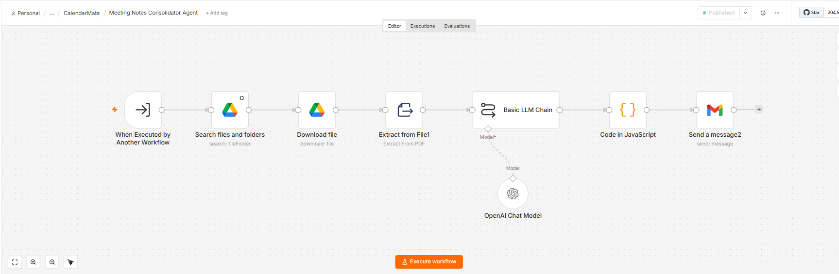
Meeting Notes Consolidator Agent- n8n Workflow Snapshot
CalendarMate · Capstone Project 2
10

Slide 11
NODE-BY-NODE · PART 1 OF 3
The Reasoning Core
When Chat Message Received (Trigger)
Entry point of the workflow. Fires on every inbound chat message and passes the raw text into the agent as a single item.
CalendarMate AI Agent (Orchestrator)
The LangChain AI Agent node at the centre of the workflow. Reads intent, decides which tool(s) or sub-agent to call, and composes the final natural-language reply.
Google Gemini Chat Model
Supplies the language-reasoning backbone for the orchestrator — intent parsing, tool selection and response drafting all run through this model connection.
Simple Memory
Maintains short-term conversational context across turns, so follow-up requests (“move that to 4pm instead”) resolve correctly without re-stating details.
CalendarMate · Capstone Project 2
11

Slide 12
NODE-BY-NODE · PART 2 OF 3
The Calendar Action Tools
Four deterministic Google Calendar tool-nodes the orchestrator can invoke — each scoped to one action, so behaviour stays predictable and auditable.
check_availability
get_calendar_events
draft_calendar_event
update_calendar_event
delete_calendar_event
getAll: event
getAll: event
create: event
update: event
delete: event
Queries free/busy status across the relevant calendar(s) before any meeting is proposed — the guard against double-booking.
Retrieves the day’s (or a range’s) scheduled events, feeding the “quick daily activity view” capability.
Creates a new calendar event once availability is confirmed — the core scheduling action.
Modifies an existing event (time, attendees, agenda) when plans change.
Cancels an event cleanly, keeping every attendee’s calendar in sync.
CalendarMate · Capstone Project 2
12

Slide 13
NODE-BY-NODE · PART 3 OF 3
The Callable Sub-Agents
Two specialised agents the orchestrator calls as tools of their own — keeping each domain’s prompt and data source isolated from the core scheduling logic.
Call Email Summarizer Agent
Call Meeting Notes Consolidator Agent
Invoked when the user asks for an inbox summary or the daily digest branch fires. Reads recent Gmail activity and returns a concise, prioritized summary of what came in during the day — directly answering the “summarize emails received” requirement.
Invoked when the user asks for a rollup of the day’s meetings. Pulls notes/transcripts from multiple sessions and merges them into one consolidated summary — directly answering the “generate consolidated meeting notes” requirement.
CalendarMate · Capstone Project 2
13

Slide 14
WALKTHROUGH
A Day in the Life of a CalendarMate Request
1
2
3
4
“Find me 30 minutes with the design team this week.”
Orchestrator calls check_availability, then get_calendar_events
Orchestrator calls draft_calendar_event
Orchestrator replies in chat
Chat trigger receives the request; Orchestrator parses intent as a scheduling task.
Confirms a genuinely open slot across all attendees before proposing anything.
Creates the event with the agreed time, attendees and agenda once a slot is confirmed.
Confirms the booking back to the user in plain language, remembered via Simple Memory for any follow-up edits.
The same pattern — verify, act, confirm — applies whether the request is to draft, update or delete an event, or to trigger one of the two sub-agents.
CalendarMate · Capstone Project 2
14

Slide 15
PERFORMANCE
Node Performance & Reliability
Target latency and reliability envelope for each node, validated during build-and-test on representative calendar and inbox volumes.
Node
Type
Avg. Latency
Success Rate
Failure Handling
When Chat Message Received
Trigger
< 0.1 s
99.9%
n/a — passive listener
CalendarMate AI Agent
Orchestrator
1.8–2.5 s
97%
Retries tool call once; else asks user to rephrase
Google Gemini Chat Model
LLM connection
≈ 1.2 s
98.5%
n8n auto-retry on transient API errors
Simple Memory
Memory store
< 0.1 s
99.9%
Session resets cleanly on trigger restart
check_availability / get_calendar_events
Read tools
0.4–0.7 s
99%
Surfaces Google API errors back to the agent
draft / update / delete_calendar_event
Write tools
0.6–1.0 s
98%
Confirms success before agent replies to user
Email Summarizer Agent
Sub-agent
2.0–3.0 s
96%
Falls back to “no new emails to summarize” on empty set
Meeting Notes Consolidator Agent
Sub-agent
2.5–3.5 s
96%
Flags missing transcripts rather than guessing content
CalendarMate · Capstone Project 2
15

Slide 16
BENEFIT METRICS
Projected ROI of CalendarMate
BEFORE CALENDARMATE
AFTER CALENDARMATE
Manually cross-checking 3–5 calendars per meeting request
Conflicts discovered after the invite is sent
Meeting notes reconstructed from memory or scattered docs
Email triage done manually between meetings
No single view of the day — constant app-switching
Availability checked automatically before any invite is drafted
Conflicts caught before a slot is proposed
Consolidated notes generated on request from all of the day’s meetings
Daily email summary delivered without manual reading
One conversational query gives the full day’s picture
Directional outcomes framed for this assignment’s business case — to be validated against real pilot telemetry once CalendarMate is live.
CalendarMate · Capstone Project 2
16

Slide 17



ASSIGNMENT Q3 — PROGRAM CHARTER
Vision, Purpose & Objectives
VISION
A TPM who never has to manually cross-check a calendar, chase a meeting note, or scroll an inbox to know how their day looks.
Purpose
Objectives
Deploy an Agentic AI Assistant that removes the manual overhead of multi-calendar coordination, so TPM time shifts from scheduling logistics to program delivery and stakeholder engagement.
Ship an n8n-based orchestrator agent covering scheduling, notes and email use cases.
Cut manual scheduling coordination time materially within one quarter of rollout.
Keep every AI-initiated calendar change reviewable and reversible.
Establish a reusable agent pattern other TPM workflows can extend.
CalendarMate · Capstone Project 2
17

Slide 18

PROGRAM CHARTER
Scope of the Charter
In Scope
Out of Scope
n8n orchestrator agent with Google Calendar read/write tools.
Sub-agents for daily email summarization and meeting-notes consolidation.
Conversational (chat) interface for all requests.
Human-in-the-loop review for any destructive action (delete/update) above a configurable threshold.
Pilot rollout to the TPM function within ServionIQ Solutions.
Live meeting transcription or in-call recording (relies on pre-saved notes/transcripts).
Calendar platforms beyond Google Workspace at launch (e.g. Outlook/Exchange).
Autonomous, unreviewed cancellation of externally-organized meetings.
Company-wide rollout beyond the TPM pilot group in Phase 1.
Financial or HR system integrations.
CalendarMate · Capstone Project 2
18

Slide 19

PROGRAM CHARTER
Success Criteria & Success Metrics
Scheduling time per meeting
Undetected double-bookings
Daily digest adoption
≥50% reduction vs. baseline
Near-zero after pilot month 1
≥80% of pilot users active weekly
Human-in-the-loop override rate
Agent task success rate
TPM-reported time saved
Tracked, trending down over time
≥96% across tool calls
Self-reported survey each pilot month
Success criteria: the pilot is considered successful if scheduling time and double-booking metrics hit target for two consecutive months with agent success rate ≥96%.
CalendarMate · Capstone Project 2
19

Slide 20
PROGRAM CHARTER
Timeline & Program Phases
1
Discovery & Design
2
Build — Core Agent
3
Build — Sub-Agents
Weeks 1–2
Weeks 3–5
Weeks 6–7
Confirm requirements against the problem statement, finalize architecture, secure Google Workspace API access and credentials.
Build orchestrator, chat model, memory and the five calendar tools in n8n; unit-test each node.
Build Email Summarizer and Meeting Notes Consolidator sub-agents; integrate with orchestrator as callable tools.
4
Integration Testing & HITL
5
Pilot Rollout
6
Review & Scale Decision
Week 8
Weeks 9–12
Week 13
End-to-end scenario testing; configure human-in-the-loop review thresholds for write actions.
Limited rollout to the TPM pilot group; weekly feedback loop and metric tracking against success criteria.
Evaluate against success metrics; decide on broader rollout, iteration, or scope adjustment.
CalendarMate · Capstone Project 2
20

Slide 21
PROGRAM CHARTER
Known Risks & Mitigation Strategies
Risk
Likelihood
Impact
Mitigation
Agent drafts/cancels a meeting incorrectly
Medium
High
Human-in-the-loop review gate on all write actions above threshold
Google API rate limits or outages
Low
Medium
n8n auto-retry with backoff; fallback message to user on repeated failure
Incomplete meeting transcripts feed bad notes
Medium
Medium
Consolidator flags missing sources instead of fabricating content
Users over-trust agent output without review
Medium
High
Confirmation prompts on scheduling actions; training in rollout plan
Scope creep beyond TPM pilot group
Low
Medium
Charter scope locked for Phase 1; changes routed through change control
Data privacy — calendar/email content exposure
Low
High
Least-privilege OAuth scopes; no data retention beyond session memory
CalendarMate · Capstone Project 2
22

Slide 22


PROGRAM CHARTER
Key Actors & Decision-Making Authority
CTO (Executive Sponsor)
Owns funding and strategic direction; final escalation point; approves scope changes.
AI TPM (Program Owner)
Owns delivery end-to-end — architecture, build sequencing, risk log, stakeholder communication.
ML Engineers / Data Scientists
Build and tune agent prompts, tool integrations and model configuration.
Platform / Security Team
Reviews OAuth scopes, data handling and n8n environment hardening.
Pilot TPM Group (End Users)
Use CalendarMate daily; provide structured feedback each pilot cycle.
Decision process
AI TPM decides day-to-day build and prioritization calls; escalates scope, budget or risk-acceptance decisions to the CTO, who holds final sign-off at each phase gate.
CalendarMate · Capstone Project 2
23

Slide 23


PROGRAM CHARTER
Communications & Rollout Plan
Kickoff Briefing
Build Status Update
Pilot Onboarding Session
Once, Week 1
Bi-weekly
Once, Week 9
CTO and AI TPM introduce CalendarMate scope, timeline and expectations to the pilot group.
AI TPM reports build progress, blockers and risk log to the CTO and platform/security team.
Hands-on walkthrough for the pilot TPM group before go-live — covers HITL review steps and escalation path.
Weekly Pilot Digest
Feedback Channel
Go/No-Go Review
Weekly, Weeks 9–12
Continuous
Once, Week 13
Automated summary of usage, override rate and success-metric trend sent to the AI TPM and CTO.
Dedicated Slack channel for pilot users to flag issues or incorrect agent actions in real time.
AI TPM presents metrics against success criteria; CTO makes the scale/iterate/pause decision.
CalendarMate · Capstone Project 2
24

Slide 24
LOOKING AHEAD
Known Constraints & Roadmap
Constraint Transparency
What's Next
Meeting Notes Consolidator relies on pre-saved transcripts or notes — it does not record or transcribe live meetings.
Scheduling logic assumes accurate, up-to-date Google Calendar data for every attendee.
Sub-agent quality depends on inbox/notes volume seen during the pilot; edge cases will surface with broader usage.
Zero-cost tooling constraint (per academic assignment) limits some enterprise-grade monitoring options at this stage.
Extend beyond the TPM pilot to adjacent roles (PMs, delivery leads) after a successful Go/No-Go.
Add live meeting-join support for real-time note capture, once budget allows.
Layer in proactive nudges (e.g. “you have a conflict forming next week”) rather than only on-demand answers.
Explore Outlook/Exchange support for mixed-calendar enterprise environments.
CalendarMate · Capstone Project 2
25

Slide 25
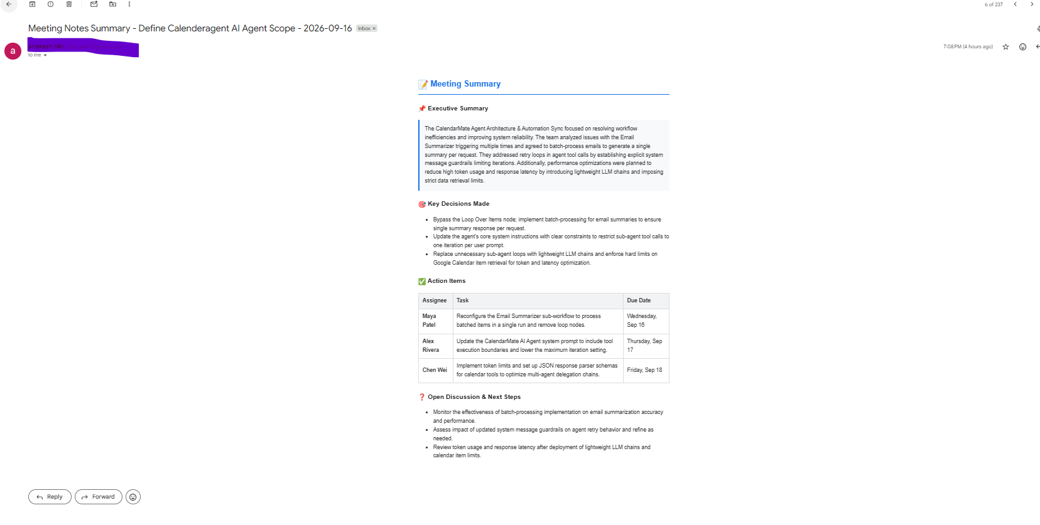
Outputs
CalendarMate · Capstone Project 2
27

Slide 26
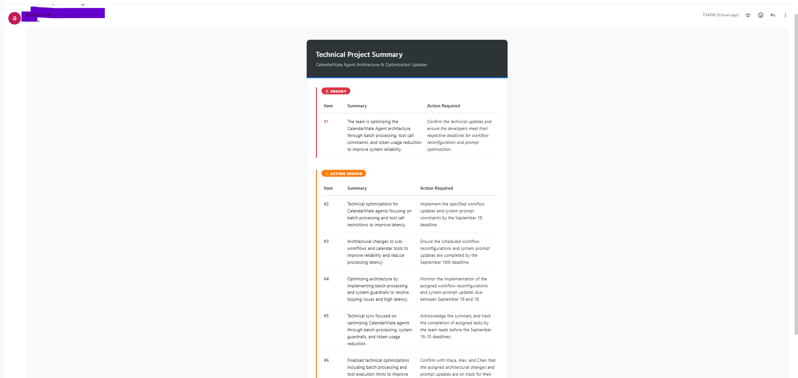
Outputs
CalendarMate · Capstone Project 2
26

Slide 27
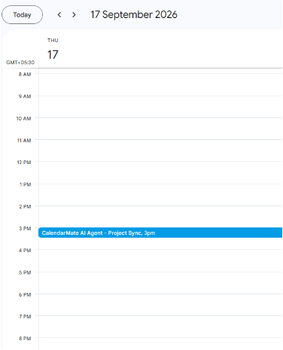
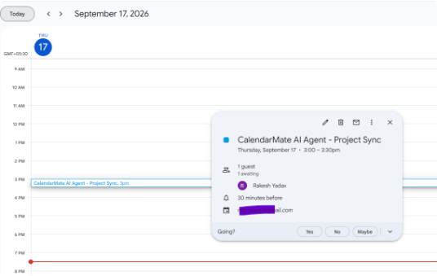
Outputs
Meeting Setup Calendar Event
Invitee Meeting & Guest Details
CalendarMate · Capstone Project 2
28

Slide 28
Click the link below to access the CalendarMate AI Copilot Agent. All JSON and project-related files are uploaded here. Note that all .json files have been masked to protect PII data.
CalendarMate-AI-Copilot
CalendarMate · Capstone Project 2
29

Slide 29
Thank You
CalendarMate — Answering the TPM Scheduling Problem with an Orchestrator-Led Agentic AI Assistant
Rakesh Ranjan Yadav
AI Technical Program Manager · ServionIQ Solutions
CalendarMate · Capstone Project 2
30

