Slide 1
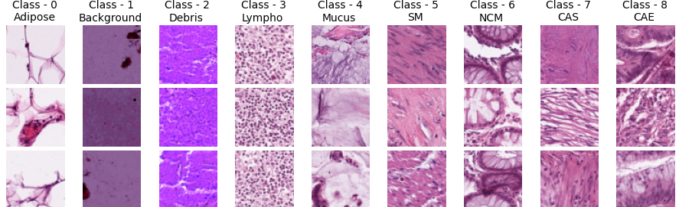

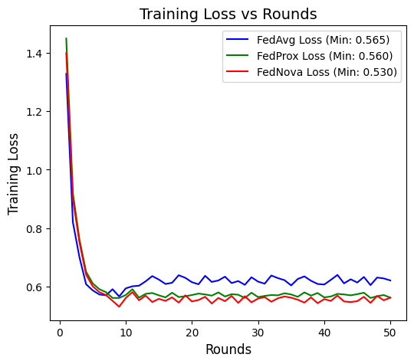
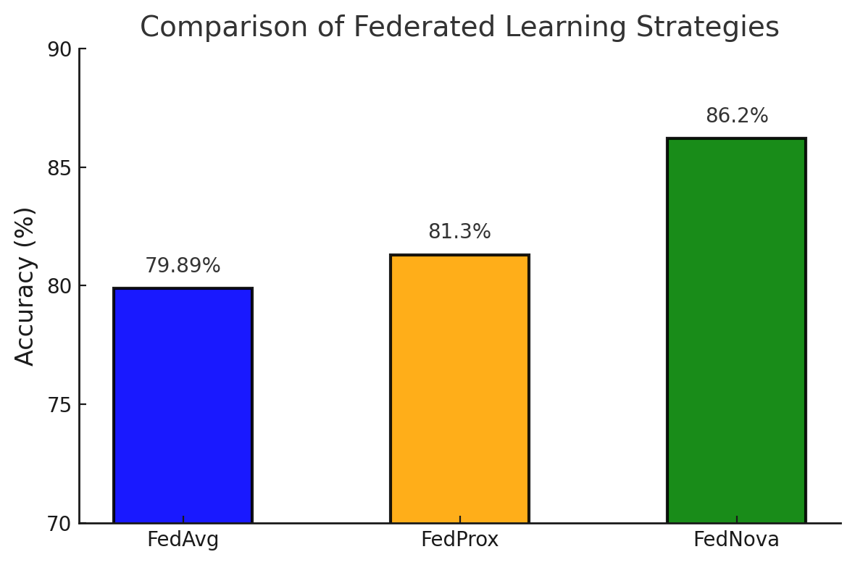
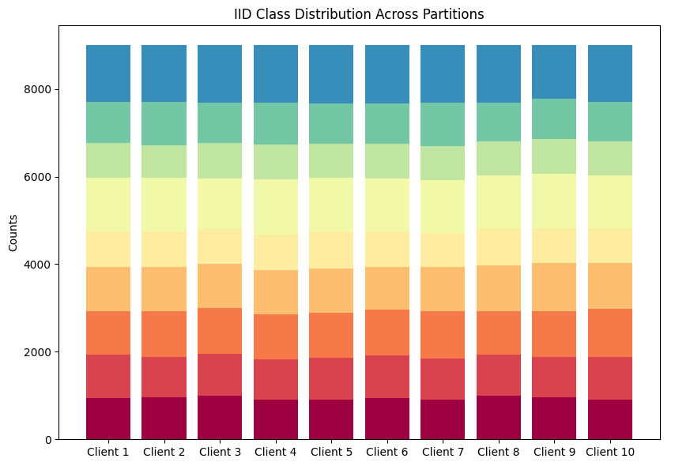
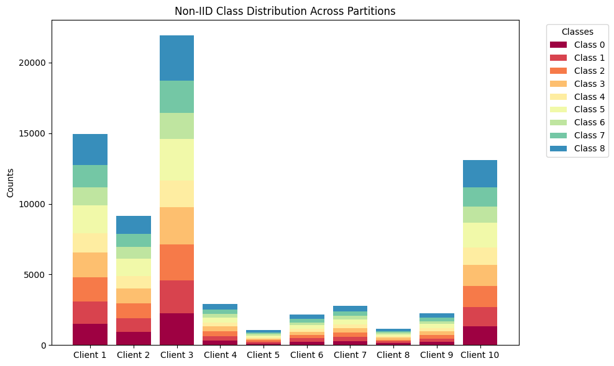
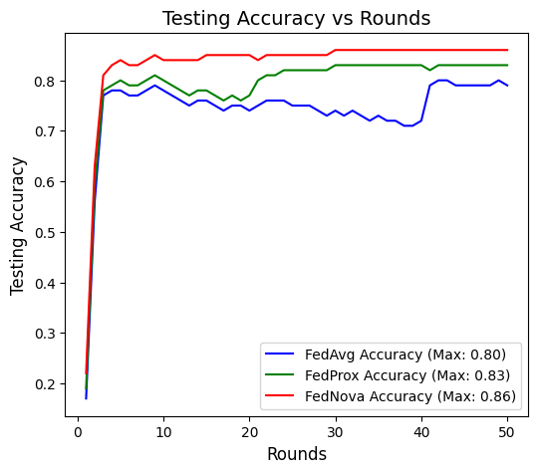
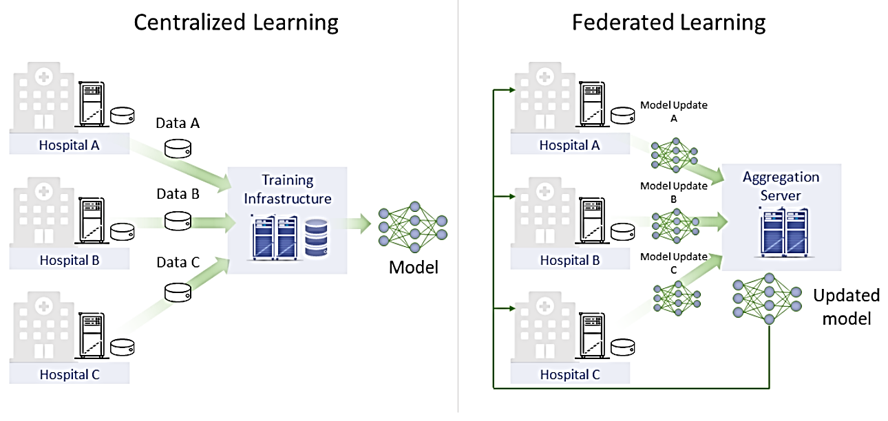
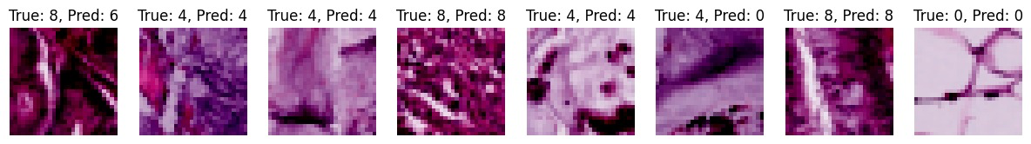
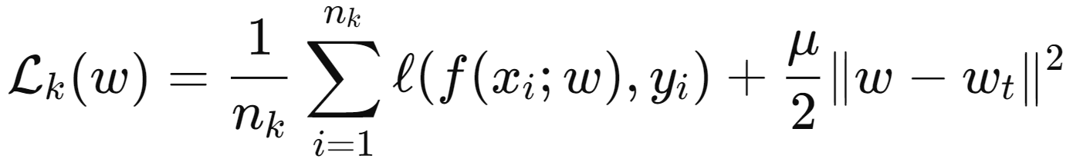
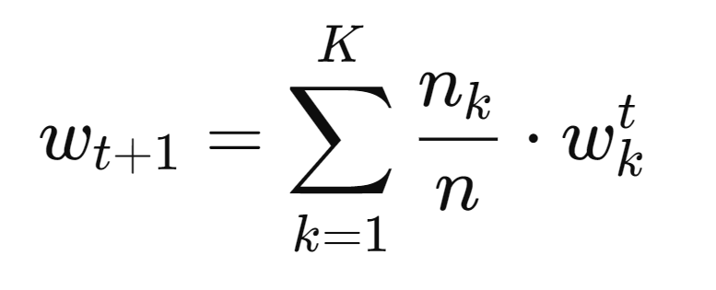
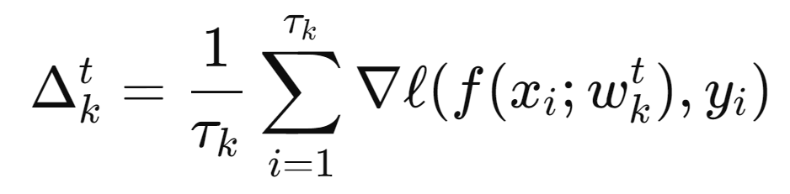
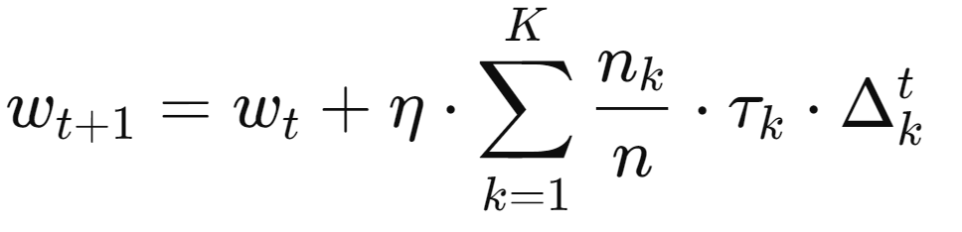
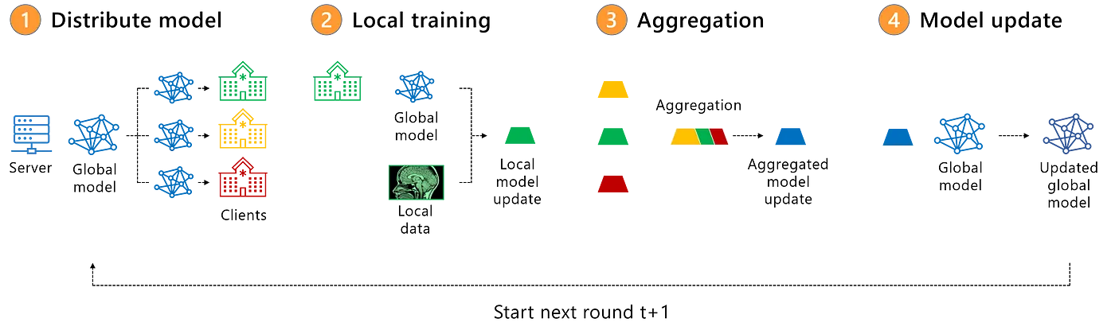
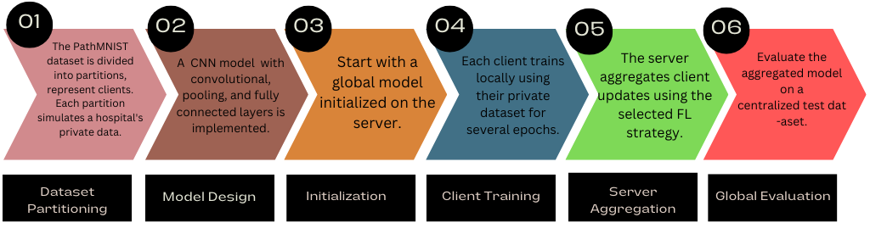
Federated Learning for Image Classification in
Distributed Medical Imaging Systems
Anirudh Kalva, Rakesh Chary Bangaroj, Sujan Chithaluri
Background and Objective
Dataset Overview
Results
Medical imaging is essential for diagnosing diseases like cancer, heart conditions, and neurological disorders, but training effective models requires access to large amounts of data.
Due to strict privacy regulations like HIPAA and GDPR, hospitals and research centers can’t easily share patient data, which limits collaboration and makes it harder to build better diagnostic tools.
This project aims to solve that problem by using Federated Learning (FL), a method that allows hospitals to work together and train machine learning models without ever sharing their actual data and integrate security using Differential Privacy(DP).
Instead, each hospital keeps its data private and only shares model updates, ensuring privacy while still improving the overall performance of the model across different institutions.
Fig 6.1
Fig 6.3
Fig 6.2
Fig 6.1. Compares the training loss trends across rounds for FedAvg, FedProx, and FedNova, highlighting that FedProx achieves the lowest minimum loss, indicating better optimization stability.
Fig 6.2. This plot shows the testing accuracy trends over rounds for FedAvg, FedProx, and FedNova, demonstrating that FedNova achieves the highest accuracy (0.86), followed by FedProx (0.83), with FedAvg (0.80) performing the lowest.
Fig 6.3. Highlights the testing accuracy of three federated learning strategies: FedAvg (79.89%), FedProx (81.3%), and FedNova (86.2%). FedNova demonstrates superior performance, effectively handling client heterogeneity and achieving better convergence.
Introduction
Federated Learning has gained significant traction in recent years, particularly in applications where privacy is paramount, such as healthcare.
Federated Learning (FL) is a decentralized machine learning approach where multiple devices or nodes collaboratively train a shared model while keeping their data localized.
Instead of transferring raw data to a central server for training, only the model updates (e.g., gradients or weights) are shared and aggregated on the central server.
The PathMNIST dataset consists of 9 tissue types for multi-class classification, with images resized to 3×28×28 from the original 3×224×224. The dataset is split into 90K training, 10K validation, and 7K testing samples, with normalization (mean=[0.5], std=[0.5]) applied and a Non-IID data setup used.
Methodology and Implementation
FedAvg: A simple strategy that aggregates local model updates by weighted averaging based on the number of samples per client.
FedProx: Extends FedAvg by introducing a proximal term to stabilize training for non-IID data by regularizing local updates.
FedNova: Normalizes client updates by the number of local steps to address heterogeneity in client workloads.
Fig 6.4. This visualization compares true and predicted labels, highlighting both correct classifications and misclassifications, emphasizing the need for model refinement.
Conclusion
Achieved secure, collaborative training with federated learning and differential privacy, ensuring data protection.
FedNova excelled with 86.2% accuracy, handling heterogeneity; FedProx outperformed FedAvg on non-IID data.
Scalable techniques enhance optimization, applicable to sensitive domains like finance and healthcare.
Workflow Of Federated Learning
Future Work
Future work includes exploring advanced models like Transformers for enhanced performance and integrating communication-efficient strategies. Additionally, we aim to refine hybrid approaches combining the strengths of FedAvg, FedProx, and FedNova for diverse real-world applications.

