Slide 1
Demonstration

Slide 2
Objective
As part of SR issue analysis of IOS-XR devices, TAC frequently requests logs from devices which generally includes below
show tech reports (IOS-XR or Admin mode)
Existing Crash/log files from device.
Output of various show commands.
You might have observed that gathering these information from device and uploading to SR case, often becomes daunting/time consuming task. So, we can use IOS-XR_TAC-Log_Automation Python script which help and automate these tasks to save time and efforts.

Slide 3
Agenda
Manual Process of gathering Logs and uploading to SR case.
Automating using Python Script
Features available in this Script
Setting up Python Virtual Environment on Jump Server

Slide 4
Manual Logs Gathering process

Slide 5
Steps in Manual Method (show tech – IOS-XR mode) gathering
Run show tech command and wait for file generation
Copy the generated file to Jump Server via SCP/SFTP etc.
Download file to local system (Laptop)
Upload to SR Case

Slide 6
Steps in Manual Method (show tech – Admin mode) gathering
Run show tech command and wait for file generation
Copy file to IOS-XR mode.
Copy the generated file to Jump Server via SCP/SFTP etc.
Download file to local system (Laptop)
Upload to SR Case

Slide 7
Logs Gathering process - Automation

Slide 8
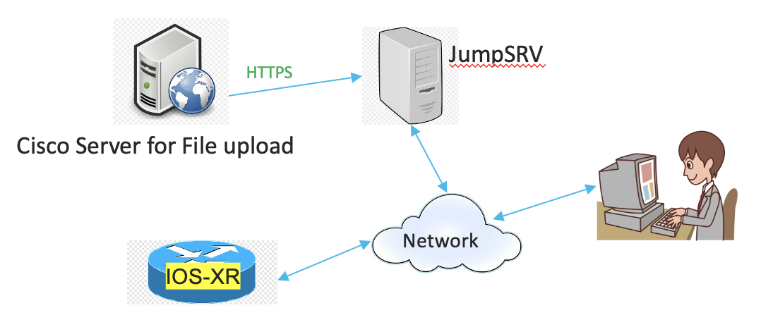
Network analogy(Automation Method)
User Need to supply information requested to Script
Script will login to device, run each command one by one, download the file to Jump Server and upload the file automatically to SR Case

Slide 9
Information required for Script Run
SR number → This will work as username for file upload to CXD (Customer Experience Drive).
Token for file Upload → This is Secure Token to upload file to CXD Drive using HTTPS put method.
Device IP and Credentials (Script doesn’t store any credentials for Security purpose)
TAC requested ‘show tech commands’ or usual ‘show commands’

Slide 10
Where to find CXD Token
Customer need to login to Cisco’s Support Case Manager using CCO ID and password.
Open the Case > Notes and search for ‘CXD Upload Credentials’
Note, Each case will have unique CXD Token. This token can be used for securely uploading files to TAC case. Also, Support Case Manger gives option to generate new one, if required.
Refer below link for more details:
https://www.cisco.com/c/en/us/support/web/tac/tac-customer-file-uploads.html

Slide 11
Benefits:
No user intervention required after required information provided to Script.
Completely safe since Script will only run ‘show commands’. It will never enter config mode
It used HTTPS protocol to upload file to case which is completely secure.
No time waiting between each step.
User can perform other tasks during script execution or simply take rest ☺
Script will check Free space before running ‘show tech’ commands. It should be over 15% to execute show tech task.
User will get summary of tasks with errors if any.
Successfully Tested on: ASR9k, NCS5500, NCS1k & NCS4k

Slide 12
Use Cases
This Script provides 5 user options to choose from:
To run show tech commands in "IOS-XR mode" and upload file/s to TAC case Choose: 1
To run show tech commands in "Admin mode" and upload file/s to TAC case Choose: 2
To upload already generated or saved file/s to TAC case Choose: 3
To run Only SHOW commands , capture output to file and upload it to TAC case Choose: 4
To upload existing file on Local machine/JumpHost to TAC case: 5

Slide 13
Steps required
Setup Virtual Environment on Jump Server (Instructions on later slides)
User need to segregate TAC requested logs as below
IOS-XR mode ‘show tech’ commands
Admin mode ‘show tech’ commands
General show commands
User run the script and Choose the respective option then provide required details to Script.

Slide 14
Initial Setup for Virtual Environment

Slide 15
Setting up Python Virtual Environment on Jump Server
- Login to Jump Server and create a folder for script and cd to it.
[rakeshk6@dansalan ~]$ mkdir script && cd script
Create Python3 Virtual Environment with name venv1
[rakeshk6@dansalan script]$ python3 -m venv venv1
Activate virtual environment:
[rakeshk6@dansalan script]$ source venv1/bin/activate
(venv1) [rakeshk6@dansalan script]$
Upgrade pip
(venv1) [rakeshk6@dansalan script]$ python -m pip install --upgrade pip

Slide 16
Setting up Python Virtual Environment on Jump Server (Cont.)
Install packages required for this script
(venv1) [rakeshk6@dansalan script]$ pip install netmiko requests tqdm
Script can be copied/downloaded from below git URL:
https://github.com/rakeshchhikara/IOS-XR-logs-collection/

Slide 17
Sample Output of Script Run For show tech commands
[rakeshk6@dansalan test-scripts]$ source venv1/bin/activate
(venv1) [rakeshk6@dansalan test-scripts]$ python ios-xr_logs_collection_v1.0.py ==================================================================================
Please select the Task number from below List and Enter as your choice on Prompt.
==================================================================================
To run show tech commands in "IOS-XR mode" and upload file/s to TAC case Choose: 1
To run show tech commands in "Admin mode" and upload file/s to TAC case Choose: 2
To upload already generated or saved file/s to TAC case Choose: 3
To run Only SHOW commands , capture output to file and upload it to TAC case Choose: 4
To upload existing file on Local machine/JumpHost to TAC case: 5
Enter your Choice: 1 >> I have used Option 1 which is for show tech files (IOS-XR mode)
Enter SR number: XXXXXXXXX >> Provide SR Number here.
Enter Upload Token: FYjWClVrsIjL7UUI >> Provide CXD token from Case Manager.
Enter device ip: 10.10.1.1 >> IOS-XR Device IP Address
Enter your username for device Login: cisco >> IOS-XR Device Username
Enter device Password: >> IOS-XR Device Password (hidden)
Enter one show tech command per line. Once all show tech commands entered,
just Hit Enter key to execute script
Enter show tech command(Only IOS-XR mode): show tech cef
Enter show tech command(Only IOS-XR mode): show tech arp
Enter show tech command(Only IOS-XR mode): show tech
Enter show tech command(Only IOS-XR mode): show tech multicast
Enter show tech command(Only IOS-XR mode): show tech kdkdl >> Invalid Show tech command used for Demo
Enter show tech command(Only IOS-XR mode):

Slide 18
Sample Output of Script Run (cont)
Now connecting to device...
SSH connection established to 10.10.1.1:22
Interactive SSH session established
****************************************************************************************************
Free space on harddisk is 62.22%. We will continue.
****************************************************************************************************
Generating "show tech cef" on device MYGTSTBDCICU003. Please wait...
Tue Jun 22 15:48:04.002 PHT
++ Show tech start time: 2021-Jun-22.154804.PHT ++
Tue Jun 22 15:48:04 PHT 2021 Waiting for gathering to complete
.................
Tue Jun 22 15:48:57 PHT 2021 Compressing show tech output
Show tech output available at 0/RP0/CPU0 : /harddisk:/showtech/showtech-MYGTSTBDCICU003-cef-2021-Jun-22.154804.PHT.tgz
++ Show tech end time: 2021-Jun-22.154858.PHT ++
Calculating md5 hash of file "/harddisk:/showtech/showtech-MYGTSTBDCICU003-cef-2021-Jun-22.154804.PHT.tgz" on device... please wait.
File "/harddisk:/showtech/showtech-MYGTSTBDCICU003-cef-2021-Jun-22.154804.PHT.tgz" copied to local machine
Calculating md5 hash of Local file "showtech-MYGTSTBDCICU003-cef-2021-Jun-22.154804.PHT.tgz" ... please wait.

Slide 19
Sample Output of Script Run (cont)
MD5 calculated on Device: 54c5c64e6c89b7af0c8559cb22ab765b
Local md5 calculated: 54c5c64e6c89b7af0c8559cb22ab765b
MD5 has matched. Download successful.
#####################################################################################################
Generating "show tech arp" on device MYGTSTBDCICU003. Please wait...
Tue Jun 22 15:49:12.570 PHT
++ Show tech start time: 2021-Jun-22.154912.PHT ++
Tue Jun 22 15:49:13 PHT 2021 Waiting for gathering to complete
...
Tue Jun 22 15:49:22 PHT 2021 Compressing show tech output
Show tech output available at 0/RP0/CPU0 : /harddisk:/showtech/showtech-MYGTSTBDCICU003-arp-2021-Jun-22.154912.PHT.tgz
++ Show tech end time: 2021-Jun-22.154923.PHT ++
Calculating md5 hash of file "/harddisk:/showtech/showtech-MYGTSTBDCICU003-arp-2021-Jun-22.154912.PHT.tgz" on device... please wait.
File "/harddisk:/showtech/showtech-MYGTSTBDCICU003-arp-2021-Jun-22.154912.PHT.tgz" copied to local machine
Calculating md5 hash of Local file "showtech-MYGTSTBDCICU003-arp-2021-Jun-22.154912.PHT.tgz" ... please wait.
MD5 calculated on Device: a965fa2e01854273a009be497dca03c6
Local md5 calculated: a965fa2e01854273a009be497dca03c6

Slide 20
Sample Output of Script Run (cont)
MD5 has matched. Download successful.
######################################################################################################
Generating "show tech" on device MYGTSTBDCICU003. Please wait...
Tue Jun 22 15:49:32.944 PHT
++ Show tech start time: 2021-Jun-22.154933.PHT ++
Tue Jun 22 15:49:33 PHT 2021 Waiting for gathering to complete
.....
Tue Jun 22 15:49:49 PHT 2021 Compressing show tech output
Show tech output available at 0/RP0/CPU0 : /harddisk:/showtech/showtech-MYGTSTBDCICU003-generic-2021-Jun-22.154933.PHT.tgz
++ Show tech end time: 2021-Jun-22.154949.PHT ++
Calculating md5 hash of file "/harddisk:/showtech/showtech-MYGTSTBDCICU003-generic-2021-Jun-22.154933.PHT.tgz" on device... please wait.
File "/harddisk:/showtech/showtech-MYGTSTBDCICU003-generic-2021-Jun-22.154933.PHT.tgz" copied to local machine
Calculating md5 hash of Local file "showtech-MYGTSTBDCICU003-generic-2021-Jun-22.154933.PHT.tgz" ... please wait.
MD5 calculated on Device: d75d6cf5364184e0b131087c206cb330
Local md5 calculated: d75d6cf5364184e0b131087c206cb330
MD5 has matched. Download successful.
######################################################################################################

Slide 21
Sample Output of Script Run (cont)
Generating "show tech multicast" on device MYGTSTBDCICU003. Please wait...
Entered command - "show tech multicast" is Invalid or Incomplete. Please re-check correct command.
########################################################################################################################
Generating "show tech kdkdl" on device MYGTSTBDCICU003. Please wait...
Entered command - "show tech kdkdl" is Invalid or Incomplete. Please re-check correct command.
########################################################################################################################
List of local files: ['showtech-MYGTSTBDCICU003-cef-2021-Jun-22.154804.PHT.tgz', 'showtech-MYGTSTBDCICU003-arp-2021-Jun-22.154912.PHT.tgz', 'showtech-MYGTSTBDCICU003-generic-2021-Jun-22.154933.PHT.tgz']
Disconnected from device - MYGTSTBDCICU003
Uploading file -"showtech-MYGTSTBDCICU003-cef-2021-Jun-22.154804.PHT.tgz" to TAC case
100%|████████████████████████████████████████████████████████████████████████| 6.17M/6.17M [00:03<00:00, 1.72MKB/s]
Uploading file -"showtech-MYGTSTBDCICU003-arp-2021-Jun-22.154912.PHT.tgz" to TAC case
100%|██████████████████████████████████████████████████████████████████████████| 242k/242k [00:02<00:00, 121kKB/s]
Uploading file -"showtech-MYGTSTBDCICU003-generic-2021-Jun-22.154933.PHT.tgz" to TAC case
100%|███████████████████████████████████████████████████████████████████████| 117k/117k [00:01<00:00, 59.9kKB/s]
####################
List of failed commands, if any: ['show tech multicast', 'show tech kdkdl']
Total execution time 3.23 minutes.
####### Thanks for using this Script. ########

