Slide 1
Movies and Video Series recommendation using emotional information.

Slide 2
Index
Aim
About Dataset
Cleaning dataset
Merging datasets
Recommended System

Slide 3
Objective
Creating dataset using given Emotional dataset and IMDB dataset to building recommended system.

Slide 4
Emotional Dataset
Emotional dataset contains 3659 records of data.
It contains scores for 20 different emotions

Slide 5
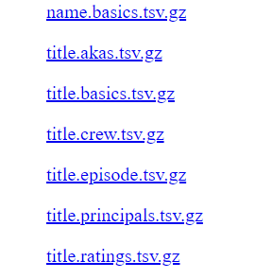
IMDB Dataset
IMDB dataset contains data about every movie, Tv-series,
episodes, Tv-shows etc.

Slide 6
Cleaning Dataset
Removing unwanted data
Adding IMDB ids to Emotional data
cleaning TV-series data of Emotional dataset

Slide 7
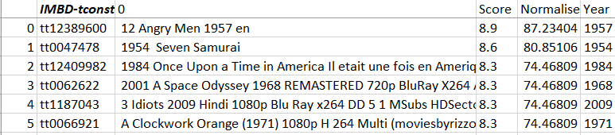
Adding IMDB ids to Emotional data

Slide 8
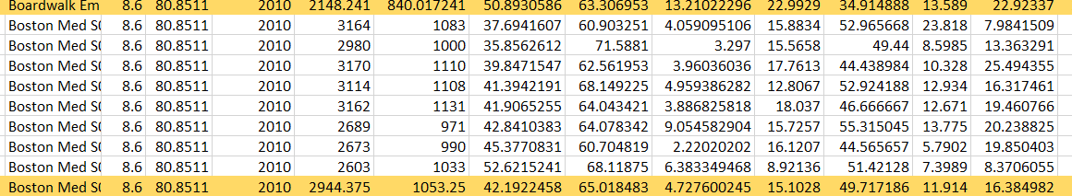
cleaning TV-series data of Emotional dataset

Slide 9
Merging Emotional dataset and IMDB dataset
Merge with name.basics.tsv
Merge with title.crew.tsv
Merge with title.crew.tsv

Slide 10
Recommended System
1. Recommendations Based on Emotion type
2. Recommendations based on Emotion and Time period
3. Recommendations based on Director Name.
4. Recommendations Based on Movie name.

Slide 11
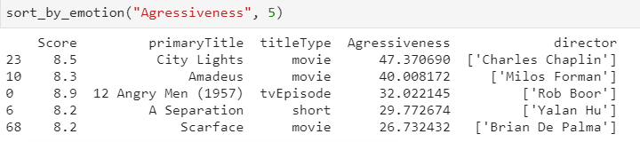
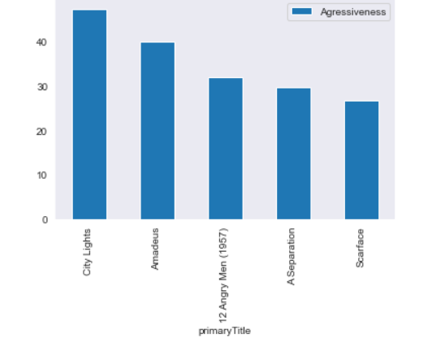
1. Recommendations Based on Emotion type
Results are based on emotion type

Slide 12
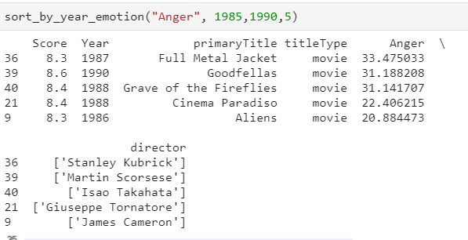
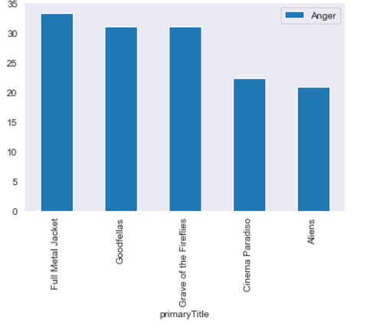
2. Recommendations based on Emotion and Time period

Slide 13
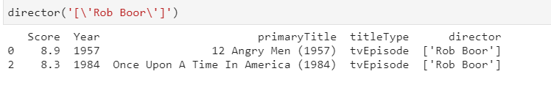
3. Recommendations based on Director Name.

Slide 14
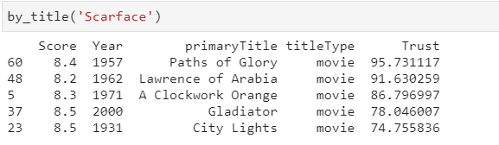
4. Recommendations Based on Movie name.

Slide 15
Git Repository
https://github.com/rakeshchowdary07/End-of-the-course-project

Slide 16
Any Questions.

Slide 17
Thank you
By:
Rakesh NUVVULA
61088
Special Thanks to:
ISEP supervisor, Professor: Raja CHIKY

