Slide 1
Movies and Video Series recommendation using emotional information.

Slide 2
Index
Objective
About Dataset
Cleaning dataset
Merging datasets
Recommended System
Learnings
References

Slide 3
Objective
Creating dataset using given Emotional dataset and IMDB dataset to building recommended system.

Slide 4
Emotional Dataset
Emotional dataset contains 3659 records of data.
It contains scores for 20 different emotions

Slide 5
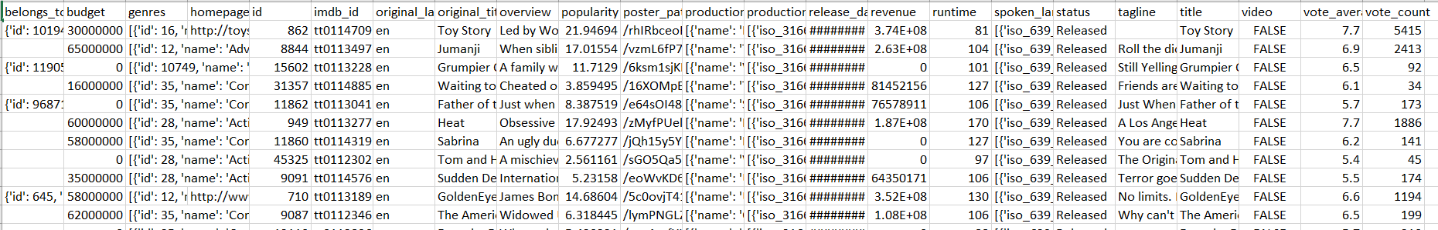
TheMovie Dataset:
TheMovie dataset have files contain metadata for all 45,000 movies listed in the Full MovieLens Dataset.
This dataset also has files containing 26 million ratings from 270,000 users for all 45,000 movies.

Slide 6
Cleaning Dataset
Removing unwanted data
Adding IMDB ids to Emotional data
Reducing TV-series data of Emotional dataset

Slide 7
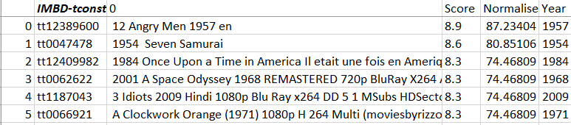
Adding IMDB ids to Emotional data

Slide 8
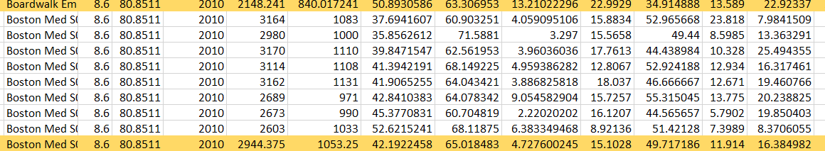
Reducing TV-series data of Emotional dataset

Slide 9
Merging Emotional dataset and TheMovie dataset
Merge with movies_metadata.csv

Slide 10
Recommended System
1. Simple Recommender based on Emotional score.
2. Content Based Recommender.
3. Collaborative Filtering.
4. Hybrid Recommender with emotional scores.

Slide 11
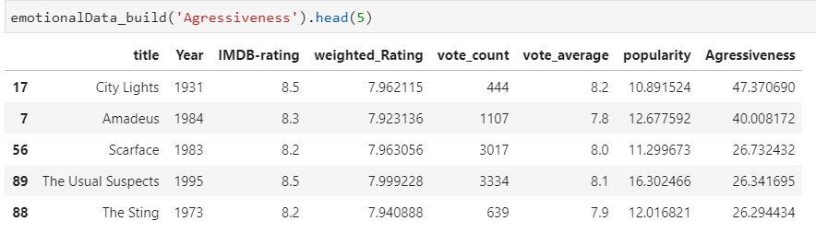
1. Simple Recommender based on Emotional score
Results are based on emotion type

Slide 12
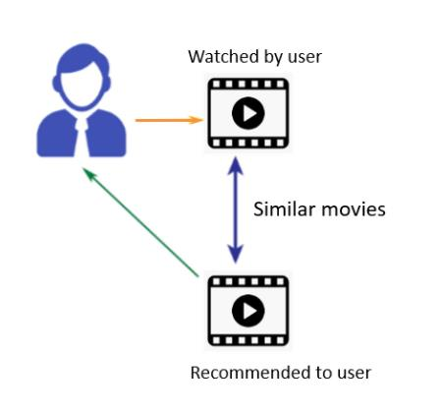
2. Content Based Recommender
Movie Overviews and Taglines
Movie Cast, Crew, Keywords and Genre

Slide 13
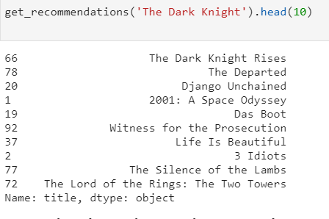
1. Movie Overviews and Taglines
It is based on Movie tag-lines and overviews

Slide 14
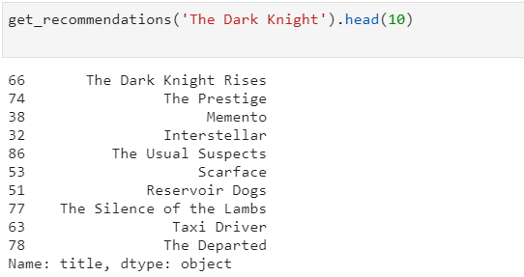
2. Movie Cast, Crew, Keywords and Genre
It is based on cast, crew, keywords; and genre of the movie

Slide 15
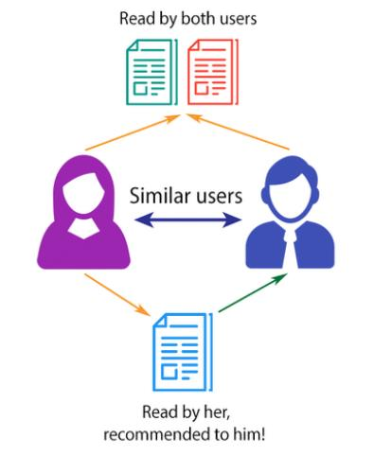
3. Collaborative Filtering
• using K-nearest neighbours • using singular-Value Decomposition

Slide 16
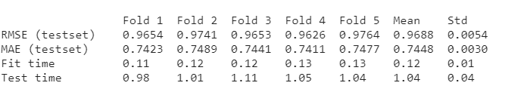


1. using K-nearest neighbours
Train data
Root Mean Square error
Predict data

Slide 17
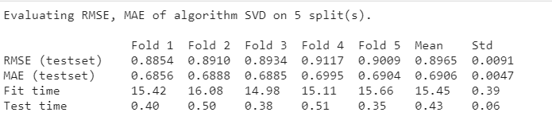


1. using singular-Value Decomposition
Root Mean Square error
Train data
Predict data

Slide 18
4. Hybrid Recommender with emotional scores.
It is the combination of content based and Collaborative Filtering recommender system
• Input: User ID and the Title of a Movie • Output: Similar movies sorted on the basis of expected ratings by that particular user and highest emotional score for the input movie

Slide 19
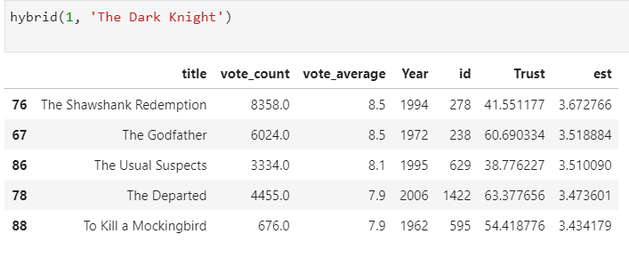
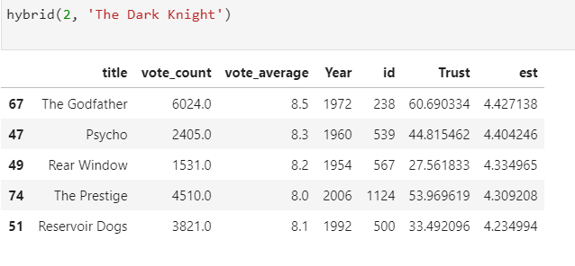

Slide 20
Learnings
• Although I have knowledge on python, I have never worked on any real-time project like this. This project helped me to gain more knowledge on python. • I learned how Netflix, amazon prime work to recommend movies. • I got really good knowledge on movie recommended system and how to implement. • I got knowledge on datasets like IMDB, movielens, TMDB, TheMovie

Slide 21
References
https://surprise.readthedocs.io/en/stable/getting_started.html https://www.imdb.com/interfaces/ https://grouplens.org/datasets/movielens/ https://www.kaggle.com/rounakbanik/the-movies-dataset https://blog.codecentric.de/en/2019/07/recommender-system-movie-lens-dataset/ https://nbviewer.jupyter.org/github/oekosheri/Recommendermovie/blob/master/Recom_walk_through.ipynb https://medium.com/@jdwittenauer/deep-learning-with-keras-recommender-systemse7b99cb29929

Slide 22
Git Repository
https://github.com/rakeshchowdary07/End-of-the-course-project

Slide 23
Any Questions.

Slide 24
Thank you
By:
Rakesh NUVVULA
61088
ISEP supervisor: Professor: Raja CHIKY

