Slide 1
Leveraging Competitive Advantage: Hidden Topics in Customer Digital Footprints Rakesh Dhote rakesh.dhote@gmail.com
Nov. 27, 2015
Presentation at the Scotiabank

Slide 2
Outline
Executive Summary
Topic Modeling (TM)
Case Studies
Tweet analysis – Scotiabank
arXiv research articles
Suggestions to Scotiabank

Slide 3
Executive Summary
Big Data era: customer data generated rapidly
Social media – customer digital body language
Actionable insights – competitive advantage
Topic modeling
2 interesting case studies:
Twitter data from the Scotiabank
Research articles from the arXiv

Slide 4
Topic Modeling (TM)
Algorithms that discover hidden (latent) topics/themes in the data
Automatically organize, understand , search, and summarize large data
Unstructured data – text, video, streams, etc.
Unsupervised machine learning algorithms
Latent Dirichlet Allocation (LDA)
Examples: Text Mining, Genetics, Image Tagging, Social Network, etc.

Slide 5
Case Studies

Slide 6
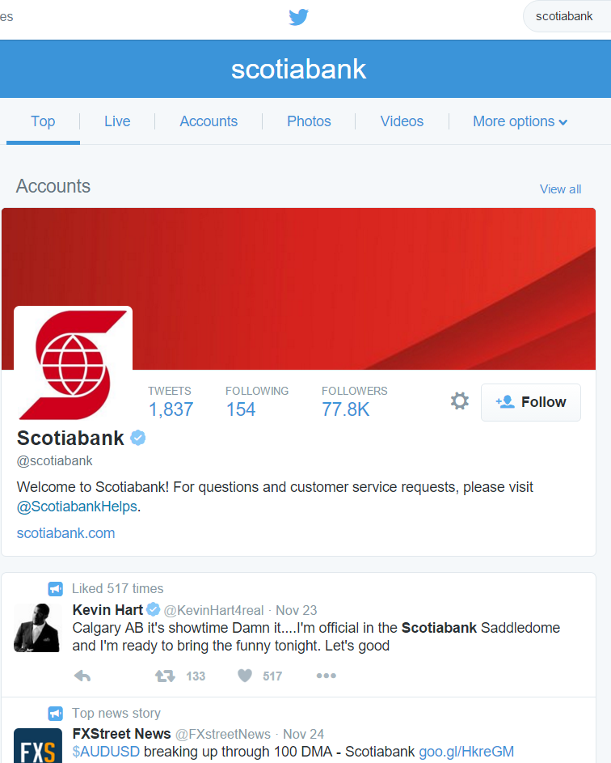
Case Study 1 – Tweet Analysis
Twitter REST API
@Scotiabank
Python tweepy package
~7.5k tweets
Data cleaning
Latent Dirichlet Allocation
# topics chosen = 3
Visualization - Wordcloud

Slide 7
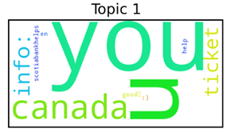
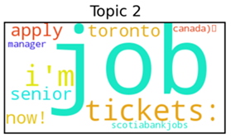
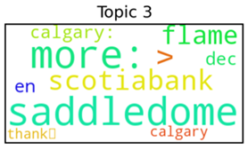
Tweet Analysis: @Scotiabank
Thank you Nsaks56 for following the Conspiracy of Equifax Scotiabank & LawSociety LSUC lawyers!
Solutions Architect (Scarborough Ontario Canada)
Ticket 3 Calgary Flames vs Dallas Stars
Scotiabank is looking for a Data Scientist \ Data Engineer in Toronto apply now! Job
Customer Relations Officer needed in Toronto at Scotiabank Apply now!
Senior IOS Developer (Scarborough Ontario Canada)
Selena Gomez concert tickets for May 17 at Scotiabank Saddledome in Calgary Canada
Got your eye on a new oven Get it Find out more:
Calgary: Calgary Flames vs Boston Bruins at Scotiabank Saddledome

Slide 8
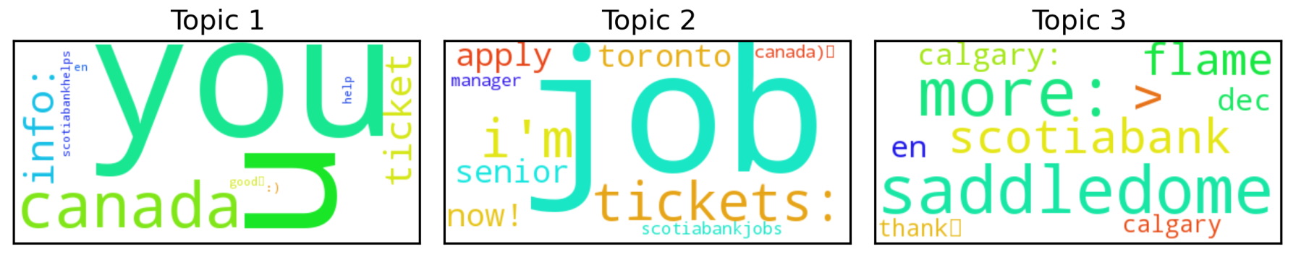
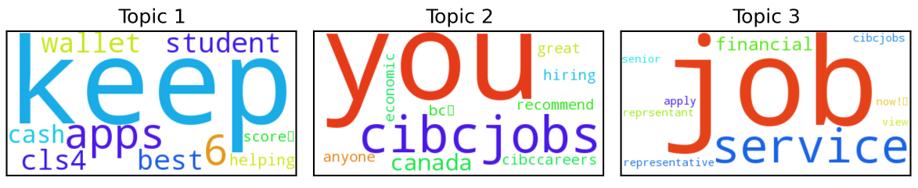
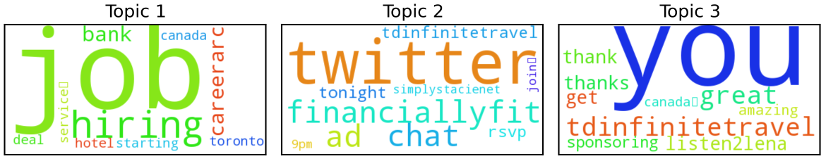
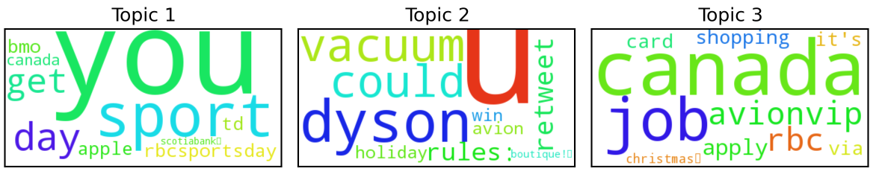
Competitive (Tweet) Analysis
Scotiabank
#tweets ~ 7.5k
CIBC
#tweets ~ 6.4k
TD
#tweets ~ 5.2k
RBC
#tweets ~ 2k

Slide 9
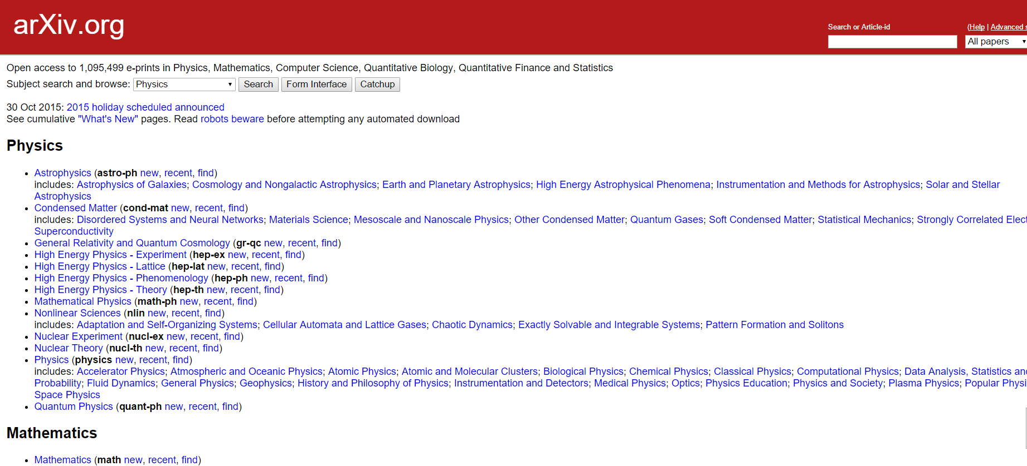
Case Study 2 – arXiv articles
~1.1 million e-prints in Physics, Mathematics, Computer Science, Quantitative Biology, Quantitative Finance and Statistics

Slide 10
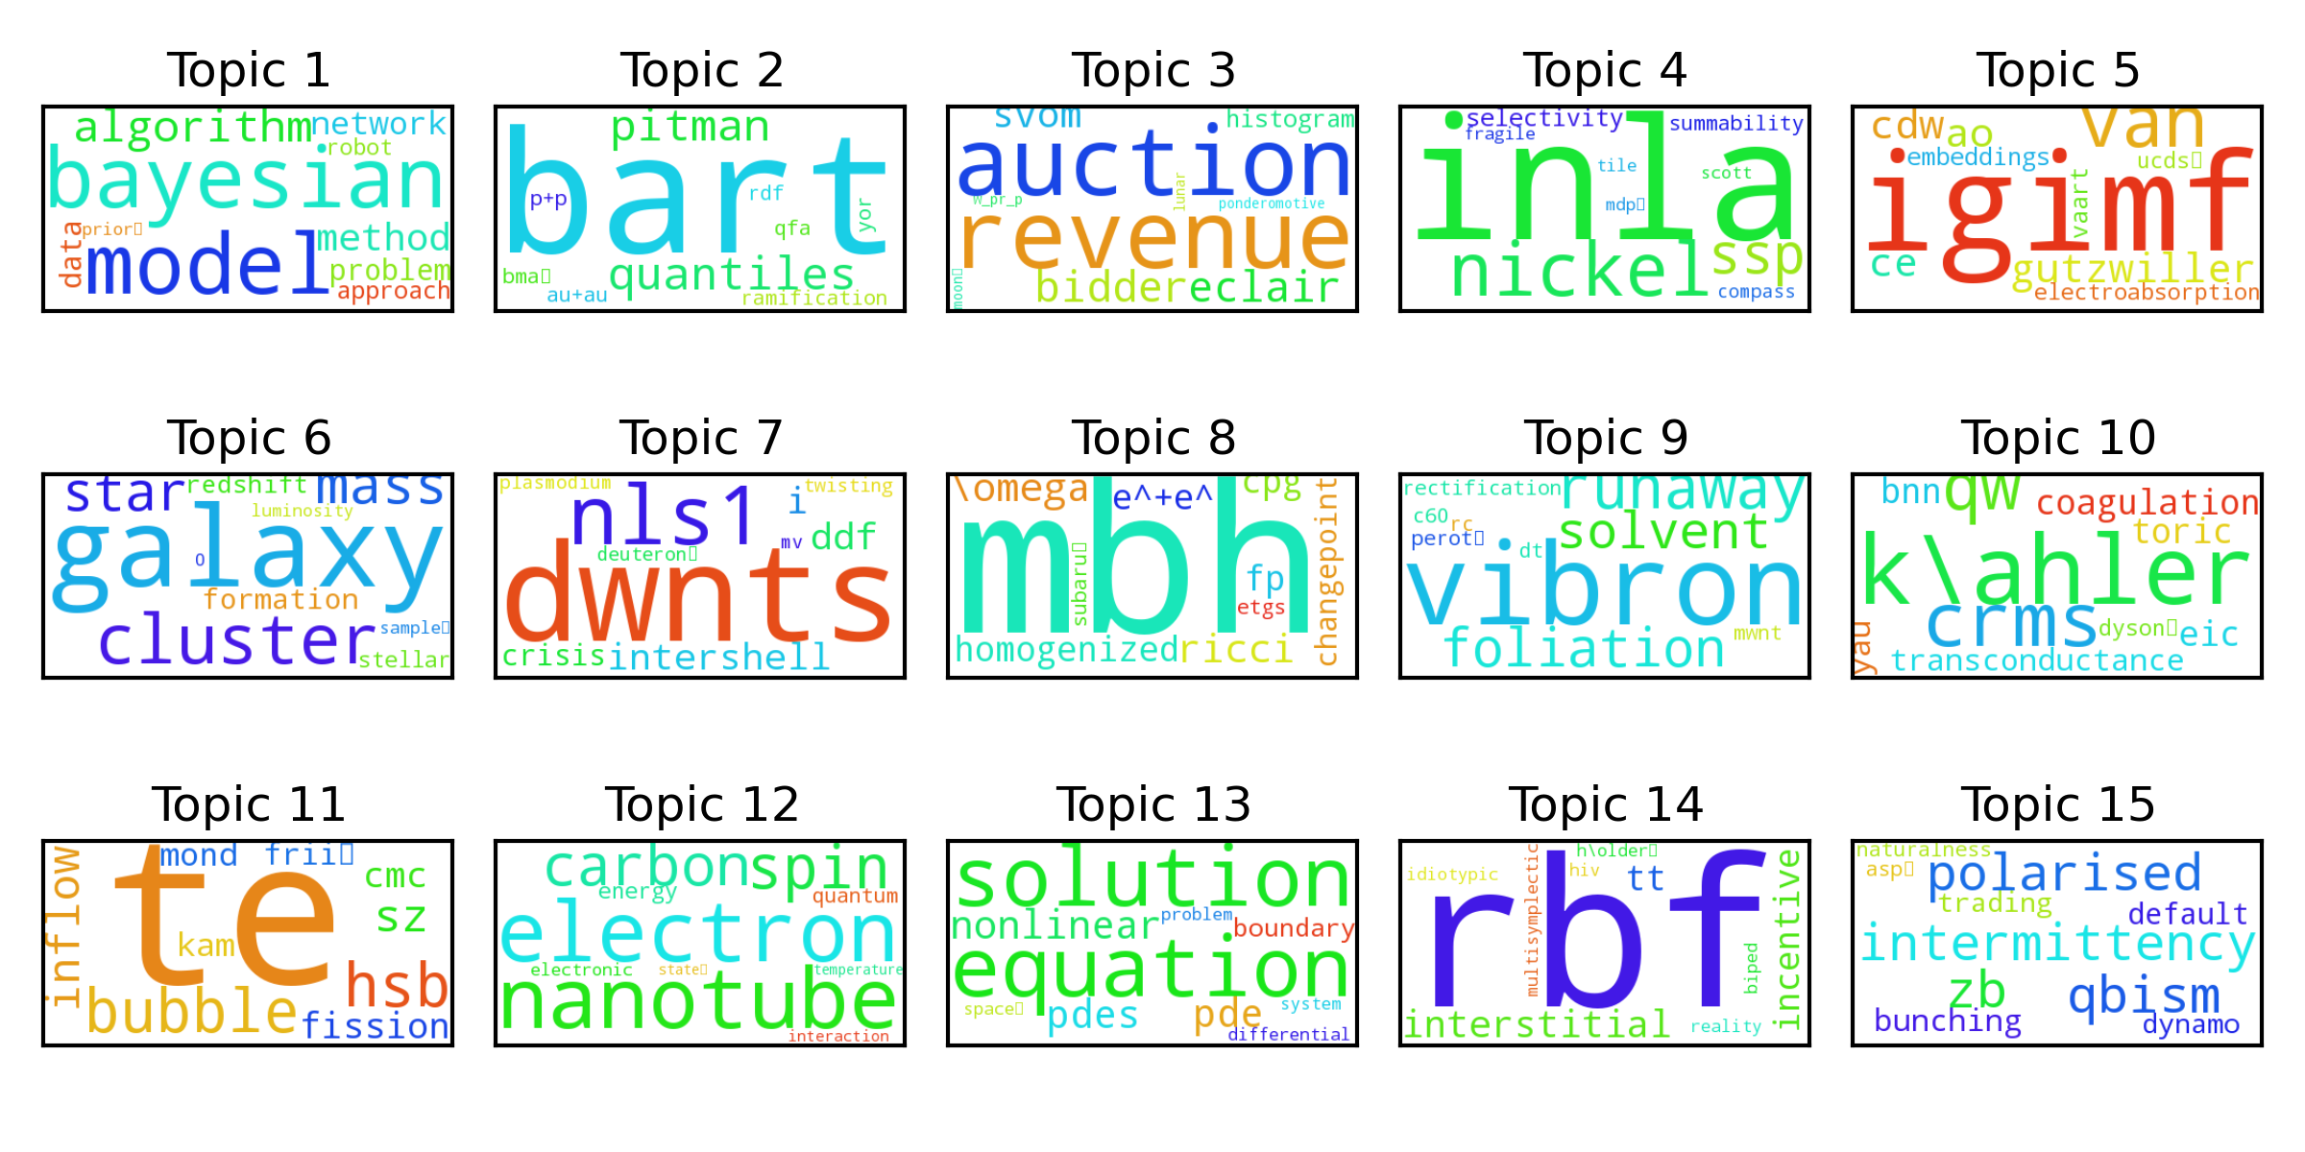
arXiv Topic Distributions

Slide 11
Suggestions to Scotiabank
Topic Modeling can be leveraged to find
State-of-the-art technology in latest financial and BI research articles → promote into production
Social media analysis → customer requirements, reduce churn rate
Customer reviews → reveal latent subtopics
Identify interdisciplinary field to accelerate business.

Slide 12
References
D. Blei, Probabilistic Topic Models, 2003,2012
D. Blei, Topic Models – video lectures part 1-2, 2009
E. Chen, Introduction to Latent Dirichlet Allocation (Weblink)
A. Oh, Topic Models Applied to Online News and Reviews (Youtube)
Blog - Topic Modeling with Mahout on Amazon EMR
Python Modules documentations
Gensim – topic modeling
Wordcloud – data visualization

Slide 13
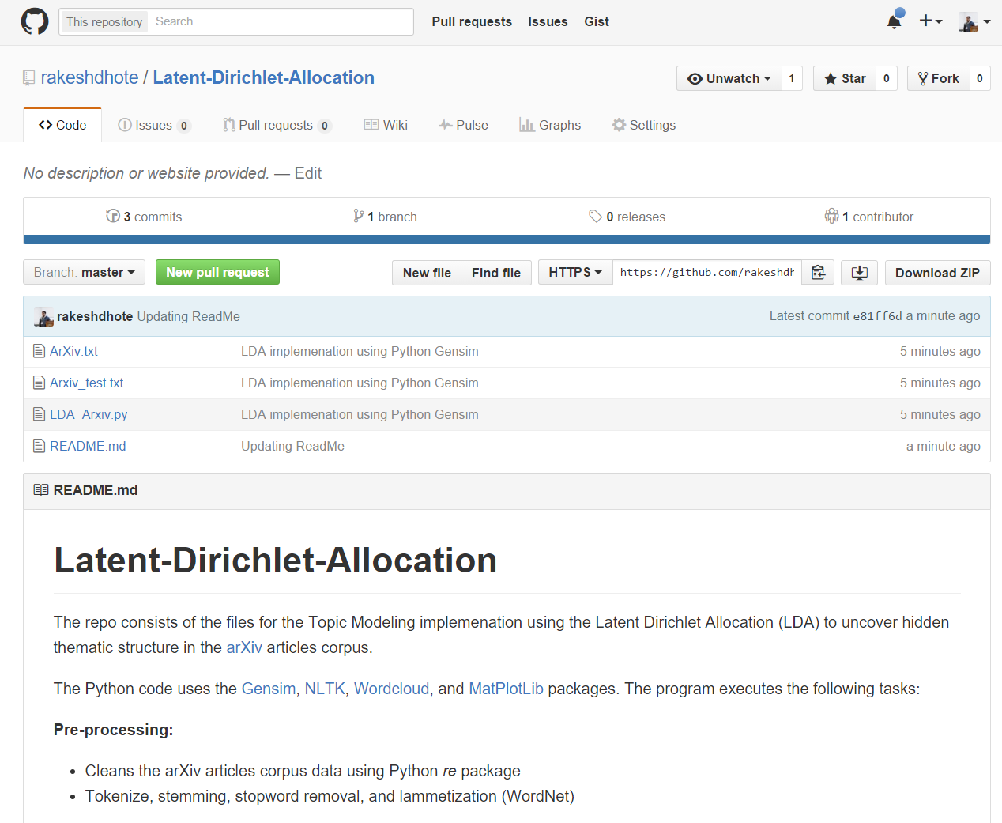

Slide 14
Thank You!

