Slide 1
Banking App
Developers
Raghu
Rakesh Hotker

Slide 2
ACTOR WISE USE CASES
user
Bank
Create an Account
Login
Deposit
Withdraw
Transfer Funds
Check Balance
Validates the Acount
Saves the funds
Transfers the funds
Records the transactions
Updates the balance

Slide 3
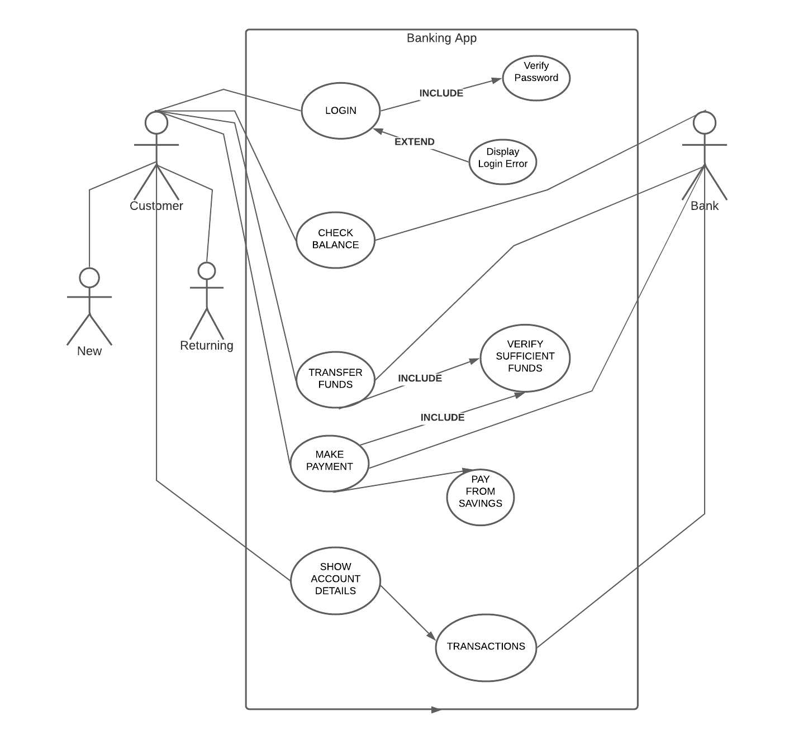
USE CASE DIAGRAM

Slide 4
USE CASE 1
NAME:REGISTER
ACTOR:USER
DESCRIPTION:ALLOWS USERS TO REGISTER FOR AN ACCOUNT
PRE-CONDITION: VALID AADHAR CARD
POST-CONDITION: ACCOUNT IS CREATED FOR THE USER
USER | APPLICATION
Chooses the register option | Prompts for aadhar number
Enters the 12 digit aadhar Number | 1) Validates the aadhar Number 2) If valid creates the account 3) Else prompts for correct input

Slide 5
USE CASE 2
NAME:LOGIN
ACTOR:USER
DESCRIPTION:ALLOWS USERS TO lOGIN
PRE-CONDITION: USER MUST HAVE A REGISTERED ACCOUNT
POST-CONDITION: GAINS ACCESS TO HIS ACCOUNT
USER | APPLICATION
Chooses the Login option | Prompts for username and password
Enters the user name and password | 1) Validates the user name
 | 2) Validates the password 3) If correct, Allows access 4) Else, denies Access

Slide 6
USE CASE 3
NAME:DEPOSIT
ACTOR:USER
DESCRIPTION:ALLOWS USERS TO DEPOSIT AMOUNT
PRE-CONDITION: USER MUST HAVE A REGISTERED ACCOUNT AND MUST LOGIN USING RIGHT CREDENTIALS
POST-CONDITION: USER GETS TO DEPOSIT AMOUNT IN TO ACCOUNT
USER | APPLICATION
Chooses the Deposit option | Prompts for Amount
Enters the amount | 1) Updates the account balance

Slide 7
USE CASE 4
NAME:WITHDRAW
ACTOR:USER
DESCRIPTION:ALLOWS USERS TO WITHDRAW AMOUNT
PRE-CONDITION: USER MUST HAVE A REGISTERED ACCOUNT AND MUST LOGIN,USING RIGHT CREDENTIALS
POST-CONDITION: USER GETS TO WITHDRAW AMOUNT FROM TO ACCOUNT
USER | APPLICATION
Chooses the Withdraw option | Prompts for Amount
Enters the amount | 1) Check for valid amount 2) IF amount>=balance 3) Allows user to withdraw 4) Else displays "insufficient funds"

Slide 8
USE CASE 5
NAME:TRANSFER FUNDS
ACTOR:USER
DESCRIPTION:ALLOWS USERS TO TRANSFER AMOUNT
PRE-CONDITION: USER MUST HAVE A REGISTERED ACCOUNT AND MUST LOGIN,USING RIGHT CREDENTIALS & USER TO WHOM AMOUNT MUST BE TRANSFERRED SHOULD HAVE A REGISTERED ACCOUNT
POST-CONDITION: USER GETS TO TRANSFER FUNDS AMOUNT FROM HIS ACCOUNT
USER | APPLICATION
Chooses the TRANSFER FUNDS option | Prompts for Amount and other user account number
Enters the amount | 1) Check for valid amount and valid account number 2) IF amount>=balance and valid account number 3) Allows user to Transfer Funds 4) If Insufficient funds displays,"Insufficient funds" 5) If wrong account number displays"Invalid account"

Slide 9
USE CASE 6
NAME:CHECK BALANCE
ACTOR:USER
DESCRIPTION:ALLOWS USERS TO CHECK BALANCE AMOUNT
PRE-CONDITION: USER MUST HAVE A REGISTERED ACCOUNT AND MUST LOGIN
POST-CONDITION: USER GETS TO SEE ACCOUNT BALANCE
USER | APPLICATION
Chooses the Check balance option | Displays the amount

