Slide 1
From Server Thinking → Platform Thinking
OpenStack → Kubernetes Mindset Shift
Summit | 2026-02-23
Summit | 2026-02-23

Slide 2
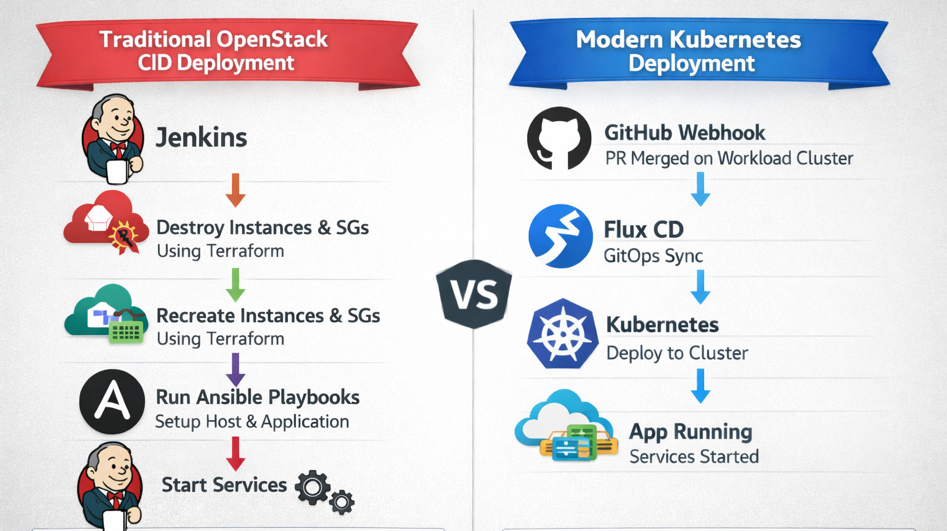

Slide 3
This migration is a mindset change, not a tooling swap
Delivery speed vs. operational safety
Standardization vs. snowflakes
Auditability & repeatability
Reliability through automation
Goal: adopt platform behaviors—declare intent and let the system reconcile.
Summit | 2026-02-23

Slide 4
What you optimize for changes
OpenStack
Kubernetes
VMs
IP addresses
Security groups
SSH access
Server configuration
Pods
Deployments
Services
Ingress
Desired state
Stop managing servers → Start declaring outcomes
Summit | 2026-02-23

Slide 5
OpenStack mindset: “I own this server”
Provision VM
SSH into it
Install + configure
Start services
Debug on the machine
Pets: patch, care, nurse back to health
Summit | 2026-02-23

Slide 6
Kubernetes mindset: “The cluster owns everything”
Define Deployment YAML / Helm
Set image + replicas + resources
Push to Git
Cluster reconciles desired state
Pods self-heal automatically
No SSH into pods. Fix by changing spec or image, then redeploy state.
Summit | 2026-02-23

Slide 7
Imperative actions vs. declarative intent
OpenStack (imperative)
Kubernetes (declarative)
“Run this playbook”
“Create this instance”
“Restart this service”
“This is what I want”
“Always keep 3 replicas”
“If it dies, recreate it”
Kubernetes is a continuous reconciliation system
Summit | 2026-02-23

Slide 8
Drift is replaced by immutability
OpenStack: configure at runtime (drift risk)
Kubernetes: immutable images (build once)
Minimal runtime configuration
Versioned deployments + rollbacks
Enterprise win: repeatable artifacts, safer rollouts, cleaner audits.
Summit | 2026-02-23

Slide 9
GitOps: change control becomes deployment control
Git = source of truth
PR merge = deployment
Drift auto-corrected
Rollback = revert commit
Operate the platform via pull requests—not by logging into environments.
Summit | 2026-02-23

Slide 10
Networking becomes service-oriented
OpenStack
Kubernetes
Security groups
Floating IPs
Port mappings
Services
Ingress controllers
NetworkPolicies
Shift: service identity + policy, not host perimeter
Summit | 2026-02-23

Slide 11
The real shift is who you become
From server admin → platform engineer
From fixing machines → designing workloads
From manual ops → automated control loops
From tickets → pull requests
Infrastructure becomes code. Deployments become reconciliations.
Summit | 2026-02-23

