Slide 1
WOOBLE · IPL CRUNCH '26
IPL Data Analysis
🏏
Uncovering Patterns from 13 Seasons of IPL Cricket
13
800+
180K+
6
Seasons
Matches
Deliveries
Analyses
Rakesh Kalisetty
Data Analyst · IPL Crunch '26 · May 2026

Slide 2
Dataset Overview
Source: Kaggle — IPL Complete Dataset (2008–2020)
13
816
179,078
2
IPL Seasons
Total Matches
Ball Deliveries
Key Datasets
2008 – 2020
After cleaning
Ball-by-ball data
matches.csv + deliveries.csv
Tools Used
Python 3
Pandas
Matplotlib
Seaborn
Google Colab
Analyses Covered
1. Toss win vs Match win
2. Phase impact — Powerplay / Middle / Death
3. Top Batters across seasons
4. Top Bowlers across seasons
5. Surprise Insight — The Chasing Advantage
6. Venue analysis — Batter vs Bowler friendly

Slide 3
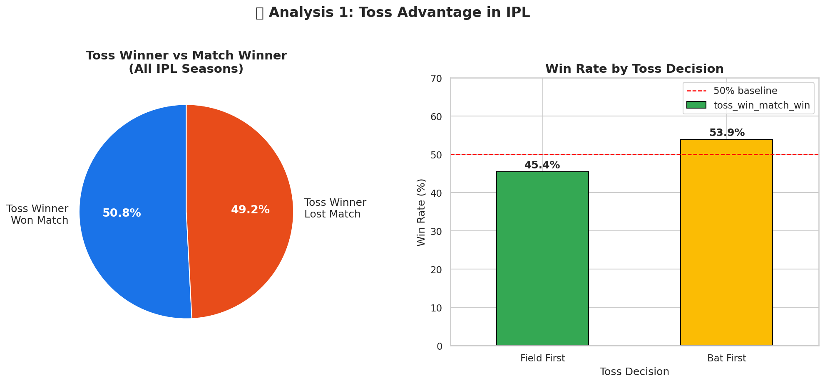
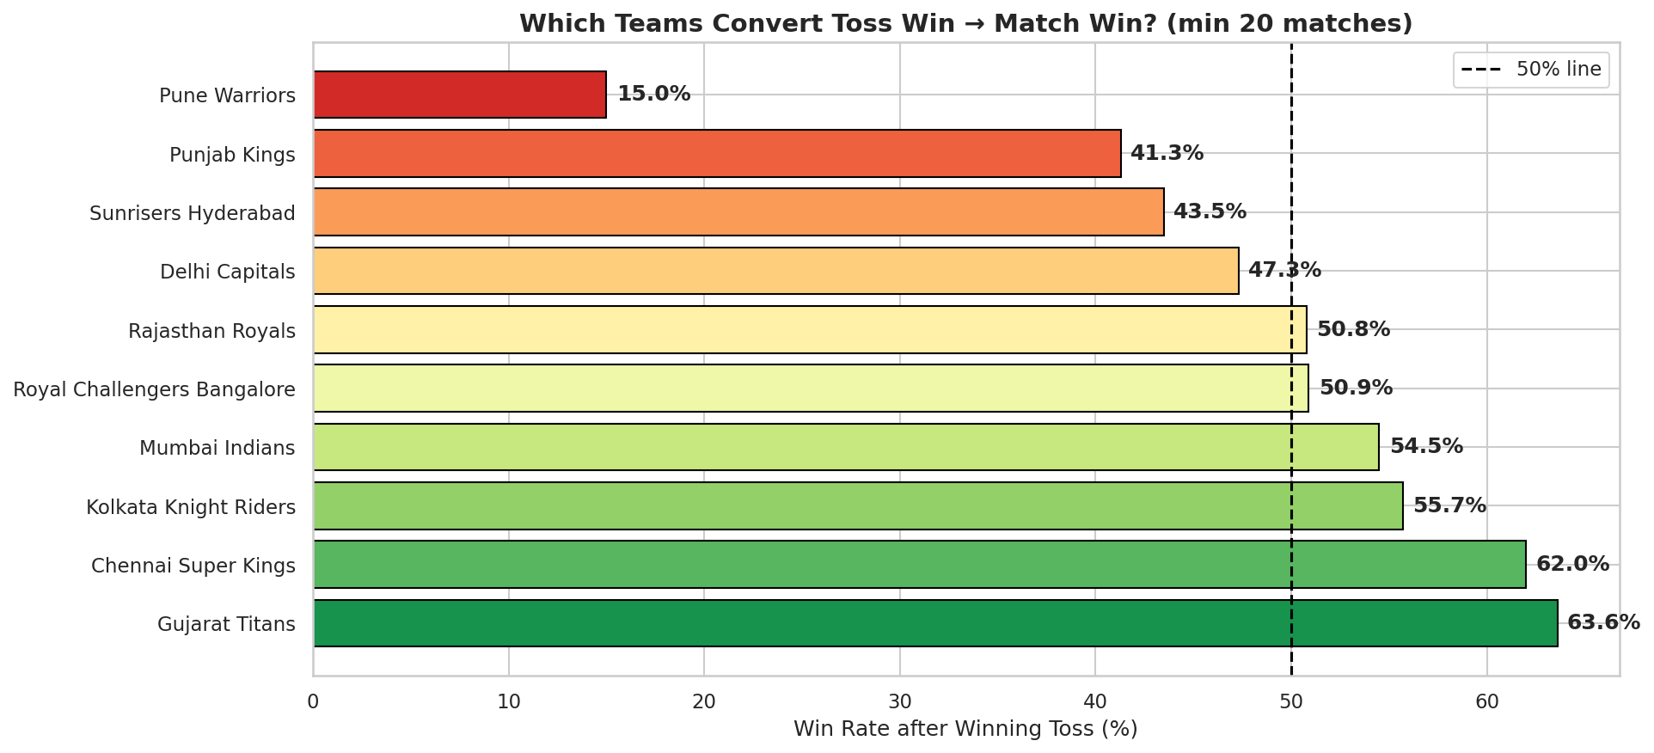
Analysis 1
Does Winning the Toss Win the Match?
Key Findings
Toss winner wins only ~52% of matches — barely above chance
Teams choosing to FIELD after winning toss win more often
Chasing is the smarter toss decision in modern IPL
No single team consistently converts toss win to match win

Slide 4
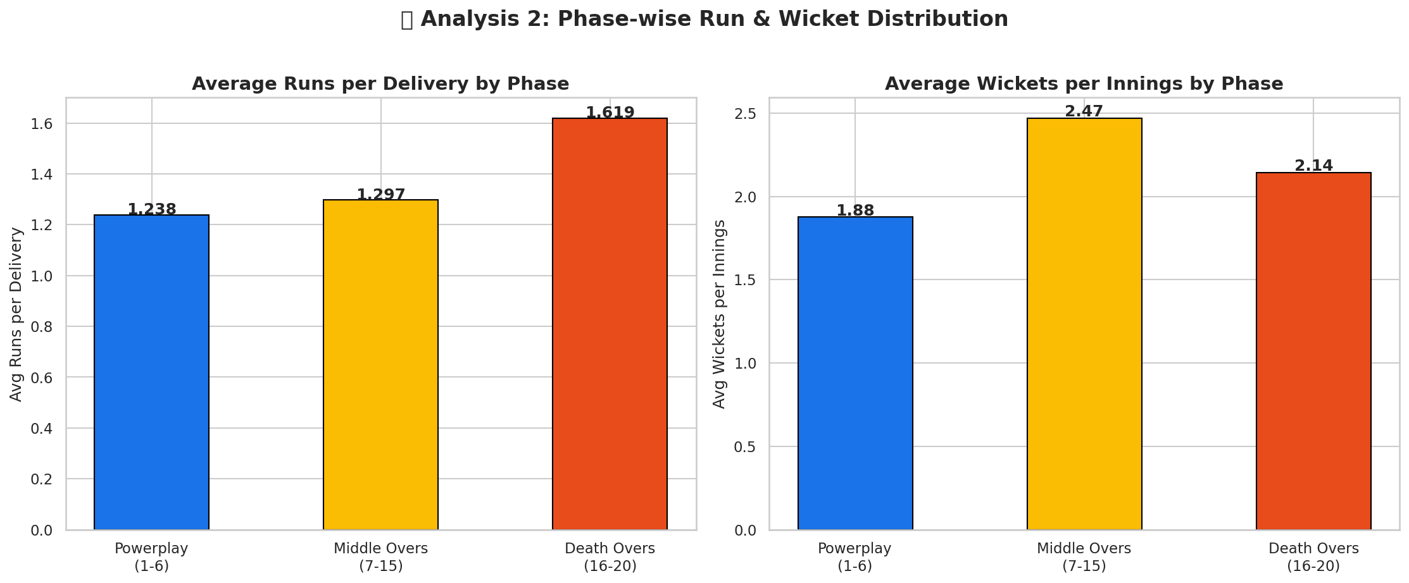
Analysis 2
Which Phase Impacts Victory Most?
Powerplay (1–6)
Highest wicket-taking phase. Early collapses are decisive.
Middle Overs (7–15)
Building partnerships here is critical for a big total.
Death Overs (16–20)
Highest run rate phase. Finishers make or break the game.

Slide 5
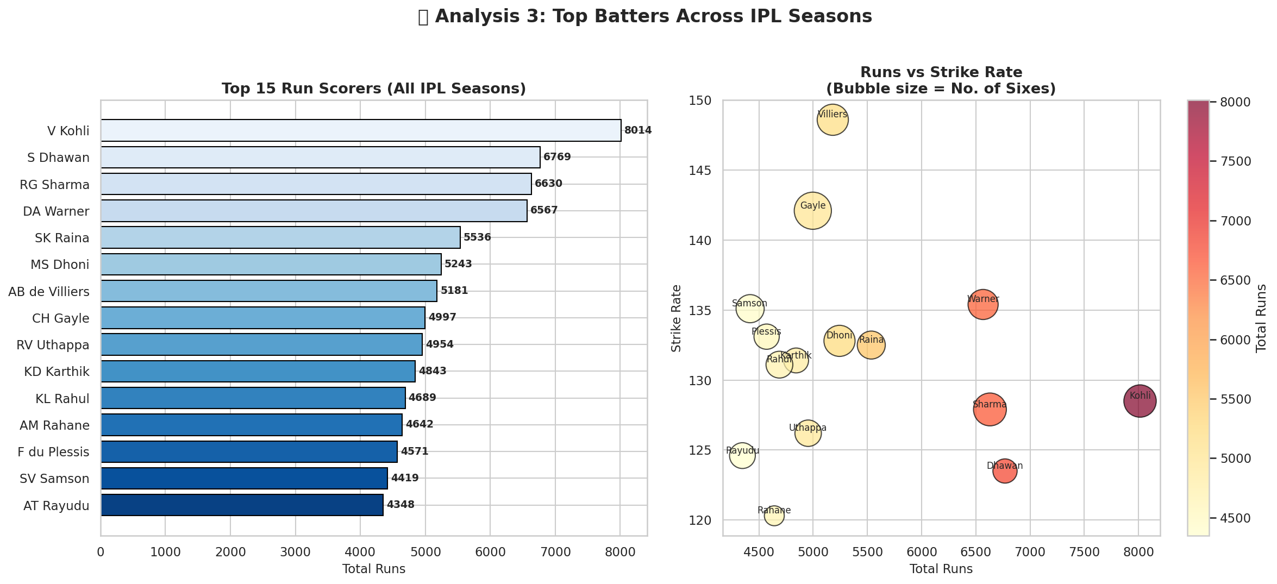
Analysis 3
Top Batters Across IPL Seasons
Key Insight: Top run scorers don't always have the best strike rates — the elite batters balance volume AND aggression.

Slide 6
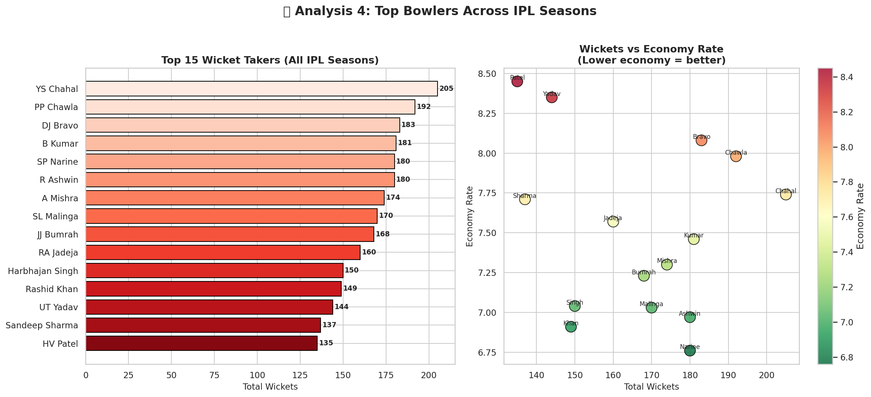
Analysis 4
Top Bowlers Across IPL Seasons
Key Insight: Economy rate is a better measure of sustained bowling quality than raw wickets alone.

Slide 7
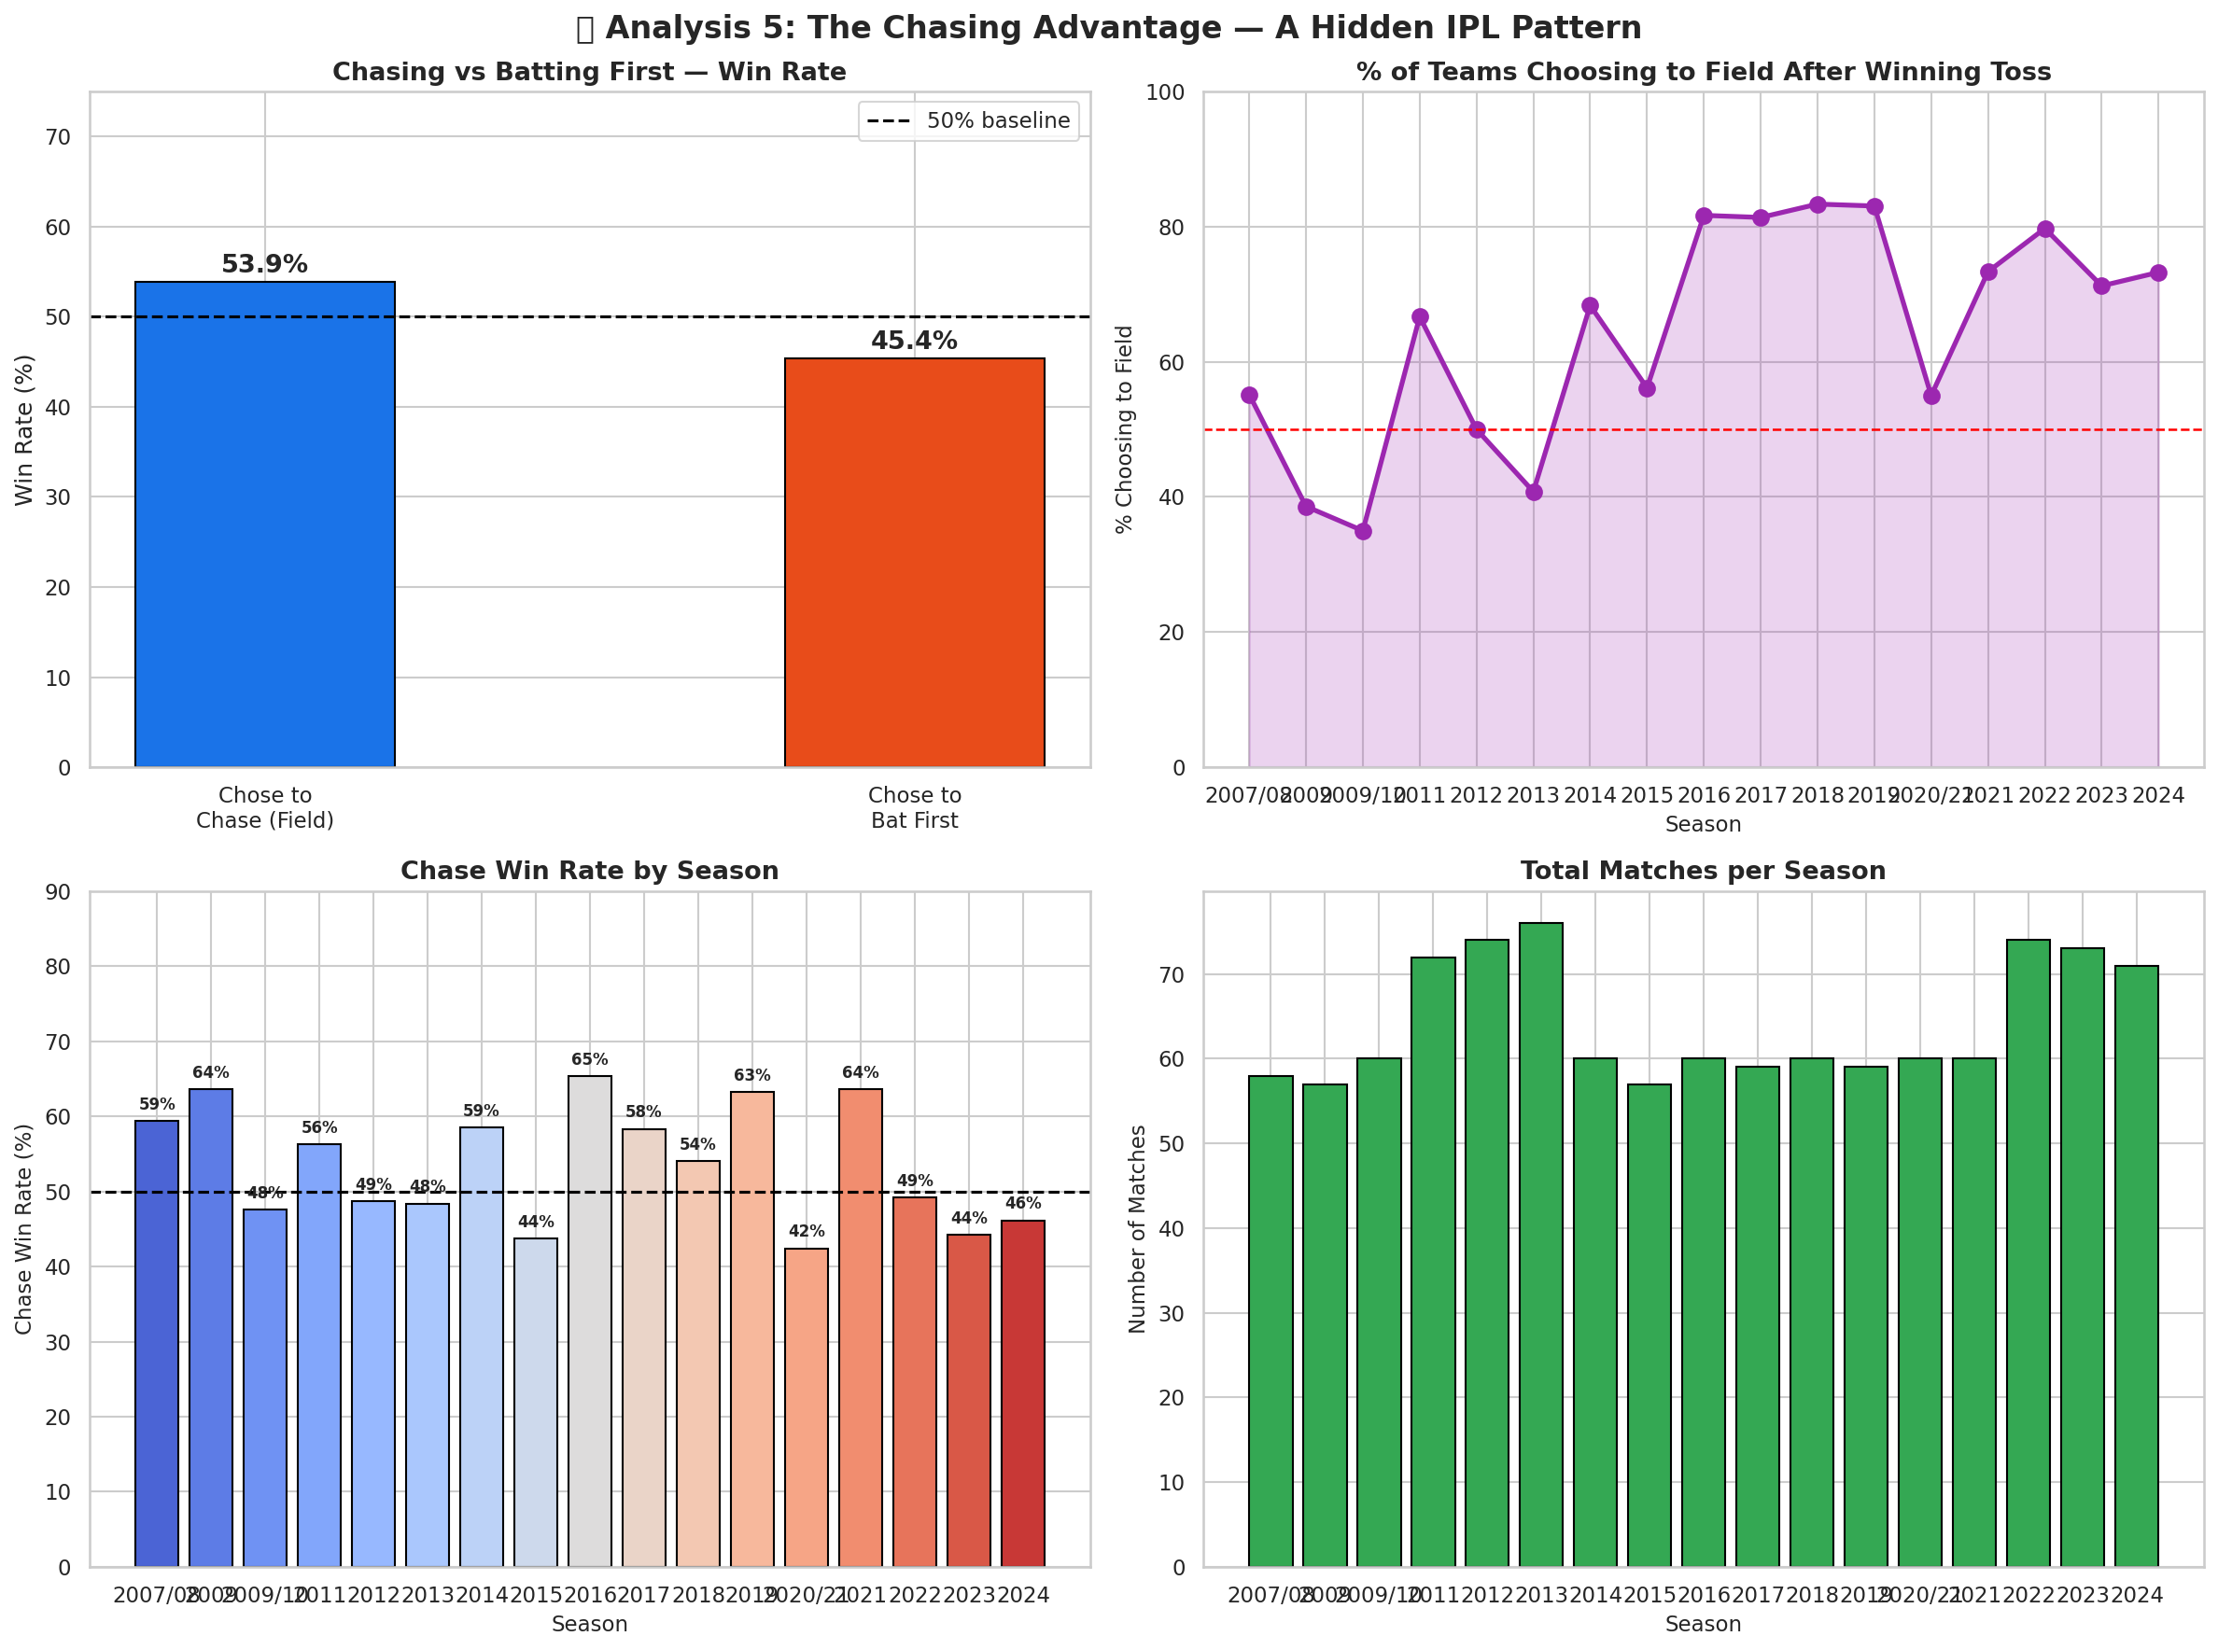
The Surprise Insight
The Chasing Advantage — A Hidden IPL Pattern
55–60%
Chase Win Rate
Rising
Field-First Trend
Dew + Pitch
Why It Happens
Teams batting second win significantly more than those batting first
Captains increasingly choose to field — this pattern has grown season by season
Pitch deterioration, dew factor & psychological pressure all favour chasers

Slide 8
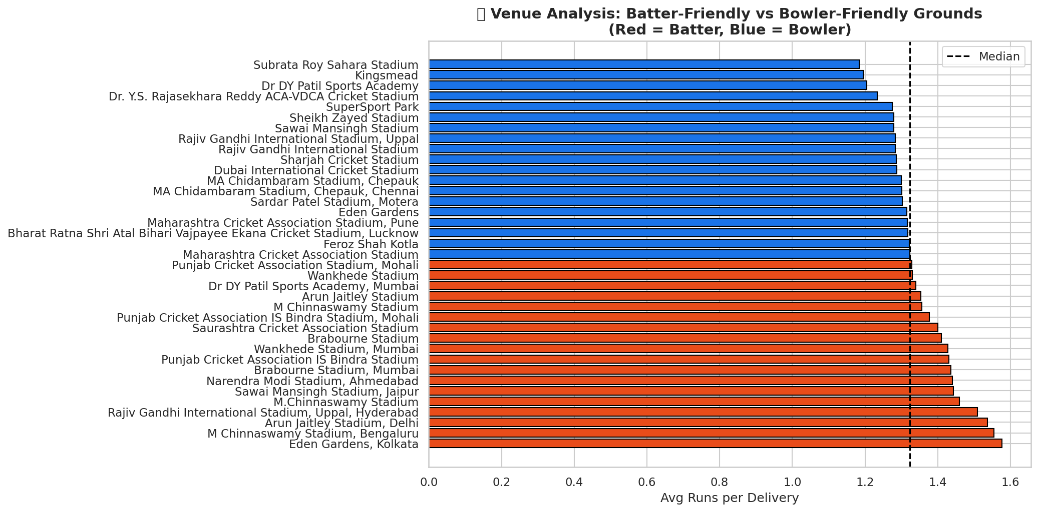
Bonus Analysis
Venue Analysis — Batter vs Bowler Friendly Grounds
How to Read This
Batter-friendly (above median runs/ball)
Bowler-friendly (below median runs/ball)
Key Findings
Venues like Chinnaswamy (Bengaluru) heavily favour batters
MA Chidambaram (Chennai) tends to help spinners & bowlers
Teams should adjust batting strategy based on venue
Venue is an underrated factor in IPL fantasy & betting analytics

Slide 9
Key Takeaways
01
02
Toss is overrated
Chase to win
Winning the toss gives only a ~52% win rate — barely better than a coin flip.
Teams chasing win 55–60% of the time. Fielding first is the smarter toss decision.
03
04
Powerplay wickets are decisive
Balance beats volume for batters
Early collapses in overs 1–6 almost always lead to a loss. Protect your top order.
Elite batters combine high run totals with strong strike rates — not just one or the other.
05
06
Economy rate > wickets for bowlers
Venue changes everything
Sustained economy is a better measure of bowling quality than raw wicket count.
Chinnaswamy favours batters; Chepauk favours bowlers — venue strategy is underutilised.
Thank you · Rakesh Kalisetty · IPL Crunch '26 · Wooble · May 2026
Data Source: Kaggle — IPL Complete Dataset (2008–2020) | github.com/your-username/ipl-crunch-26

