Slide 1
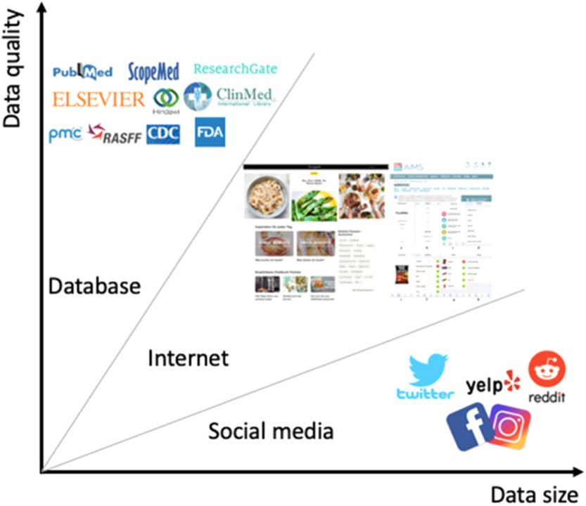
Forecasting future food technologies using the trends in the food sector
Ideal Data Collection Sources

Slide 2
Normalization
Lower casing Punctuation removal
Stopwords removal
Rare words removal
Spelling correction
Stemming
Lemmatization
…
Joint Analysis
Possible future blockbusters
Fast growing popular technologies
Traditional niche topics/tech
Traditional popular topics/tech
Word-level analysis
Count Vectorizer Term Frequency(TF)
Inverse Document Frequency(IDF)
TF-IDF transformation
…
Word association analysis
Context similarity
Co-occurrence matrix
…
Noise Removal
Html/Xml removal
Metadata removal
URL/regex removal
…
Semantic Mapping
Semantic analysis
Document similarity
…
Tokenization
Unigram
Bigram
N-grams
…
Advanced text analytics
Text classification
Clustering
Topic Modelling
…
Trend Mapping
Frequency index
Trending Index
Popularity Index
…
Text Processing
Text Analysis
Joint Analysis

Slide 3
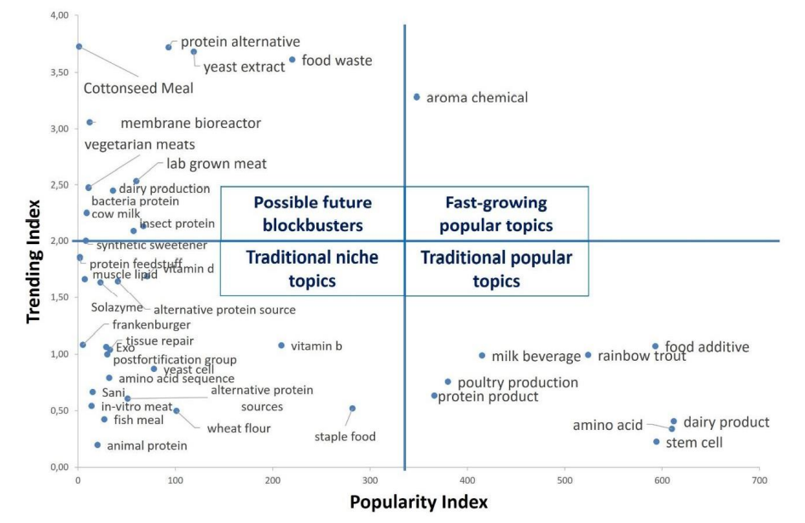
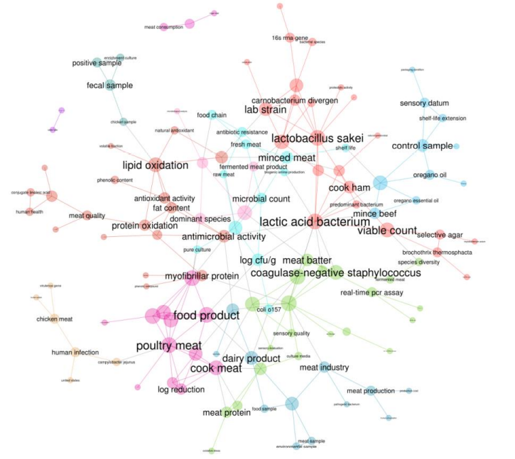
Trend Map
Semantic Map

Slide 4
References
(PDF) Mapping the Radical Innovations in Food Industry: A Text Mining Study (researchgate.net)
(PDF) Quantitative analysis of technology futures: A review of techniques, uses and characteristics (researchgate.net)
Technological Forecasting (hbr.org)
(PDF) Mapping trends in novel and emerging food processing technologies around the world (researchgate.net)

