Slide 1
Keap CRM Providers
Participants:
Rakesh KS

Slide 2
Keap
Services for Keap CRM
What is Connector for Keap
Keap's CRM is powered by sales and marketing automation to help and optimize customer experiences and end the chaos of running business.
Connectors for Keap are developed to automate these tasks for any business/applications intending to use Keap CRM features. As of now connectors are developed for creating, updating, listing and deleting the contacts. Going forward the features will be extended to manage the appointments, sending alerts based on tags, order management, affiliate management etc.

Slide 3
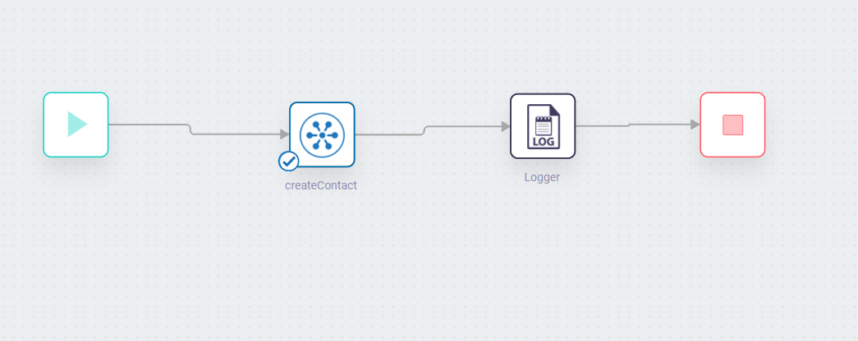
Screenshots for workflow
Workflow for Adding Contacts in Keap
Add Contact Workflow

Slide 4
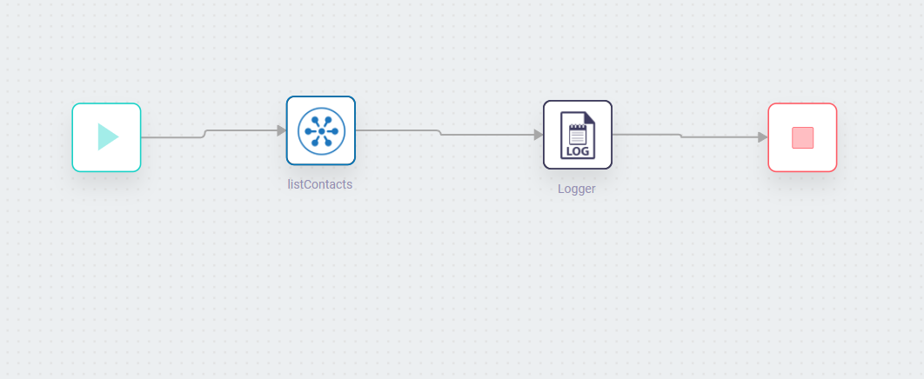
Screenshots for workflow
Workflow for Listing Contacts in Keap
List Contact Workflow

Slide 5
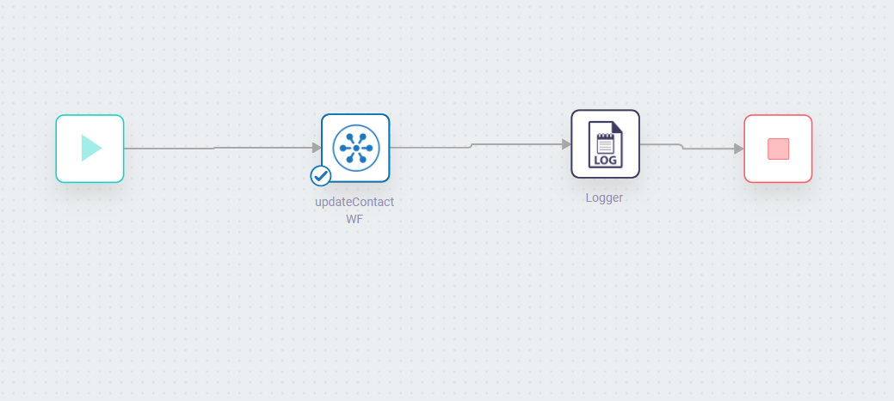
Screenshots for workflow
Workflow for Updating Contacts in Keap
Update Contact Workflow

Slide 6
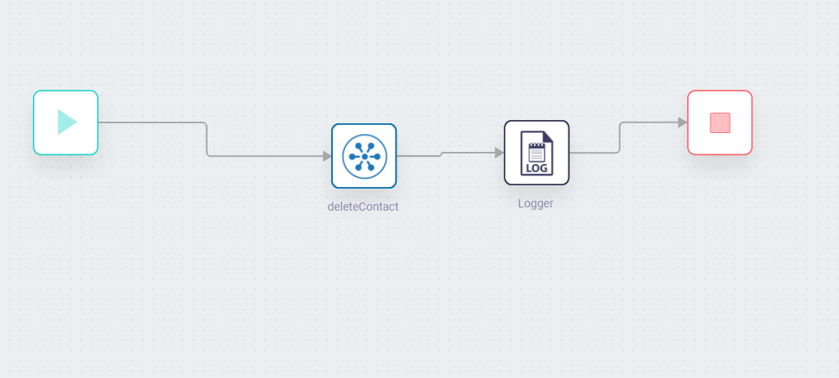
Screenshots for workflow
Workflow for Deleting Contacts in Keap
Delete Contact Workflow

Slide 7
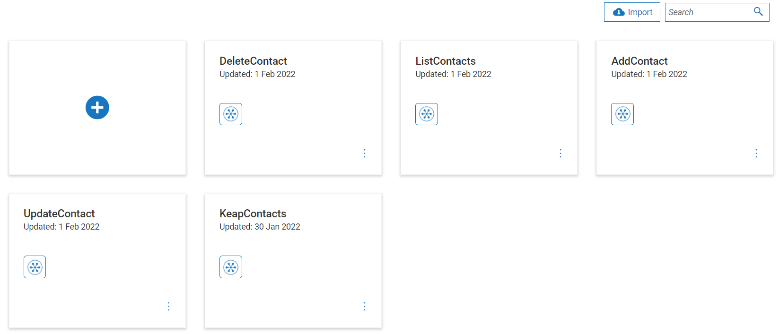
Screenshots for flowservice
List of Flow Services

