Slide 1

1
Thermo Fisher Scientific logo
Min -Width : 180px Height : 40px
Top Margin : 16px
Bottom Margin : 14px
#333333 and 13px is the default color and size for all text/copy, respectfully.
1
3
2
Sign in Button
Font: 13px, bold #ffffff
Button Height: 38 px/34px
Left/Right padding: 20 px
Top/bottom padding: 7 px
Background color : #ee3134
Border: 1 pixel wide and #dd1f25
Hover: Border : #dd1f25
Background Color : #dd1f25
5
2
3
Healthy Work and Healthy Life
H,W,H,L – color #26BCD7
Font size: 28px
Line height: 41px
margin-bottom: 11px
margin-left: 0px
margin-right: 0px
margin-top: 11px
4
News and Events
Font family: Helvetica Neue Light
Font size: 22px
Line height: 30px
All the images got distorted, make it 100%
4
5
Remove blue line

Slide 2
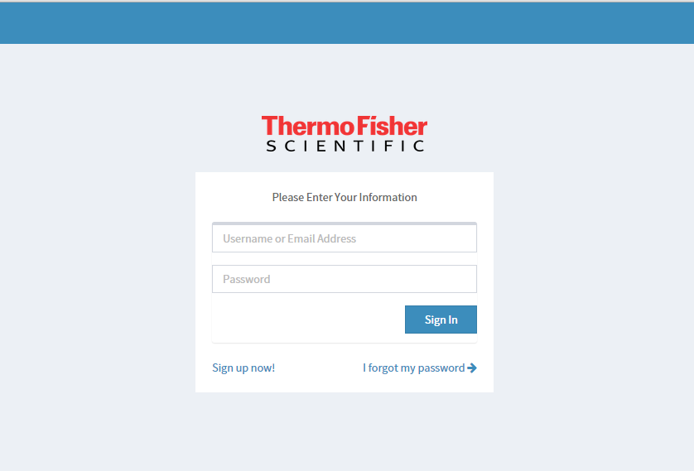
#333333 and 13px is the default color and size for all text/copy, respectfully.
6
Sign in Button
Font: 13px, bold #ffffff
Button Height: 38 px/34px
Left/Right padding: 20 px
Top/bottom padding: 7 px
Background color : #ee3134
Border: 1 pixel wide and #dd1f25
Hover: Border : #dd1f25
Background Color : #dd1f25
8
7
Standard input Field
Field Height: 37 px
Left/Right padding: 6 px
Top/bottom padding: 8 px
Input box shadow: inset, 1px horizontal/vertical, rgba(0, 0, 0, 0.075)
Muted preview text: 13 px, Helvetica Neue #c9c8c8
9
10
8
Remove Header
7
9
Background Color #ffffff
6
10
Thermo Fisher Scientific logo
Width : 180px
Height : 40px
Top Margin : 16px
Bottom Margin : 14px

Slide 3
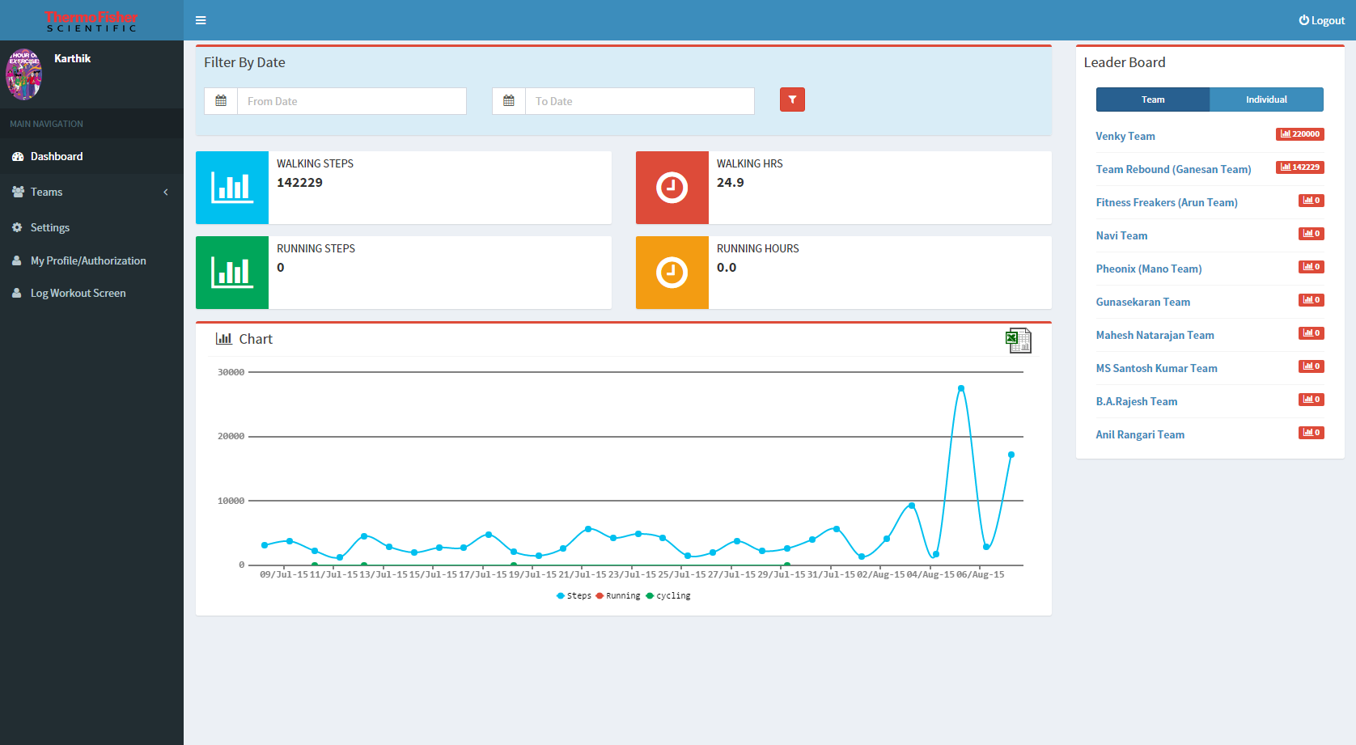
11
Thermo Fisher Scientific logo
Width : 180px
Height : 40px
Top Margin : 16px
Bottom Margin : 14px
11
19
12
Profile Picture
Min Width : 100px
Min Height : 100px
12
14
20
13
Slide Menu
Width : 250px
Background Color #616265
Selection BG #B5B7B4
Text Normal #ffffff
Text selected #616265
15
16
17
18
14
Standard input Field
Field Height: 37 px
Left/Right padding: 6 px
Top/bottom padding: 8 px
Input box shadow: inset, 1px horizontal/vertical, rgba(0, 0, 0, 0.075)
Muted preview text: 13 px, Helvetica Neue #c9c8c8
13
15
Walking Steps
Bg color # 009EDB
16
Walking hrs
Bg color # 558476
17
Running Steps
Bg color # B5BF00
18
Running Steps
Bg color # EF8200
19
Navigation Bar
Bg color # 5381AC
20
Tabs
Normal btn Bg color # 5381AC
Selected btn bg color # 293E6B

Slide 4
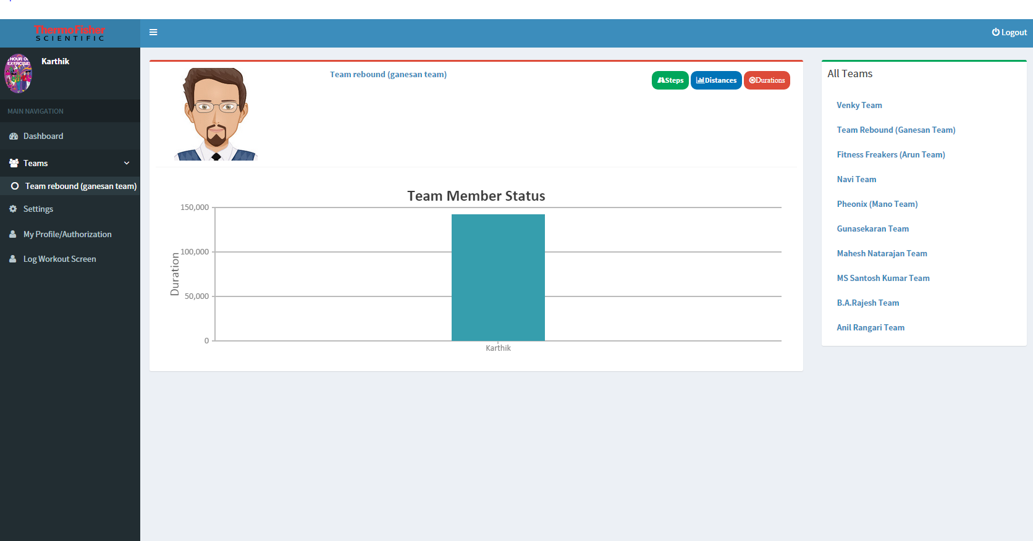
21
btns
Font: 11px, bold
Button Height: 34 px
Left/Right padding: 10 px
Top/bottom padding: 5 px
22
Chart
Use any colors from below
#F2CB65; #7A6691; #8A9E99; #C6D2E1
#558476; #C4C1A0; #624D7D; #26BCD7
#009EDB; #293E6B; #78256F
21
22

Slide 5
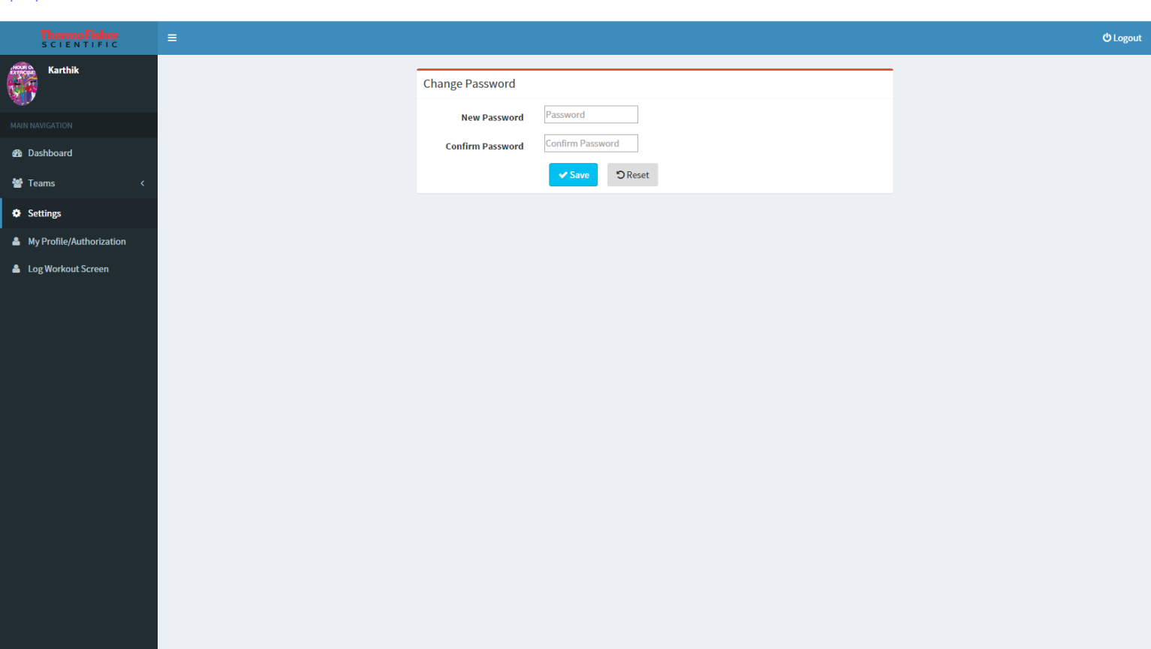
23
Standard input Field
Field Height: 37 px
Left/Right padding: 6 px
Top/bottom padding: 8 px
Input box shadow: inset, 1px horizontal/vertical, rgba(0, 0, 0, 0.075)
Muted preview text: 13 px, Helvetica Neue #c9c8c8
23
24
Buttons
Save-
Font: 13px, bold #ffffff
Button Height: 38 px/34px
Left/Right padding: 20 px
Top/bottom padding: 7 px
Background color : #ee3134
Border: 1 pixel wide and #dd1f25
Hover: Border : #dd1f25
Background Color : #dd1f25
Reset- Background color: #ffffff
Border: 1 pixel wide and #dcdcdc
Typography: 13px, bold and #333333
Hover:Border : #333333
Background Color : #f3f3f3
24

Slide 6
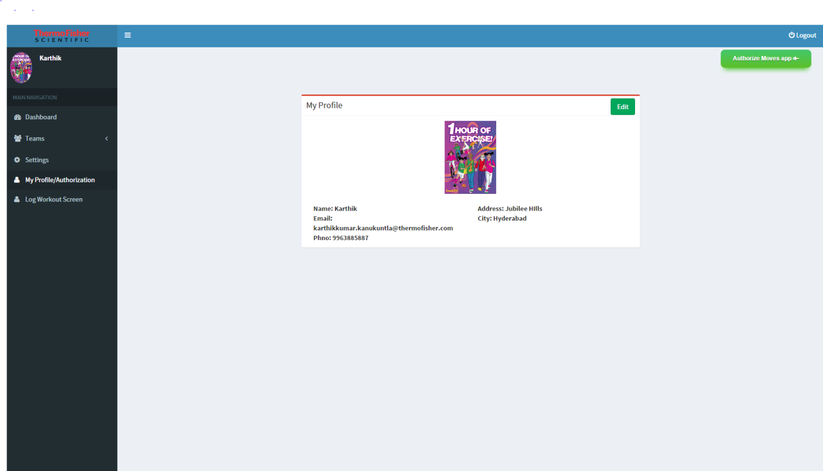
25
Button-Edit Font: 13px, bold
Button Height: 38 px
Left/Right padding: 20 px
Top/bottom padding: 7 px
Background color: #ffffff
Border: 1 pixel wide and #dcdcdc
Typography: 13px, bold and #333333
Hover:Border : #333333
Background Color : #f3f3f3
26
26
Button-Authorise Moves app Font: 13px, bold
Button Height: 38 px
Left/Right padding: 20 px
Top/bottom padding: 7 px
Background color: #7fba00
Border: 1 pixel wide and #7fba00
Typography: 13px, bold and #ffffff
Hover:Border : #5f8a00
Background Color : #5f8a00
25

Slide 7
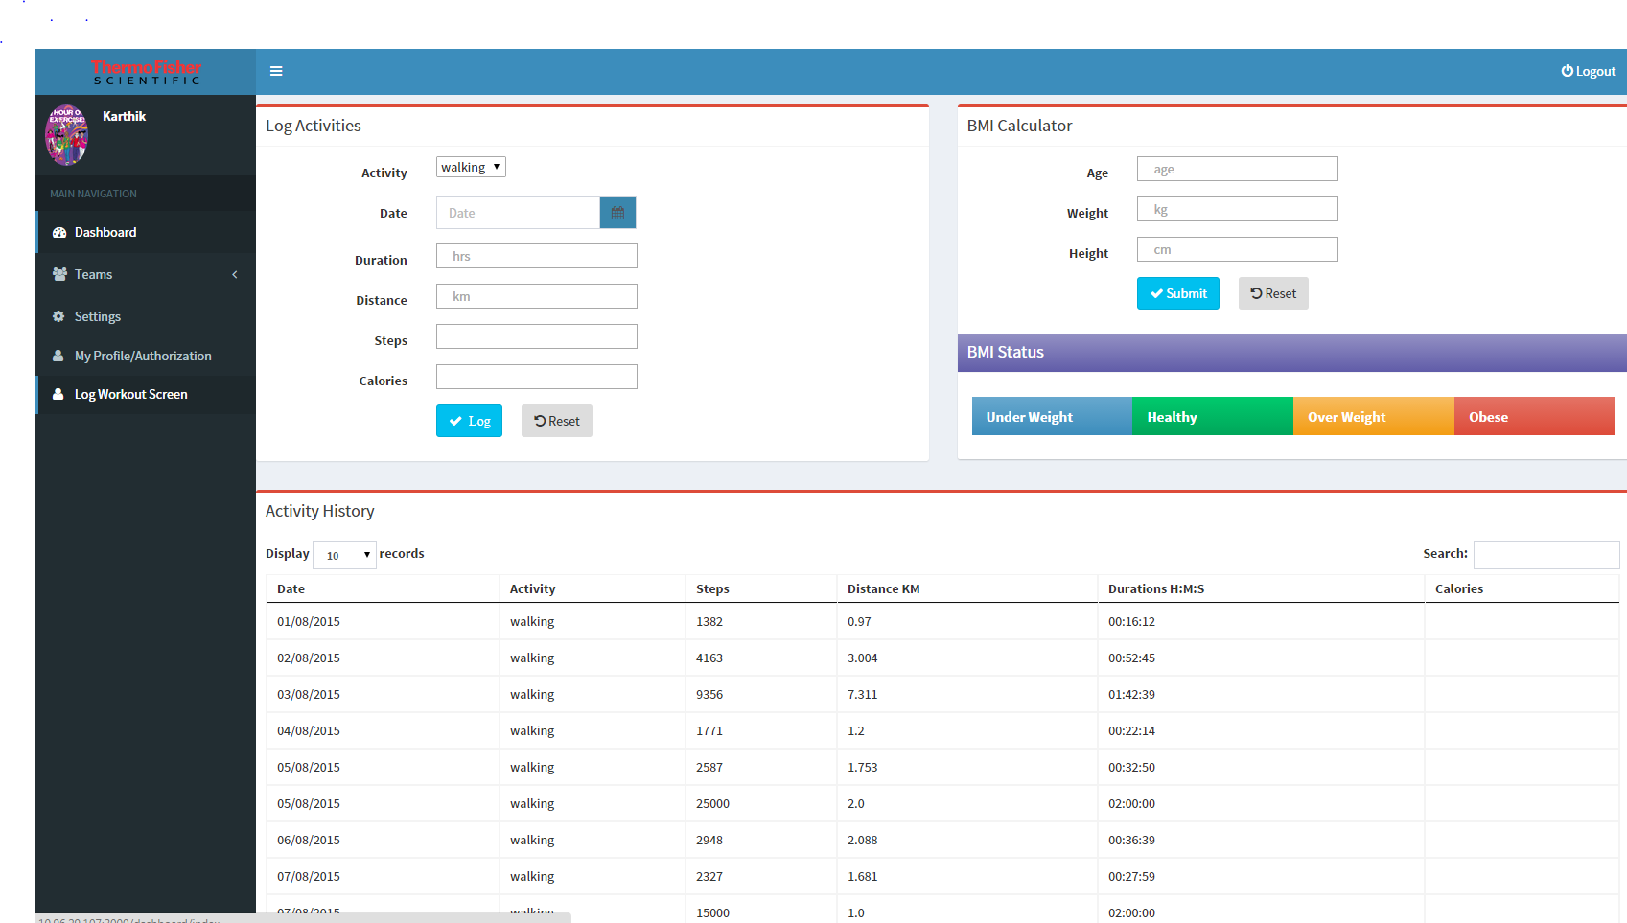
27
Standard input Field
Field Height: 37 px
Left/Right padding: 6 px
Top/bottom padding: 8 px
Input box shadow: inset, 1px horizontal/vertical, rgba(0, 0, 0, 0.075)
Muted preview text: 13 px, Helvetica Neue #c9c8c8Standard input Field
Field Height: 37 px
Left/Right padding: 6 px
Top/bottom padding: 8 px
Input box shadow: inset, 1px horizontal/vertical, rgba(0, 0, 0, 0.075)
Muted preview text: 13 px, Helvetica Neue #c9c8c8
27
27
28
28
Buttons
Log and Submit
Font: 13px, bold #ffffff
Button Height: 38 px/34px
Left/Right padding: 20 px
Top/bottom padding: 7 px
Background color : #ee3134
Border: 1 pixel wide and #dd1f25
Hover: Border : #dd1f25
Background Color : #dd1f25
Reset- Background color: #ffffff
Border: 1 pixel wide and #dcdcdc
Typography: 13px, bold and #333333
Hover:Border : #333333
Background Color : #f3f3f3
29
28
30
Use any colors from below
#F2CB65; #7A6691; #8A9E99; #C6D2E1
#558476; #C4C1A0; #624D7D; #26BCD7
#009EDB; #293E6B; #78256F
29
30
Table rows
Row height: 47px
Padding: 8px
Text alignment: middle
Table header:Background color: #ffffff
Helvetica, bold weight
Bottom border: #dddddd
Table rows:
Background Cclor: Row background color should alternate between #ffffff and #f3f3f3
Bottom border: #dddddd
Helvetica
Table Properties
Width: May vary, but 740px is standard for a two column layout.
Table Border (optional)
Border: #dddddd

