Slide 1

Battle of neighborhoods
Coursera Capstone Project
Notes:
NOTE:
To change the image on this slide, select the picture and delete it. Then click the Pictures icon in the placeholder to insert your own image.

Slide 2
Index
Introduction
Data Acquisition and Cleansing
Methodology
Results and Discussion
Conclusion

Slide 3
Introduction
When you are new to a city, it is always a tedious task to find our favorite restaurant.
Many-a-times, we choose to dine out in the nearest restaurant as we are not aware of cuisine locations.
Analyze and identify potential neighborhoods in Brooklyn, New York with multiple Italian cuisines.
Saves lot of time searching for restaurants in search engines as well.

Slide 4
Data Acquisition and Cleansing
Neighborhoods data from NYU Spatial Data Repository portal.
https://geo.nyu.edu/catalog/nyu_2451_34572
Venues data for neighborhoods from Foursquare API.
https://developer.foursquare.com/
JSON format data from both data sets needs to be merged for further analysis.

Slide 5
Methodology
Filter out data for Brooklyn from original data.
Filter out for restaurants to locate them on map.
Un-supervised Machine Learning algorithm fits in well as data is not labelled.
Cluster Italian restaurants using K-Means Clustering algorithm.

Slide 6
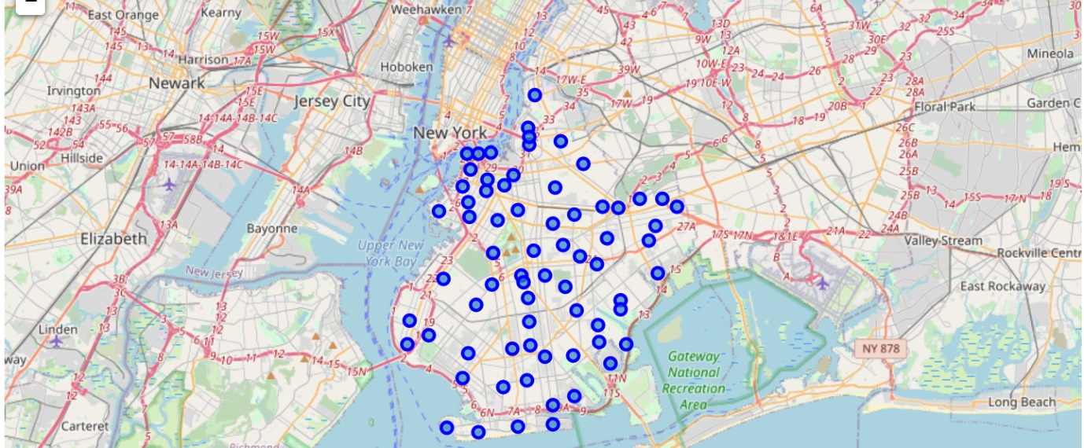
Results and Discussion
Brooklyn neighborhoods highlighted in blue on New York city map.

Slide 7
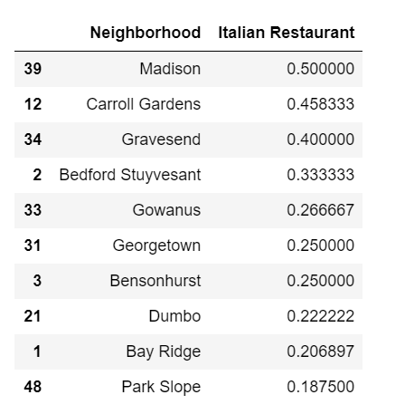
Results and Discussion
Top 10 neighborhoods in Brooklyn with an Italian restaurant as the most common cuisine.
Madison can be the best option. Why? Why not?
Triggers clustering.

Slide 8
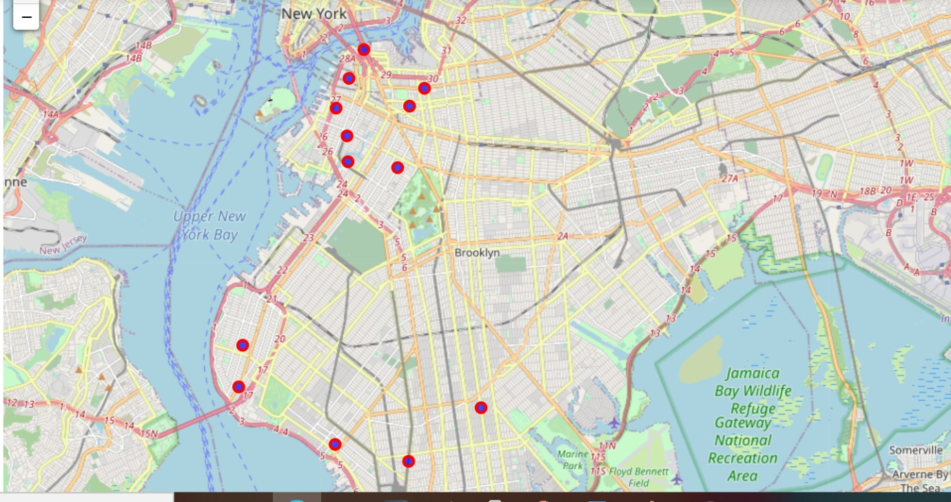
Results and Discussion
K-Means clustering suggests north-western part of Brooklyn will be a better option.
Madison is from southern part with less similar cuisines around it.
“Carroll Gardens” is the best neighborhood.
Tips data from Foursquare API will be helpful to find out the restaurants doing well around that time.

Slide 9
Conclusion
“Carroll Gardens” and then “Bedford Stuyvesant” turn out to be better neighborhoods for someone looking for an Italian cuisine in Brooklyn borough of New York city.

