Slide 1

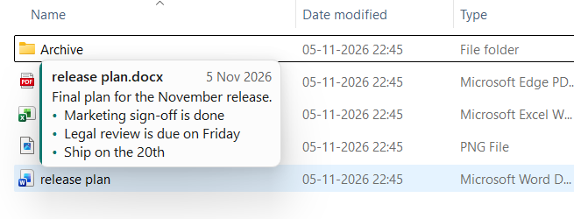
Flyleaf
A note on every file.
Hover over any file or folder in Windows File Explorer and read its note, without opening it.
Notes:
Open with the idea in one line: every file can now explain itself, right where you already look for it.

Slide 2
File names can't tell the whole story
?
?
?
Which one is final?
Can I delete this?
Why does this exist?
report_final_v3_REAL.docx sits next to four near-identical copies.
An old folder might be junk, or it might be the only copy of something vital.
The person who made it has moved on, and so has their memory of it.
So we open files, search old emails and interrupt colleagues, just to find one small piece of context.
Notes:
Everyone recognises these moments. The information exists, but it's in someone's head or an old email, not on the file.

Slide 3
The answer appears the moment you need it
No opening. No asking.
1
Works where you already are: File Explorer
2
Shows what matters, including bullet lists
3
Disappears when you move away
Notes:
This is the real product running in real File Explorer. Point at a file and the note appears, with no extra window to open.

Slide 4
Three steps, and no new habits
1
2
3
Right-click
Write
Hover
Choose Add Flyleaf note on any file or folder.
Type your note. Use bullets if you like, then save.
Rest your pointer on the item and read the note, any time.
Notes:
Keep this quick. The point is that there's nothing to learn.

Slide 5
Small tool, thoughtful details
Note history
Bullet lists
Missing-file alerts
Every earlier version is kept with its date.
Enter continues the list, as in a word processor.
Moved or deleted items turn red in the list.
Same-name clarity
Follows your theme
Easy to back up
Files that share a name each get a labelled section.
The note card is designed for light and dark modes.
All notes are in one readable file.
Notes:
Pick the two or three that matter most to this audience.

Slide 6
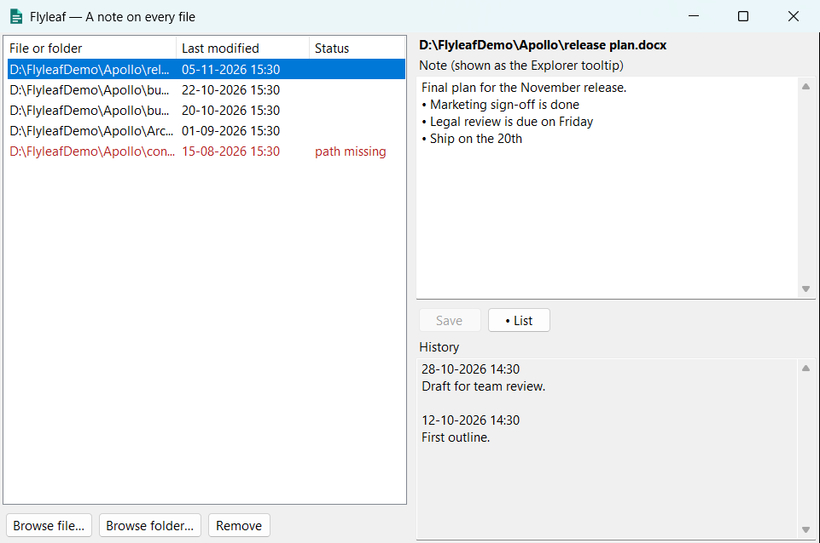
Everything in one simple window
Every note, one list
See all your noted files and when they changed.
Nothing gets lost
Earlier versions stay under History.
Spot what moved
Red rows show paths that no longer exist.
Notes:
The window stays out of the way in the system tray until you want it.

Slide 7
Your files stay yours
Nothing beside your files
Nothing leaves your PC
No hidden files and no changes to the files themselves.
No network code, cloud service or tracking.
No account
Plain, readable data
Nothing to sign up for and no password to manage.
Notes are in one JSON file that you can open and back up.
Notes:
All four of these are design facts. Flyleaf has no network code at all.

Slide 8
Built for anyone with too many files
Project teams
Freelancers
Students and researchers
Anyone who forgets
Mark the current version and explain each folder.
Record what the client approved, and when.
Keep sources and drafts straight.
Leave a note for your future self.
Notes:
Tailor this to the room. Lead with the group closest to your audience.

Slide 9
Better than the workarounds
 | Shows on hover | Works on any file | Leaves files untouched | Keeps history
Flyleaf | Yes | Yes | Yes | Yes
Long file names | No | Yes | No | No
A readme.txt in the folder | No | Folder level | Adds a file | By hand
File properties and comments | Some file types | No | No | No
Asking a colleague | No | If they remember | Yes | No
Notes:
Be fair here: each workaround has its place, but none of them shows context on hover without touching the file or folder.

Slide 10
Where Flyleaf is heading
1
Built today
2
Next
3
Ideas we're exploring
Hover notes in File Explorer
Note editor with history and lists
Right-click to add a note
Test the installed package
Submit to the Microsoft Store
Confirm the main right-click menu
Notes shared across a team
Notes that follow moved files
Notes in search results
Notes:
Be clear that Flyleaf is pre-release. The items on the right are ideas under consideration, not commitments.

Slide 11
Give every file a voice
Flyleaf. A note on every file.
Follow the project on GitHub
github.com/rakeshnamadi/FlyLeaf
Notes:
End with the tagline and invite them to follow the project on GitHub. Don't promise a release date.

