Slide 1

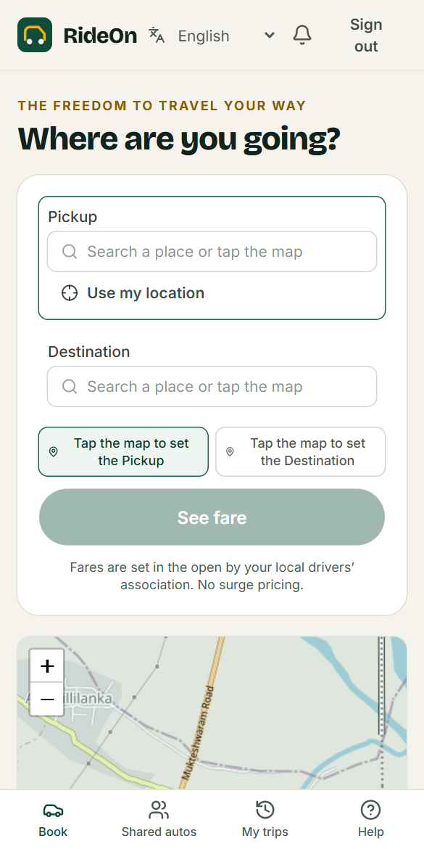
Your city.
Your people.
Your ride.
RideOn
The auto-rickshaw platform run by the drivers who move your town.
Notes:
Open with the promise. RideOn is not another ride app that sits above drivers. It is a platform local driver unions run for themselves, starting in Ainavilli, Andhra Pradesh.

Slide 2


Every auto ride starts with a negotiation
Passengers
Drivers
Unions
Guess the price
Decide nothing
Run on memory
No published fare, no way to compare, and little to show a family who is driving you.
Rules and rates are often set elsewhere, deductions are hard to see, and turns at the stand depend on who is watching.
Members, stands, decisions and money sit in notebooks, with no shared record anyone can check.
Notes:
Three groups, one root cause: the people closest to the ride have no tools of their own. Before presenting externally, support this slide with quotes from local union conversations.

Slide 3
Unions run the network. RideOn runs the tech
The union decides
RideOn provides
Who drives, and which vehicles
What fares are, by vote
Stands, stops and shared routes
Its own name, logo and team
Its own rules and reports
Booking and dispatch
Maps and live trip tracking
Identity and licence verification
Safety tools and support
Permanent records of every decision
Notes:
This is the whole idea. Each union is self-governing: its console shows only its own data, and its decisions are its own. RideOn provides the technology and earns a published service fee.

Slide 4
A different model for ride booking
 | Typical ride app | RideOn
Who sets the fare? | The app’s pricing system | The local union, by recorded vote
Can the price surge? | Often, with demand | No. Only a published night charge, if the union sets one
Who gets the next ride? | The app decides | First come, first served at the stand
What does a driver see? | Varies by app | Every fare and every fee, trip by trip
Is there a fare history? | Rarely public | Public and permanent
Notes:
Keep this about the model, not any named competitor. The left column describes the general pattern of algorithm-led ride apps, which varies by company and city.

Slide 5

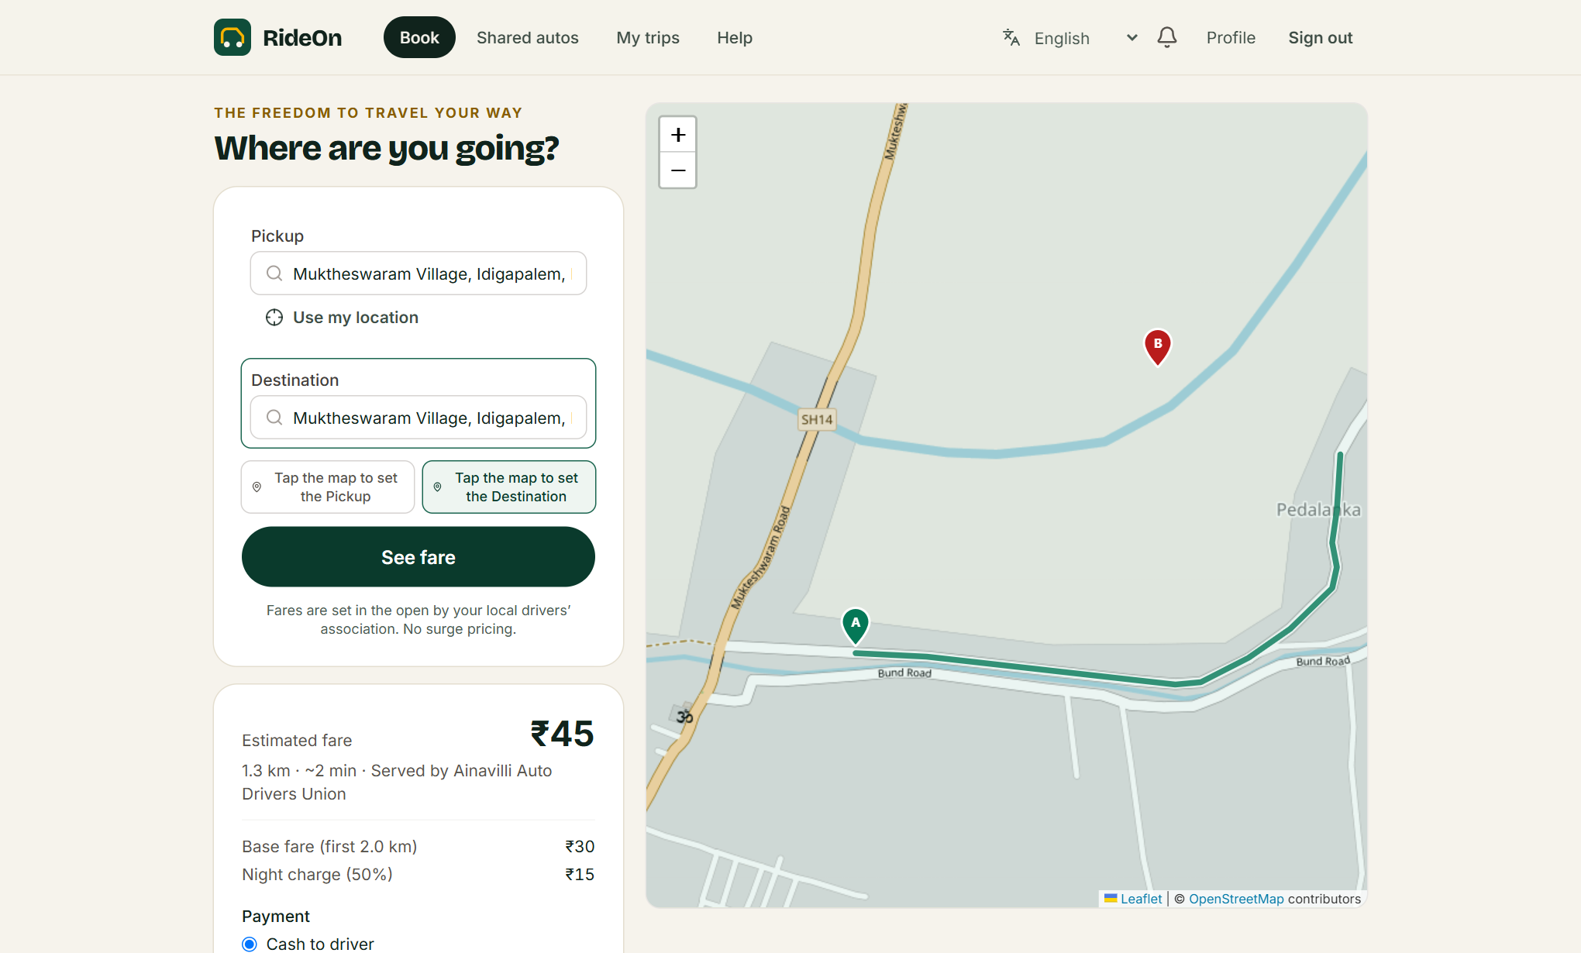



The freedom to travel your way
A whole auto or one seat
Book door to door, or a seat on a shared route.
The fare, before you go
Shown line by line, then locked when you book.
Safety in your hand
Start PIN, trip sharing and an emergency button.
In your language
తెలుగు, English and हिन्दी.
Notes:
Passengers see who serves them and how the fare was worked out before they commit. Screenshot is from the working product with sample data. Cash is live; online payment follows when a gateway is chosen.

Slide 6




Respect for the people who move your city
Fares from your union
₹84.00
Not from an algorithm. Drivers can give feedback and suggest prices.
Example fare
₹78.12
93%
Driver keeps
Fair turns
₹4.20
First come, first served at the stand.
Platform fee
₹1.68
Union fund
Decisions on record
Approvals and appeals are recorded, with reasons.
Every fare, every fee, on every trip.
Example: 5.6 km daytime trip at sample rates (5% platform fee, 2% union fund). Real rates are set by the fee schedule and each union.
Privacy respected
Location is deleted when you go offline.
Notes:
The worked example uses the demo fee schedule: ₹30 for the first 2 km plus ₹15 per km gives ₹84 for 5.6 km. Platform 5% is ₹4.20, union 2% is ₹1.68, driver keeps ₹78.12, which is 93%. Final commercial rates are still to be decided, so present this as an example.

Slide 7
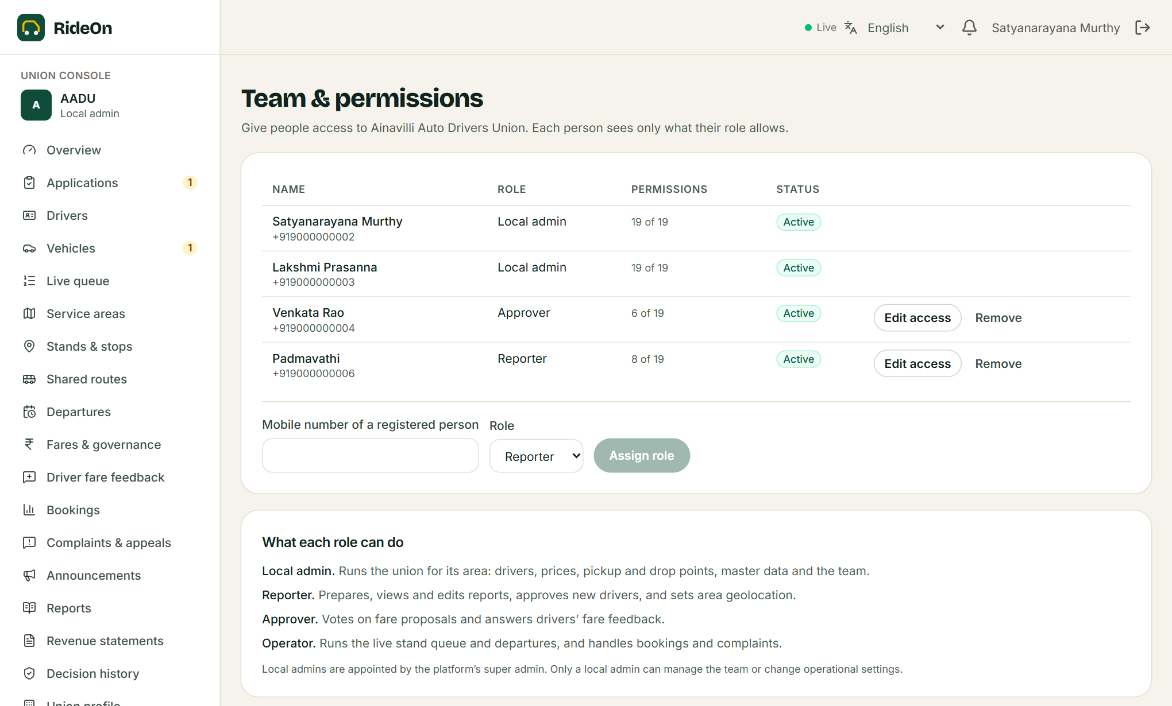




Every union gets its own console
Its own identity
Name, logo, colour and contacts, seen by the public.
Its own team
Give roles, and switch on individual permissions.
Its own network
Service areas, stands, stops, routes and schedules.
Its own reports
Prepare, publish and export for members’ meetings.
Notes:
A union sees only its own data. The API enforces this on every request, and a test suite confirms another union’s admin is refused. Local admins can delegate without giving away control of the team.

Slide 8




Fares are voted on, not calculated
Drivers speak
Union proposes
Approvers vote
Safeguard
Published
Feedback and suggested prices go to the union.
A local admin proposes a new fare, with reasons.
One rejection stops it. Self-approval is off by default.
Large increases also get a platform review.
A new version goes live with a public history.
No surge. No hidden change. A passenger’s booked fare never moves when a new fare is published.
Notes:
This is the differentiator. Fare history is append-only at database level, so nobody can quietly rewrite it. Rule changes such as cancellation fees follow the same vote. Note that waiting charges from the published fare can still apply to a booked trip.

Slide 9





Six roles, one platform
Super admin
Local admin
Reporter
Onboards unions, verifies drivers, sets fees and assigns roles.
Runs the union: drivers, fares, points, master data and team.
Prepares reports, approves new drivers, sets service areas.
Approver
Operator
Driver
Votes on fares and answers driver feedback.
Runs the live queue and departures, and handles complaints.
Runs trips, sees every rupee, and gives feedback on fares.
Notes:
Passengers are the seventh audience and need no special access. Everyone sees only the pages their permissions allow, and a local admin can fine-tune each delegate.

Slide 10






Safety and trust are built in
Start PIN
Trip sharing
A trip can’t start without the passenger’s code.
A live link for family, valid for 12 hours.
10 → 3
Emergency alert
Numbers stay private
10 passengers race for 3 seats at the same moment. Exactly 3 succeed, on seats 1 to 3.
Instant urgent ticket to union and platform staff.
Passengers and drivers never see each other’s phone.
Verified drivers
Permanent records
And when two drivers accept one trip, exactly one wins. Both are proven by automated tests.
Licence, documents, membership and vehicle are all checked.
The database blocks edits to fare history and the audit log.
Notes:
Trust comes from what the system makes impossible, not from promises. The two concurrency cases are real integration tests against a real MySQL database.

Slide 11

Built, tested and working today
132
4
6
3
automated tests passing, including 18 full browser journeys
consoles: passenger, driver, union and platform
roles, with permissions set per person
languages: Telugu, English and Hindi
Working today, end to end
Sign-up to completed trip, cash payment, shared seats, driver onboarding, fare votes, union consoles, reports, complaints and safety alerts.
Notes:
Test figures are from the latest recorded run on 5 November 2026: API 98, web 16, browser 18. Be clear about what remains: a real payment gateway and SMS delivery are deliberately on hold, and it has not yet run with real customers.

Slide 12
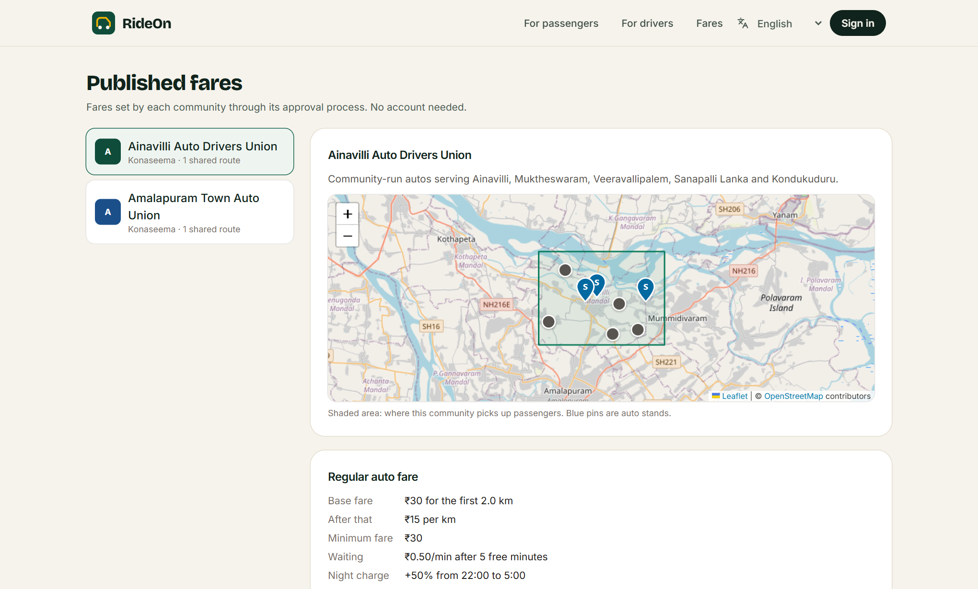


Starting where it matters: 533211
Ainavilli, Konaseema, Andhra Pradesh
Mapped for this area
Service areas, stands and routes are set up around it.
Telugu first
తెలుగు is the first choice in the language menu.
Grows union by union
Each new union adds its area and runs itself.
Notes:
The map shows sample data, and union names in the product are placeholders, not real organisations. Agreements with real unions are still to come. The Telugu translation needs a native speaker’s review before the pilot.

Slide 13
The road to launch
Now
Next
Pilot
Grow
Product built
Go-live essentials
One union, one pincode
Union by union
Booking, shared seats, governance and consoles work, with cash payment.
Payment gateway, SMS alerts, hosted maps and Telugu review.
Real drivers and passengers in 533211, with real fares agreed.
New unions across Konaseema, then beyond, each run locally.
Notes:
Dates are intentionally left out until the gateway and SMS providers are chosen and a pilot union is agreed. Add them when they are known.

Slide 14

Let’s put the first union on the road
Unions
Drivers
Partners
Run your own network, with your own fares and your own records.
Join a platform that shows you every rupee and listens.
Help bring community-run transport to more towns.
Your city. Your people. Your ride.
Notes:
End on the ask. Tailor it to the room: for a union, invite them to be the pilot; for a partner, ask for support on the gateway, SMS or the pilot. Add your contact details to this slide before sharing.

