Slide 1
NexTurn
Mini-Project on
Set monitoring for an applications java applications. App to be deployed on a Kubernetes cluster
By:
Rakesh Kumar Sahu
Sai Gouda
Sridevi Jayaraman

Slide 2
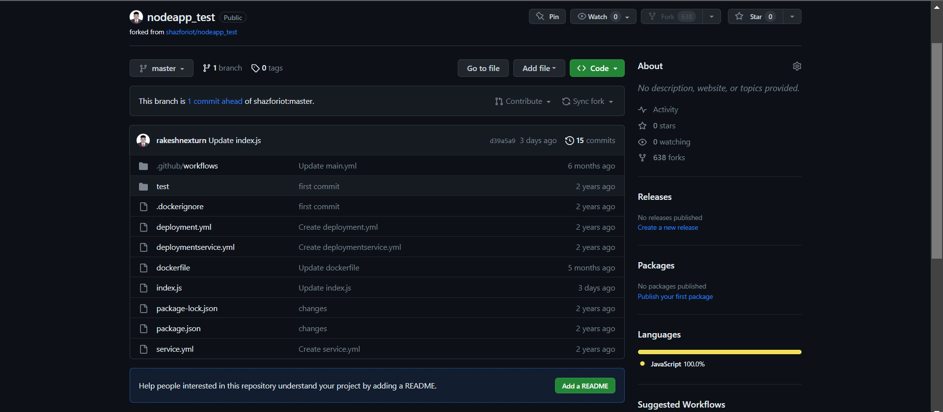

Slide 3
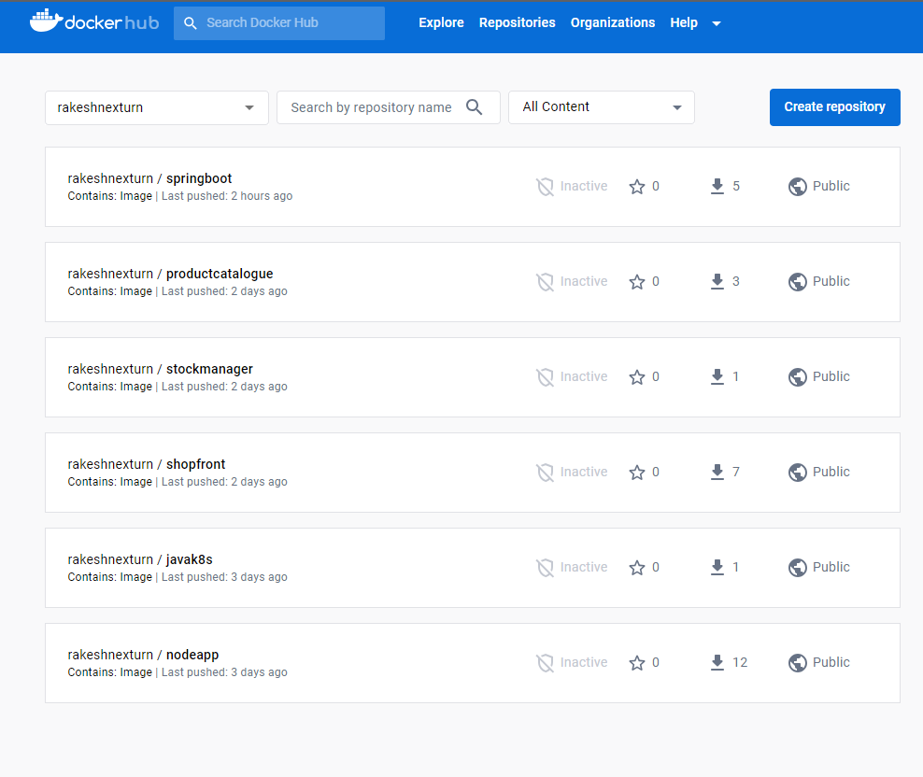

Slide 4
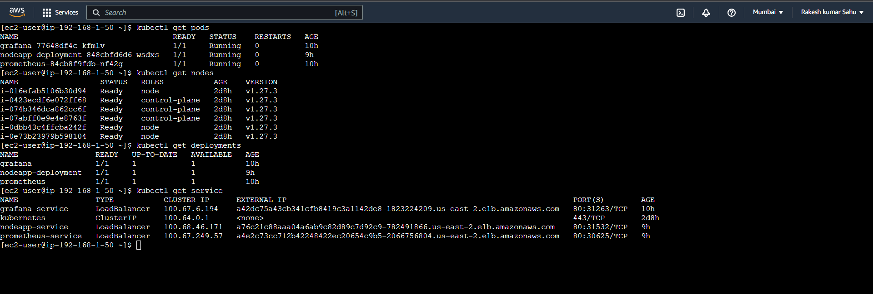

Slide 5
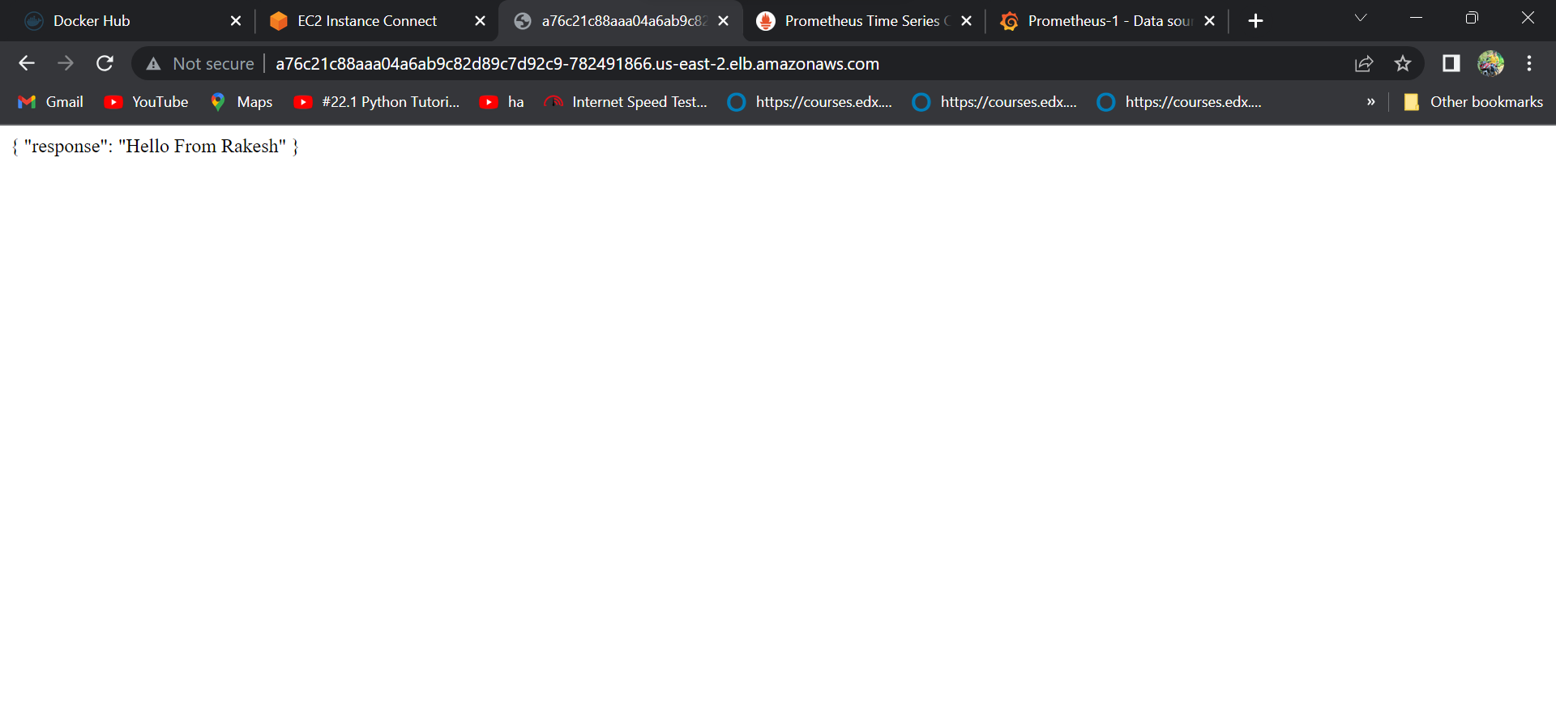

Slide 6
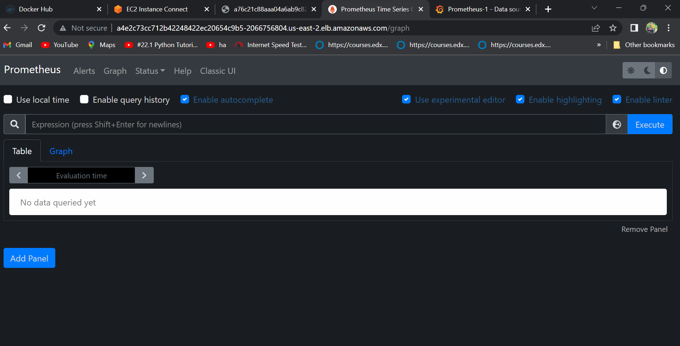

Slide 7
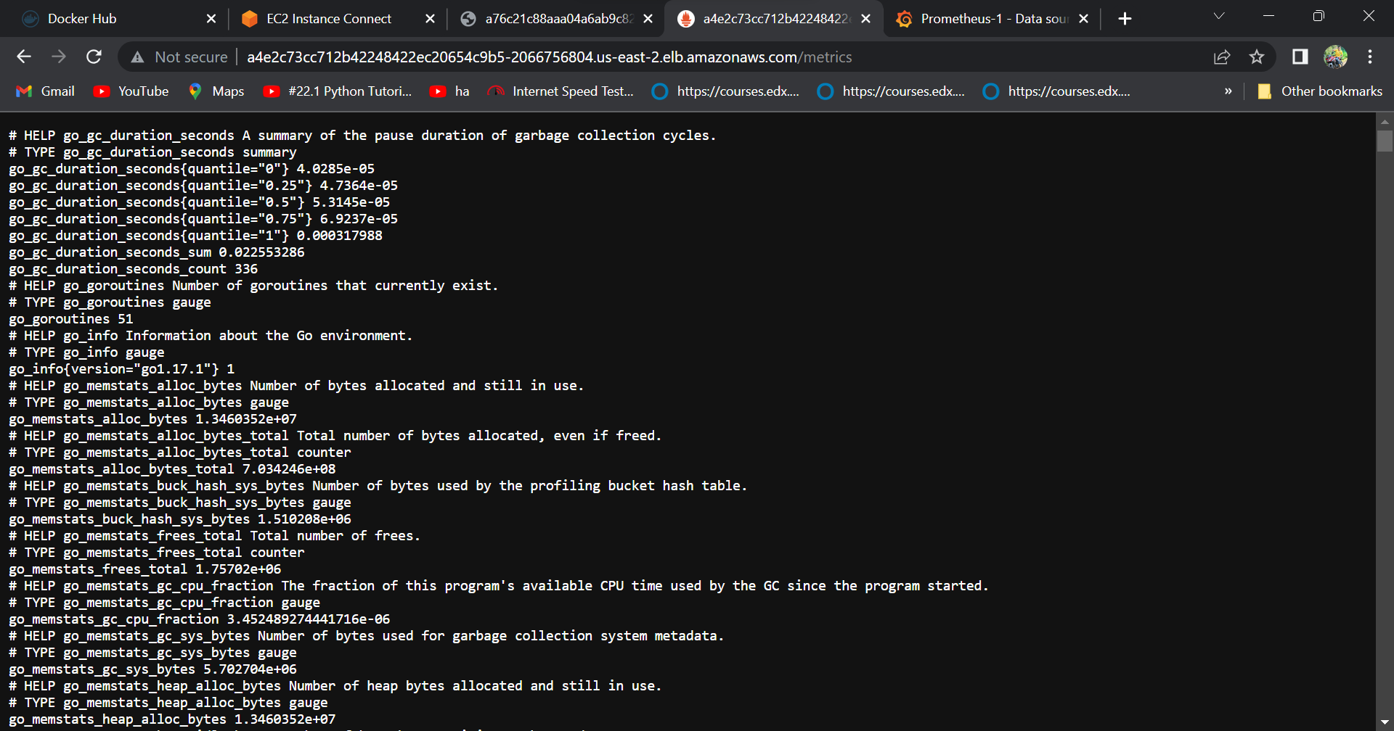

Slide 8
