Slide 1
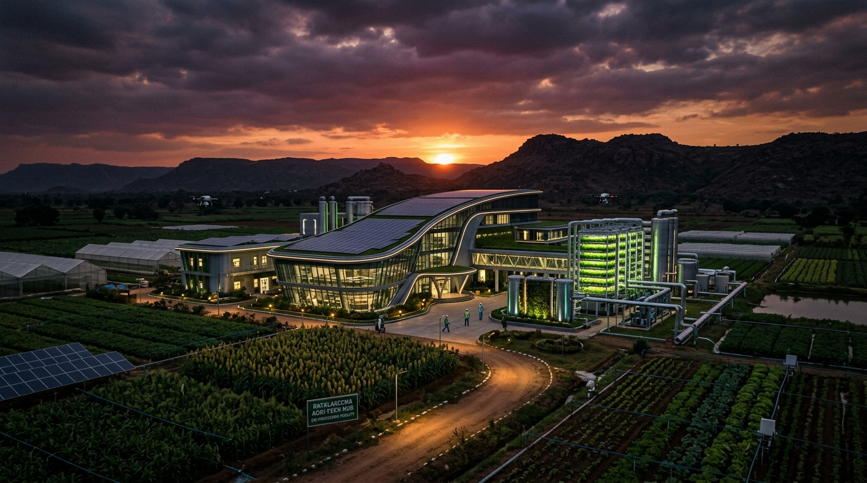
SAMARTH FOUNDATION PROPOSAL
Rayalaseema Green Industrial Grid (RGIG)
Decentralized Agri-Waste Hubs for Sustainable Industrial Development
• Themes: Industrial Development & Sustainable Environment
• Concept: Village-Level Biomass & Fibre Processing Hubs
• Target Region: Rayalaseema (Anantapur, Kurnool, Kadapa, Chittoor, Tirupati)
• Impact: +₹18,000 Annual Farmer Income Boost | 450+ Jobs per 10-Hub Cluster
Notes:
Respected Judges, welcome to our proposal: The Rayalaseema Green Industrial Grid (RGIG). Instead of viewing agricultural waste as an environmental burden, RGIG converts crop residues into raw materials for high-value industrial manufacturing, creating a new economic engine for Rayalaseema.

Slide 2

THE REGIONAL CHALLENGE
Water Scarcity & Unutilized Crop Residues
Rayalaseema produces millions of tonnes of agricultural biomass currently burnt or wasted due to groundwater stress.
3.2M Tons
Agri-Waste Generated
Groundnut shells, cotton & banana residue produced annually.
₹0 Value
Farmer Waste Return
Crop residues currently burnt or dumped with zero income.
85% Stress
Groundwater Depletion
Restricts traditional water-heavy manufacturing factories.
72% Youth
Rural Migration Rate
Out-migration due to lack of local manufacturing jobs.
Notes:
Rayalaseema faces severe groundwater stress, making traditional water-heavy manufacturing difficult. Meanwhile, over 3 million tonnes of crop waste are burnt every year. RGIG turns this environmental challenge into our strongest economic asset.

Slide 3
PROPOSED INNOVATION
Decentralized Village Processing Hubs (RGIG)
A 4-step closed-loop economic model: Farmer → Collection → Processing → Industrial Sales.
STEP 1
Village Collection Hubs
Farmers sell groundnut shells, cotton stalks, and banana husk directly at local village centers for immediate cash.
STEP 2
Micro-Processing Units
Decentralized, low-water units process raw residue into standardized pellets, eco-fibres, and carbonized biochar.
STEP 3
High-Value Manufacturing
Produces high-calorific industrial fuel pellets, bio-packaging boards, and soil moisture improvers.
STEP 4
Digital Grid & Sales
Centralized marketplace connects village hubs directly to regional industrial buyers in Tirupati & Anantapur.
Notes:
Here is the RGIG architecture. Small processing units near villages pay farmers on the spot for crop residues, local youth operate the machinery, and finished eco-products are shipped to nearby industrial buyers in Anantapur and Tirupati.

Slide 4
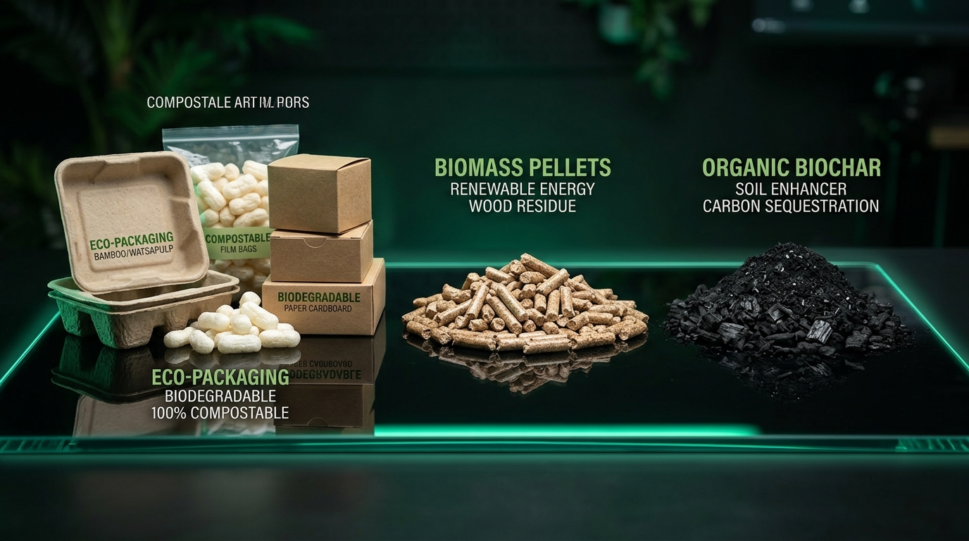
PRODUCT MATRIX & REVENUE
3 High-Value Eco-Industrial Product Lines
Zero freshwater consumption required during primary processing.
COAL SUBSTITUTE
Biomass Pellets & Briquettes
High-calorific eco-fuel replacing coal for industrial boilers, brick kilns, and thermal power units.
ECO-PACKAGING
Agri-Fibre Bio-Packaging
Biodegradable packaging material & particle boards produced from banana husk & cotton stalks.
SOIL MODIFIER
Bio-Char Soil Improver
Carbon-rich soil modifier that increases soil moisture retention by +40% in drought-prone fields.
Notes:
RGIG manufactures three high-demand items: biomass fuel pellets that replace coal in industrial boilers, biodegradable packaging, and moisture-retaining bio-char that directly helps Rayalaseema's drought-prone soil.

Slide 5
EMPIRICAL IMPACT & ROI
Economic & Social Impact Projections
Calculated 3-Year Projection per 10-Hub Village Cluster.
+₹18,000
Annual Farmer Income
Additional annual income per smallholder selling crop residues.
450+ Jobs
Rural Youth Jobs
Direct local technical employment generated per 10-hub cluster.
120,000 T
CO2 Offset / Year
Reduces fossil fuel burning and eliminates open field crop burning.
14 Months
Hub Payback Period
Rapid ROI with low capital expenditure micro-processing machinery.
Notes:
The financial feasibility is compelling. A single cluster of 10 village hubs boosts farmer income by ₹18,000 per year, creates 450 local jobs, and pays back initial capital in just 14 months.

Slide 6
3-PHASE EXECUTION PLAN
Implementation Roadmap & Scalability
Phased rollout from pilot hubs in Anantapur to a regional Rayalaseema grid.
PHASE 1 (MONTHS 1–6)
Pilot Launch in Anantapur & Kurnool
Deploy 2 Pilot Hubs; sign off-take supply agreements with local industrial boiler units & brick kilns.
PHASE 2 (MONTHS 7–18)
10-Hub Grid & Skill Center
Scale to 10 Village Hubs; launch digital marketplace app & youth machinery training program.
PHASE 3 (MONTHS 19–36)
Regional RGIG Expansion (50+ Hubs)
Establish full regional grid across Tirupati, Kadapa, Chittoor & integrate carbon credit trading.
Notes:
We start with a 2-hub pilot in Anantapur & Kurnool within 6 months, expand to 10 hubs in Phase 2, and build a 50-hub regional grid by Year 3. RGIG connects sustainable environment with industrial development!

