Slide 1
PREDICTIVE MAINTENANCE FOR MACHINE TOOL FAILURES

Slide 2
GROUP MEMBERS:
GUTHIKONDA SAI PRANITHA - 700740867
BOPPANA VEERA VENKATA SATYANARAYANA - 700740862
TEJASWI REDDY ANAPALLI - 700740567
RAKESH PEDDAPALLI - 700740294

Slide 3
Role / Responsibilities and Contribution in project
As this is a group project, we performed Data Cleaning, Power Point Presentation and Documentations together.
And worked individually by divided the classification algorithms among us.
Linear Regression: Rakesh Peddapalli SVC: Boppana Veera Venkata Satyanarayana Random Forest: Guthikonda Sai Pranitha K-Nearest Neighbor: Tejaswi Reddy Anapalli

Slide 4
Motivation
Any type of gadget is susceptible to deterioration and harm. The regularity of their upkeep determines whether or not they will live longer.
Similarly, any machine eventually fail, but the effects might be very different.
A single missing bolt results in significant wear and tear, shortened equipment life, and unexpected downtime.
As a result of this we are left with increased recovery costs, decreased production value
In this case Predictive maintenance is very helpful in giving the right time to perform the maintenance.

Slide 5
Objectives
We are mainly focused on evaluating different Machine Learning algorithms in predicting when the failure occurs and what type of failure occurs. This paper has two main objectives:
Predicting when a failure will occur using independent variables.
Predicting type of failure will occur using predicting variables.

Slide 6
Related work
Before proposing a structure for the broad subject of machine learning and providing an introduction to its fundamental language, they explored the constraints of efficient production systems, the constraints of machine learning, and its benefits from a mechanical point of view. The structure is classifying the available methods and applications into three categories: standard supervised learning, RL, and unsupervised machine learning. The traditional supervised learning algorithm SVMs was successfully applied in manufacturing, as demonstrated by the authors in their example. They claimed that the capability of Machine learning algorithms to handle large multidimensional challenges and datasets is one of their advantages.

Slide 7
Problem Statement
Problem Statement 1 :
Predicting when a failure will occur using independent variables.
Response Variables: Target
Problem Statement 2:
Predicting type of failure will occur using predicting variables.
Response Variables: Failure Type.
Variables: Air temperature [k], Type, Process temperature [k], Rotational Speed [rpm], Torque [Nm], Tool ware [min].

Slide 8
Proposed Solution
Considering proper Data Set.
Perform Data Cleaning like Dropping unwanted features ,Visualizing the data,
Encoding, Scaling etc.,
The obtained data will be split into train and test splits.
Then we fit the training dataset into classification models such as Logistic Regression, K-Nearest Neighbor (KNN), SVC, Random Forest.
From all the classification algorithms trained, the best model with better accuracy is selected.

Slide 9
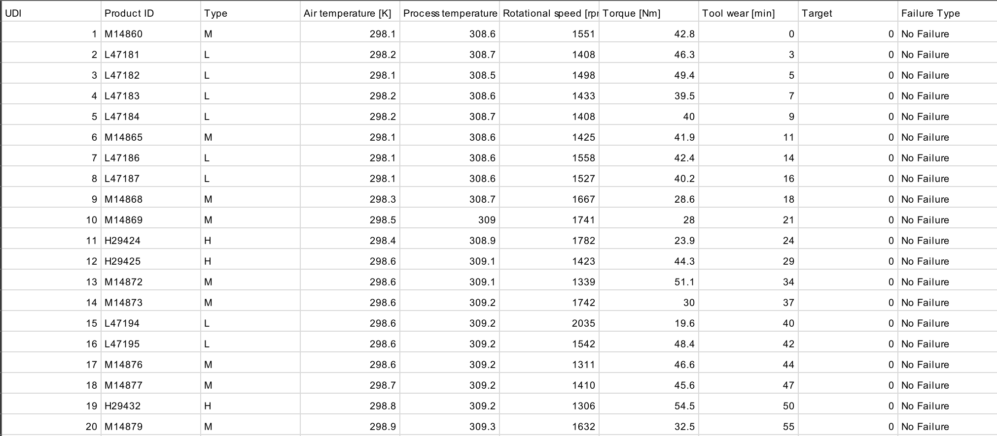
Data Set

Slide 10
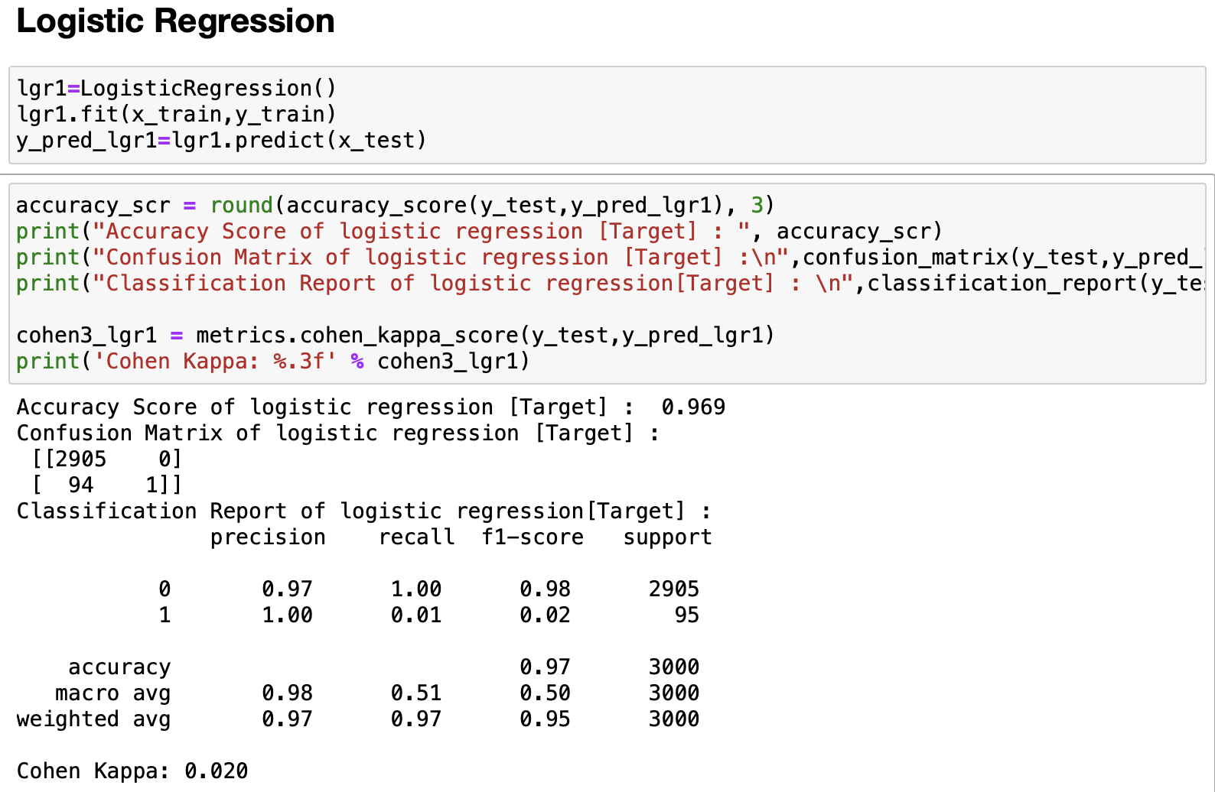
Results/Simulations
Logistic Regression for Statement 1

Slide 11
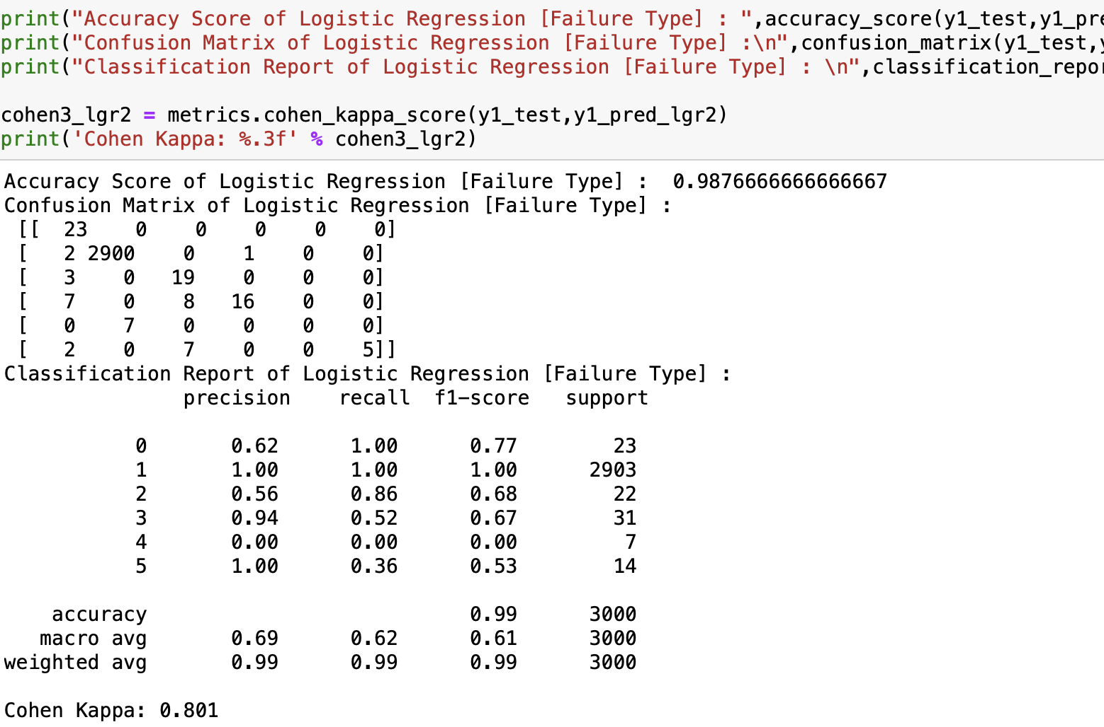
Logistic Regression for Statement 2

Slide 12
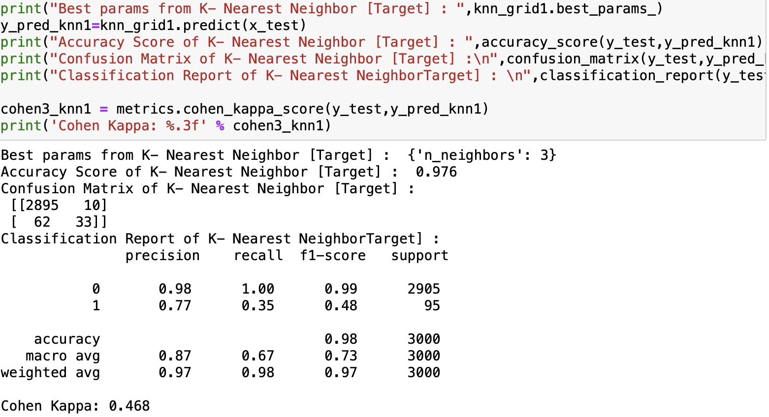
K-Nearest Neighbor (KNN) for statement 1

Slide 13
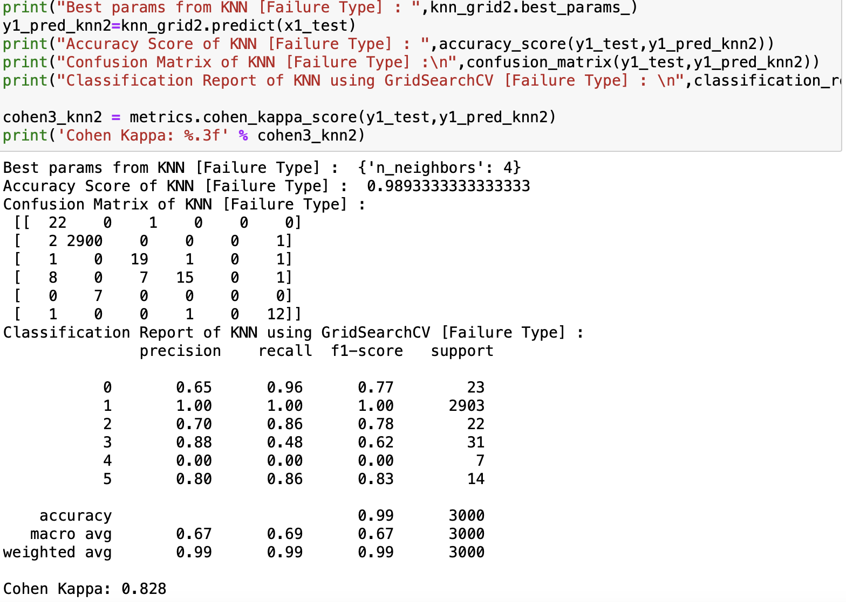
K-Nearest Neighbor (KNN) for statement 2

Slide 14
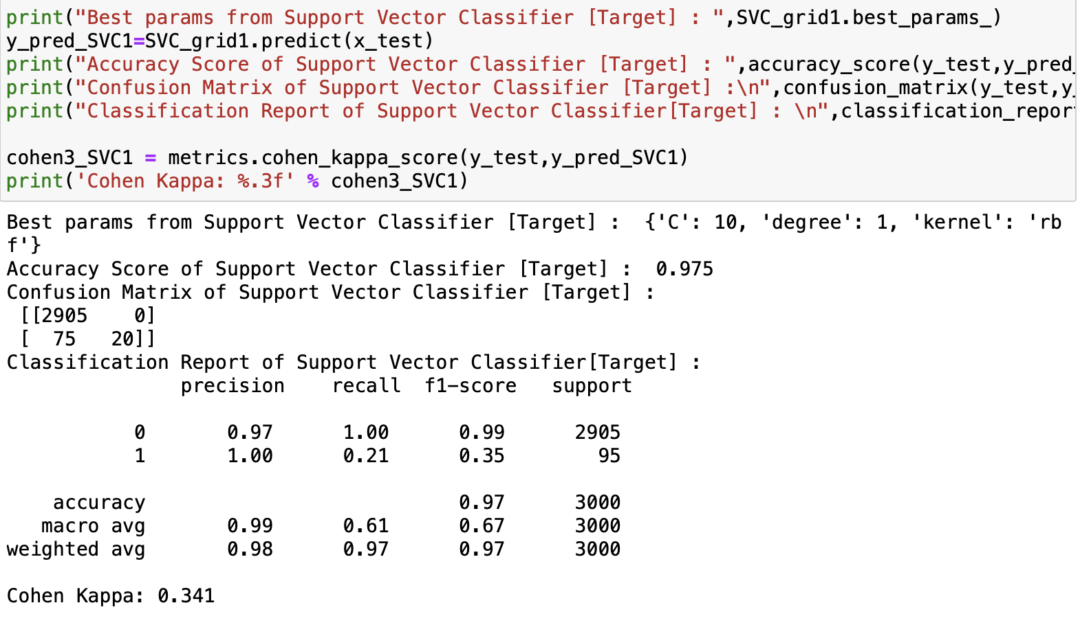
SVC Algorithm for Statement 1

Slide 15
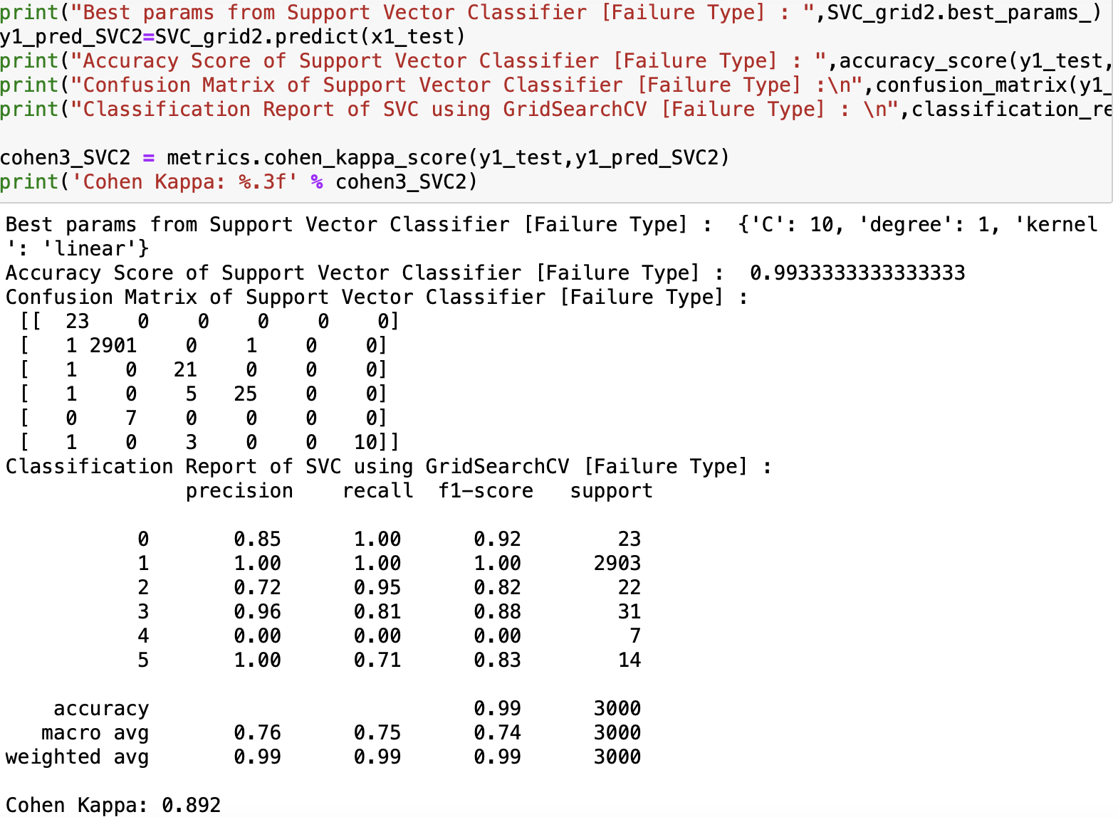
SVC Algorithm for Statement 2

Slide 16
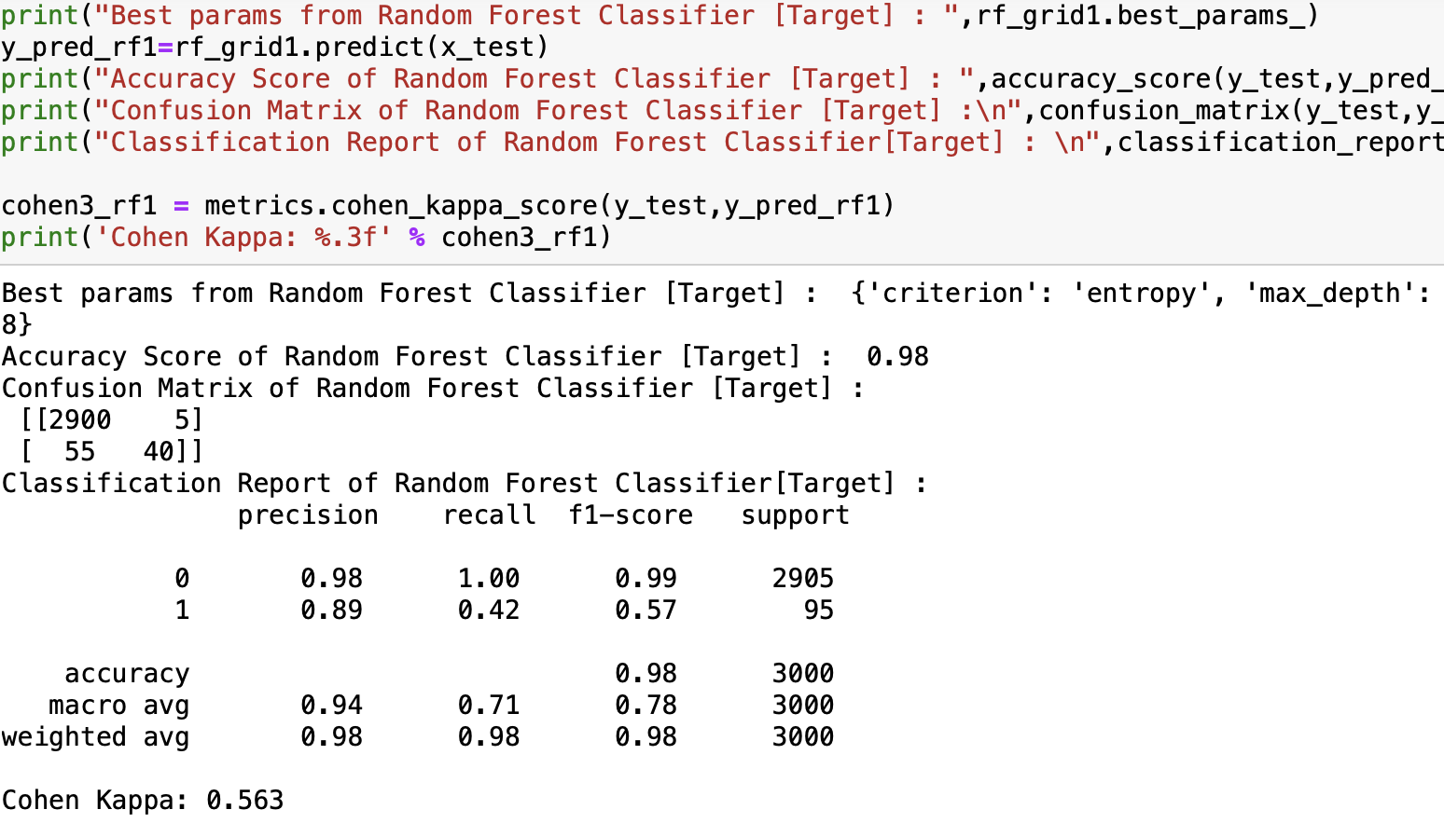
Random Forest for Statement 1

Slide 17
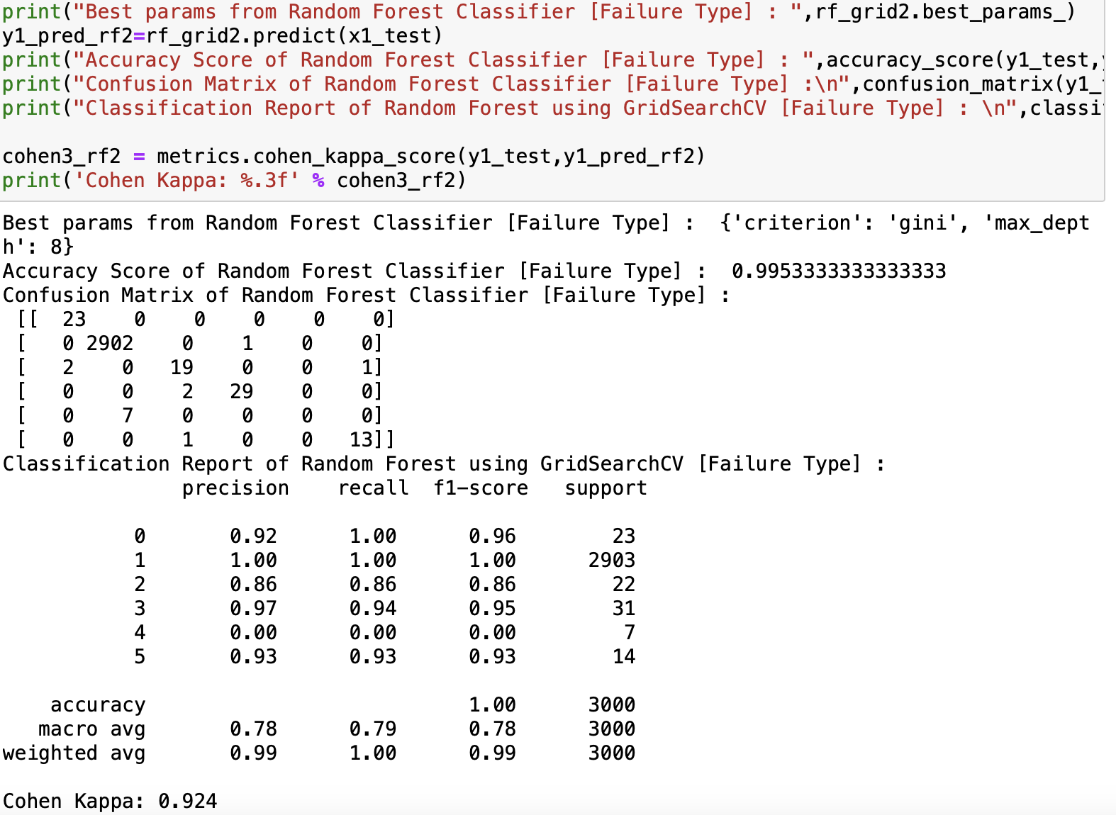
Random Forest for Statement 2

Slide 18
Conclusion
Initially, we have done data preprocessing, EDA and data visualization on to the dataset and then we tried fitting and testing all the models. And we have two predicated variables are Target and Failure Type. So, we are proposing Random Forest using GridSearchCV as our solution to problem statement 1 which is for Target Variable. And finally, we are proposing Random Forest using GridSearchCV as our solution to problem statement 2 which is for Failure Type. ‘Predicting both when a failure will occur and the type of the failure’ by considering precision, recall, f1_scores.

Slide 19
References
Bin, L., Min, Y. Analysis model of drilling tool failure based on PSO-SVM and its application. In 2012 Fourth International Conference on Computational and Information Sciences (pp. 1307- 1310). IEEE.
Carvalho, T. P., Soares, F. A., Vita, R., Francisco, R. D. P., Basto, J. P., Alcala ́, S. G. (2019). A systematic literature review of machine learn- ing methods applied to predictive maintenance. Computers Industrial Engineering, 137, 106024.
Cho, S., Asfour, S., Onar, A., Kaundinya, N. Tool breakage detection using support vector machine learning in a milling process. International Journal of Machine Tools and Manufacture, 45(3), 241- 249.
Sohyung Cho, Shihab Asfour, Arzu Onar, Nandita Kaundinya, Tool breakage detection using support vector machine learning in a milling process, International Journal of Machine Tools and Manufacture

