Slide 1

US Airline Analysis
Presenters: Rakesh Reddy Poddutoori
Durga Prasad
Hiranmai

Slide 2
Introduction
Performing analysis on customer feedback, such as opinions in survey responses and social media conversations, allows brands to listen attentively to their customers, and tailor products and services to meet their needs. However, all the opinionated data from Twitter is in the form of text which is unstructured.
This unstructured data is hard to analyze, understand, sort through, and also time-consuming and expensive. Sentiment analysis, however, helps businesses make sense of all this unstructured text by automatically understanding, processing, and tagging it.
Sentiment analysis is a text analysis technique that detects polarity.
Objective of this project is to perform sentiment analysis on the tweets of six US airlines. The scrapped tweets contain positive, negative, or neutral sentiments about the airline from their respective customers.
Few of the algorithms used for sentiment analysis are Naïve Bayes, SVM, Logistic Regression, Bert, Distilled Bert and LSTM

Slide 3
DATASET Details
The dataset is borrowed from Kaggle, Twitter US Airline Sentiment. This data originally came from Crowdflower’s Data for everyone library. Number of instances: 14640
Number of class: 3 (positive, negative, neutral) Number of attributes: 15
tweet_id
Airline_sentiment
Airline_sentiment_confidence
Negativereason
Negativereason_confidence
Airline

Slide 4
Airline_sentiment_gold
Name
Negativereason_gold
Retweet_count
Text
Tweet_coord
Tweet_created
Tweet_location
User_timezone

Slide 5
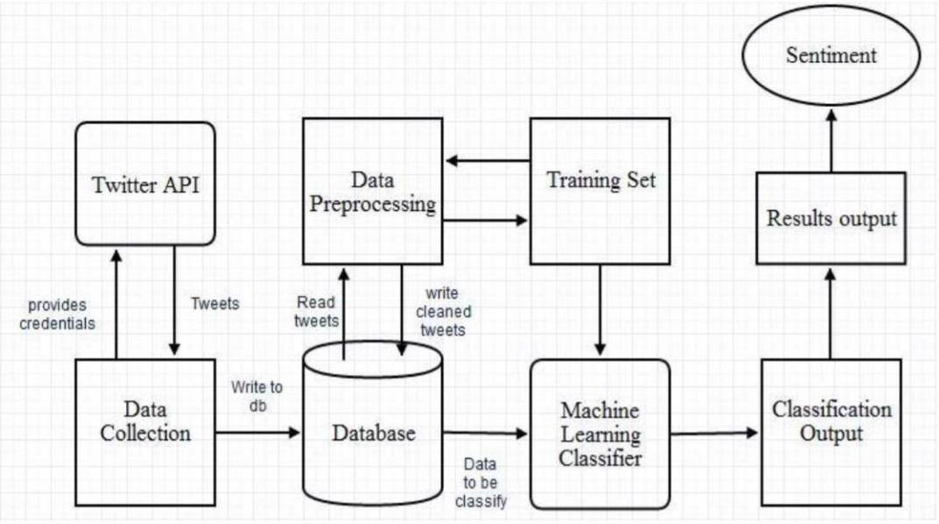
Approach

Slide 6
In this project, the following steps are implemented to build a Naïve Bayes Tweet Classifier model to predict the sentiment of the tweets:
ImportingLibraries&LoadingData
DataPreprocessing
SplittingtheDataforClassification
TextPreprocessing
BuildingDictionary/Vocabulary
BuildingtheNaïveBayesTweetClassifierModel
ModelTraining&Evaluation
TryingtoImprovetheModelPerformance

Slide 7
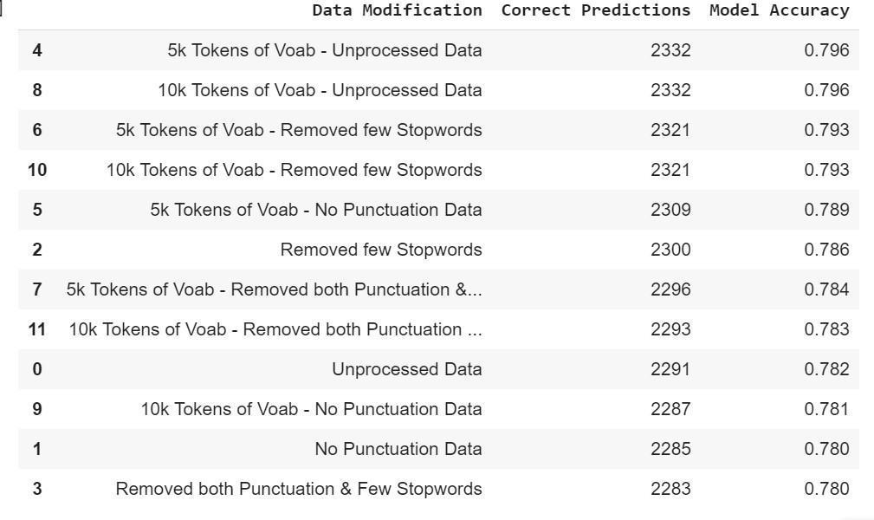
Output: correct predictions, Model Accuracy

Slide 8
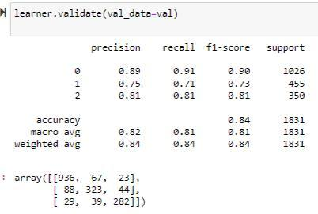
Output: precision, recall, f1-score, support

Slide 9
Conclusion
The final take away from this project is to understand the computations in the Naïve Bayes Classifier. Code the text processing methods and the model in Python without using any libraries. Analyze the effect of text processing methods on the model performance. Understand the effect of reduced vocabulary size on the model performance.

