Slide 1
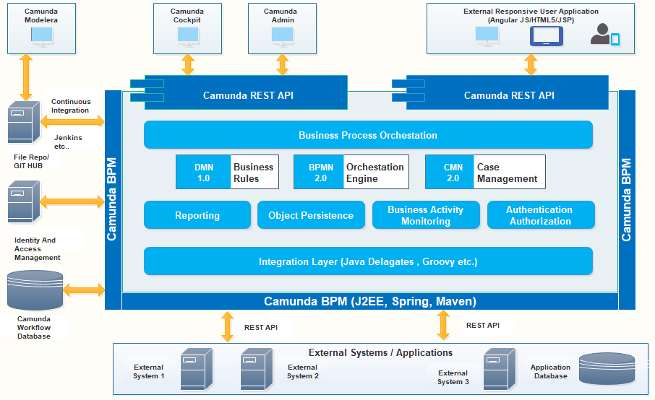
BPMN – Business Process Model and Notation

