Slide 1
React JS

Slide 2
What is React ?
React is a JavaScript library for building user interfaces.
React is used to build single page applications.
React allows us to create reusable UI components.

Slide 3
Create React App
In order to learn and test React, you should set up a React Environment on your computer.
This tutorial uses the create-react-app.
The create-react-app is an officially supported way to create React applications.
If you have NPM and Node.js installed, you can create a React application by first installing the create-react-app.
Install create-react-app by running this command in your terminal:
$ npm install -g create-react-app
You are now ready to create your first React application!
Run this command to create a React application named myfirstreact:
$ npx create-react-app myfirstreact
Run the React Application
If you followed the two commands above, you are ready to run your first real React application!
Run this command to move to the myfirstreact directory:
$ cd myfirstreact
Run this command to execute the React application myfirstreact:
$ npm start
A new browser window will pop up with your newly created React App! If not, open your browser and type localhost:3000 in the address bar.

Slide 4
What You Should Already Know
Before starting with React.JS, you should have intermediate experience in:
HTML
CSS
JavaScript

Slide 5
What is React?
React is a JavaScript library created by Facebook.
React is a tool for building UI components.
How does React Work?
React creates a VIRTUAL DOM in memory.
Instead of manipulating the browser's DOM directly, React creates a virtual DOM in memory, where it does all the necessary manipulating, before making the changes in the browser DOM.
React only changes what needs to be changed!
React finds out what changes have been made, and changes only what needs to be changed.
You will learn the various aspects of how React does this in the rest of this tutorial.
React.JS History
Current version of React.JS is V17.0.2 (March 2021).
Initial Release to the Public (V0.3.0) was in July 2013.
React.JS was first used in 2011 for Facebook's Newsfeed feature.
Facebook Software Engineer, Jordan Walke, created it.
The create-react-app version 2.0 package was released in October 2018.
Create-react-app version 2.0 supports Babel 7, webpack 4, and Jest23.

Slide 6
React Without Node
To use React in production, you need NPM and Node.js
To get an overview of what React is, you can write React code directly in HTML.
But in order to use React in production, you need NPM and Node.js installed.
React Directly in HTML
The quickest way start learning React is to write React directly in your HTML files.
Start by including three scripts, the first two let us write React code in our JavaScripts, and the third, Babel, allows us to write JSX syntax and ES6 in older browsers.
<!DOCTYPE html>
<html>
<script src="https://unpkg.com/react@16/umd/react.production.min.js"></script>
<script src="https://unpkg.com/react-dom@16/umd/react-dom.production.min.js"></script>
<script src="https://unpkg.com/babel-standalone@6.15.0/babel.min.js"></script>
<body>
<div id="mydiv"></div>
<script type="text/babel">
class Hello extends React.Component {
render() {
return <h1>Hello World!</h1>
}
}
ReactDOM.render(<Hello />, document.getElementById('mydiv'))
</script>
</body>
</html>

Slide 7
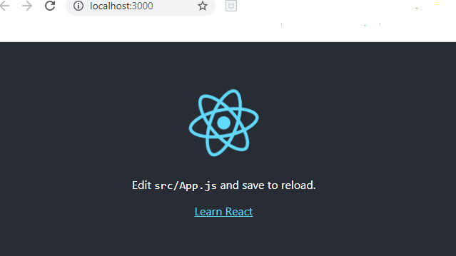
$ npm install -g create-react-app
$ npx create-react-app first-app
$ cd first-app
$ npm start

Slide 8
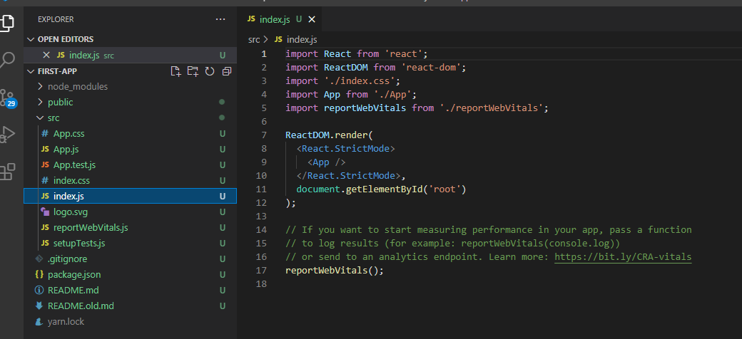

Slide 9
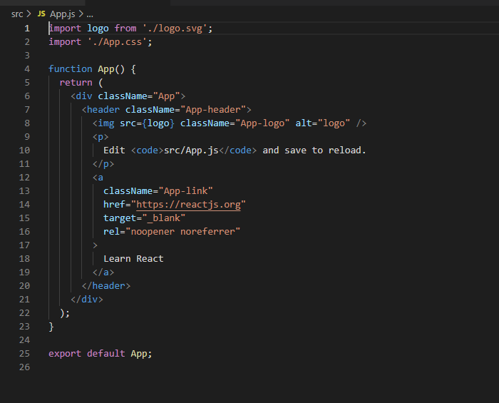

Slide 10
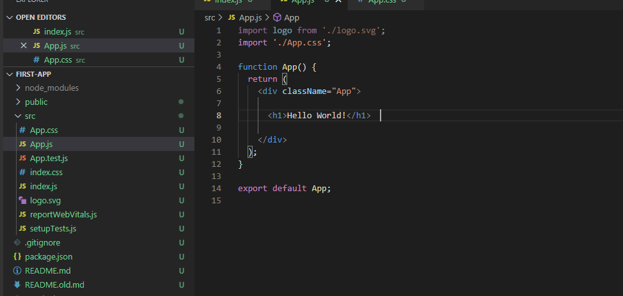
After Modifying first app

Slide 11
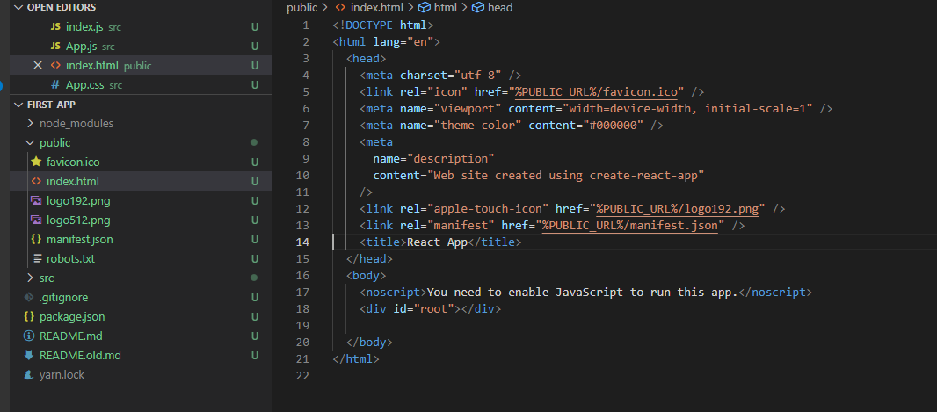

Slide 12
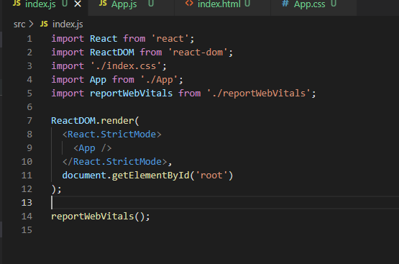

Slide 13
What is ESS6?
ES6 stands for ECMAScript 6.
ECMAScript was created to standardize JavaScript, and ES6 is the 6th version of ECMAScript, it was published in 2015, and is also known as ECMAScript 2015.
Why Should I Learn ES6?
React uses ES6, and you should be familiar with some of the new features like:
Classes
Arrow Functions
Variables (let, const, var)

Slide 14
Classes
ES6 introduced classes.
A class is a type of function, but instead of using the keyword function to initiate it, we use the keyword class, and the properties are assigned inside a constructor() method.
Example
A simple class constructor:
class Car {
constructor(name) {
this.brand = name;
}
}

Slide 15
Inheritence
Class Inheritance
To create a class inheritance, use the extends keyword.
A class created with a class inheritance inherits all the methods from another class:
class Car {
constructor(name) {
this.brand = name;
}
present() {
return 'I have a ' + this.brand;
}
}
class Model extends Car {
constructor(name, mod) {
super(name);
this.model = mod;
}
show() {
return this.present() + ', it is a ' + this.model
}
}
mycar = new Model("Ford", "Mustang");
mycar.show();

Slide 16
Inheritence
The super() method refers to the parent class.
By calling the super() method in the constructor method, we call the parent's constructor method and gets access to the parent's properties and methods.
Arrow Functions
Arrow functions were introduced in ES6.
Arrow functions allow us to write shorter function syntax:
Before:
hello = function() {
return "Hello World!";
}
With Arrow Function:
hello = () => {
return "Hello World!";
}
It gets shorter! If the function has only one statement, and the statement returns a value, you can remove the brackets and the return keyword:
Arrow Functions Return Value by Default:
hello = () => "Hello World!";
Arrow Function With Parameters:
hello = (val) => "Hello " + val;
In fact, if you have only one parameter, you can skip the parentheses as well:
Arrow Function Without Parentheses:
hello = val => "Hello " + val;

Slide 17
This
What About this?
The handling of this is also different in arrow functions compared to regular functions.
In short, with arrow functions there are no binding of this.
In regular functions the this keyword represented the object that called the function, which could be the window, the document, a button or whatever.
With arrow functions, the this keyword always represents the object that defined the arrow function.
Let us take a look at two examples to understand the difference.
Both examples call a method twice, first when the page loads, and once again when the user clicks a button.
The first example uses a regular function, and the second example uses an arrow function.
The result shows that the first example returns two different objects (window and button), and the second example returns the Header object twice.

Slide 18
<!DOCTYPE html>
<html>
<body>
<h1>Regular Function</h1>
<p>The <strong>this</strong> keyword represents different objects depending on how the function was called.</p>
<button id="btn">Click Me!</button>
<p><strong>this</strong> represents:</p>
<p id="demo"></p>
<p>See the difference before and after the button is clicked.</p>
<script>
class Header {
constructor() {
this.color = "Red";
}
changeColor = function() {
document.getElementById("demo").innerHTML += this;
}
}
myheader = new Header();
//The window object calls the function:
window.addEventListener("load", myheader.changeColor);
//A button object calls the function:
document.getElementById("btn").addEventListener("click", myheader.changeColor);
</script>
</body>
</html>

Slide 19
with arraow function this
<!DOCTYPE html>
<html>
<body>
<h1>Arrow Function</h1>
<p>The <strong>this</strong> keyword represents the Header object.</p>
<button id="btn">Click Me!</button>
<p><strong>this</strong> represents:</p>
<p id="demo"></p>
<script>
class Header {
constructor() {
this.color = "Red";
}
changeColor = () => {
document.getElementById("demo").innerHTML += this;
}
}
myheader = new Header();
//The window object calls the function:
window.addEventListener("load", myheader.changeColor);
//A button object calls the function:
document.getElementById("btn").addEventListener("click", myheader.changeColor);
</script>
</body>
</html>

Slide 20
Remember these differences when you are working with functions. Sometimes the behavior of regular functions is what you want, if not, use arrow functions.

Slide 21
React Render HTML
React's goal is in many ways to render HTML in a web page.
React renders HTML to the web page by using a function called ReactDOM.render().
The Render Function
The ReactDOM.render() function takes two arguments, HTML code and an HTML element.
The purpose of the function is to display the specified HTML code inside the specified HTML element.

Slide 22
React JSX
What is JSX?
JSX stands for JavaScript XML.
JSX allows us to write HTML in React.
JSX makes it easier to write and add HTML in React.
Coding JSX
JSX allows us to write HTML elements in JavaScript and place them in the DOM without any createElement() and/or appendChild() methods.
JSX converts HTML tags into react elements.
You are not required to use JSX, but JSX makes it easier to write React applications.
JSX:
const myelement = <h1>I Love JSX!</h1>;
ReactDOM.render(myelement, document.getElementById('root'));
Without JSX:
const myelement = React.createElement('h1', {}, 'I do not use JSX!'); ReactDOM.render(myelement, document.getElementById('root'));
As you can see in the first example, JSX allows us to write HTML directly within the JavaScript code.
JSX is an extension of the JavaScript language based on ES6, and is translated into regular JavaScript at runtime.

Slide 23
Expressions in JSX
With JSX you can write expressions inside curly braces { }.
The expression can be a React variable, or property, or any other valid JavaScript expression. JSX will execute the expression and return the result:
Example
const myelement = <h1>React is {5 + 5} times better with JSX</h1>;

Slide 24
Inserting a Large Block of HTML
To write HTML on multiple lines, put the HTML inside parentheses:
Create a list with three list items:
const myelement = (
<ul>
<li>Apples</li>
<li>Bananas</li>
<li>Cherries</li>
</ul>
);
One Top Level Element
The HTML code must be wrapped in ONE top level element.
So if you like to write two headers, you must put them inside a parent element, like a div element

Slide 25
const myelement = (
<div>
<h1>I am a Header.</h1>
<h1>I am a Header too.</h1>
</div>
);
Elements Must be Closed
JSX follows XML rules, and therefore HTML elements must be properly closed.
const myelement = <input type="text" />;

Slide 26
React Component
Components are like functions that return HTML elements.
React Components
Components are independent and reusable bits of code. They serve the same purpose as JavaScript functions, but work in isolation and return HTML via a render() function.
Components come in two types, Class components and Function components, in this tutorial we will concentrate on Class components.
Create a Class Component
When creating a React component, the component's name must start with an upper case letter.
The component has to include the extends React.Component statement, this statement creates an inheritance to React.Component, and gives your component access to React.Component's functions.
The component also requires a render() method, this method returns HTML.
Create a Class component called Car
class Car extends React.Component {
render() {
return <h2>Hi, I am a Car!</h2>;
}
}
Now your React application has a component called Car, which returns a <h2> element.
To use this component in your application, use similar syntax as normal HTML: <Car />
Example
Display the Car component in the "root" element:
ReactDOM.render(<Car />, document.getElementById('root'));

Slide 27
Function Component
Create a Function Component
Here is the same example as above, but created using a Function component instead.
A Function component also returns HTML, and behaves pretty much the same way as a Class component, but Class components have some additions, and will be preferred in this tutorial.
Create a Function component called Car
function Car() {
return <h2>Hi, I am also a Car!</h2>;
}
Once again your React application has a Car component.
Refer to the Car component as normal HTML (except in React, components must start with an upper case letter):
Display the Car component in the "root" element:
ReactDOM.render(<Car />, document.getElementById('root'));

Slide 28
Component Constructor
If there is a constructor() function in your component, this function will be called when the component gets initiated.
The constructor function is where you initiate the component's properties.
In React, component properties should be kept in an object called state.
You will learn more about state later in this tutorial.
The constructor function is also where you honor the inheritance of the parent component by including the super() statement, which executes the parent component's constructor function, and your component has access to all the functions of the parent component (React.Component).
class Car extends React.Component {
constructor() {
super();
this.state = {color: "red"};
}
render() {
return <h2>I am a Car!</h2>;
}
}

Slide 29
Use the color property in the render() function:
class Car extends React.Component {
constructor() {
super();
this.state = {color: "red"};
}
render() {
return <h2>I am a {this.state.color} Car!</h2>;
}
}

Slide 30
Props
Another way of handling component properties is by using props.
Props are like function arguments, and you send them into the component as attributes.
You will learn more about props in the next chapter.
Example
Use an attribute to pass a color to the Car component, and use it in the render() function:
//Props
class Car extends React.Component {
render() {
return <h2>I am a {this.props.color} Car!</h2>;
}
}
ReactDOM.render(<Car color="red"/>, document.getElementById('root'));

Slide 31
Components in Components
We can refer to components inside other components:
Use the Car component inside the Garage component:
class Car extends React.Component {
render() {
return <h2>I am a Car!</h2>;
}
}
class Garage extends React.Component {
render() {
return (
<div>
<h1>Who lives in my Garage?</h1>
<Car />
</div>
);
}
}
ReactDOM.render(<Garage />, document.getElementById('root'));

Slide 32
Components in Files
React is all about re-using code, and it can be smart to insert some of your components in separate files.
To do that, create a new file with a .js file extension and put the code inside it:
Note that the file must start by importing React (as before), and it has to end with the statement export default Car;.
Example
This is the new file, we named it "App.js":
import React from 'react';
import ReactDOM from 'react-dom';
class Car extends React.Component {
render() {
return <h2>Hi, I am a Car!</h2>;
}
}
export default Car;

Slide 33
Components in File
To be able to use the Car component, you have to import the file in your application.
Example
Now we import the "App.js" file in the application, and we can use the Car component as if it was created here.
import React from 'react';
import ReactDOM from 'react-dom';
import Car from './App.js';
ReactDOM.render(<Car />, document.getElementById('root'));

Slide 34
Create component using commands
$ npx generate-react-cli component props-comp
$ npx generate-react-cli component props-comp --withTest=false
class Car extends React.Component {
render() {
return <h2>I am a {this.props.brand}!</h2>;
}
}
export default Car;
const myelement = <Car brand="Ford" />;
ReactDOM.render(myelement, document.getElementById('root'));

Slide 35
Pass Data
Props are also how you pass data from one component to another, as parameters.
import React from 'react';
class Car extends React.Component {
render() {
return <h2>I am a {this.props.brand}!</h2>;
}
}
export default Car;
import React from 'react';
import Car from './Car';
class Garage extends React.Component {
render() {
return (
<div>
<h1>Who lives in my garage?</h1>
<Car brand="Ford" />
</div>
);
}
}
export default Garage;

Slide 36
import React from 'react';
class Emp extends React.Component {
render() {
return <h2>I am a {this.props.data.name}!</h2>;
}
}
export default Emp;
import React from 'react';
import Emp from './Emp';
class Department extends React.Component {
render() {
const empInfo = {name: "Rakesh", agge: "30"};
return (
<div>
<h1>Who works in my department?</h1>
<Emp data={empInfo} />
</div>
);
}
}
export default Department;

Slide 37
Props in the Constructor
If your component has a constructor function, the props should always be passed to the constructor and also to the React.Component via the super() method.
class Emp extends React.Component {
constructor(props) {
super(props);
}
render() {
return <h2>I am a {this.props.name}!</h2>;
}
}

Slide 38
React State
React components has a built-in state object.
The state object is where you store property values that belongs to the component.
When the state object changes, the component re-renders.
Creating the state Object
The state object is initialized in the constructor:
import React from 'react';
class Car extends React.Component {
constructor(props) {
super(props);
this.state = {brand: "Ford"};
}
render() {
return (
<div>
<h1>My Car</h1>
</div>
);
}
}
export default Car;

Slide 39
import React from 'react';
class Car extends React.Component {
constructor(props) {
super(props);
this.state = {
brand: "Ford",
model: "Mustang",
color: "red",
year: 1964
};
}
render() {
return (
<div>
<h1>My Car</h1>
</div>
);
}
}
export default Car;

Slide 40
Using the state Object
Refer to the state object anywhere in the component by using the this.state.propertyname syntax:
class Car extends React.Component {
constructor(props) {
super(props);
this.state = {
brand: "Ford",
model: "Mustang",
color: "red",
year: 1964
};
}
render() {
return (
<div>
<h1>My {this.state.brand}</h1>
<p>
It is a {this.state.color}
{this.state.model}
from {this.state.year}.
</p>
</div>
);
}
}

Slide 41
Changing the state Object
To change a value in the state object, use the this.setState() method.
When a value in the state object changes, the component will re-render, meaning that the output will change according to the new value(s).
import React from 'react';
//Add a button with an onClick event that will change the color property:
class Car extends React.Component {
constructor(props) {
super(props);
this.state = { brand: "Ford",
model: "Mustang",
color: "red",
year: 1964
};
}
changeColor = () => {
this.setState({color: "blue"});
}
render() {
return (
<div>
<h1>My {this.state.brand}</h1>
<p>
It is a {this.state.color} {this.state.model} from {this.state.year}. </p>
<button type="button“ onClick={this.changeColor} >Change color</button>
</div>
);
}
}
export default Car;

Slide 42
State
Always use the setState() method to change the state object, it will ensure that the component knows its been updated and calls the render() method (and all the other lifecycle methods).

Slide 43
React Events
Just like HTML, React can perform actions based on user events.
React has the same events as HTML: click, change, mouseover etc.
Adding Events
React events are written in camelCase syntax:
onClick instead of onclick.
React event handlers are written inside curly braces:
onClick={shoot} instead of onClick="shoot()".
React:
<button onClick={shoot}>Take the Shot!</button>
HTML:
<button onclick="shoot()">Take the Shot!</button>

Slide 44
Event Handlers
A good practice is to put the event handler as a method in the component class:
Example:
Put the shoot function inside the Football component:
class Football extends React.Component {
shoot() {
alert("Great Shot!");
}
render() {
return (
<button onClick={this.shoot}>Take the shot!</button>
);
}
}
ReactDOM.render(<Football />, document.getElementById('root'));

Slide 45
Bind this
Bind this
For methods in React, the this keyword should represent the component that owns the method.
That is why you should use arrow functions. With arrow functions, this will always represent the object that defined the arrow function.
Example:
class Football extends React.Component {
shoot = () => {
alert(this);
/*
The 'this' keyword refers to the component object
*/
}
render() {
return (
<button onClick={this.shoot}>Take the shot!</button>
);
}
}
ReactDOM.render(<Football />, document.getElementById('root'));

Slide 46
Why Arrow Functions?
In class components, the this keyword is not defined by default, so with regular functions the this keyword represents the object that called the method, which can be the global window object, a HTML button, or whatever.
Read more about binding this in our React ES6 'What About this?' chapter.
If you must use regular functions instead of arrow functions you have to bind this to the component instance using the bind() method:
Example:
Make this available in the shoot function by binding it in the constructor function:
class Football extends React.Component {
constructor(props) {
super(props)
this.shoot = this.shoot.bind(this)
}
shoot() {
alert(this);
/*
Thanks to the binding in the constructor function,
the 'this' keyword now refers to the component object
*/
}
render() {
return (
<button onClick={this.shoot}>Take the shot!</button>
);
}
}
ReactDOM.render(<Football />, document.getElementById('root'));

Slide 47
Passing Arguments
If you want to send parameters into an event handler, you have two options:
1. Make an anonymous arrow function:
Example:
Send "Goal" as a parameter to the shoot function, using arrow function:
class Football extends React.Component {
shoot = (a) => {
alert(a);
}
render() {
return (
<button onClick={() => this.shoot("Goal")}>Take the shot!</button>
);
}
}
ReactDOM.render(<Football />, document.getElementById('root'));

Slide 48
Or:
2. Bind the event handler to this.
Note that the first argument has to be this.
Example:
Send "Goal" as a parameter to the shoot function:
class Football extends React.Component {
shoot(a) {
alert(a);
}
render() {
return (
<button onClick={this.shoot.bind(this, "Goal")}>Take the shot!</button>
);
}
}
ReactDOM.render(<Football />, document.getElementById('root'));
Note on the second example: If you send arguments without using the bind method, (this.shoot(this, "Goal") instead of this.shoot.bind(this, "Goal")), the shoot function will be executed when the page is loaded instead of waiting for the button to be clicked.

Slide 49
React Event Object
Event handlers have access to the React event that triggered the function.
In our example the event is the "click" event. Notice that once again the syntax is different when using arrow functions or not.
With the arrow function you have to send the event argument manually:
Example:
Arrow Function: Sending the event object manually:
class Football extends React.Component {
shoot = (a, b) => {
alert(b.type);
/*
'b' represents the React event that triggered the function,
in this case the 'click' event
*/
}
render() {
return (
<button onClick={(ev) => this.shoot("Goal", ev)}>Take the shot!</button>
);
}
}
ReactDOM.render(<Football />, document.getElementById('root'));

Slide 50
React Forms
Just like in HTML, React uses forms to allow users to interact with the web page.
Adding Forms in React
You add a form with React like any other element:
Example:
Add a form that allows users to enter their name:
class MyForm extends React.Component {
render() {
return (
<form>
<h1>Hello</h1>
<p>Enter your name:</p>
<input
type="text"
/>
</form>
);
}
}
ReactDOM.render(<MyForm />, document.getElementById('root'));

Slide 51
React Forms
Handling Forms
Handling forms is about how you handle the data when it changes value or gets submitted.
In HTML, form data is usually handled by the DOM.
In React, form data is usually handled by the components.
When the data is handled by the components, all the data is stored in the component state.
You can control changes by adding event handlers in the onChange attribute:
Example:
Add an event handler in the onChange attribute, and let the event handler update the state object:
class MyForm extends React.Component {
constructor(props) {
super(props);
this.state = { username: '' };
}
myChangeHandler = (event) => {
this.setState({username: event.target.value});
}
render() {
return (
<form>
<h1>Hello {this.state.username}</h1>
<p>Enter your name:</p>
<input
type='text'
onChange={this.myChangeHandler}
/>
</form>
);
}
}
ReactDOM.render(<MyForm />, document.getElementById('root'));

Slide 52
React Forms
Conditional Rendering
If you do not want to display the h1 element until the user has done any input, you can add an if statement.
Look at the example below and note the following:
1. We create an empty variable, in this example we call it header.
2. We add an if statement to insert content to the header variable if the user has done any input.
3. We insert the header variable in the output, using curly brackets.

Slide 53
React Forms
Display the header only if username is defined:
class MyForm extends React.Component {
constructor(props) {
super(props);
this.state = { username: '' };
}
myChangeHandler = (event) => {
this.setState({username: event.target.value});
}
render() {
let header = '';
if (this.state.username) {
header = <h1>Hello {this.state.username}</h1>;
} else {
header = '';
}
return (
<form>
{header}
<p>Enter your name:</p>
<input
type='text'
onChange={this.myChangeHandler}
/>
</form>
);
}
}
ReactDOM.render(<MyForm />, document.getElementById('root'));

Slide 54
React Forms
Example:
Add a submit button and an event handler in the onSubmit attribute:
class MyForm extends React.Component {
constructor(props) {
super(props);
this.state = { username: '' };
}
mySubmitHandler = (event) => {
event.preventDefault();
alert("You are submitting " + this.state.username);
}
myChangeHandler = (event) => {
this.setState({username: event.target.value});
}
render() {
return (
<form onSubmit={this.mySubmitHandler}>
<h1>Hello {this.state.username}</h1>
<p>Enter your name, and submit:</p>
<input
type='text'
onChange={this.myChangeHandler}
/>
<input
type='submit'
/>
</form>
);
}
}
ReactDOM.render(<MyForm />, document.getElementById('root'));

Slide 55
React Forms
Note that we use event.preventDefault() to prevent the form from actually being submitted.
Multiple Input Fields
You can control the values of more than one input field by adding a name attribute to each element.
When you initialize the state in the constructor, use the field names.
To access the fields in the event handler use the event.target.name and event.target.value syntax.
To update the state in the this.setState method, use square brackets [bracket notation] around the property name.
Example:
Write a form with two input fields:
class MyForm extends React.Component {
constructor(props) {
super(props);
this.state = {
username: '',
age: null,
};
}
myChangeHandler = (event) => {
let nam = event.target.name;
let val = event.target.value;
this.setState({[nam]: val});
}
render() {
return (
<form>
<h1>Hello {this.state.username} {this.state.age}</h1>
<p>Enter your name:</p>
<input
type='text'
name='username'
onChange={this.myChangeHandler}
/>
<p>Enter your age:</p>
<input
type='text'
name='age'
onChange={this.myChangeHandler}
/>
</form>
);
}
}
ReactDOM.render(<MyForm />, document.getElementById('root'));

Slide 56
React Forms
Validating Form Input
You can validate form input when the user is typing or you can wait until the form gets submitted.
Example:
When you fill in your age, you will get an alert if the age field is not numeric:
class MyForm extends React.Component {
constructor(props) {
super(props);
this.state = {
username: '',
age: null,
};
}
myChangeHandler = (event) => {
let nam = event.target.name;
let val = event.target.value;
if (nam === "age") {
if (!Number(val)) {
alert("Your age must be a number");
}
}
this.setState({[nam]: val});
}
render() {
return (
<form>
<h1>Hello {this.state.username} {this.state.age}</h1>
<p>Enter your name:</p>
<input
type='text'
name='username'
onChange={this.myChangeHandler}
/>
<p>Enter your age:</p>
<input
type='text'
name='age'
onChange={this.myChangeHandler}
/>
</form>
);
}
}
ReactDOM.render(<MyForm />, document.getElementById('root'));

Slide 57
React Forms
Below you will see the same example as above, but the validation is done when the form gets submitted instead of when you write in the field.
Example:
Same example, but with the validation at form submit:
class MyForm extends React.Component {
constructor(props) {
super(props);
this.state = {
username: '',
age: null,
};
}
mySubmitHandler = (event) => {
event.preventDefault();
let age = this.state.age;
if (!Number(age)) {
alert("Your age must be a number");
}
}
myChangeHandler = (event) => {
let nam = event.target.name;
let val = event.target.value;
this.setState({[nam]: val});
}
render() {
return (
<form onSubmit={this.mySubmitHandler}>
<h1>Hello {this.state.username} {this.state.age}</h1>
<p>Enter your name:</p>
<input
type='text'
name='username'
onChange={this.myChangeHandler}
/>
<p>Enter your age:</p>
<input
type='text'
name='age'
onChange={this.myChangeHandler}
/>
<br/>
<br/>
<input type='submit' />
</form>
);
}
}
ReactDOM.render(<MyForm />, document.getElementById('root'));

Slide 58
React Forms
Adding Error Message
Error messages in alert boxes can be annoying, so let's make an error message that is empty by default, but displays the error when the user inputs anything invalid:
Example:
When you fill in your age as not numeric, an error message is displayed:
class MyForm extends React.Component {
constructor(props) {
super(props);
this.state = {
username: '',
age: null,
errormessage: ''
};
}
myChangeHandler = (event) => {
let nam = event.target.name;
let val = event.target.value;
let err = '';
if (nam === "age") {
if (val !="" && !Number(val)) {
err = <strong>Your age must be a number</strong>;
}
}
this.setState({errormessage: err});
this.setState({[nam]: val});
}
render() {
return (
<form>
<h1>Hello {this.state.username} {this.state.age}</h1>
<p>Enter your name:</p>
<input
type='text'
name='username'
onChange={this.myChangeHandler}
/>
<p>Enter your age:</p>
<input
type='text'
name='age'
onChange={this.myChangeHandler}
/>
{this.state.errormessage}
</form>
);
}
}
ReactDOM.render(<MyForm />, document.getElementById('root'));

Slide 59
React Forms
Textarea
The textarea element in React is slightly different from ordinary HTML.
In HTML the value of a textarea was the text between the start tag <textarea> and the end tag </textarea>, in React the value of a textarea is placed in a value attribute:
Example:
A simple textarea with some content initialized in the constructor:
class MyForm extends React.Component {
constructor(props) {
super(props);
this.state = {
description: 'The content of a textarea goes in the value attribute'
};
}
render() {
return (
<form>
<textarea value={this.state.description} />
</form>
);
}
}
ReactDOM.render(<MyForm />, document.getElementById('root'));

Slide 60
React Forms
In React, the selected value is defined with a value attribute on the select tag:
Example:
A simple select box, where the selected value "Volvo" is initialized in the constructor:
class MyForm extends React.Component {
constructor(props) {
super(props);
this.state = {
mycar: 'Volvo'
};
}
render() {
return (
<form>
<select value={this.state.mycar}>
<option value="Ford">Ford</option>
<option value="Volvo">Volvo</option>
<option value="Fiat">Fiat</option>
</select>
</form>
);
}
}
ReactDOM.render(<MyForm />, document.getElementById('root'));

Slide 61
Styling React Using CSS
There are many ways to style React with CSS, this tutorial will take a closer look at inline styling, and CSS stylesheet.
Inline Styling
To style an element with the inline style attribute, the value must be a JavaScript object:
Example:
Insert an object with the styling information:
class MyHeader extends React.Component {
render() {
return (
<div>
<h1 style={{color: "red"}}>Hello Style!</h1>
<p>Add a little style!</p>
</div>
);
}
}

Slide 62
CSS
camelCased Property Names
Since the inline CSS is written in a JavaScript object, properties with two names, like background-color, must be written with camel case syntax:
Example:
Use backgroundColor instead of background-color:
class MyHeader extends React.Component {
render() {
return (
<div>
<h1 style={{backgroundColor: "lightblue"}}>Hello Style!</h1>
<p>Add a little style!</p>
</div>
);
}
}

Slide 63
CSS
JavaScript Object
You can also create an object with styling information, and refer to it in the style attribute:
Example:
Create a style object named mystyle:
class MyHeader extends React.Component {
render() {
const mystyle = {
color: "white",
backgroundColor: "DodgerBlue",
padding: "10px",
fontFamily: "Arial"
};
return (
<div>
<h1 style={mystyle}>Hello Style!</h1>
<p>Add a little style!</p>
</div>
);
}
}

Slide 64
CSS
CSS Stylesheet
You can write your CSS styling in a separate file, just save the file with the .css file extension, and import it in your application.
App.css:
Create a new file called "App.css" and insert some CSS code in it:
body {
background-color: #282c34;
color: white;
padding: 40px;
font-family: Arial;
text-align: center;
}

Slide 65
CSS
Import the stylesheet in your application:
import React from 'react';
import ReactDOM from 'react-dom';
import './App.css';
class MyHeader extends React.Component {
render() {
return (
<div>
<h1>Hello Style!</h1>
<p>Add a little style!.</p>
</div>
);
}
}
ReactDOM.render(<MyHeader />, document.getElementById('root'));

Slide 66
CSS
CSS Modules
Another way of adding styles to your application is to use CSS Modules.
CSS Modules are convenient for components that are placed in separate files.
The CSS inside a module is available only for the component that imported it, and you do not have to worry about name conflicts.
Create the CSS module with the .module.css extension, example: mystyle.module.css.
mystyle.module.css:
Create a new file called "mystyle.module.css" and insert some CSS code in it:
.bigblue {
color: DodgerBlue;
padding: 40px;
font-family: Arial;
text-align: center;
}

Slide 67
CSS
Import the stylesheet in your component:
App.js:
import React from 'react';
import ReactDOM from 'react-dom';
import styles from './mystyle.module.css';
class Car extends React.Component {
render() {
return <h1 className={styles.bigblue}>Hello Car!</h1>;
}
}
export default Car;

Slide 68
React Router
React Router
Routing is a process in which a user is directed to different pages based on their action or request. ReactJS Router is mainly used for developing Single Page Web Applications. React Router is used to define multiple routes in the application. When a user types a specific URL into the browser, and if this URL path matches any 'route' inside the router file, the user will be redirected to that particular route.
React Router is a standard library system built on top of the React and used to create routing in the React application using React Router Package. It provides the synchronous URL on the browser with data that will be displayed on the web page. It maintains the standard structure and behavior of the application and mainly used for developing single page web applications.
Need of React Router
React Router plays an important role to display multiple views in a single page application. Without React Router, it is not possible to display multiple views in React applications. Most of the social media websites like Facebook, Instagram uses React Router for rendering multiple views.

Slide 69
React Router
React Router Installation
React contains three different packages for routing. These are:
react-router: It provides the core routing components and functions for the React Router applications.
react-router-native: It is used for mobile applications.
react-router-dom: It is used for web applications design.
It is not possible to install react-router directly in your application. To use react routing, first, you need to install react-router-dom modules in your application. The below command is used to install react router dom.
$ npm install --save react-router-dom

Slide 70
React Router
Components in React Router
There are two types of router components:
<BrowserRouter>: It is used for handling the dynamic URL.
<HashRouter>: It is used for handling the static request.
Example
About.js
import React from 'react'
class About extends React.Component {
render() {
return <h1>About</h1>
}
}
export default About

Slide 71
React Router
Contact.js
import React from 'react'
class Contact extends React.Component {
render() {
return <h1>Contact</h1>
}
}
export default Contact

Slide 72
React Router
App.js
import React from 'react'
class App extends React.Component {
render() {
return (
<div>
<h1>Home</h1>
</div>
)
}
}
export default App

Slide 73
React Router
Step-2: For Routing, open the index.js file and import all the three component files in it. Here, you need to import line: import { Route, Link, BrowserRouter as Router } from 'react-router-dom' which helps us to implement the Routing. Now, our index.js file looks like below.
What is Route?
It is used to define and render component based on the specified path. It will accept components and render to define what should be rendered.

Slide 74
React Router
Index.js
import React from 'react';
import ReactDOM from 'react-dom';
import { Route, Link, BrowserRouter as Router } from 'react-router-dom'
import './index.css';
import App from './App';
import About from './about'
import Contact from './contact'
const routing = (
<Router>
<div>
<h1>React Router Example</h1>
<Route path="/" component={App} />
<Route path="/about" component={About} />
<Route path="/contact" component={Contact} />
</div>
</Router>
)
ReactDOM.render(routing, document.getElementById('root'));

Slide 75
React Router
Adding Navigation using Link component
Sometimes, we want to need multiple links on a single page. When we click on any of that particular Link, it should load that page which is associated with that path without reloading the web page. To do this, we need to import <Link> component in the index.js file.
What is < Link> component?
This component is used to create links which allow to navigate on different URLs and render its content without reloading the webpage.

Slide 76
React Router
Index.js
import React from 'react';
import ReactDOM from 'react-dom';
import { Route, Link, BrowserRouter as Router } from 'react-router-dom'
import './index.css';
import App from './App';
import About from './about'
import Contact from './contact'
const routing = (
<Router>
<div>
<h1>React Router Example</h1>
<ul>
<li>
<Link to="/">Home</Link>
</li>
<li>
<Link to="/about">About</Link>
</li>
<li>
<Link to="/contact">Contact</Link>
</li>
</ul>
<Route exact path="/" component={App} />
<Route path="/about" component={About} />
<Route path="/contact" component={Contact} />
</div>
</Router>
)
ReactDOM.render(routing, document.getElementById('root'));

Slide 77
React Router
React Router Switch
The <Switch> component is used to render components only when the path will be matched. Otherwise, it returns to the not found component.
To understand this, first, we need to create a notfound component.

Slide 78
React Router
notfound.js
import React from 'react'
const Notfound = () => <h1>Not found</h1>
export default Notfound

Slide 79
React Router
Index.js
import React from 'react';
import ReactDOM from 'react-dom';
import { BrowserRouter as Router, Route, Link, NavLink, Switch } from 'react-router-dom'
import './index.css';
import App from './App';
import About from './about'
import Contact from './contact'
import Notfound from './notfound'
const routing = (
<Router>
<div>
<h1>React Router Example</h1>
<ul>
<li>
<NavLink to="/" exact activeStyle={
{color:'red'}
}>Home</NavLink>
</li>
<li>
<NavLink to="/about" exact activeStyle={
{color:'green'}
}>About</NavLink>
</li>
<li>
<NavLink to="/contact" exact activeStyle={
{color:'magenta'}
}>Contact</NavLink>
</li>
</ul>
<Switch>
<Route exact path="/" component={App} />
<Route path="/about" component={About} />
<Route path="/contact" component={Contact} />
<Route component={Notfound} />
</Switch>
</div>
</Router>
)
ReactDOM.render(routing, document.getElementById('root'));

Slide 80
React Router
React Router <Redirect>
A <Redirect> component is used to redirect to another route in our application to maintain the old URLs. It can be placed anywhere in the route hierarchy.
Nested Routing in React
Nested routing allows you to render sub-routes in your application. It can be understood in the below example.
Example
index.js

Slide 81
React Router
import React from 'react';
import ReactDOM from 'react-dom';
import { BrowserRouter as Router, Route, Link, NavLink, Switch } from 'react-router-dom'
import './index.css';
import App from './App';
import About from './about'
import Contact from './contact'
import Notfound from './notfound'
const routing = (
<Router>
<div>
<h1>React Router Example</h1>
<ul>
<li>
<NavLink to="/" exact activeStyle={
{color:'red'}
}>Home</NavLink>
</li>
<li>
<NavLink to="/about" exact activeStyle={
{color:'green'}
}>About</NavLink>
</li>
<li>
<NavLink to="/contact" exact activeStyle={
{color:'magenta'}
}>Contact</NavLink>
</li>
</ul>
<Switch>
<Route exact path="/" component={App} />
<Route path="/about" component={About} />
<Route path="/contact" component={Contact} />
<Route component={Notfound} />
</Switch>
</div>
</Router>
)
ReactDOM.render(routing, document.getElementById('root'));
In t

Slide 82
React Router
In the contact.js file, we need to import the React Router component to implement the subroutes.
contact.js
import React from 'react'
import { Route, Link } from 'react-router-dom'
const Contacts = ({ match }) => <p>{match.params.id}</p>
class Contact extends React.Component {
render() {
const { url } = this.props.match
return (
<div>
<h1>Welcome to Contact Page</h1>
<strong>Select contact Id</strong>
<ul>
<li>
<Link to="/contact/1">Contacts 1 </Link>
</li>
<li>
<Link to="/contact/2">Contacts 2 </Link>
</li>
<li>
<Link to="/contact/3">Contacts 3 </Link>
</li>
<li>
<Link to="/contact/4">Contacts 4 </Link>
</li>
</ul>
<Route path="/contact/:id" component={Contacts} />
</div>
)
}
}
export default Contact

Slide 83
React Router
Benefits Of React Router
The benefits of React Router is given below:
In this, it is not necessary to set the browser history manually.
Link uses to navigate the internal links in the application. It is similar to the anchor tag.
It uses Switch feature for rendering.
The Router needs only a Single Child element.
In this, every component is specified in .

Slide 84
React Router

Slide 85
React Router

Slide 86
React Router

Slide 87
React Router

Slide 88
React Router

Slide 89
React Router

Slide 90
React Router

Slide 91
Sass
What is Sass
Sass is a CSS pre-processor.
Sass files are executed on the server and sends CSS to the browser.
Can I use Sass?
If you use the create-react-app in your project, you can easily install and use Sass in your React projects.
Install Sass by running this command in your terminal:
C:\Users\Your Name>npm install node-sass
Now you are ready to include Sass files in your project!
Create a Sass file
Create a Sass file the same way as you create CSS files, but Sass files have the file extension .scss
In Sass files you can use variables and other Sass functions:

Slide 92
Sass
mysass.scss:
Create a variable to define the color of the text:
$myColor: red;
h1 {
color: $myColor;
}

Slide 93
Sass
Import the Sass file the same way as you imported a CSS file:
index.js:
import React from 'react';
import ReactDOM from 'react-dom';
import './mysass.scss';
class MyHeader extends React.Component {
render() {
return (
<div>
<h1>Hello Style!</h1>
<p>Add a little style!.</p>
</div>
);
}
}
ReactDOM.render(<MyHeader />, document.getElementById('root'));

Slide 94
React Life Cycle

Slide 95
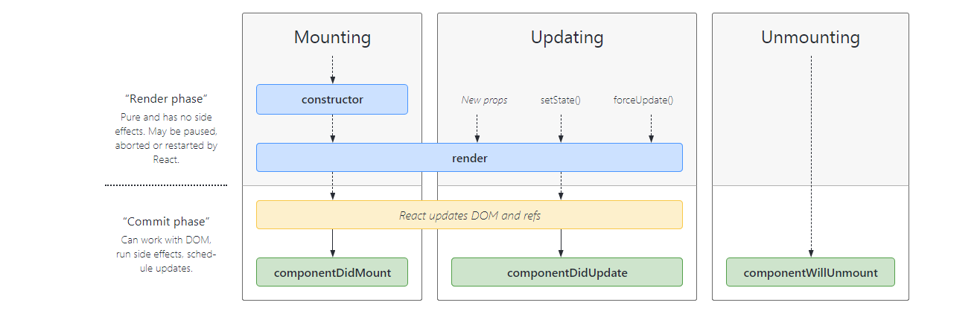
Life cycle in brief

Slide 96
Life cycle in brief
The Component Lifecycle
Each component has several “lifecycle methods” that you can override to run code at particular times in the process. You can use this lifecycle diagram as a cheat sheet. In the list below, commonly used lifecycle methods are marked as bold. The rest of them exist for relatively rare use cases.
Mounting
These methods are called in the following order when an instance of a component is being created and inserted into the DOM:
constructor()
static getDerivedStateFromProps()
render()
componentDidMount()
Note:
These methods are considered legacy and you should avoid them in new code:
UNSAFE_componentWillMount()
Updating
An update can be caused by changes to props or state. These methods are called in the following order when a component is being re-rendered:
static getDerivedStateFromProps()
shouldComponentUpdate()
render()
getSnapshotBeforeUpdate()
componentDidUpdate()
Note:
These methods are considered legacy and you should avoid them in new code:
UNSAFE_componentWillUpdate()
UNSAFE_componentWillReceiveProps()
Unmounting
This method is called when a component is being removed from the DOM:
componentWillUnmount()
Error Handling
These methods are called when there is an error during rendering, in a lifecycle method, or in the constructor of any child component.
static getDerivedStateFromError()
componentDidCatch()

Slide 97
LifeCycle
Lifecycle of Components
Each component in React has a lifecycle which you can monitor and manipulate during its three main phases.
The three phases are: Mounting, Updating, and Unmounting.
Mounting
Mounting means putting elements into the DOM.
React has four built-in methods that gets called, in this order, when mounting a component:
constructor()
getDerivedStateFromProps()
render()
componentDidMount()
The render() method is required and will always be called, the others are optional and will be called if you define them.
constructor
The constructor() method is called before anything else, when the component is initiated, and it is the natural place to set up the initial state and other initial values.
The constructor() method is called with the props, as arguments, and you should always start by calling the super(props) before anything else, this will initiate the parent's constructor method and allows the component to inherit methods from its parent (React.Component).
Example:
The constructor method is called, by React, every time you make a component:

Slide 98
LifeCycle
getDerivedStateFromProps
The getDerivedStateFromProps() method is called right before rendering the element(s) in the DOM.
This is the natural place to set the state object based on the initial props.
It takes state as an argument, and returns an object with changes to the state.
The example below starts with the favorite color being "red", but the getDerivedStateFromProps() method updates the favorite color based on the favcol attribute:
Example:
The getDerivedStateFromProps method is called right before the render method:
class Header extends React.Component {
constructor(props) {
super(props);
this.state = {favoritecolor: "red"};
}
static getDerivedStateFromProps(props, state) {
return {favoritecolor: props.favcol };
}
render() {
return (
<h1>My Favorite Color is {this.state.favoritecolor}</h1>
);
}
}
ReactDOM.render(<Header favcol="yellow"/>, document.getElementById('root'));

Slide 99
LifeCycle
componentDidMount
The componentDidMount() method is called after the component is rendered.
This is where you run statements that requires that the component is already placed in the DOM.
At first my favorite color is red, but give me a second, and it is yellow instead:
class Header extends React.Component {
constructor(props) {
super(props);
this.state = {favoritecolor: "red"};
}
componentDidMount() {
setTimeout(() => {
this.setState({favoritecolor: "yellow"})
}, 1000)
}
render() {
return (
<h1>My Favorite Color is {this.state.favoritecolor}</h1>
);
}
}
ReactDOM.render(<Header />, document.getElementById('root'));

Slide 100
Life cycle
Updating
The next phase in the lifecycle is when a component is updated.
A component is updated whenever there is a change in the component's state or props.
React has five built-in methods that gets called, in this order, when a component is updated:
getDerivedStateFromProps()
shouldComponentUpdate()
render()
getSnapshotBeforeUpdate()
componentDidUpdate()
The render() method is required and will always be called, the others are optional and will be called if you define them.
getDerivedStateFromProps
Also at updates the getDerivedStateFromProps method is called. This is the first method that is called when a component gets updated.
This is still the natural place to set the state object based on the initial props.
The example below has a button that changes the favorite color to blue, but since the getDerivedStateFromProps() method is called, which updates the state with the color from the favcol attribute, the favorite color is still rendered as yellow:

Slide 101
Life cycle
Example:
If the component gets updated, the getDerivedStateFromProps() method is called:
class Header extends React.Component {
constructor(props) {
super(props);
this.state = {favoritecolor: "red"};
}
static getDerivedStateFromProps(props, state) {
return {favoritecolor: props.favcol };
}
changeColor = () => {
this.setState({favoritecolor: "blue"});
}
render() {
return (
<div>
<h1>My Favorite Color is {this.state.favoritecolor}</h1>
<button type="button" onClick={this.changeColor}>Change color</button>
</div>
);
}
}
ReactDOM.render(<Header favcol="yellow"/>, document.getElementById('root'));

Slide 102
Life cycle
shouldComponentUpdate
In the shouldComponentUpdate() method you can return a Boolean value that specifies whether React should continue with the rendering or not.
The default value is true.
The example below shows what happens when the shouldComponentUpdate() method returns false:
Example:
Stop the component from rendering at any update:
class Header extends React.Component {
constructor(props) {
super(props);
this.state = {favoritecolor: "red"};
}
shouldComponentUpdate() {
return false;
}
changeColor = () => {
this.setState({favoritecolor: "blue"});
}
render() {
return (
<div>
<h1>My Favorite Color is {this.state.favoritecolor}</h1>
<button type="button" onClick={this.changeColor}>Change color</button>
</div>
);
}
}
ReactDOM.render(<Header />, document.getElementById('root'));

Slide 103
Life cycle
Example:
Same example as above, but this time the shouldComponentUpdate() method returns true instead:
class Header extends React.Component {
constructor(props) {
super(props);
this.state = {favoritecolor: "red"};
}
shouldComponentUpdate() {
return true;
}
changeColor = () => {
this.setState({favoritecolor: "blue"});
}
render() {
return (
<div>
<h1>My Favorite Color is {this.state.favoritecolor}</h1>
<button type="button" onClick={this.changeColor}>Change color</button>
</div>
);
}
}
ReactDOM.render(<Header />, document.getElementById('root'));
render
The render() method is of course called when a component gets updated, it has to re-render the HTML to the DOM, with the new changes.
The example below has a button that changes the favorite color to blue:

Slide 104
class Header extends React.Component {
constructor(props) {
super(props);
this.state = {favoritecolor: "red"};
}
changeColor = () => {
this.setState({favoritecolor: "blue"});
}
render() {
return (
<div>
<h1>My Favorite Color is {this.state.favoritecolor}</h1>
<button type="button" onClick={this.changeColor}>Change color</button>
</div>
);
}
}
ReactDOM.render(<Header />, document.getElementById('root'));

Slide 105
getSnapshotBeforeUpdate
In the getSnapshotBeforeUpdate() method you have access to the props and state before the update, meaning that even after the update, you can check what the values were before the update.
If the getSnapshotBeforeUpdate() method is present, you should also include the componentDidUpdate() method, otherwise you will get an error.
The example below might seem complicated, but all it does is this:
When the component is mounting it is rendered with the favorite color "red".
When the component has been mounted, a timer changes the state, and after one second, the favorite color becomes "yellow".
This action triggers the update phase, and since this component has a getSnapshotBeforeUpdate() method, this method is executed, and writes a message to the empty DIV1 element.
Then the componentDidUpdate() method is executed and writes a message in the empty DIV2 element:

Slide 106
Example:
Use the getSnapshotBeforeUpdate() method to find out what the state object looked like before the update:
class Header extends React.Component {
constructor(props) {
super(props);
this.state = {favoritecolor: "red"};
}
componentDidMount() {
setTimeout(() => {
this.setState({favoritecolor: "yellow"})
}, 1000)
}
getSnapshotBeforeUpdate(prevProps, prevState) {
document.getElementById("div1").innerHTML =
"Before the update, the favorite was " + prevState.favoritecolor;
}
componentDidUpdate() {
document.getElementById("div2").innerHTML =
"The updated favorite is " + this.state.favoritecolor;
}
render() {
return (
<div>
<h1>My Favorite Color is {this.state.favoritecolor}</h1>
<div id="div1"></div>
<div id="div2"></div>
</div>
);
}
}
ReactDOM.render(<Header />, document.getElementById('root'));

Slide 107
componentDidUpdate
The componentDidUpdate method is called after the component is updated in the DOM.
The example below might seem complicated, but all it does is this:
When the component is mounting it is rendered with the favorite color "red".
When the component has been mounted, a timer changes the state, and the color becomes "yellow".
This action triggers the update phase, and since this component has a componentDidUpdate method, this method is executed and writes a message in the empty DIV element:
Example:
The componentDidUpdate method is called after the update has been rendered in the DOM:
class Header extends React.Component {
constructor(props) {
super(props);
this.state = {favoritecolor: "red"};
}
componentDidMount() {
setTimeout(() => {
this.setState({favoritecolor: "yellow"})
}, 1000)
}
componentDidUpdate() {
document.getElementById("mydiv").innerHTML =
"The updated favorite is " + this.state.favoritecolor;
}
render() {
return (
<div>
<h1>My Favorite Color is {this.state.favoritecolor}</h1>
<div id="mydiv"></div>
</div>
);
}
}
ReactDOM.render(<Header />, document.getElementById('root'));

Slide 108
Unmounting
The next phase in the lifecycle is when a component is removed from the DOM, or unmounting as React likes to call it.
React has only one built-in method that gets called when a component is unmounted:
componentWillUnmount()
componentWillUnmount
The componentWillUnmount method is called when the component is about to be removed from the DOM.

Slide 109
Click the button to delete the header:
class Container extends React.Component {
constructor(props) {
super(props);
this.state = {show: true};
}
delHeader = () => {
this.setState({show: false});
}
render() {
let myheader;
if (this.state.show) {
myheader = <Child />;
};
return (
<div>
{myheader}
<button type="button" onClick={this.delHeader}>Delete Header</button>
</div>
);
}
}
class Child extends React.Component {
componentWillUnmount() {
alert("The component named Header is about to be unmounted.");
}
render() {
return (
<h1>Hello World!</h1>
);
}
}
ReactDOM.render(<Container />, document.getElementById('root'));

Slide 110
Without arrow function, the React event object is sent automatically as the last argument when using the bind() method:
Example:
With the bind() method, the event object is sent as the last argument:
class Football extends React.Component {
shoot = (a, b) => {
alert(b.type);
/*
'b' represents the React event that triggered the function,
in this case the 'click' event
*/
}
render() {
return (
<button onClick={this.shoot.bind(this, "Goal")}>Take the shot!</button>
);
}
}
ReactDOM.render(<Football />, document.getElementById('root'));

Slide 111
Fetch data from server
import React, { Component, Fragment } from 'react';
import styles from './fetch.module.css';
const API = process.env.REACT_APP_API || 'http://localhost:8080/rest';
class EmpFetch extends Component {
state = {
loading: true,
emps: [],
error: null,
};
componentDidMount() {
let employees = this.getEmployees();
console.log(this.state.emps);
}
async fetch(method, endpoint, body) {
try {
const response = await fetch(`${API}${endpoint}`, {
method,
body: body && JSON.stringify(body),
headers: {
'content-type': 'application/json',
accept: 'application/json',
// authorization: `Bearer ${await this.props.authService.getAccessToken()}`,
},
});
return await response.json();
} catch (error) {
console.error(error);
this.setState({ error });
}
}
async getEmployees() {
this.setState({ loading: false, emps: (await this.fetch('get', '/employees')) || [] });
}
saveEmp = async (emp) => {
if (emp.id) {
await this.fetch('put', `/employees/${emp.id}`, emp);
} else {
await this.fetch('post', '/employees', emp);
}
this.getEmployees();
}
async deleteEmp(emp) {
if (window.confirm(`Are you sure you want to delete "${emp.name}"`)) {
await this.fetch('delete', `/employees/${emp.id}`);
this.getEmployees();
}
}
/* renderEmpEditor = ({ match: { params: { id } } }) => {
if (this.state.loading) return null;
const emp = find(this.state.emps, { id: Number(id) });
if (!emp && id !== 'new') return <Redirect to="/posts" />;
return <PostEditor post={post} onSave={this.savePost} />;
};
*/
render() {
const { classes } = this.props;
console.log(this.state.emps)
let elements = <div></div>;
let employees = {};
if (this.state.emps) {
employees = this.state.emps;
employees.forEach(e => {
console.log(e)
});
/* <table border="1">
<tbody>
elements = employees.map((e) => (
<tr>
<td>{e.firstName}</td>
<td>{e.lastName}</td>
</tr>
</tbody>
</table>
)) */
elements = employees.map((e) => (
<div className={styles.row} key={e.id}>
<div className={styles.col} key={e.firstName}>{e.firstName}</div>
<div className={styles.col} key={e.lastName}>{e.lastName}</div>
</div>
))
console.log(elements)
}
return (
<div id="emp" className={styles.table}>
<div className={styles.row} key="id">
<div className={styles.col} key="firstName">First Name</div>
<div className={styles.col} key="lastName">Last Name</div>
</div>
{elements}
</div>
);
}
}
export default EmpFetch;

Slide 112
Fetching data
/* .table{
display: table;
}
#employee {
font-family: Arial, Helvetica, sans-serif;
width: 100%;
display: table;
border: 2px solid blue;
}
.row {
border: 1px solid rgb(226, 46, 46);
padding: 8px;
display: table-row;
width: 100%;
}
.col {
border: 1px solid #ddd;
padding: 8px;
float: left;
display: table-column;
}
.row:nth-child(even){background-color: #f2f2f2;}
.row:hover {background-color: #ddd;}
.header {
padding-top: 12px;
padding-bottom: 12px;
text-align: left;
background-color: #04AA6D;
color: white;
}
*/
.table {
width: 90%;
display: table;
margin-left: 2%;
}
.row {
display: table-row;
width: auto;
clear: both;
}
.col {
display: table-cell;
padding: 10px;
text-align: justify;
border: 1px solid black;
}
.row:nth-child(even){background-color: #f2f2f2;}
.row:hover {background-color: rgb(79, 66, 128);}

Slide 113
Create a Form to Save data on server
import React from 'react'
import styles from './emp.form.module.css';
import EmployeeList from './EmployeesList';
const API = process.env.REACT_APP_API || 'http://localhost:8080/rest';
class EmployeeForm extends React.Component {
constructor(props) {
super(props)
this.state = {
loading: true,
emp: {},
employees: [],
error: null,
};
}
componentDidMount() {
this.getEmployees();
}
async getEmployees() {
this.setState({ loading: false, employees: (await this.fetch('get', '/employees')) || [] });
}
saveEmp = async () => {
let emp = this.state.emp;
if (emp.id) {
console.log(emp.id)
await this.fetch('put', `/employees/${emp.id}`, emp);
} else {
await this.fetch('post', '/employees', emp);
}
this.getEmployees();
}
async fetch(method, endpoint, body) {
try {
const response = await fetch(`${API}${endpoint}`, {
method,
body: body && JSON.stringify(body),
headers: {
'content-type': 'application/json',
accept: 'application/json',
// authorization: `Bearer ${await this.props.authService.getAccessToken()}`,
},
});
return await response.json();
} catch (error) {
console.error(error);
this.setState({ error });
}
}
handleChange = (event) => {
let e = { [event.target.name]: event.target.value };
console.log(e);
this.setState(prevState => ({
emp: { // object that we want to update
...prevState.emp, // keep all other key-value pairs
[event.target.name]: event.target.value // update the value of specific key
}
}))
console.log(this.state.emp)
}
render() {
let emp = {};
emp = this.state.emp
return (
<div>
<form action="http://localhost:8080/rest/employees" method="post">
<div className={styles.table}>
<div className={styles.row}>
<div className={styles.column}>
<label> ID</label>
</div>
<div className={styles.column}>
<input type="text" name="id" id="id" onChange={this.handleChange} />
</div>
</div>
<div className={styles.row}>
<div className={styles.column}>
<label> First Name</label>
</div>
<div className={styles.column}>
<input type="text" name="firstName" id="firstName" onChange={this.handleChange} />
</div>
</div>
<div className={styles.row}>
<div className={styles.column}>
<label>Last Name</label>
</div>
<div className={styles.column}>
<input type="text" name="lastName" id="lastName" onChange={this.handleChange} />
</div>
</div>
<div className={styles.row}>
<div className={styles.column}>
<input type="button" value="Save" onClick={this.saveEmp} />
</div>
<div className={styles.column}>
<input type="button" value="Update" onClick={this.saveEmp} />
</div>
</div>
</div>
</form>
<div>
<EmployeeList employees={this.state.employees} />
</div>
</div>
)
}
}
export default EmployeeForm;

Slide 114
Emp.form.module.css
.table {
width: 40%;
display: table;
margin-left: 20%;
margin-top: 2%;
border: 1px solid black;
}
.row {
display: table-row;
width: auto;
clear: both;
}
.column {
display: table-cell;
padding: 10px;
text-align: justify;
}

Slide 115
Employee List
import React from 'react'
import styles from './emp.list.module.css';
const API = process.env.REACT_APP_API || 'http://localhost:8080/rest';
class EmployeeList extends React.Component {
constructor(props) {
super(props)
/* this.state = {
loading: true,
employees: [],
error: null,
}; */
}
/* componentDidMount() {
this.getEmployees();
}
async getEmployees() {
this.setState({ loading: false, employees: (await this.fetch('get', '/employees')) || [] });
}
*/
async fetch(method, endpoint, body) {
try {
const response = await fetch(`${API}${endpoint}`, {
method,
body: body && JSON.stringify(body),
headers: {
'content-type': 'application/json',
accept: 'application/json',
// authorization: `Bearer ${await this.props.authService.getAccessToken()}`,
},
});
return await response.json();
} catch (error) {
console.error(error);
this.setState({ error });
}
}
render() {
//let employees = {}
// let elements = {}
if (!this.props.employees) {
return <div>Loading Employees...</div>
}
let employees = this.props.employees;
/* elements = employees.map((e) => (
<div className={styles.row} key={e.id}>
<div className={styles.col} key={e.id}>{e.id}</div>
<div className={styles.col} key={e.firstName}>{e.firstName}</div>
<div className={styles.col} key={e.lastName}>{e.lastName}</div>
</div>
)) */
let elements = employees.map((e) => (
<tr>
<td className={styles.col}>{e.id}</td>
<td className={styles.col}>{e.firstName}</td>
<td className={styles.col}>{e.lastName}</td>
</tr>
)
)
return (<div>
<table id="employee" className={styles.empTable}>
<thead>
<tr>
<th className={styles.header}>ID</th>
<th className={styles.header}>First Name</th>
<th className={styles.header}>Last Name</th>
</tr>
</thead>
<tbody>
{elements}
</tbody>
</table>
</div>
);
}
}
export default EmployeeList;

Slide 116
emp.list.modules.css
.empTable {
font-family: Arial, Helvetica, sans-serif;
border-collapse: collapse;
width: 80%;
border: 1px solid gold;
margin-left: 10%;
margin-right: 10%;
}
.empTable col {
border: 1px solid #ddd;
padding: 8px;
}
.empTable tr:nth-child(even){background-color: #f2f2f2;}
.empTable tr:hover {background-color: #ddd;}
.empTable .header {
padding-top: 12px;
padding-bottom: 12px;
text-align: left;
background-color: #04AA6D;
color: white;
}

