Slide 1
JavaScript

Slide 2
What is JavaScript ?
JavaScript is a dynamic computer programming language.
It is lightweight and most commonly used as a part of web pages, whose implementations allow client-side script to interact with the user and make dynamic pages.
It is an interpreted programming language with object-oriented capabilities.
JavaScript was first known as LiveScript, but Netscape changed its name to JavaScript, possibly because of the excitement being generated by Java. JavaScript made its first appearance in Netscape 2.0 in 1995 with the name LiveScript.
The general-purpose core of the language has been embedded in Netscape, Internet Explorer, and other web browsers

Slide 3
Advantages of JavaScript
The merits of using JavaScript are −
Less server interaction − You can validate user input before sending the page off to the server. This saves server traffic, which means less load on your server.
Immediate feedback to the visitors − They don't have to wait for a page reload to see if they have forgotten to enter something.
Increased interactivity − You can create interfaces that react when the user hovers over them with a mouse or activates them via the keyboard.
Richer interfaces − You can use JavaScript to include such items as drag-and-drop components and sliders to give a Rich Interface to your site visitors.

Slide 4
<html>
<body>
<script language = "javascript" type = "text/javascript">
alert("Hello World!");
console.log(“Hello World”);
</script>
</body>
</html>

Slide 5
Semicolons are Optional
<script language = "javascript" type = "text/javascript">
<!--
var1 = 10
var2 = 20
//-->
</script>
But when formatted in a single line as follows, you must use semicolons −
<script language = "javascript" type = "text/javascript">
<!--
var1 = 10; var2 = 20;
//-->
</script>

Slide 6
Comments
Java Style comment

Slide 7
Inline JavaScript
<html>
<head>
<script type = "text/javascript">
<!--
function sayHello() {
alert("Hello World")
}
//-->
</script>
</head>
<body>
<script type = "text/javascript">
<!--
document.write("Hello World")
//-->
</script>
<input type = "button" onclick = "sayHello()" value = "Say Hello" />
</body>
</html>

Slide 8
External JavaScript
<html>
<head>
<script type = "text/javascript" src = “<filename.js>" ></script>
</head>
<body>
.......
</body>
</html>

Slide 9
Data Type
JavaScript allows you to work with three primitive data types −
Numbers, eg. 123, 120.50 etc.
Strings of text e.g. "This text string" etc.
Boolean e.g. true or false.
JavaScript also defines two trivial data types, null and undefined, each of which defines only a single value. In addition to these primitive data types, JavaScript supports a composite data type known as object.

Slide 10
Variable
There are 3 ways to declare a JavaScript variable:
Using var
Using let
Using const
This chapter uses var.
<script>
var x = 5; var y = 6; var z = x + y;
</script>
One Statement, Many Variables
You can declare many variables in one statement.
Start the statement with var and separate the variables by comma:
var person = "John Doe", carName = "Volvo", price = 200;
A variable declared without a value will have the value undefined.

Slide 11
Variable
JavaScript Variable Scope
The scope of a variable is the region of your program in which it is defined. JavaScript variables have only two scopes.
Global Variables − A global variable has global scope which means it can be defined anywhere in your JavaScript code.
Local Variables − A local variable will be visible only within a function where it is defined. Function parameters are always local to that function.
Within the body of a function, a local variable takes precedence over a global variable with the same name. If you declare a local variable or function parameter with the same name as a global variable, you effectively hide the global variable. Take a look into the following example.
Live Demo
<html>
<body onload = checkscope();>
<script type = "text/javascript">
<!--
var myVar = "global"; // Declare a global variable
function checkscope( ) {
var myVar = "local"; // Declare a local variable
document.write(myVar);
}
//-->
</script>
</body>
</html>

Slide 12
Variable JavaScript Let
The let keyword was introduced in ES6 (2015).
Variables defined with let cannot be Redeclared.
Variables defined with let must be Declared before use.
Variables defined with let have Block Scope.
Cannot be Redeclared
Variables defined with let cannot be redeclared.
You cannot accidentally redeclare a variable.
With let you can not do this:
Example
let x = "John Doe"; let x = 0; // SyntaxError: 'x' has already been declared
With var you can:
Example
var x = "John Doe"; var x = 0;

Slide 13
Let
Block Scope
Before ES6 (2015), JavaScript had only Global Scope and Function Scope.
ES6 introduced two important new JavaScript keywords: let and const.
These two keywords provide Block Scope in JavaScript.
Variables declared inside a { } block cannot be accessed from outside the block:
Example
{ let x = 2; } // x can NOT be used here
Variables declared with the var keyword can NOT have block scope.
Variables declared inside a { } block can be accessed from outside the block.
Example
{ var x = 2; } // x CAN be used here

Slide 14
Redeclaring Variables
Redeclaring a variable using the var keyword can impose problems.
Redeclaring a variable inside a block will also redeclare the variable outside the block:
Example
var x = 10; // Here x is 10 { var x = 2; // Here x is 2 } // Here x is 2

Slide 15
Redeclaring variable
Redeclaring a variable using the let keyword can solve this problem.
Redeclaring a variable inside a block will not redeclare the variable outside the block:
Example
let x = 10; // Here x is 10 { let x = 2; // Here x is 2 } // Here x is 10

Slide 16
Redeclaring
Redeclaring a JavaScript variable with var is allowed anywhere in a program:
Example
var x = 2; // Now x is 2 var x = 3; // Now x is 3
With let, redeclaring a variable in the same block is NOT allowed:
Example
var x = 2; // Allowed let x = 3; // Not allowed { let x = 2; // Allowed let x = 3 // Not allowed } { let x = 2; // Allowed var x = 3 // Not allowed }
Redeclaring a variable with let, in another block, IS allowed:
Example
let x = 2; // Allowed { let x = 3; // Allowed } { let x = 4; // Allowed }

Slide 17
Let Hoisting
Variables defined with var are hoisted to the top and can be initialized at any time.
Meaning: You can use the variable before it is declared:
Example
This is OK:
carName = "Volvo"; var carName;
Variables defined with let are also hoisted to the top of the block, but not initialized.
Meaning: Using a let variable before it is declared will result in a ReferenceError:
Example
carName = "Saab"; let carName = "Volvo";

Slide 18
JavaScript Const
The const keyword was introduced in ES6 (2015).
Variables defined with const cannot be Redeclared.
Variables defined with const cannot be Reassigned.
Variables defined with const have Block Scope.
Cannot be Reassigned
const PI = 3.141592653589793; PI = 3.14; // This will give an error PI = PI + 10; // This will also give an error
Must be Assigned
JavaScript const variables must be assigned a value when they are declared:
Correct
const PI = 3.14159265359;
Incorrect
const PI; PI = 3.14159265359;

Slide 19
Const
When to use JavaScript const?
As a general rule, always declare a variables with const unless you know that the value will change.
Always use const when you declare:
A new Array
A new Object
A new Function
A new RegExp
Constant Objects and Arrays
The keyword const is a little misleading.
It does not define a constant value. It defines a constant reference to a value.
Because of this you can NOT:
Reassign a constant value
Reassign a constant array
Reassign a constant object
But you CAN:
Change a constant array
Change a constant object
Constant Arrays
You can change the elements of a constant array:
Example
// You can create a constant array: const cars = ["Saab", "Volvo", "BMW"]; // You can change an element: cars[0] = "Toyota"; // You can add an element: cars.push("Audi");

Slide 20
Const
But you can NOT reassign the array:
Example
const cars = ["Saab", "Volvo", "BMW"]; cars = ["Toyota", "Volvo", "Audi"]; // ERROR
Constant Objects
You can change the properties of a constant object:
Example
// You can create a const object: const car = {type:"Fiat", model:"500", color:"white"}; // You can change a property: car.color = "red"; // You can add a property: car.owner = "Johnson";
Try it Yourself »
But you can NOT reassign the object:
Example
const car = {type:"Fiat", model:"500", color:"white"}; car = {type:"Volvo", model:"EX60", color:"red"}; // ERROR

Slide 21
Const
Block Scope
Declaring a variable with const is similar to let when it comes to Block Scope.
The x declared in the block, in this example, is not the same as the x declared outside the block:
Example
const x = 10; // Here x is 10 { const x = 2; // Here x is 2 } // Here x is 10

Slide 22
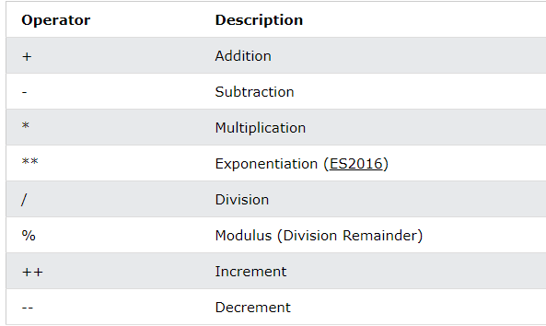
Operator
let x = 5; let y = 2; let z = x + y;

Slide 23
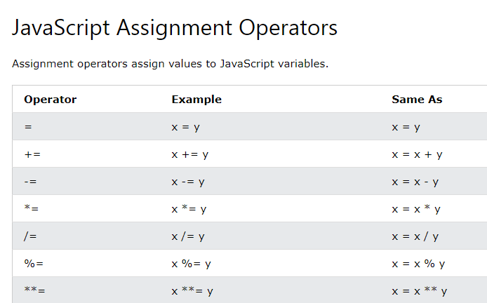
Assignment Operators

Slide 24
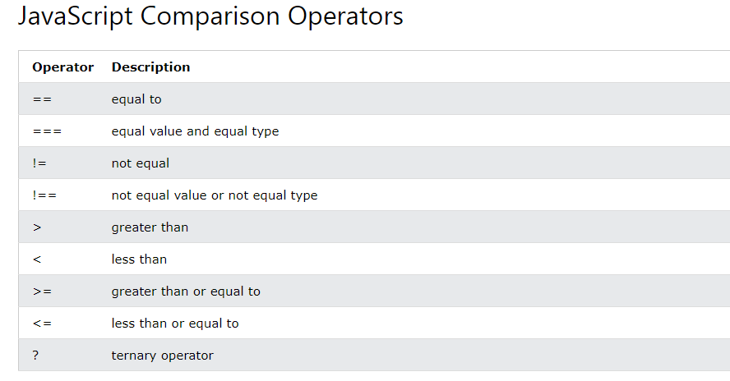
Comparison Operator

Slide 25
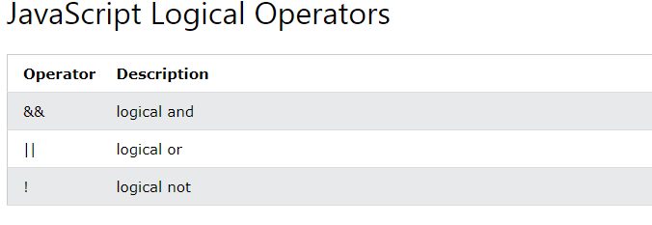
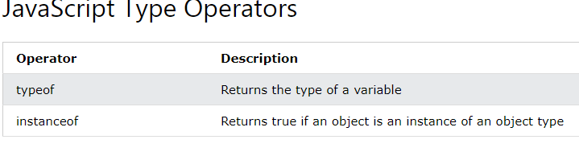
Logical Operator

Slide 26
Function
JavaScript Functions
A JavaScript function is a block of code designed to perform a particular task.
A JavaScript function is executed when "something" invokes it (calls it).
function myFunction(p1, p2) { return p1 * p2; // The function returns the product of p1 and p2 }
JavaScript Function Syntax
A JavaScript function is defined with the function keyword, followed by a name, followed by parentheses ().
Function names can contain letters, digits, underscores, and dollar signs (same rules as variables).
The parentheses may include parameter names separated by commas: (parameter1, parameter2, ...)
The code to be executed, by the function, is placed inside curly brackets: {}
function name(parameter1, parameter2, parameter3) { // code to be executed }

Slide 27
Function
Function Return
When JavaScript reaches a return statement, the function will stop executing.
If the function was invoked from a statement, JavaScript will "return" to execute the code after the invoking statement.
Functions often compute a return value. The return value is "returned" back to the "caller":
Example
Calculate the product of two numbers, and return the result:
let x = myFunction(4, 3); // Function is called, return value will end up in x function myFunction(a, b) { return a * b; // Function returns the product of a and b }

Slide 28
JavaScript Objects
Objects are variables too. But objects can contain many values.
This code assigns many values (Fiat, 500, white) to a variable named car:
const car = {type:"Fiat", model:"500", color:"white"};
The values are written as name:value pairs (name and value separated by a colon).
It is a common practice to declare objects with the const keyword.
const person = {firstName:"John", lastName:"Doe", age:50, eyeColor:"blue"};
Spaces and line breaks are not important. An object definition can span multiple lines:
Example
const person = { firstName: "John", lastName: "Doe", age: 50, eyeColor: "blue" };

Slide 29
Accessing Object Properties
You can access object properties in two ways:
objectName.propertyName
or
objectName["propertyName"]
Example1
person.lastName;
Example2
person["lastName"];

Slide 30
Object Method
Object Methods
Objects can also have methods.
Methods are actions that can be performed on objects.
Methods are stored in properties as function definitions.
Example
const person = { firstName: "John", lastName : "Doe", id : 5566, fullName : function() { return this.firstName + " " + this.lastName; } };
The this Keyword
In a function definition, this refers to the "owner" of the function.
In the example above, this is the person object that "owns" the fullName function.
In other words, this.firstName means the firstName property of this object.

Slide 31
Accessing Object Methods
You access an object method with the following syntax:
objectName.methodName()
Example
name = person.fullName();
If you access a method without the () parentheses, it will return the function definition:
Example
name = person.fullName;
Do Not Declare Strings, Numbers, and Booleans as Objects!
When a JavaScript variable is declared with the keyword "new", the variable is created as an object:
x = new String(); // Declares x as a String object y = new Number(); // Declares y as a Number object z = new Boolean(); // Declares z as a Boolean object
Avoid String, Number, and Boolean objects. They complicate your code and slow down execution speed.

Slide 32
String
JavaScript Strings
A JavaScript string is zero or more characters written inside quotes.
Example
let text = "John Doe";
You can use single or double quotes:
Example
let carName1 = "Volvo XC60"; // Double quotes let carName2 = 'Volvo XC60'; // Single quotes
You can use quotes inside a string, as long as they don't match the quotes surrounding the string:
Example
let answer1 = "It's alright"; let answer2 = "He is called 'Johnny'"; let answer3 = 'He is called "Johnny"'; String Length
To find the length of a string, use the built-in length property:
Example
let text = "ABCDEFGHIJKLMNOPQRSTUVWXYZ"; text.length; // Will return 26
Escape Character
Because strings must be written within quotes, JavaScript will misunderstand this string:
let text = "We are the so-called "Vikings" from the north.";
The string will be chopped to "We are the so-called ".
The solution to avoid this problem, is to use the backslash escape character.
The backslash (\) escape character turns special characters into string characters:

Slide 33
String Method
String Methods and Properties
Primitive values, like "John Doe", cannot have properties or methods (because they are not objects).
But with JavaScript, methods and properties are also available to primitive values, because JavaScript treats primitive values as objects when executing methods and properties.
String Length
The length property returns the length of a string:
Example
let txt = "ABCDEFGHIJKLMNOPQRSTUVWXYZ"; txt.length // Returns 26
Finding a String in a String
The indexOf() method returns the index of (the position of) the first occurrence of a specified text in a string:
Example
let str = "Please locate where 'locate' occurs!"; str.indexOf("locate") // Returns 7
JavaScript counts positions from zero. 0 is the first position in a string, 1 is the second, 2 is the third ...
The lastIndexOf() method returns the index of the last occurrence of a specified text in a string:
Example
let str = "Please locate where 'locate' occurs!"; str.lastIndexOf("locate") // Returns 21
Both indexOf(), and lastIndexOf() return -1 if the text is not found:
Example
let str = "Please locate where 'locate' occurs!"; str.lastIndexOf("John") // Returns -1
Both methods accept a second parameter as the starting position for the search:

Slide 34
Example
let str = "Please locate where 'locate' occurs!"; str.indexOf("locate", 15) // Returns 21
The lastIndexOf() methods searches backwards (from the end to the beginning), meaning: if the second parameter is 15, the search starts at position 15, and searches to the beginning of the string.
Example
let str = "Please locate where 'locate' occurs!"; str.lastIndexOf("locate", 15) // Returns 7
Searching for a String in a String
The search() method searches a string for a specified value and returns the position of the match:
Example
let str = "Please locate where 'locate' occurs!"; str.search("locate") // Returns 7
Did You Notice?
The two methods, indexOf() and search(), are equal?
They accept the same arguments (parameters), and return the same value?
The two methods are NOT equal. These are the differences:
The search() method cannot take a second start position argument.
The indexOf() method cannot take powerful search values (regular expressions).

Slide 35
Extracting String Parts
There are 3 methods for extracting a part of a string:
slice(start, end)
substring(start, end)
substr(start, length)
The slice() Method
slice() extracts a part of a string and returns the extracted part in a new string.
The method takes 2 parameters: the start position, and the end position (end not included).
This example slices out a portion of a string from position 7 to position 12 (13-1):
Example
let str = "Apple, Banana, Kiwi"; str.slice(7, 13) // Returns Banana
Remember: JavaScript counts positions from zero. First position is 0.
If a parameter is negative, the position is counted from the end of the string.
This example slices out a portion of a string from position -12 to position -6:
Example
let str = "Apple, Banana, Kiwi"; str.slice(-12, -6) // Returns Banana

Slide 36
If you omit the second parameter, the method will slice out the rest of the string:
Example
str.slice(7); // Returns Banana,Kiwi
or, counting from the end:
Example
str.slice(-12) // Returns Banana,Kiwi
The substring() Method
substring() is similar to slice().
The difference is that substring() cannot accept negative indexes.
Example
let str = "Apple, Banana, Kiwi"; substring(7, 13) // Returns Banana
If you omit the second parameter, substring() will slice out the rest of the string.
The substr() Method
substr() is similar to slice().
The difference is that the second parameter specifies the length of the extracted part.
Example
let str = "Apple, Banana, Kiwi"; str.substr(7, 6) // Returns Banana
The result of res will be:
Banana

Slide 37
If you omit the second parameter, substr() will slice out the rest of the string.
Example
let str = "Apple, Banana, Kiwi"; str.substr(7) // Returns Banana,Kiwi
If the first parameter is negative, the position counts from the end of the string.
Example
let str = "Apple, Banana, Kiwi"; str.substr(-4) // Returns Kiwi
Replacing String Content
The replace() method replaces a specified value with another value in a string:
Example
let text = "Please visit Microsoft!"; let newText = text.replace("Microsoft", "W3Schools");
The replace() method does not change the string it is called on. It returns a new string.
By default, the replace() method replaces only the first match:
Example
let text = "Please visit Microsoft and Microsoft!"; let newText = text.replace("Microsoft", "W3Schools");

Slide 38
By default, the replace() method is case sensitive. Writing MICROSOFT (with upper-case) will not work:
Example
let text = "Please visit Microsoft!"; let newText = text.replace("MICROSOFT", "W3Schools");
To replace case insensitive, use a regular expression with an /i flag (insensitive):
Example
let text = "Please visit Microsoft!"; let newText = text.replace(/MICROSOFT/i, "W3Schools");
Note that regular expressions are written without quotes.
To replace all matches, use a regular expression with a /g flag (global match):
Example
let text = "Please visit Microsoft and Microsoft!"; let newText = text.replace(/Microsoft/g, "W3Schools");

Slide 39
Converting to Upper and Lower Case
A string is converted to upper case with toUpperCase():
Example
let text1 = "Hello World!"; // String let text2 = text1.toUpperCase(); // text2 is text1 converted to upper
A string is converted to lower case with toLowerCase():
Example
let text1 = "Hello World!"; // String let text2 = text1.toLowerCase(); // text2 is text1 converted to lower
The concat() Method
concat() joins two or more strings:
Example
let text1 = "Hello"; let text2 = "World"; let text3 = text1.concat(" ", text2);

Slide 40
String method
The concat() method can be used instead of the plus operator. These two lines do the same:
Example
text = "Hello" + " " + "World!"; text = "Hello".concat(" ", "World!");
All string methods return a new string. They don't modify the original string. Formally said: Strings are immutable: Strings cannot be changed, only replaced.
String.trim()
The trim() method removes whitespace from both sides of a string:
Example
let text = " Hello World! "; text.trim() // Returns "Hello World!"
JavaScript String Padding
ECMAScript 2017 added two String methods: padStart and padEnd to support padding at the beginning and at the end of a string.
Example
let text = "5"; text.padStart(4,0) // Returns 0005
Example
let text = "5"; text.padEnd(4,0) // Returns 5000

Slide 41
String method
Extracting String Characters
There are 3 methods for extracting string characters:
charAt(position)
charCodeAt(position)
Property access [ ]
The charAt() Method
The charAt() method returns the character at a specified index (position) in a string:
Example
let text = "HELLO WORLD"; text.charAt(0) // Returns H
The charCodeAt() Method
The charCodeAt() method returns the unicode of the character at a specified index in a string:
The method returns a UTF-16 code (an integer between 0 and 65535).
Example
let text = "HELLO WORLD"; text.charCodeAt(0) // Returns 72

Slide 42
String Method
Property Access
ECMAScript 5 (2009) allows property access [ ] on strings:
Example
let text = "HELLO WORLD"; text[0] // returns H
Property access might be a little unpredictable:
It makes strings look like arrays (but they are not)
If no character is found, [ ] returns undefined, while charAt() returns an empty string.
It is read only. str[0] = "A" gives no error (but does not work!)
Example
let text = "HELLO WORLD"; text[0] = "A" // Gives no error, but does not work text[0] // returns H
If you want to work with a string as an array, you can convert it to an array.
Converting a String to an Array
A string can be converted to an array with the split() method:
Example
text.split(",") // Split on commas text.split(" ") // Split on spaces text.split("|") // Split on pipe
If the separator is omitted, the returned array will contain the whole string in index [0].
If the separator is "", the returned array will be an array of single characters:
Example
text.split("") // Split in characters

Slide 43
Remaining
Number
JS Number Methods
JS Arrays
JS Array Methods
JS Array Sort
JS Array Iteration
JS Array Const
JS Dates
JS Date Formats
JS Date Get Methods
JS Date Set Methods
JS Math
JS Random
JS Booleans
JS Comparisons
JS Conditions
JS Switch
JS Loop For
JS Loop For In
JS Loop For Of
JS Loop While
JS Break
JS Typeof
JS Type Conversion
JS Bitwise
JS RegExp
JS Errors
JS Scope
JS Hoisting
JS Strict Mode
JS this Keyword
JS Arrow Function
JS Classes
JS JSON
JS Debugging

Slide 44
JS Forms
JS Forms
Forms API
JS Objects
Object Definitions
Object Properties
Object Methods
Object Display
Object Accessors
Object Constructors
Object Prototypes
Object Reference
Object Map()
Object Set()
JS Functions
Function Definitions
Function Parameters
Function Invocation
Function Call
Function Apply
Function Closures
JS Classes
Class Intro
Class Inheritance
Class Static
JS Async
JS Callbacks
JS Asynchronous
JS Promises
JS Async/Await

Slide 45
If/Condition
if (age < 18) text = "Too young to buy alcohol";
if (condition1) { // block of code to be executed if condition1 is true } else if (condition2) { // block of code to be executed if the condition1 is false and condition2 is true } else { // block of code to be executed if the condition1 is false and condition2 is false }

Slide 46
Switch
switch(expression) { case x: // code block break; case y: // code block break; default: // code block }
switch (new Date().getDay()) { case 0: day = "Sunday"; break; case 1: day = "Monday"; break; case 2: day = "Tuesday"; break; case 3: day = "Wednesday"; break; case 4: day = "Thursday"; break; case 5: day = "Friday"; break; case 6: day = "Saturday"; }

Slide 47
Loop
for (let i = 0; i < cars.length; i++) { text += cars[i] + "<br>"; }
Different Kinds of Loops
JavaScript supports different kinds of loops:
for - loops through a block of code a number of times
for/in - loops through the properties of an object
for/of - loops through the values of an iterable object
while - loops through a block of code while a specified condition is true
do/while - also loops through a block of code while a specified condition is true

Slide 48
The For Loop
The for loop has the following syntax:
for (statement 1; statement 2; statement 3) { // code block to be executed }
The For In Loop
The JavaScript for in statement loops through the properties of an Object:
Syntax
for (key in object) { // code block to be executed }
Example
const person = {fname:"John", lname:"Doe", age:25}; let text = ""; for (let x in person) { text += person[x]; }
const numbers = [45, 4, 9, 16, 25]; let txt = ""; for (let x in numbers) { txt += numbers[x]; }

Slide 49
The For Of Loop
The JavaScript for of statement loops through the values of an iterable object.
It lets you loop over iterable data structures such as Arrays, Strings, Maps, NodeLists, and more:
Syntax
for (variable of iterable) { // code block to be executed }
The While Loop
The while loop loops through a block of code as long as a specified condition is true.
Syntax
while (condition) { // code block to be executed }
while (i < 10) { text += "The number is " + i; i++; }

Slide 50
The Do While Loop
The do while loop is a variant of the while loop. This loop will execute the code block once, before checking if the condition is true, then it will repeat the loop as long as the condition is true.
Syntax
do { // code block to be executed } while (condition);

Slide 51
JavaScript Arrow Function
Arrow functions were introduced in ES6.
Arrow functions allow us to write shorter function syntax:
Before:
hello = function() { return "Hello World!"; }
hello = () => { return "Hello World!"; }
It gets shorter! If the function has only one statement, and the statement returns a value, you can remove the brackets and the return keyword:
Arrow Functions Return Value by Default:
hello = () => "Hello World!";
Arrow Function With Parameters:
hello = (val) => "Hello " + val;

Slide 52
Arrow Function Without Parentheses:
hello = val => "Hello " + val;

Slide 53
JavaScript Class Syntax
Use the keyword class to create a class.
Always add a method named constructor():
class ClassName { constructor() { ... } }
Example
class Car { constructor(name, year) { this.name = name; this.year = year; } }
Using a Class
When you have a class, you can use the class to create objects:
Example
let myCar1 = new Car("Ford", 2014); let myCar2 = new Car("Audi", 2019);

Slide 54
The Constructor Method
The constructor method is a special method:
It has to have the exact name "constructor"
It is executed automatically when a new object is created
It is used to initialize object properties
If you do not define a constructor method, JavaScript will add an empty constructor method.
Class Methods
Class methods are created with the same syntax as object methods.
Use the keyword class to create a class.
Always add a constructor() method.
Then add any number of methods.
Syntax
class ClassName { constructor() { ... } method_1() { ... } method_2() { ... } method_3() { ... } }

Slide 55
class Car { constructor(name, year) { this.name = name; this.year = year; } age() { let date = new Date(); return date.getFullYear() - this.year; } } let myCar = new Car("Ford", 2014); document.getElementById("demo").innerHTML = "My car is " + myCar.age() + " years old.";

Slide 56
JSON
JSON is a format for storing and transporting data.
JSON is often used when data is sent from a server to a web page.
What is JSON?
JSON stands for JavaScript Object Notation
JSON is a lightweight data interchange format
JSON is language independent *
JSON is "self-describing" and easy to understand
* The JSON syntax is derived from JavaScript object notation syntax, but the JSON format is text only. Code for reading and generating JSON data can be written in any programming language.
JSON Example
This JSON syntax defines an employees object: an array of 3 employee records (objects):
JSON Example
{ "employees":[ {"firstName":"John", "lastName":"Doe"}, {"firstName":"Anna", "lastName":"Smith"}, {"firstName":"Peter", "lastName":"Jones"} ] }

Slide 57
JSON Objects
JSON objects are written inside curly braces.
Just like in JavaScript, objects can contain multiple name/value pairs:
{"firstName":"John", "lastName":"Doe"}
JSON Arrays
JSON arrays are written inside square brackets.
Just like in JavaScript, an array can contain objects:
"employees":[ {"firstName":"John", "lastName":"Doe"}, {"firstName":"Anna", "lastName":"Smith"}, {"firstName":"Peter", "lastName":"Jones"} ]
In the example above, the object "employees" is an array. It contains three objects.
Each object is a record of a person (with a first name and a last name).

Slide 58
Converting a JSON Text to a JavaScript Object
A common use of JSON is to read data from a web server, and display the data in a web page.
For simplicity, this can be demonstrated using a string as input.
First, create a JavaScript string containing JSON syntax:
let text = '{ "employees" : [' + '{ "firstName":"John" , "lastName":"Doe" },' + '{ "firstName":"Anna" , "lastName":"Smith" },' + '{ "firstName":"Peter" , "lastName":"Jones" } ]}';
Then, use the JavaScript built-in function JSON.parse() to convert the string into a JavaScript object:
const obj = JSON.parse(text);
<p id="demo"></p> <script> document.getElementById("demo").innerHTML = obj.employees[1].firstName + " " + obj.employees[1].lastName; </script>

Slide 59
JavaScript Class Syntax
Use the keyword class to create a class.
Always add a method named constructor():
class ClassName { constructor() { ... } }
Example
class Car { constructor(name, year) { this.name = name; this.year = year; } }
Using a Class
When you have a class, you can use the class to create objects:
Example
let myCar1 = new Car("Ford", 2014); let myCar2 = new Car("Audi", 2019);

Slide 60
JavaScript Class Syntax
Use the keyword class to create a class.
Always add a method named constructor():
class ClassName { constructor() { ... } }
Example
class Car { constructor(name, year) { this.name = name; this.year = year; } }
Using a Class
When you have a class, you can use the class to create objects:
Example
let myCar1 = new Car("Ford", 2014); let myCar2 = new Car("Audi", 2019);

Slide 61
JavaScript Class Syntax
Use the keyword class to create a class.
Always add a method named constructor():
class ClassName { constructor() { ... } }
Example
class Car { constructor(name, year) { this.name = name; this.year = year; } }
Using a Class
When you have a class, you can use the class to create objects:
Example
let myCar1 = new Car("Ford", 2014); let myCar2 = new Car("Audi", 2019);

Slide 62
JavaScript Events
HTML events are "things" that happen to HTML elements.
When JavaScript is used in HTML pages, JavaScript can "react" on these events.
HTML Events
An HTML event can be something the browser does, or something a user does.
Here are some examples of HTML events:
An HTML web page has finished loading
An HTML input field was changed
An HTML button was clicked
Often, when events happen, you may want to do something.
JavaScript lets you execute code when events are detected.
HTML allows event handler attributes, with JavaScript code, to be added to HTML elements.
With single quotes:
<element event='some JavaScript'>
With double quotes:
<element event="some JavaScript">

Slide 63
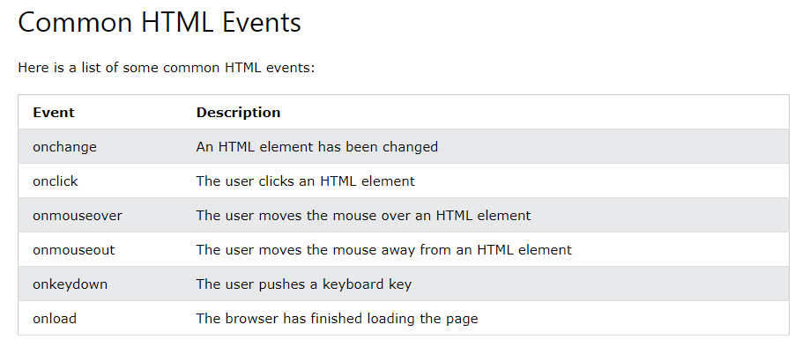
<button onclick="document.getElementById('demo').innerHTML = Date()">The time is?</button>

Slide 64
Array
JavaScript arrays are used to store multiple values in a single variable.
Example
const cars = ["Saab", "Volvo", "BMW"];
What is an Array?
An array is a special variable, which can hold more than one value at a time.
If you have a list of items (a list of car names, for example), storing the cars in single variables could look like this:
let car1 = "Saab"; let car2 = "Volvo"; let car3 = "BMW";
However, what if you want to loop through the cars and find a specific one? And what if you had not 3 cars, but 300?
The solution is an array!
An array can hold many values under a single name, and you can access the values by referring to an index number.
Creating an Array
Using an array literal is the easiest way to create a JavaScript Array.
Syntax:
const array_name = [item1, item2, ...];
Example
const cars = ["Saab", "Volvo", "BMW"];
Spaces and line breaks are not important. A declaration can span multiple lines:
Example
const cars = [ "Saab", "Volvo", "BMW" ];

Slide 65
const cars = []; cars[0]= "Saab"; cars[1]= "Volvo"; cars[2]= "BMW";
Using the JavaScript Keyword new
The following example also creates an Array, and assigns values to it:
const cars = new Array("Saab", "Volvo", "BMW");
Access the Elements of an Array
You access an array element by referring to the index number:
const cars = ["Saab", "Volvo", "BMW"]; let x = cars[0]; // x = "Saab“
Changing an Array Element
This statement changes the value of the first element in cars:
cars[0] = "Opel";
Example
const cars = ["Saab", "Volvo", "BMW"]; cars[0] = "Opel";
Array Properties and Methods
The real strength of JavaScript arrays are the built-in array properties and methods:
cars.length // Returns the number of elements cars.sort() // Sorts the array

Slide 66
Looping Array Elements
The safest way to loop through an array, is using a for loop:
Example
const fruits = ["Banana", "Orange", "Apple", "Mango"]; let fLen = fruits.length; text = "<ul>"; for (let i = 0; i < fLen; i++) { text += "<li>" + fruits[i] + "</li>"; } text += "</ul>";
You can also use the Array.forEach() function:
Example
const fruits = ["Banana", "Orange", "Apple", "Mango"]; let text = "<ul>"; fruits.forEach(myFunction); text += "</ul>"; function myFunction(value) { text += "<li>" + value + "</li>"; }

Slide 67
Adding Array Elements
The easiest way to add a new element to an array is using the push() method:
Example
const fruits = ["Banana", "Orange", "Apple"]; fruits.push("Lemon"); // Adds a new element (Lemon) to fruits
Popping
The pop() method removes the last element from an array:
Example
const fruits = ["Banana", "Orange", "Apple", "Mango"]; fruits.pop(); // Removes "Mango" from fruits
Shifting Elements
Shifting is equivalent to popping, working on the first element instead of the last.
The shift() method removes the first array element and "shifts" all other elements to a lower index.
Example
const fruits = ["Banana", "Orange", "Apple", "Mango"]; fruits.shift(); // Removes "Banana" from fruits
Deleting Elements
Since JavaScript arrays are objects, elements can be deleted by using the JavaScript operator delete:
Example
const fruits = ["Banana", "Orange", "Apple", "Mango"]; delete fruits[0];

Slide 68
Splicing an Array
The splice() method can be used to add new items to an array:
Example
const fruits = ["Banana", "Orange", "Apple", "Mango"]; fruits.splice(2, 0, "Lemon", "Kiwi");
The first parameter (2) defines the position where new elements should be added (spliced in).
The second parameter (0) defines how many elements should be removed.
The rest of the parameters ("Lemon" , "Kiwi") define the new elements to be added.
The splice() method returns an array with the deleted items:

Slide 69
Using splice() to Remove Elements
With clever parameter setting, you can use splice() to remove elements without leaving "holes" in the array:
Example
const fruits = ["Banana", "Orange", "Apple", "Mango"]; fruits.splice(0, 1); // Removes the first element
Try it Yourself »
The first parameter (0) defines the position where new elements should be added (spliced in).
The second parameter (1) defines how many elements should be removed.
The rest of the parameters are omitted. No new elements will be added.
Merging (Concatenating) Arrays
The concat() method creates a new array by merging (concatenating) existing arrays:
Example (Merging Two Arrays)
const myGirls = ["Cecilie", "Lone"]; const myBoys = ["Emil", "Tobias", "Linus"]; // Concatenate (join) myGirls and myBoys const myChildren = myGirls.concat(myBoys);
Try it Yourself »
The concat() method does not change the existing arrays. It always returns a new array.
The concat() method can take any number of array arguments:
Example (Merging Three Arrays)
const arr1 = ["Cecilie", "Lone"]; const arr2 = ["Emil", "Tobias", "Linus"]; const arr3 = ["Robin", "Morgan"]; const myChildren = arr1.concat(arr2, arr3);
Try it Yourself »
The concat() method can also take strings as arguments:
Example (Merging an Array with Values)
const arr1 = ["Emil", "Tobias", "Linus"]; const myChildren = arr1.concat("Peter");
Try it Yourself »
Slicing an Array
The slice() method slices out a piece of an array into a new array.
This example slices out a part of an array starting from array element 1 ("Orange"):
Example
const fruits = ["Banana", "Orange", "Lemon", "Apple", "Mango"]; const citrus = fruits.slice(1);
Try it Yourself »
The slice() method creates a new array. It does not remove any elements from the source array.
This example slices out a part of an array starting from array element 3 ("Apple"):
Example
const fruits = ["Banana", "Orange", "Lemon", "Apple", "Mango"]; const citrus = fruits.slice(3);
Try it Yourself »
The slice() method can take two arguments like slice(1, 3).
The method then selects elements from the start argument, and up to (but not including) the end argument.
Example
const fruits = ["Banana", "Orange", "Lemon", "Apple", "Mango"]; const citrus = fruits.slice(1, 3);
Try it Yourself »
If the end argument is omitted, like in the first examples, the slice() method slices out the rest of the array.
Example
const fruits = ["Banana", "Orange", "Lemon", "Apple", "Mango"]; const citrus = fruits.slice(2);
Try it Yourself »
Automatic toString()
JavaScript automatically converts an array to a comma separated string when a primitive value is expected.
This is always the case when you try to output an array.
These two examples will produce the same result:
Example
const fruits = ["Banana", "Orange", "Apple", "Mango"]; document.getElementById("demo").innerHTML = fruits.toString();
Try it Yourself »
Example
const fruits = ["Banana", "Orange", "Apple", "Mango"]; document.getElementById("demo").innerHTML = fruits;
Try it Yourself »
All JavaScript objects have a toString() method.
Finding Max and Min Values in an Array
There are no built-in functions for finding the highest or lowest value in a JavaScript array.
You will learn how you solve this problem in the next chapter of this tutorial.

