Slide 1
Git Tutorial

Slide 2
Git is a version-control system for tracking changes in computer files and coordinating work on those files among multiple people. Git is a Distributed Version Control System. So Git does not necessarily rely on a central server to store all the versions of a project’s files. Instead, every user “clones” a copy of a repository (a collection of files) and has the full history of the project on their own hard drive. This clone has all of the metadata of the original while the original itself is stored on a self-hosted server or a third party hosting service like GitHub.

Slide 3
Advantages
Free and Open source
Fast and small
Implicit backup
Security
No Need of powerful hardware
Easy branching

Slide 4
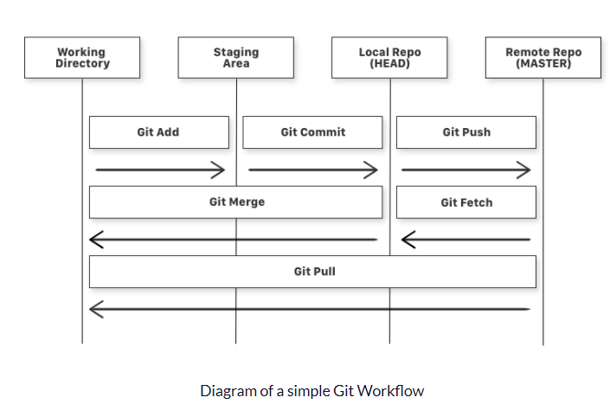

Slide 5
Basic Commands
git add is a command used to add a file that is in the working directory to the staging area.
git commit is a command used to add all files that are staged to the local repository.
git push is a command used to add all committed files in the local repository to the remote repository. So in the remote repository, all files and changes will be visible to anyone with access to the remote repository.
git fetch is a command used to get files from the remote repository to the local repository but not into the working directory.
git merge is a command used to get the files from the local repository into the working directory.
git pull is command used to get files from the remote repository directly into the working directory. It is equivalent to a git fetch and a git merge .

Slide 6
git add is a command used to add a file that is in the working directory to the staging area.
git commit is a command used to add all files that are staged to the local repository.
git push is a command used to add all committed files in the local repository to the remote repository. So in the remote repository, all files and changes will be visible to anyone with access to the remote repository.
git fetch is a command used to get files from the remote repository to the local repository but not into the working directory.
git merge is a command used to get the files from the local repository into the working directory.
git pull is command used to get files from the remote repository directly into the working directory. It is equivalent to a git fetch and a git merge .

Slide 7
git config --global user.name "YOUR_USERNAME"
git config --global user.email <email>
git config --global --list # To check the info you just provided

Slide 8
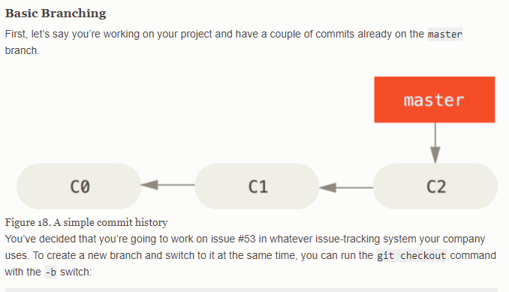
Basic Branching

Slide 9
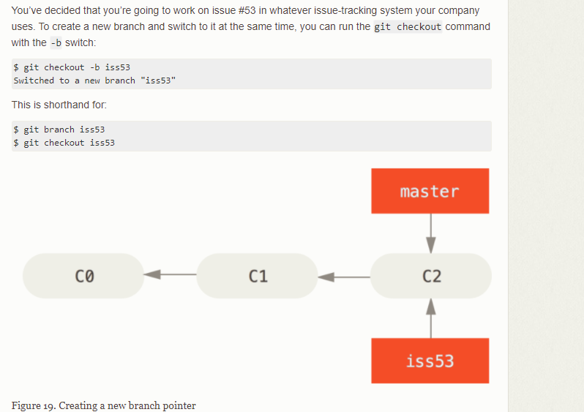
Basic Branch

Slide 10
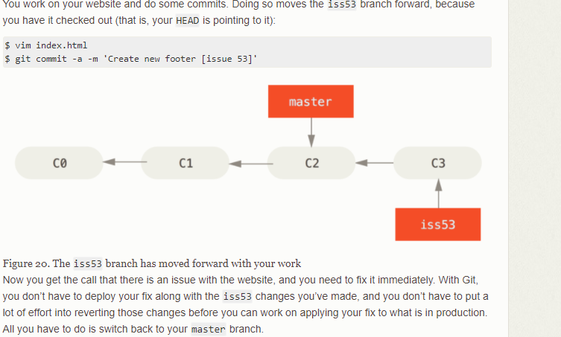

Slide 11
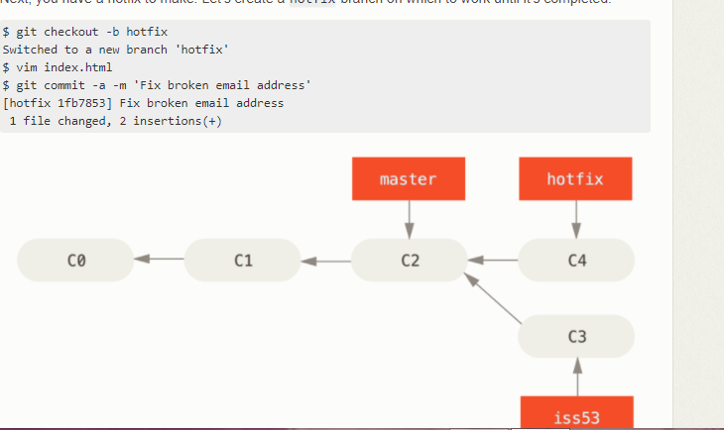

Slide 12
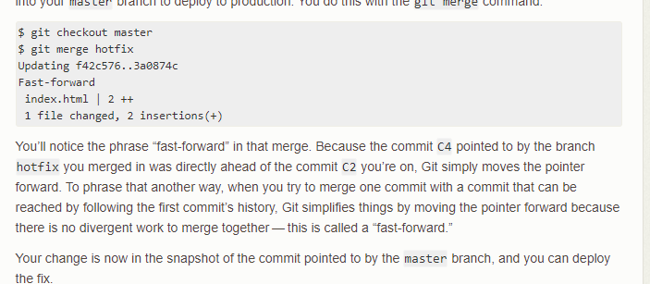

Slide 13
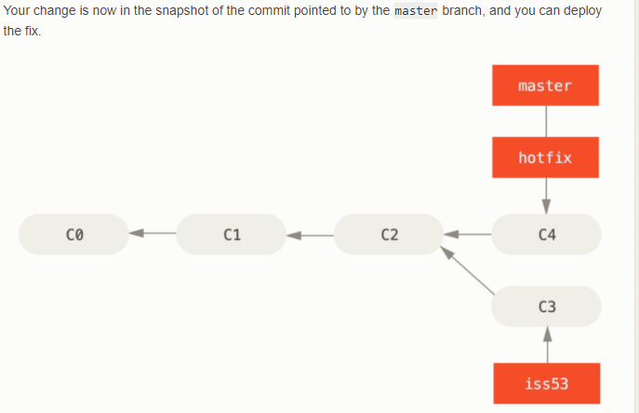

Slide 14
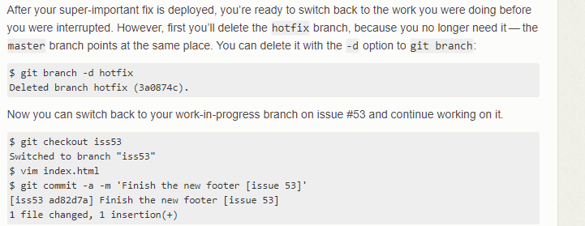

Slide 15
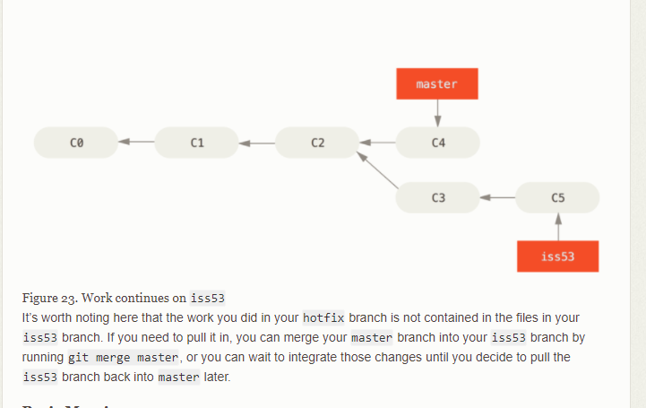

Slide 16
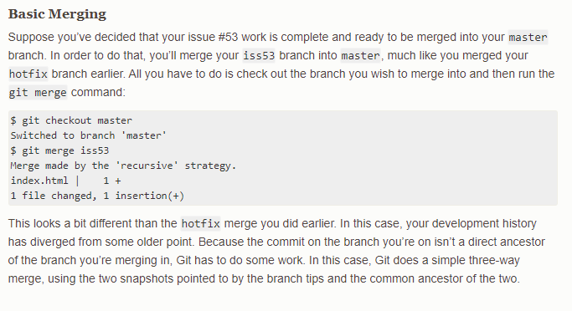

Slide 17
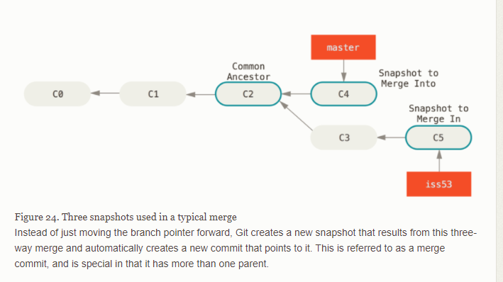

Slide 18
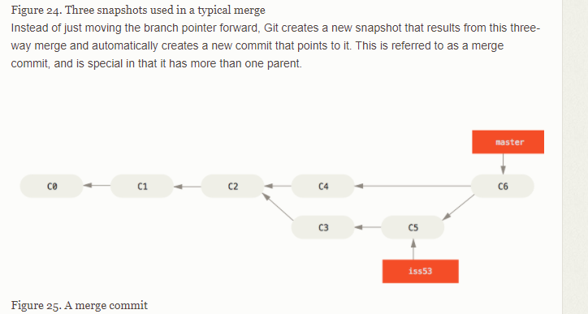

Slide 19
Basich commads
git config
git init
git clone
git add
git commit
git diff
git reset
git status
git log
git show
git tag
git branch
git checkout
git merge
git remote
git push
git pull
git stash

Slide 20
Git setup and config

Slide 21
Git command
Sart development from a known tag
$ git clone git://git.kernel.org/pub/scm/.../linux-2.6 my2.6
$ cd my2.6
$ git branch my2.6.14 v2.6.14 (1)
$ git switch my2.6.14
Above two step could be combined into a single step with "checkout -b my2.6.14 v2.6.14".
Delete an unneeded branch
$ git clone git://git.kernel.org/.../git.git my.git
$ cd my.git
$ git branch -d -r origin/todo origin/html origin/man (1)
$ git branch -D test (2)
1. Delete the remote-tracking branches "todo", "html" and "man". The next fetch or pull will create them again unless you configure them not to.
2. Delete the "test" branch even if the "master" branch (or whichever branch is currently checked out) does not have all commits from the test branch.

Slide 22
git-clone
git clone git://git.kernel.org/pub/scm/.../linux.git my-linux
cd my-linux
$ make
git show-branch
To display branch
$ git add <file>
$ git commit –m ”<message>” file(s)

Slide 23
git-checkout - Switch branches or restore working tree files
$ git checkout -b foo (1)
$ git branch foo (2)
$ git tag foo (3)
creates a new branch foo, which refers to commit f, and then updates HEAD to refer to branch foo. In other words, we’ll no longer be in detached HEAD state after this command.
similarly creates a new branch foo, which refers to commit f, but leaves HEAD detached.
creates a new tag foo, which refers to commit f, leaving HEAD detached.

Slide 24
Git checkout
The following sequence checks out the master branch, reverts the Makefile to two revisions back, deletes hello.c by mistake, and gets it back from the index.
$ git checkout master (1)
$ git checkout master~2 Makefile (2)
$ rm -f hello.c
$ git checkout hello.c (3)

Slide 25
Git checkout
Switch to new branch
git checkout mytopic

Slide 26
git-clean - Remove untracked files from the working tree
git-clean –i
It will ask what to do
Would remove the following item:
test.txt
*** Commands ***
1: clean 2: filter by pattern 3: select by numbers
4: ask each 5: quit 6: help

Slide 27
git-diff - Show changes between commits, commit and working tree, etc
$ git diff (1)
$ git diff --cached (2)
$ git diff HEAD (3)
1. Changes in the working tree not yet staged for the next commit.
2. Changes between the index and your last commit; what you would be committing if you run git commit without -a option.
3. Changes in the working tree since your last commit; what you would be committing if you run git commit –a
$ git diff test (1)
$ git diff HEAD -- ./test (2)
$ git diff HEAD^ HEAD (3)
Instead of using the tip of the current branch, compare with the tip of "test" branch.
Instead of comparing with the tip of "test" branch, compare with the tip of the current branch, but limit the comparison to the file "test".
Compare the version before the last commit and the last commit.
Comparing branches

Slide 28
Create Patch
git diff > mypatch.patch
git diff --cached > mypatch.patch (to include git add files)
git apply mypatch.patch

