Slide 1
Java

Slide 2
Java
What is Java?
Java is a popular programming language, created in 1995.
It is owned by Oracle, and more than 3 billion devices run Java.
It is used for:
Mobile applications (specially Android apps)
Desktop applications
Web applications
Web servers and application servers
Games
Database connection
And much, much more!

Slide 3
Why Use Java?
Java works on different platforms (Windows, Mac, Linux, Raspberry Pi, etc.)
It is one of the most popular programming language in the world
It is easy to learn and simple to use
It is open-source and free
It is secure, fast and powerful
It has a huge community support (tens of millions of developers)
Java is an object oriented language which gives a clear structure to programs and allows code to be reused, lowering development costs
As Java is close to C++ and C#, it makes it easy for programmers to switch to Java or vice versa

Slide 4
Java Syntax
public class HelloWorld{
public static void main(String[] args) { System.out.println("Hello World");
}
}

Slide 5
Comment
Single line comment
// This is a comment
Multi-line comment
/* The code below will print the words Hello World to the screen, and it is amazing */

Slide 6
Java Variable
Variables are containers for storing data values.
In Java, there are different types of variables, for example:
String - stores text, such as "Hello". String values are surrounded by double quotes
int - stores integers (whole numbers), without decimals, such as 123 or -123
float - stores floating point numbers, with decimals, such as 19.99 or -19.99
char - stores single characters, such as 'a' or 'B'. Char values are surrounded by single quotes
boolean - stores values with two states: true or false
Declaring (Creating) Variables
To create a variable, you must specify the type and assign it a value:
Syntax
type variable = value;
Where type is one of Java's types (such as int or String), and variable is the name of the variable (such as x or name). The equal sign is used to assign values to the variable.

Slide 7
Java Data Type
public class Main {
public static void main(String[] args) {
int myNum = 5; // integer (whole number)
float myFloatNum = 5.99f; // floating point number
char myLetter = 'D'; // character
boolean myBool = true; // boolean
String myText = "Hello"; // String
System.out.println(myNum);
System.out.println(myFloatNum);
System.out.println(myLetter);
System.out.println(myBool);
System.out.println(myText);
}
}

Slide 8
Primitive Data Types
Data Type | Size | Description
byte | 1 byte | Stores whole numbers from -128 to 127
short | 2 bytes | Stores whole numbers from -32,768 to 32,767
int | 4 bytes | Stores whole numbers from -2,147,483,648 to 2,147,483,647
long | 8 bytes | Stores whole numbers from -9,223,372,036,854,775,808 to 9,223,372,036,854,775,807
float | 4 bytes | Stores fractional numbers. Sufficient for storing 6 to 7 decimal digits
double | 8 bytes | Stores fractional numbers. Sufficient for storing 15 decimal digits
boolean | 1 bit | Stores true or false values
char | 2 bytes | Stores a single character/letter or ASCII values

Slide 9
Java Type Casting
Type casting is when you assign a value of one primitive data type to another type.
In Java, there are two types of casting:
Widening Casting (automatically) - converting a smaller type to a larger type size byte -> short -> char -> int -> long -> float -> double
Narrowing Casting (manually) - converting a larger type to a smaller size type double -> float -> long -> int -> char -> short -> byte

Slide 10
Widening Casting Widening casting is done automatically when passing a smaller size type to a larger size type: public class Main { public static void main(String[] args) { int myInt = 9; double myDouble = myInt; // Automatic casting: int to double System.out.println(myInt); System.out.println(myDouble); } }

Slide 11
Narrowing Casting Narrowing casting must be done manually by placing the type in parentheses in front of the value: public class Main { public static void main(String[] args) { double myDouble = 9.78; int myInt = (int) myDouble; // Explicit casting: double to int System.out.println(myDouble); System.out.println(myInt); } }

Slide 12
Java Operators
Operators are used to perform operations on variables and values.
In the example below, we use the + operator to add together two values:

Slide 13
Arithmetic Operators Arithmetic operators are used to perform common mathematical operations.
Operator | Name | Description | Example
+ | Addition | Adds together two values | x + y
- | Subtraction | Subtracts one value from another | x - y
* | Multiplication | Multiplies two values | x * y
/ | Division | Divides one value by another | x / y
% | Modulus | Returns the division remainder | x % y
++ | Increment | Increases the value of a variable by 1 | ++x
-- | Decrement | Decreases the value of a variable by 1 | --x

Slide 14
Assignment Operators
Operator | Example | Same As
= | x = 5 | x = 5
+= | x += 3 | x = x + 3
-= | x -= 3 | x = x - 3
*= | x *= 3 | x = x * 3
/= | x /= 3 | x = x / 3
%= | x %= 3 | x = x % 3
&= | x &= 3 | x = x & 3
|= | x |= 3 | x = x | 3
^= | x ^= 3 | x = x ^ 3
>>= | x >>= 3 | x = x >> 3
<<= | x <<= 3 | x = x << 3

Slide 15
Comparison Operator
Operator | Name | Example
== | Equal to | x == y
!= | Not equal | x != y
> | Greater than | x > y
< | Less than | x < y
>= | Greater than or equal to | x >= y
<= | Less than or equal to | x <= y

Slide 16
Logical Operator
Operator | Name | Description | Example
&& | Logical and | Returns true if both statements are true | x < 5 && x < 10
|| | Logical or | Returns true if one of the statements is true | x < 5 || x < 4
! | Logical not | Reverse the result, returns false if the result is true

Slide 17
Java if/else
public class Main {
public static void main(String[] args) {
int time = 22;
if (time < 10) {
System.out.println("Good morning.");
} else if (time < 20) {
System.out.println("Good day.");
} else {
System.out.println("Good evening.");
}
}
}

Slide 18
Switch
public class Main {
public static void main(String[] args) {
int day = 4;
switch (day) {
case 1:
System.out.println("Monday");
break;
case 2:
System.out.println("Tuesday");
break;
case 3:
System.out.println("Wednesday");
break;
case 4:
System.out.println("Thursday");
break;
case 5:
System.out.println("Friday");
break;
case 6:
System.out.println("Saturday");
break;
case 7:
System.out.println("Sunday");
break;
}
}
}

Slide 19
Loop
public class Main {
public static void main(String[] args) {
int i = 0;
while (i < 5) {
System.out.println(i);
i++;
}
}
}
public class Main {
public static void main(String[] args) {
int i = 0;
do {
System.out.println(i);
i++; }
while (i < 5);
}
}​

Slide 20
For Loop
public class Main {
public static void main(String[] args) {
for (int i = 0; i < 5; i++) {
System.out.println(i);
}
}
}

Slide 21
Break
public static void main(String[] args) {
for (int i = 0; i < 10; i++) {
if (i == 4) {
break;
}
System.out.println(i);
}
}
}

Slide 22
Java Continue The continue statement breaks one iteration (in the loop), if a specified condition occurs, and continues with the next iteration in the loop. This example skips the value of 4:
public class Main {
public static void main(String[] args) {
for (int i = 0; i < 10; i++) {
if (i == 4) {
continue;
}
System.out.println(i);
}
}
}

Slide 23
Java Arrays
Arrays are used to store multiple values in a single variable, instead of declaring separate variables for each value.
To declare an array, define the variable type with square brackets:
String[] cars;
String[] cars = {"Volvo", "BMW", "Ford", "Mazda"};
int[] myNum = {10, 20, 30, 40};
Change an Array Element
cars[0] = "Opel";
Array Length
System.out.println(cars.length);

Slide 24
Loop through Array
public class Main {
public static void main(String[] args) {
String[] cars = {"Volvo", "BMW", "Ford", "Mazda"};
for (int i = 0; i < cars.length; i++) {
System.out.println(cars[i]);
}
//using for each
for (String i : cars) {
System.out.println(i);
}
}
}

Slide 25
Multi Dimensional array
public class Main {
public static void main(String[] args) {
int[][] myNumbers = { {1, 2, 3, 4}, {5, 6, 7} };
for (int i = 0; i < myNumbers.length; ++i) {
for(int j = 0; j < myNumbers[i].length; ++j) {
System.out.println(myNumbers[i][j]);
}
}
}
}

Slide 26
Package
A package in Java is used to group related classes. Think of it as a folder in a file directory. We use packages to avoid name conflicts, and to write a better maintainable code. Packages are divided into two categories:
Built-in Packages (packages from the Java API)
User-defined Packages (create your own packages)

Slide 27
Java Methods
public class Main {
static void myMethod() {
System.out.println("I just got executed!");
}
public static void main(String[] args) {
myMethod();
}
}

Slide 28
public class Main {
static void myMethod(String fname) {
System.out.println(fname + " Refsnes");
}
public static void main(String[] args) {
myMethod("Liam");
myMethod("Jenny");
myMethod("Anja");
}
}

Slide 29
public class Main {
static void myMethod(String fname, int age) {
System.out.println(fname + " is " + age);
}
public static void main(String[] args) {
myMethod("Liam", 5);
myMethod("Jenny", 8);
myMethod("Anja", 31);
}
}
//Return value
public class Main {
static int myMethod(int x) {
return 5 + x;
}
public static void main(String[] args) {
System.out.println(myMethod(3));
}
}

Slide 30
Method Overloading
public class Main {
static int plusMethodInt(int x, int y) {
return x + y;
}
static double plusMethodDouble(double x, double y) {
return x + y;
}
public static void main(String[] args) {
int myNum1 = plusMethodInt(8, 5);
double myNum2 = plusMethodDouble(4.3, 6.26);
System.out.println("int: " + myNum1);
System.out.println("double: " + myNum2);
}
}

Slide 31
Method Scope

Slide 32
Recursion
public class Main {
public static void main(String[] args) {
int result = sum(5, 10);
System.out.println(result);
}
public static int sum(int start, int end) {
if (end > start) {
return end + sum(start, end - 1);
} else {
return end;
}
}
}

Slide 33
Java Classes
OOPS
Classes/object
Class Attribute
Class Method
Constructor
Modifier
Encapsulation
Inheritance
Polymorphism
Abstraction
Interface

Slide 34
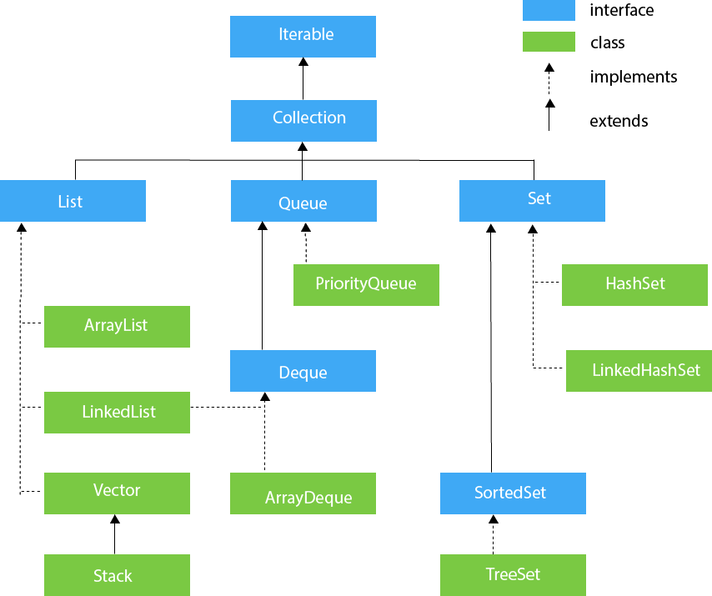
Collection

Slide 35
Enum
enum Level {
LOW,
MEDIUM,
HIGH
}
public class Main {
public static void main(String[] args) {
Level myVar = Level.MEDIUM;
System.out.println(myVar);
}
}

Slide 36
Wrapper Classes

Slide 37
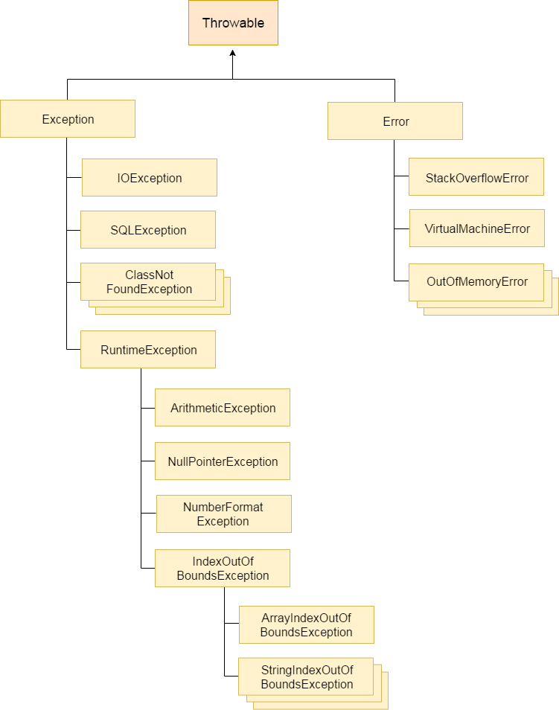
Exceptions

Slide 38
Inner class
class OuterClass {
int x = 10;
class InnerClass {
int y = 5;
}
}
public class Main {
public static void main(String[] args) {
OuterClass myOuter = new OuterClass();
OuterClass.InnerClass myInner = myOuter.new InnerClass();
System.out.println(myInner.y + myOuter.x);
}
}

Slide 39
Java8
Lambda expressions,
Method references,
Functional interfaces,
Stream API,
Default methods,
Static methods in interface,
Optional class,
Collectors class,

