Slide 1
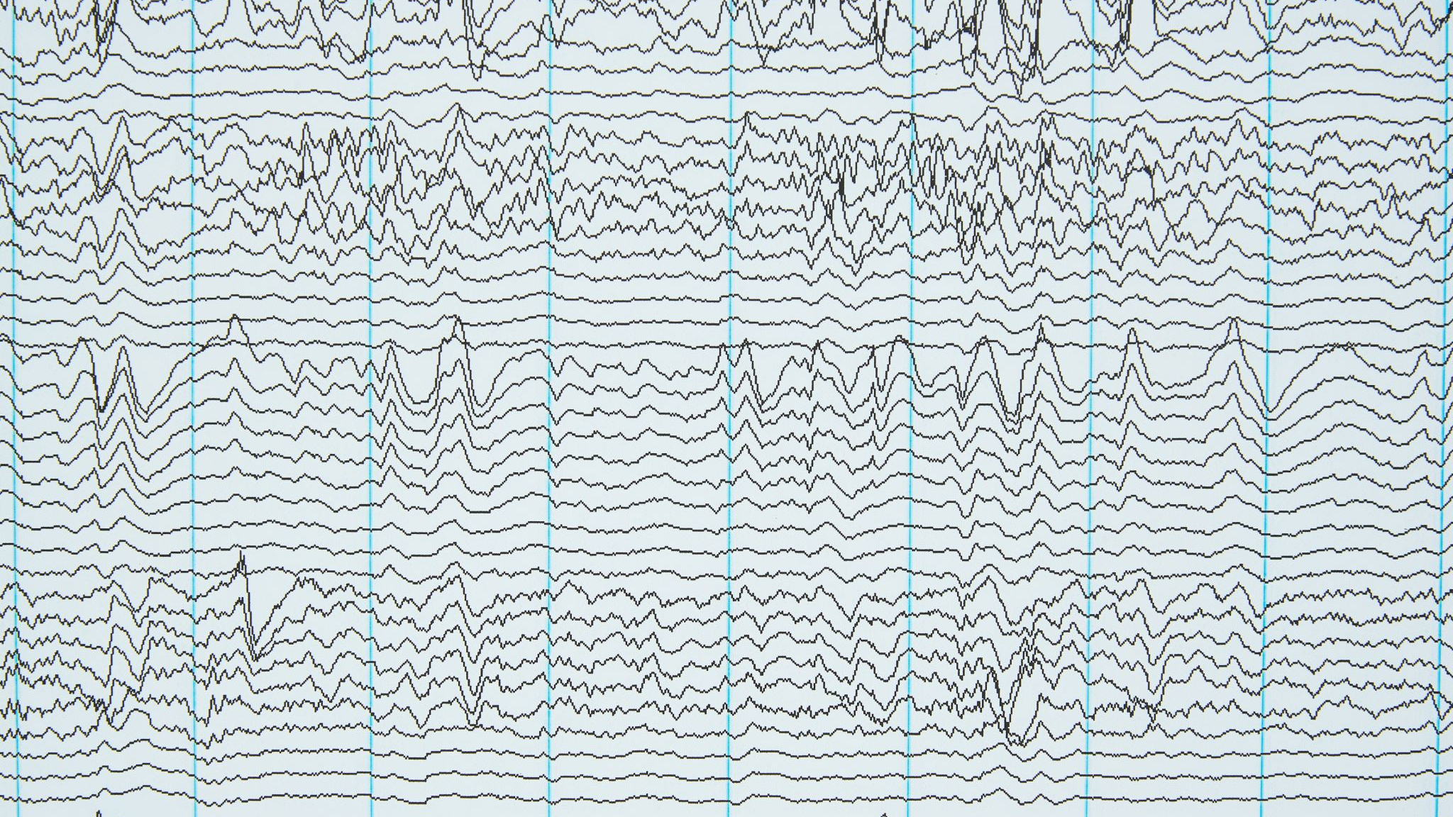
FILTERING ECG SIGNALS
~HARISH M(21BEC1142)
~RAKESH RAM M(21BEC1836)

Slide 2

MATLAB CODE TO FILTER POWERLINE WANDER:

Slide 3
clear all; clc; close all; Fs = 360; Fnotch = 0.67; BW = 5; Apass = 1; [b, a] = iirnotch (Fnotch/ (Fs/2), BW/(Fs/2), Apass); Hd = dfilt.df2 (b, a); x=load ('ecg.csv’); x1=x (:, 2);x2=x1./max(x1); subplot (3, 1, 1); plot(x2); title ('ECG Signal with baswline wander’); grid ony0=filter (Hd, x2); subplot (3, 1, 2); plot(y0); title ('ECG signal with low-frequency noise (baswline wander) Removed'), grid onFnotch = 60; BW = 120; Apass = 1; [b, a] = iirnotch (Fnotch/ (Fs/2), BW/ (Fs/2), Apass); Hd1 = dfilt.df2 (b, a);y1=filter (Hd1, y0); subplot (3, 1, 3); plot (y1); title ('ECG signal with power line noise Removed’); grid on

Slide 4

OUTPUT

Slide 5
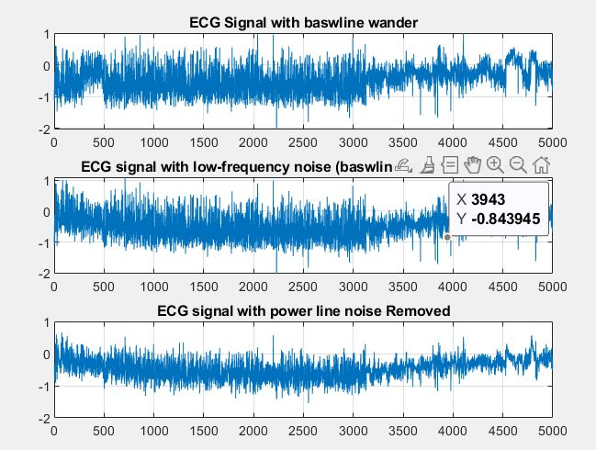

Slide 6

MATLAB CODE FOR FILTERING BASELINE WANDER:

Slide 7
x=load ('ecg.csv’); x1=x (:,2);x2=x1./1000; x2=x2*(170000:215000); subplot (2,1,1); plot(x2); title ('ECG Signal with baseline wander’); grid on [C, L] = wavedec (x2,9,'bior3.7’); % Decomposition a9 = wrcoef ('a', C, L,'bior3.7',9); % Approximate Component d9 = wrcoef ('d', C, L,'bior3.7',9); % Detailed componentsd8 = wrcoef ('d', C, L,'bior3.7',8); d7 = wrcoef ('d', C, L,'bior3.7',7); d6 = wrcoef ('d', C, L,'bior3.7',6); d5 = wrcoef ('d', C, L,'bior3.7',5); d4 = wrcoef ('d', C, L,'bior3.7',4); d3 = wrcoef ('d', C, L,'bior3.7',3); d2 = wrcoef ('d', C, L,'bior3.7',2); d1 = wrcoef ('d', C, L,'bior3.7',1); y= d9+d8+d7+d6+d5+d4+d3+d2+d1; subplot (2,1,2); plot(y); title ('ECG Signal after baseline wander REMOVED’); grid on

Slide 8
OUTPUT

Slide 9
