Slide 1
Smart Car Parking Management System
Submitted to:
Dr. Sonali Agarwal
By:
Navratna Sharma(iit2013148)
Amit Khanna(iim2014004)
Rakesh Ranjan(bim2014004)
Vijay kumar(iit2014165)

Slide 2
Introduction
Smart Car parking using Internet of things.
Helps find the user nearest available parking slot.
Can be used on any smart device as it is connected to cloud.
Involves IR sensors which gives real time data.

Slide 3
Internet of Things
Internet of things was first introduced in 1999.
It connects all our surroundings things to a network.
Communication is with each other with less human involvement.
An embedded environment attached with sensors or made connected to network via wired or wireless connections.
IOT in smart car parking comprises of sensing, processing, and connectivity

Slide 4
Features of Project
Infrared sensors detect the presence of car in the parking slot by transmitting and receiving signals on a frequent basis.
After the detection the information is sent to cloud that the space is occupied and hence the parking slot is made-unavailable.
Raspberry pi, the Arduino starts to give the status of the parking by taking the input form the IR sensors and giving it in digital signal form (either 0 or 1).

Slide 5
Raspberry pi and Arduino
Raspberry pi is a series of small single board computers.
Arduino board designs uses a variety of microprocessors and controllers.
Arduino can interact with buttons, LEDs, motors, speakers, GPS units, cameras, the internet, smartphones etc.

Slide 6
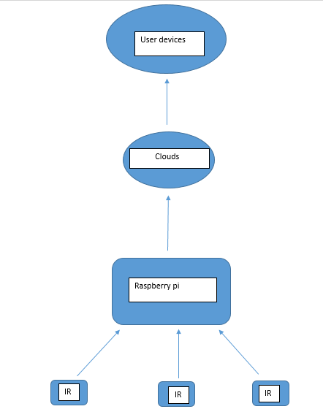
Flow Diagram

Slide 7
Working
All the components are connected accordingly and power supply is given to raspberry pi.
The Arduino starts to give the status of the parking by taking the input form the IR sensors and giving it in digital signal form (either 0 or 1).
If there is no car in parking slot, the interface will turn on the green light for that slot.
Similarly when a car arrives , the chain of input breaks and IR sensors give the direction to change the scenario.

Slide 8
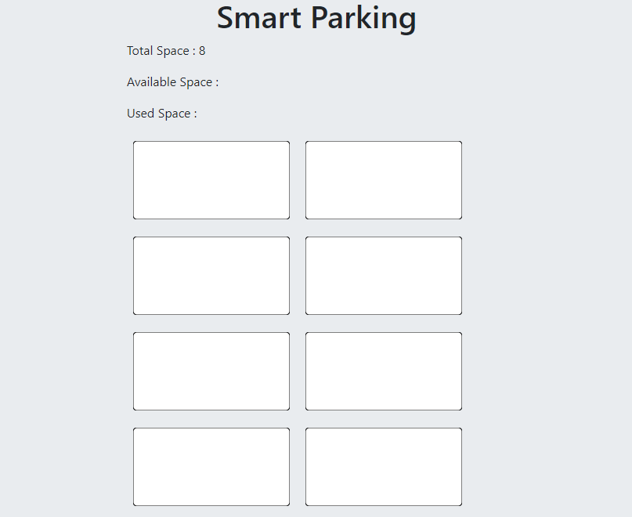

Slide 9
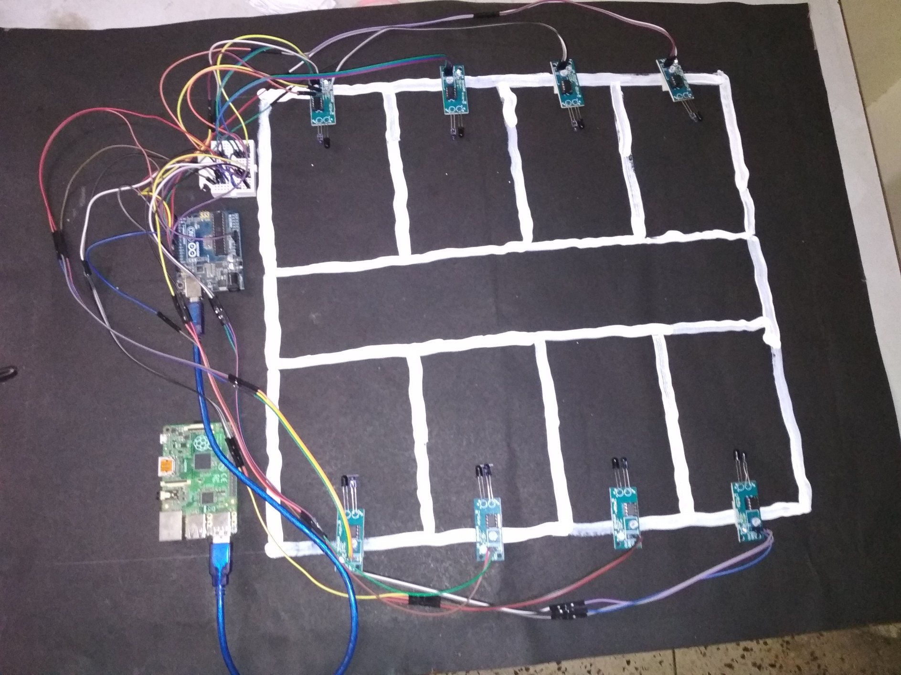

Slide 10
Future Scope
Smart car parking not only saves time but also reduces carbon footprints by saving fuel energy.
Parking booking system can be developed so that pre-booking is available on relatable prices.
Also enhance to send more notification to user when enters in a shopping area or some busy streets.
Satellite navigation device so that user is aware of parking spaces available.
Smart cities of future have to adapt this technology.

