Slide 1



Slide 2
Team
Members
24KD1A0220 - B.PRAVEEN
24KD1A0223 - B.DILEEP
24KD1A0229 - CH.ROHITH
24KD1A0231 - D.LOKEASWARI
24KD1A0232 - D.KRISHNA KUMAR
24KD1A0233 - D.SAI KUMAR
24KD1A0238 - G.LAVANYA

Slide 3

“Fault detection in
transmission lines
with IOT “

Slide 4
CONTENTS
Introduction to design thinking
Problem statement
Empathy
Define
Ideate
Story boarding
Prototype
Prototype explaining story
Conclusion.

Slide 5

1. Introduction to Design Thinking
Design thinking is a problem‑solving approach that focuses on understanding user needs and developing innovative solutions.
Steps include Empathy, Define, Ideate, Prototype, and Test.
In this project, design thinking is used to develop an effective fault detection system for transmission lines.

Slide 6
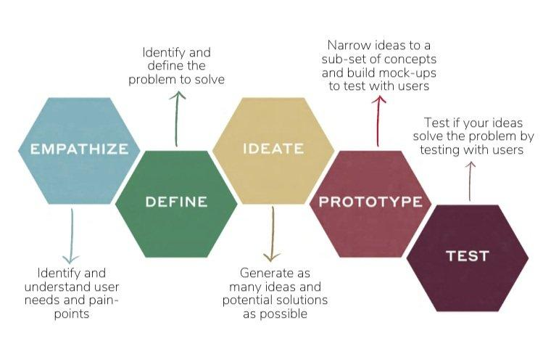

Slide 7
2. Problem Statement
Transmission lines carry electrical power over long distances.
Faults such as short circuits, line breaks, or insulation failure can interrupt power supply.
The problem is to quickly detect and locate faults in transmission lines to reduce power outages and improve system reliability.

Slide 8

3. Empathy
1.5 why's
2.Interview questions
3.Persona's
4.Empathy map
5.Experience map

Slide 9
5 WHY’S ?
1. Why do faults occur in transmission lines?
2. Why is fault detection important in power systems?
3. Why are IoT devices used in transmission line fault detection?
4. Why do transmission lines get damaged during bad weather conditions?
5. Why is quick fault identification necessary to avoid power interruptions?

Slide 10
Our thoughts on 5 why’s
B.PRAVEEN-24KD1A0220
Q1. Why faults occur in transmission lines?
A: Faults occur due to insulation failure, lightning, or short circuits.
Q2. Why is fault detection important in power systems?
A: Fault detection helps maintain continuous power supply.
Q3. Why are IoT devices used in transmission line fault detection?
A: IoT devices provide real-time monitoring of transmission lines.
Q4. Why do transmission lines get damaged during bad weather conditions?
A: Bad weather weakens conductors and damages insulators.
Q5. Why is quick fault identification necessary to avoid power interruptions?
A: Quick identification reduces power loss and equipment damage.

Slide 11
B.DILEEP - 24KD1A0223
Q1. Why do faults occur in transmission lines?
A: Most faults happen because of aging equipment and poor maintenance.
Q2. Why is fault detection important in power systems?
A: Detecting faults early prevents major breakdowns.
Q3. Why are IoT devices used in transmission line fault detection?
A: IoT helps engineers monitor systems remotely.
Q4. Why do transmission lines get damaged during bad weather conditions?
A: Storms and heavy winds can break transmission wires.
Q5. Why is quick fault identification necessary to avoid power interruptions?
A: Fast fault detection saves repair time and cost.

Slide 12
CH.ROHITH - 24KD1A0229
Q1. Why do faults occur in transmission lines?
A: Overloading and voltage fluctuations mainly cause faults.
Q2. Why is fault detection important in power systems?
A: Fault detection improves system reliability and stability.
Q3. Why are IoT devices used in transmission line fault detection?
A: IoT sensors continuously collect electrical data.
Q4. Why do transmission lines get damaged during bad weather conditions?
A: Rain and lightning create insulation problems.
Q5. Why is quick fault identification necessary to avoid power interruptions?
A: Rapid fault location prevents large-scale blackouts.

Slide 13
D.LOKEASWARI - 24KD1A0231
Q1. Why do faults occur in transmission lines?
A: Faults occur when abnormal current flows in the line.
Q2. Why is fault detection important in power systems?
A: Detection systems protect electrical equipment from damage.
Q3. Why are IoT devices used in transmission line fault detection?
A: IoT enables automatic alerts and smart analysis.
Q4. Why do transmission lines get damaged during bad weather conditions?
A: Extreme weather affects signal transmission and hardware.
Q5. Why is quick fault identification necessary to avoid power interruptions?
A: Early response minimizes downtime in the network.

Slide 14
D.KRISHNA KUMAR - 24KD1A0232
Q1. Why do faults occur in transmission lines?
A: Faults can happen because of tree contact or conductor failure.
Q2. Why is fault detection important in power systems?
A: Detecting faults ensures public and worker safety.
Q3. Why are IoT devices used in transmission line fault detection?
A: IoT devices reduce the need for risky manual inspections.
Q4. Why do transmission lines get damaged during bad weather conditions?
A: Weather conditions increase chances of electrical accidents.
Q5. Why is quick fault identification necessary to avoid power interruptions?
A: Immediate detection avoids dangerous fire hazards.

Slide 15
D.SAI KUMAR - 24KD1A0233
Q1. Why do faults occur in transmission lines?
A: Transmission line faults are caused by both natural and technical issues.
Q2. Why is fault detection important in power systems?
A: Fault detection improves efficiency of the power system.
Q3. Why are IoT devices used in transmission line fault detection?
A: IoT supports data collection for intelligent decision-making.
Q4. Why do transmission lines get damaged during bad weather conditions?
A: Environmental conditions accelerate equipment wear and tear.
Q5. Why is quick fault identification necessary to avoid power interruptions?
A: Faster detection helps restore electricity quickly.

Slide 16
G.LAVANYA - 24KD1A0238
Q1. Why do faults occur in transmission lines?
A: Faults usually occur due to loose connections or damaged wires.
Q2. Why is fault detection important in power systems?
A: Finding faults quickly keeps consumers satisfied.
Q3. Why are IoT devices used in transmission line fault detection?
A: IoT devices make monitoring easier for technicians.
Q4. Why do transmission lines get damaged during bad weather conditions?
A: Heavy winds and falling branches often damage lines.
Q5. Why is quick fault identification necessary to avoid power interruptions?
A: Quick action reduces outage time in affected areas.

Slide 17
Interview questions ⁉️
1. What is the main purpose of fault detection in transmission lines using IoT?
2. Which components are mainly used in the IoT-based fault detection system?
3. How does the system identify a fault in the transmission line?
4. What are the advantages of using IoT in transmission line monitoring?
5. What happens when a fault is detected in the system?

Slide 18

PERSONA’S
1. Question: What is the main purpose of fault detection in transmission lines using IoT?
Answer: The main purpose is to quickly detect faults, reduce power outages, and improve the reliability of the power system through real-time monitoring.
2. Question: Which components are mainly used in the IoT-based fault detection system?
Answer: The system mainly uses sensors, a microcontroller, communication modules, and cloud technology for monitoring and alert generation.
3. Question: How does the system identify a fault in the transmission line?
Answer: The system continuously monitors parameters like voltage, current, and temperature. Any abnormal change indicates a fault.
4. Question: What are the advantages of using IoT in transmission line monitoring?
Answer: IoT provides real-time monitoring, remote access, faster fault detection, reduced maintenance time, and improved system efficiency.
Name: Ravi Kumar
Age: 24 Years
Occupation
Electrical Engineering Student / Junior Power System Engineer
Challenges
Difficulty in locating faults manually
Delay in maintenance and repair response
Lack of continuous monitoring in remote locations
High maintenance costs in traditional fault detection systems

Slide 19

1. Question: What is the main purpose of fault detection in transmission lines using IoT?
Answer: The purpose of the system is to identify transmission line faults instantly and help engineers take quick corrective action to maintain continuous power supply.
2. Question: Which components are mainly used in the IoT-based fault detection system?
Answer: The project uses current and voltage sensors, IoT modules, controllers like Arduino or Raspberry Pi, and internet connectivity for data transfer.
3. Question: How does the system identify a fault in the transmission line?
Answer: The system compares normal electrical values with real-time readings, and when unusual variations occur, it recognizes them as faults.
4. Question: What are the advantages of using IoT in transmission line monitoring?
Answer: IoT technology helps in automatic monitoring, quick fault location, reduced human effort, and better protection of electrical equipment.
Name: Sneha Reddy
Age: 22 Years
Occupation
Final Year Electrical Engineering Student
Challanges
Traditional fault detection methods take more time
Difficulty in monitoring transmission lines in remote areas
Delay in receiving fault information
Increased maintenance costs due to manual inspection

Slide 20

1. Question: What is the main purpose of fault detection in transmission lines using IoT?
Answer: The main aim is to monitor transmission lines continuously and detect faults at an early stage to avoid major power system failures.
2. Question: Which components are mainly used in the IoT-based fault detection system?
Answer: The system includes sensors, microcontrollers, Wi-Fi or GSM modules, cloud storage, and display units for monitoring and communication.
3. Question: How does the system identify a fault in the transmission line?
Answer: The system detects faults by analyzing changes in electrical parameters and identifying conditions that exceed safe operating limits.
4. Question: What are the advantages of using IoT in transmission line monitoring?
Answer: IoT improves transmission line safety, enables remote supervision, minimizes downtime, and supports faster maintenance operations.
Name: Suresh Rao
Age: 61 Years
Occupation
Retired Electrical Department Supervisor
Challanges
Traditional fault detection methods take more time
Manual inspection requires more manpower
Remote transmission lines are difficult to monitor
Delayed fault detection increases repair costs

Slide 21

1. Question: What is the main purpose of fault detection in transmission lines using IoT?
Answer: The system is designed to improve power transmission reliability by detecting faults quickly and preventing long-duration power interruptions.
2. Question: Which components are mainly used in the IoT-based fault detection system?
Answer: The project uses monitoring sensors, processing units, communication devices, and cloud-based platforms to collect and share transmission line data.
3. Question: How does the system identify a fault in the transmission line?
Answer: Faults are identified when the monitored values differ from predefined normal operating conditions of the transmission line.
4. Question: What are the advantages of using IoT in transmission line monitoring?
Answer: IoT allows continuous data collection, instant fault reporting, reduced manual inspection, and better management of power systems.
Name:Priya Sharma
Age:29 Years
Occupation:PowerSystem Maintenance Engineer
Challanges
Difficulty in identifying faults in remote areas
Delays in manual fault inspection
High maintenance workload during emergencies
Power interruptions affecting consumers

Slide 22
Empathy mapping
1. Says “Faults should be detected quickly to avoid power cuts.” “Manual inspection takes too much time.” “Real-time monitoring can improve power system reliability.” “IoT technology makes maintenance easier and faster.” | 3. Does Monitors transmission line parameters like voltage and current. Uses sensors and IoT devices for data collection. Checks system alerts and responds to faults quickly. Maintains and repairs damaged transmission lines.
2. Thinks Needs a smarter and automated monitoring system. Wants to reduce maintenance costs and downtime. Thinks continuous monitoring can prevent major failures. Believes quick alerts can improve safety and efficiency. | 4. Feels Worried about unexpected power failures. Frustrated with delays in traditional fault detection methods. Confident when using automated monitoring systems. Satisfied when faults are detected and solved quickly.

Slide 23
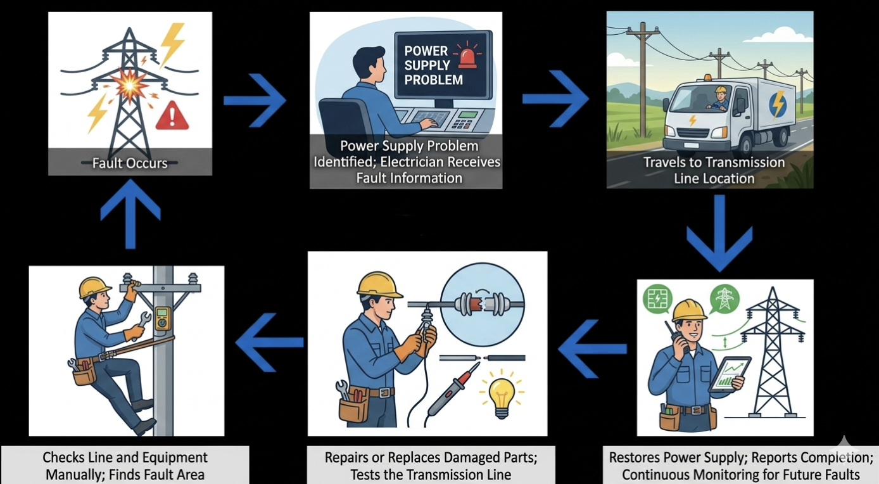
Experience map

Slide 24
Understanding
The electrician travels to the transmission line location and manually checks the line and equipment to find the damaged area. After locating the fault, the damaged parts are repaired or replaced, and the transmission line is tested to ensure proper functioning. then the power supply is restored, the maintenance work is reported as completed.

Slide 25
4. Define
Goal: Design a system that can detect faults in transmission lines quickly and accurately.
The system should monitor line parameters such as current and voltage.
When abnormal conditions occur, the system identifies and reports the fault.

Slide 26

5. Ideation
1.brain writing
2.brain stroming
3.dot voting

Slide 27
Brain writing
Brainwriting is a silent idea-generation technique where each person writes ideas and passes them to others to build on. Here are strong, practical ideas you can use for your project:
Brain storming
Brainstorming focuses on generating many ideas quickly without judging them. Here are creative and practical ideas for your project:

Slide 28
Brain storming sessions

Slide 29
The solutions
1. IoT-Based Monitoring System
Uses sensors and internet technology to monitor transmission lines in real time and detect faults quickly.
2. Protective Relays and Circuit Breakers
Automatically identify faulty sections and disconnect them to protect the power system.
3. SCADA Remote Monitoring System
Enables continuous remote supervision and control of transmission lines for faster fault detection.
4. Drone and Thermal Imaging Inspection
Helps locate damaged or overheated components in transmission lines, especially in remote areas.

Slide 30
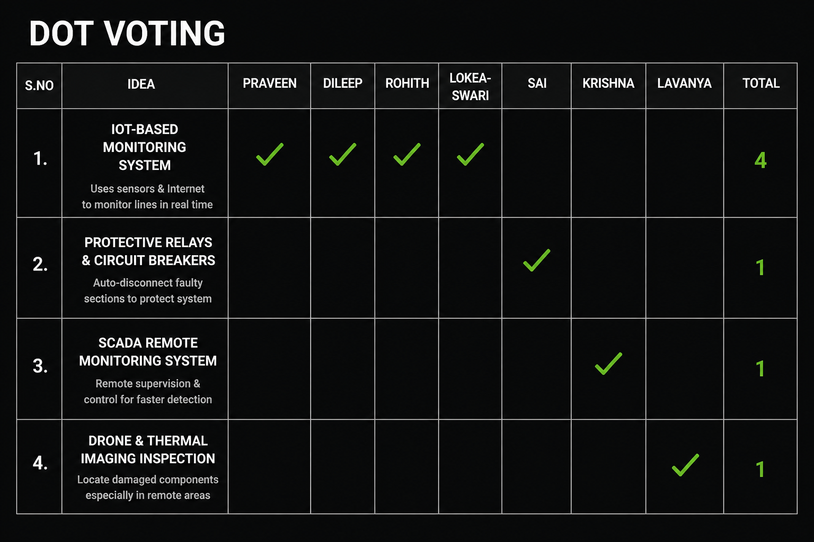

Slide 31
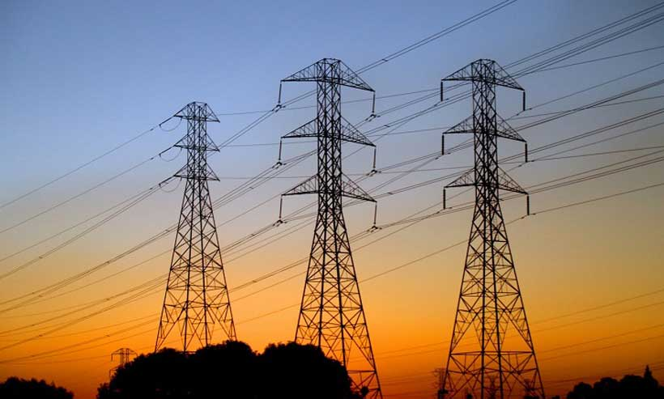
The proposed solution
Fault detection in transmission lines with IOT
Fault detection in transmission lines with IoT is used to identify faults such as short circuits, line breaks, and overloads quickly and accurately. Sensors placed on the transmission line collect real-time data like voltage and current, and send it through the Internet to monitoring systems. This helps electricity departments detect problems early, reduce power outages, improve safety, and maintain a reliable power supply.

Slide 32
Required
Components
1.ESP-32 with 12C back
2.current sensor
3.voltage sensor
4.display
5.wifi module
6.battery supply
7.required jumper wires

Slide 33
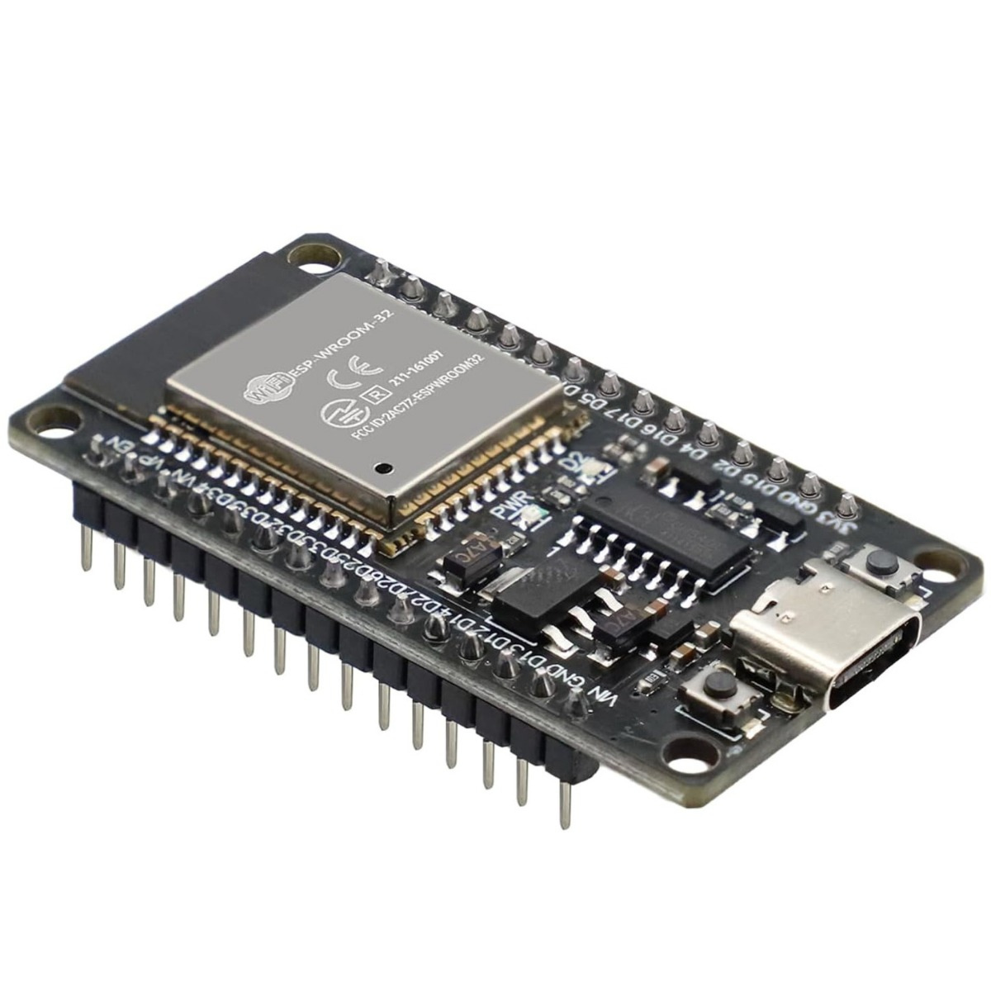
ESP-32 D
ESP32 is a low-cost and powerful microcontroller with built-in Wi-Fi and Bluetooth features. It is widely used in IoT projects for connecting devices to the internet, collecting sensor data, and controlling systems remotely. ESP32 is popular because it is fast, energy efficient, and easy to program.

Slide 34
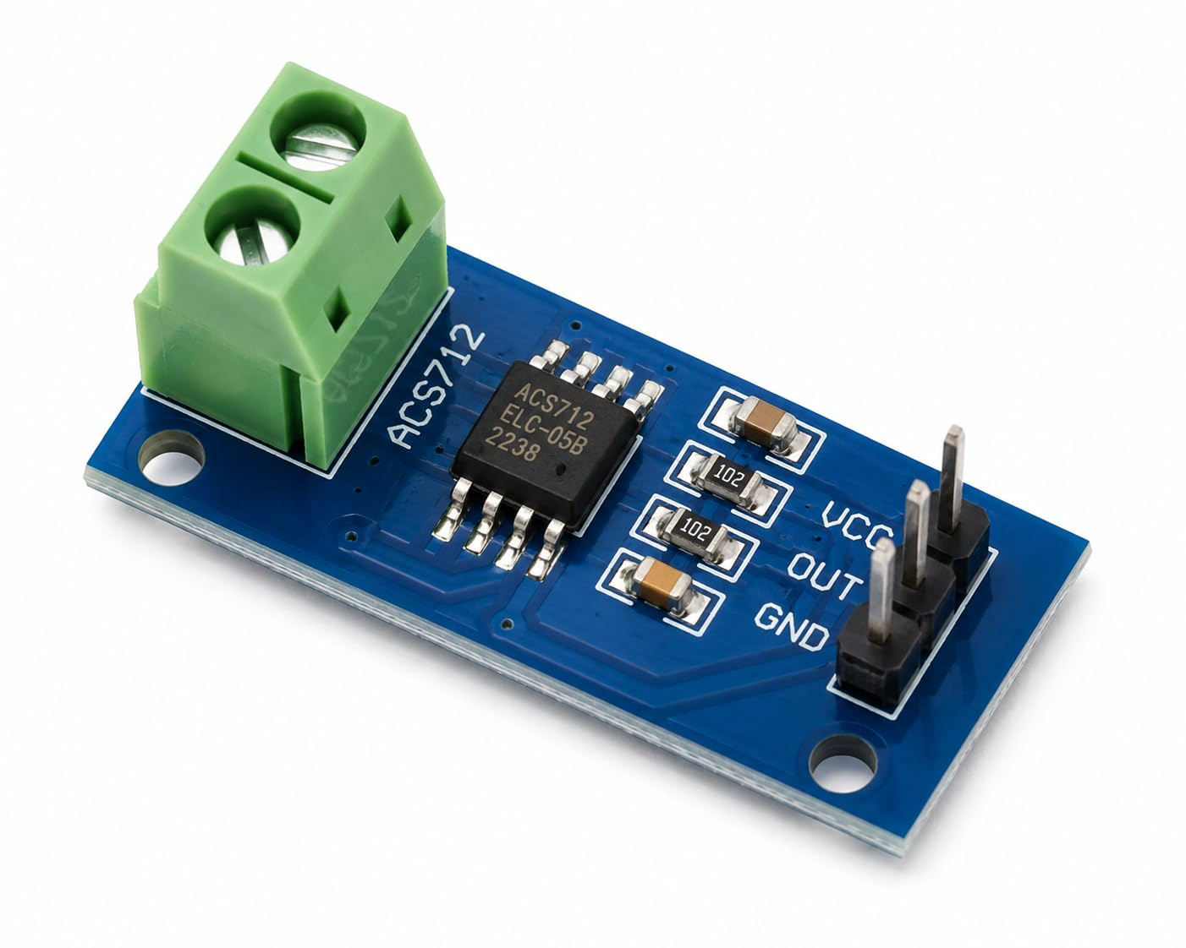
Current sensor ACS712 5A
ACS712 Current Sensor Module is a current sensing module used to measure AC and DC current in electrical circuits. It is commonly used in IoT and electrical projects for monitoring current and detecting faults.

Slide 35
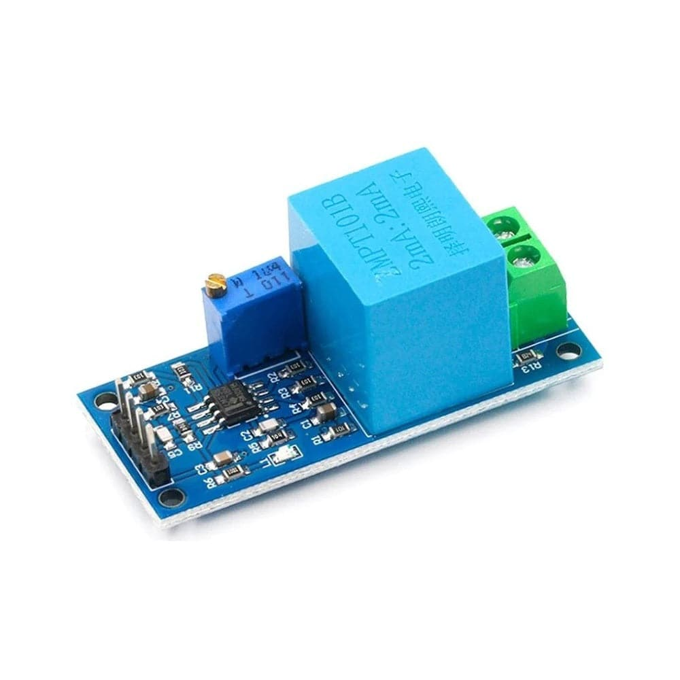
Voltage sensor ZMPT101B
ZMPT101B Voltage Sensor Module is a voltage sensing module used to measure AC voltage in electrical circuits. It is commonly used in IoT and power monitoring projects for voltage measurement, fault detection, and system protection.

Slide 36
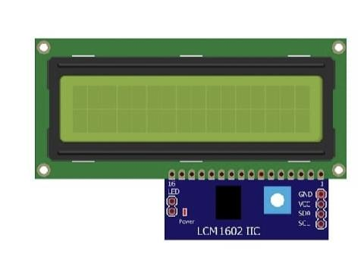
16x2 LCD Display
16x2 LCD Display Module is an electronic display used to show text, sensor values, and system status in embedded and IoT projects. It is commonly connected with microcontrollers like ESP32 and Arduino for displaying real-time information.

Slide 37
Ideation
The solution:
A practical solution for fault detection in transmission lines using IoT involves deploying smart sensor nodes along the power lines to continuously monitor parameters such as voltage, current, temperature, and line condition. These sensors are connected to microcontrollers that analyze the data in real time and detect abnormalities like short circuits, open circuits, or overloads. When a fault occurs, the system instantly sends alerts through communication technologies such as GSM, Wi-Fi, or cloud-based platforms to control centers and maintenance teams. This enables quick identification of the exact fault location, reducing downtime and improving system reliability. Additionally, IoT-based systems can store historical data for analysis, helping predict potential failures and support preventive maintenance. Overall, this approach enhances efficiency, ensures faster response, and minimizes power losses in transmission networks.

Slide 38
6. Story Boarding
Step 1: Transmission line operates normally.
Step 2: Fault occurs (short circuit or line break).
Step 3: Sensors detect abnormal current.
Step 4: Control unit processes the signal.
Step 5: Fault indication or alarm is generated.

Slide 39
7. Prototype
Prototype components:
• Transmission line model
• Current sensor or relay
• Microcontroller / control circuit
• Indicator LEDs or buzzer
The prototype simulates faults and demonstrates detection.

Slide 40
8. Prototype Explaining Story
When the transmission line operates normally, current flows within safe limits.
If a fault occurs, the current increases suddenly.
The sensor detects this change and sends a signal to the controller.
The controller activates an indicator showing that a fault has occurred.

Slide 41
9. Conclusion
Fault detection systems improve power system reliability and safety.
Using sensors and control circuits helps detect faults quickly.
This project demonstrates a simple and effective method for transmission line fault detection.

Slide 42


