Slide 1
DESIGN THINKING AND PRODUCT INNOVATION
Presented by:
B.MANOJ KUMAR- 25KD5A0202
K.CHANDINI- 25KD5A0206
B.SRIKAR- 25KD5A0201
CH.NAVYA- 25KD5A0203
G.MANISHA- 25KD5A0204
V.JASWANTH- 24KD1A02C7
Y.UDAYASRI- 24KD1A02C8

Slide 2
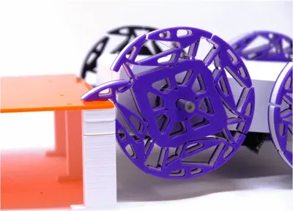
“THE PATS TRANSFORMABLE WHEELS”

Slide 3
CONTENTS
INTRODUCTION TO DESIGN THINKING
PROBLEM STATEMENT
EMPATHY
DEFINE
IDEATE
STORY BOARDING
PROTOTYPE
PROTOTYPE EXPLAINING STORY
CONCLUSION

Slide 4
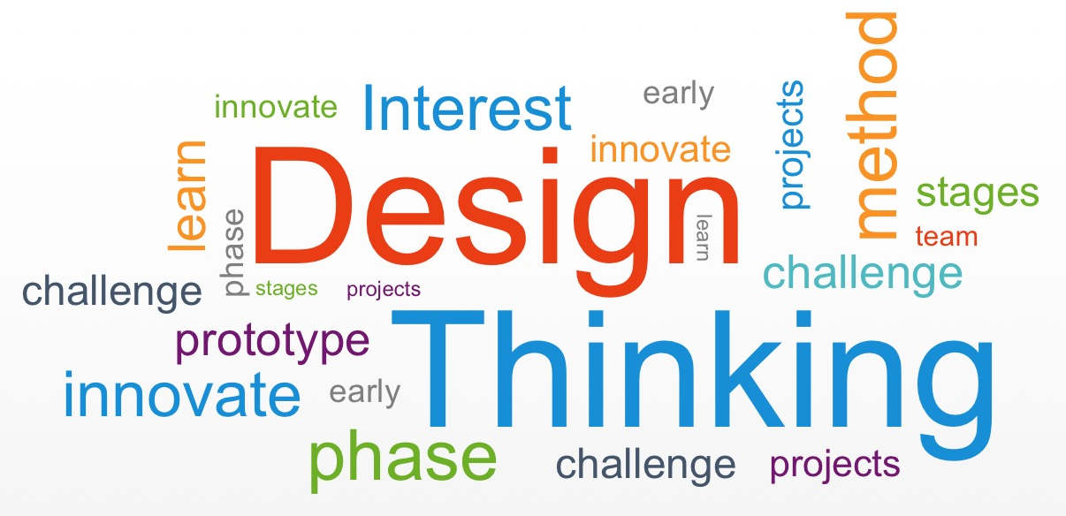
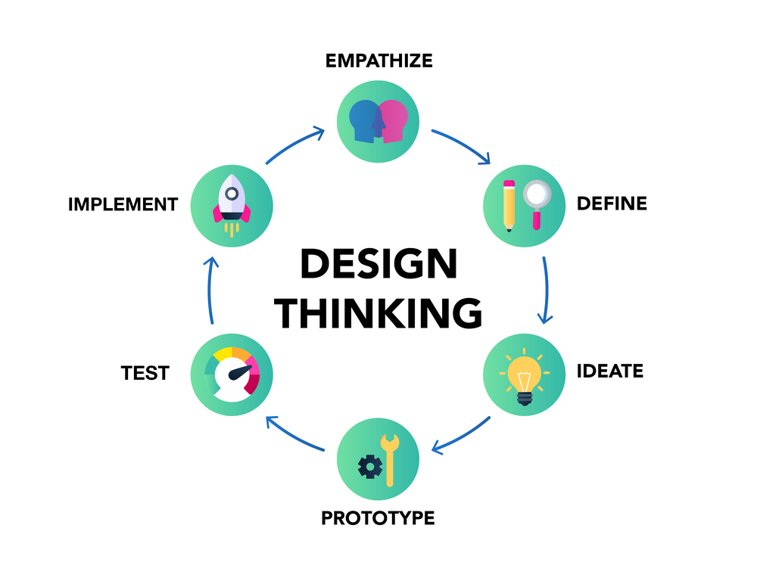
What is design thinking and innovation?
Design Thinking is a human-centered, iterative process used to understand users, challenge assumptions, redefine problems, and create innovative solutions.

Slide 5
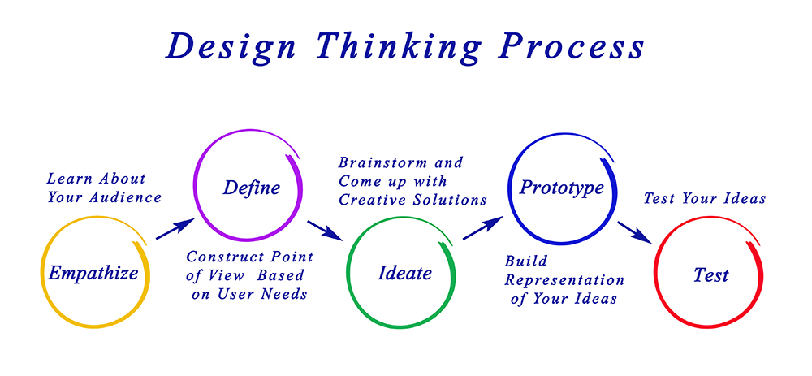

Slide 6
PROBLEM STATEMENT
Traditional mobile robots use circular wheels, which work efficiently on smooth and flat surfaces. However, these wheels face serious limitations when the robot needs to move over stairs, uneven terrain, obstacles, or rough surfaces. In such situations, the robot may lose traction, get stuck, or fail to climb obstacles, which reduces its mobility and efficiency.
The main problem addressed in this project is how to improve robot mobility on different types of surfaces using a wheel mechanism that can transform between normal rolling mode and obstacle-climbing mode.

Slide 7
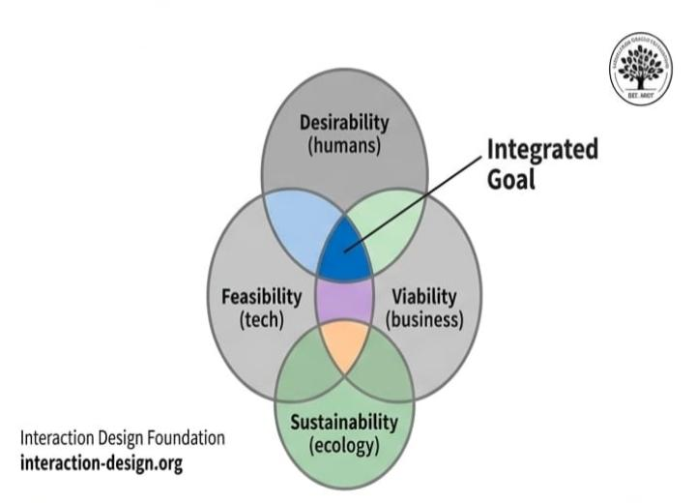
EMPATHY
5 WHY’ S
PERSONA’ S
INTERVIEW QUESTIONS
EMPATHY MAP
EXPERIENCE MAP

Slide 8
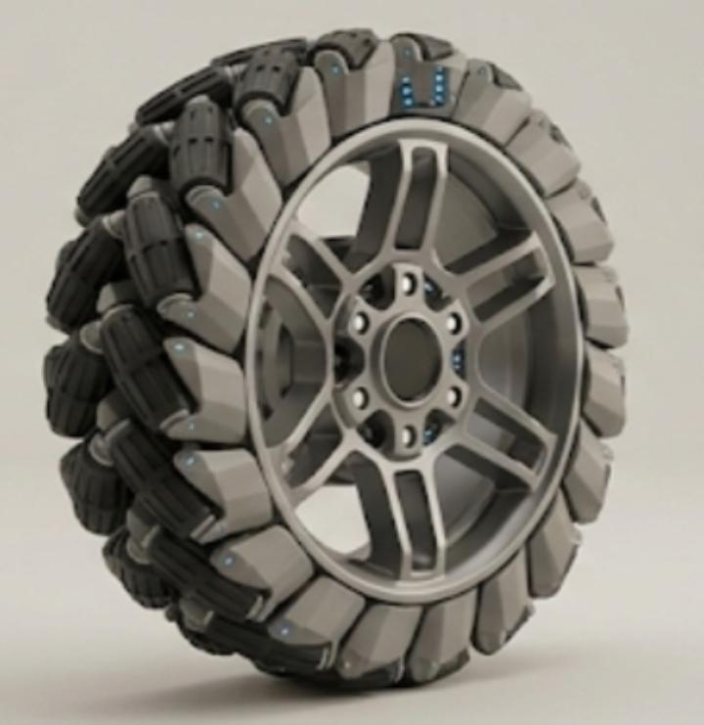
5 WHY’S
Why standard wheels perform poorly?
↓(why?)
Surface roughness & obstacles
↓(why?)
Limited contact area & slip
↓(why?)
Lack of terrain adaption
↓(why?)
Insufficient integrated sensing

Slide 9
INTERVIEW QUESTIONS
Can you share what challenges you faced with your previous wheel design?
How has our reinvented smooth-climbing wheel impacted your daily life?
What specific circumstances did you test the wheel's stair-climbing feature?
Have you experienced any terrain that was difficult for the wheel?
What do you think could further enhance the wheel's performance or features?
What advice would you give to others considering this reinvented wheel design?

Slide 10

Answers
Person 1:
Name: Ramesh Kumar
Age: 35
Job: Delivery Driver
Hobbies: Listening to music
Habits: No drinking habit
1.Can you share what challenges you faced with your previous wheel design?
My previous wheel had difficulty climbing stairs and uneven surfaces. It often got stuck.
2. How has our reinvented smooth-climbing wheel impacted your daily life?
It made my daily movement much easier and smoother, especially on steps.
3. What specific circumstances did you test the wheel’s stair-climbing feature?
I tested it on stairs, small curbs, and rough roads.
4. Have you experienced any terrain that was difficult for the wheel?
Yes, slippery surfaces were a bit difficult.
5. What do you think could further enhance the wheel’s performance or features?
Adding better grip would improve performance.
6. What advice would you give to others considering this reinvented wheel design?
It is very useful, especially for rough and uneven areas.
Problems facing:
Accidents due to poor road conditions Stress while driving long hours Traffic issues.

Slide 11

Person 2:
Name: varalaxmi
Age: 30
Job: fruits seller
Hobbies: Playing games
Habits: Occasional drinking
1.Can you share what challenges you faced with your previous wheel design?
The old wheel could not handle obstacles like stairs properly.
2. How has our reinvented smooth-climbing wheel impacted your daily life?
It saved my time and reduced effort in daily movement.
3. What specific circumstances did you test the wheel’s stair-climbing feature?
I tested it on staircases and rocky paths.
4. Have you experienced any terrain that was difficult for the wheel?
Muddy areas were slightly difficult.
5. What do you think could further enhance the wheel’s performance or features?
Improving durability would help.
6. What advice would you give to others considering this reinvented wheel design?
It is a good choice for better mobility.
Problems facing:
Fruits selling cart
While moving it from one place to other she faces difficult

Slide 12
User Journey
Stage | Action | Behavior
The Limitation | Traditional wheel struggles with obstacles taller than its radius. | Obstacle contact, limited mobility, vehicle stopped.
Transformation | Mechanism is "pressed" triggering transformation to Wheg. | Whegs deploy hooks for "climbing" without motors.
Reset | Wheel returns to a full circle after clearing obstacle. | Efficient flat-surface travel resumed.
Experience
Stage | State | Feeling | Solution
State | Frustrated by failure to ascend. | Stuck, powerless. | A need for transformable, passive design.
Feeling | Engaged by automatic, efficient mechanics. | Cunningly capable, automated. | PATS Hybrid achieves 70% diameter step-climbing.
Solution | Optimized for high-speed efficiency. | Efficient, optimized. | Dual mode is optimized for speed and obstacles.

Slide 13
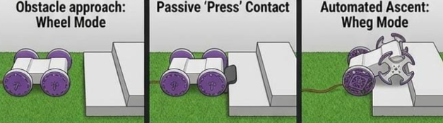
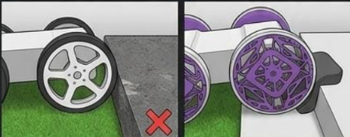
Operational performance
Obstacle approach: Wheel Mode
Passive 'Press' Contact Transformats
Automated Ascent: Wheg Mode
"Pure" Wheel Limitation
PATS Hybrid Capability
"Pure" Wheel Limitation
Stuck. Fails to ascend.
Requires external intervention
PTS Hybrid Capability
70% OF DIAMETER. CLEARED.

Slide 14
UNDERSTANDING
A traditional wheel is optimized for flat ground but cannot navigate unstructured terrain. Standard "Wheg" systems are inefficient on smooth surfaces. Adding complex sensors and actuators for multi-terrain capability increases cost, weight, and failure points. This project demonstrates a novel approach: using passive mechanical intelligence to solve complex navigation problems without sensors or motors.

Slide 15
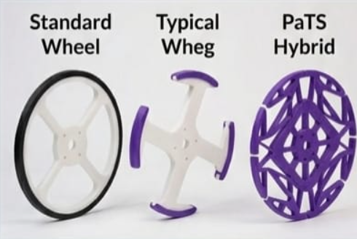
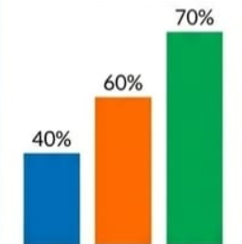
Climbing Height (%Diameter)
Wheel Wheg Hybrid

Slide 16
DEFINE
1. What is the problem?
Traditional robot wheels cannot climb stairs or large obstacles.
2. Where does the problem occur?
In rough terrains, disaster zones, uneven surfaces, and staircases.
3. Why does it happen?
Normal wheels do not have enough grip or adaptability.
4. Who is affected?
Robots used in rescue operations, military surveillance, and exploration.
5. What is the solution?
Designing a reinvented wheel with expandable or claw-like structures.

Slide 17

IDEATION
BRAIN WRITING
BRAIN STORMING
DOT VOTING

Slide 18
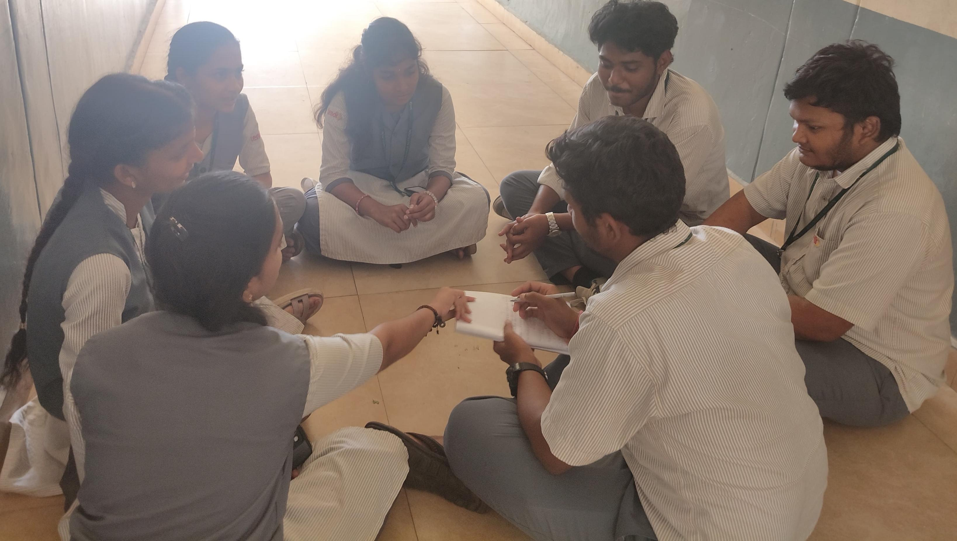
BRAIN STORMING
Brainstorming is a group problem-solving technique that involves sharing creative ideas from all members of the team.
In this project, brainstorming helps generate solutions for improving robot wheels so they can climb stairs, move over rocks, and travel smoothly on uneven surfaces.

Slide 19
DOT VOTING
BRAIN WRITING
Brainwriting is an idea generation technique where team members write down their ideas to solve a problem without discussion.
For this project, participants suggest different ideas to improve robot movement on rough terrain and obstacles. These written ideas help in developing an innovative solution such as a reinvented or transformable wheel mechanism for better mobility.
After generating several ideas, we applied the Dot Voting method to prioritize the most effective solution. This method helped us select ideas based on team agreement and practical value. Our ideas are :-
PATS Transformable Wheels ✓ ✓ ✓ ✓ ✓ Shape-Morphing Robotic Wheels ✓ ✓ ✓ Amphibious Transformable Wheel ✓ ✓ Stair-Climbing Wheel Mechanism ✓ ✓ ✓
By this dot voting we have decided that to select the project PATS Transformable wheels as our DTI project.

Slide 20
IDEATION
The Solution:
Flexible Wheel Design: One of the initial ideas was to develop wheels using flexible materials that can slightly adjust their shape according to the terrain. This approach can improve movement on uneven surfaces, but it may not be sufficient for climbing obstacles like stairs.
Advanced Suspension System: Another solution was to improve the suspension system of the vehicle so that it can absorb shocks and maintain stability on rough roads. While this helps in comfort and smooth movement, it does not fully solve the problem of mobility on extreme terrains.
Multi-Wheel Mechanism: The team also considered using multiple wheels arranged in a special configuration to assist in climbing obstacles. This method can improve support, but it increases the complexity and cost of the system.
Mechanical Transformation System: A more innovative idea was to design a mechanism that allows the wheel to physically change its structure based on the terrain. This concept provides better adaptability and opens the possibility for multi-terrain movement.

Slide 21
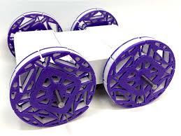
Proposed Solution
After evaluating all ideas, the best solution selected was the PATS transformable wheel. This wheel can change from a circular shape for normal roads to a triangular shape for climbing stairs and rough surfaces. This solution provides better grip, stability, and efficiency, making it highly suitable for real-world applications.

Slide 22
Required components
N20 Motors
Motor Driver or MOSFET
Battery
ESP32

Slide 23
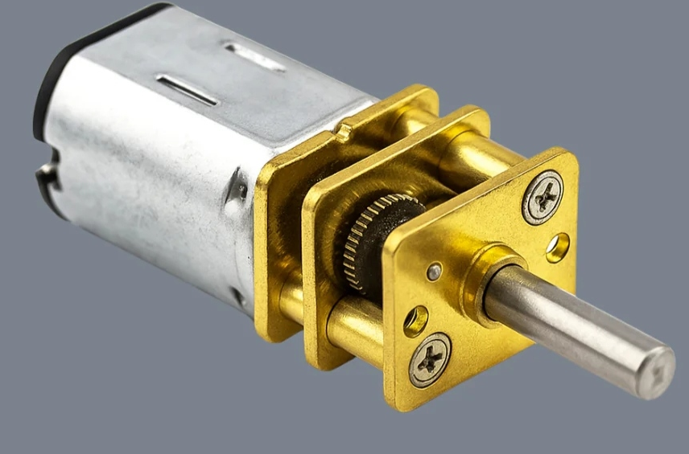
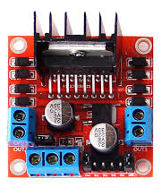
N20 MOTOR
Purpose: Provides controlled rotational motion to drive the wheel mechanism with high torque and low speed.
The N20 DC gear motor is used to rotate the expandable wheel. Its high torque helps the robot climb obstacles and move on rough terrains effectively, making it more suitable than a normal DC motor.
Motor Driver
A motor driver is an essential power amplifier circuit that acts as an interface between a low-power microcontroller (like Arduino) and high-power motors, managing speed, direction, and braking.
Using an H-bridge configuration, it allows motors to rotate forward/backward and supports Pulse Width Modulation (PWM) for precise speed control.
Prevents motor burnout and protects microcontrollers from overcurrent.

Slide 24
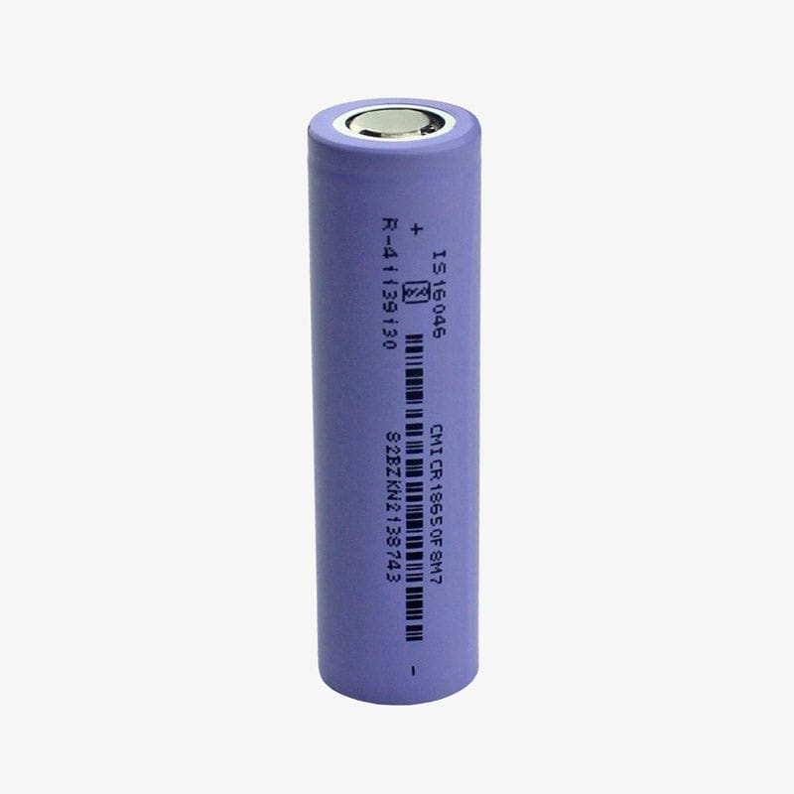
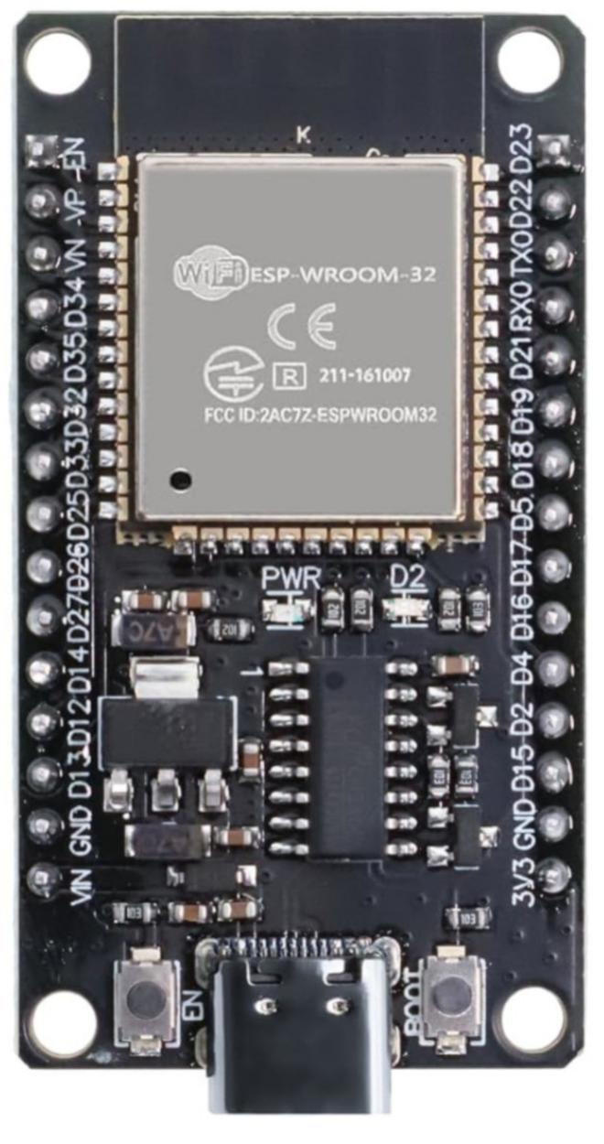
Lithium Ion Battery
Lithium-ion (Li-ion) batteries are rechargeable energy storage devices utilizing lithium ions moving between cathodes and anodes to generate electrical energy, commonly used in electronics and electric vehicles.
They offer high energy density, low weight, and no memory effect but face limitations regarding cost, thermal runaway risks, and sensitivity to degradation.
During discharge, Lithium ions flow from the anode (usually graphite) to the cathode (metal oxide) through an electrolyte, while electrons move through an external circuit, generating electricity.
ESP32 MODULE
It has built-in Wi-Fi and Bluetooth connectivity.
ESP32 is widely used in IOT, robotics, automation, and smart projects. It supports multiple sensors, motors, and communication protocols. It is faster and more efficient compared to many basic microcontrollers.

Slide 25
Conclusion
By "reinventing the wheel," this design successfully bridges the functional gap between high-speed efficiency on flat ground and high-torque traversal over rugged obstacles.​The core achievement lies in the geometric synergy between the base frame, the compression-spring-loaded linkages, and the transformable outer rim. Unlike traditional designs that require active motors to change shape, the PATS wheel utilizes passive energy storage. When the wheel encounters an obstacle, the impact force triggers a bistable snapping mechanism, instantly deploying claws that allow the robot to scale heights up to 70% of its own diameter. This project proves that through clever engineering and simple physics, we can create machines that are more capable, durable, and energy-efficient than ever before.

