Slide 1
DESIGN THINKING AND PRODUCT INNOVAtion
Present by:
24KD1A0265-K.koteswara Rao
24KD1A0266-K.Ramana Pradeep
24KD1A0269-K.Tarun
24KD1A0275-L.Venkat Lakshmi
24KD1A0276-M.Dinesh
24KD1A0277-M.Lokesh
24KD1A0278-M.laxman

Slide 2

Resqux to save the people in danger

Slide 3
CONTENTS
Introduction to design thinking
Problem statement
Empathy
Define
Ideate
Story bording
Proto type
Proto type explanation story
conclusion

Slide 4
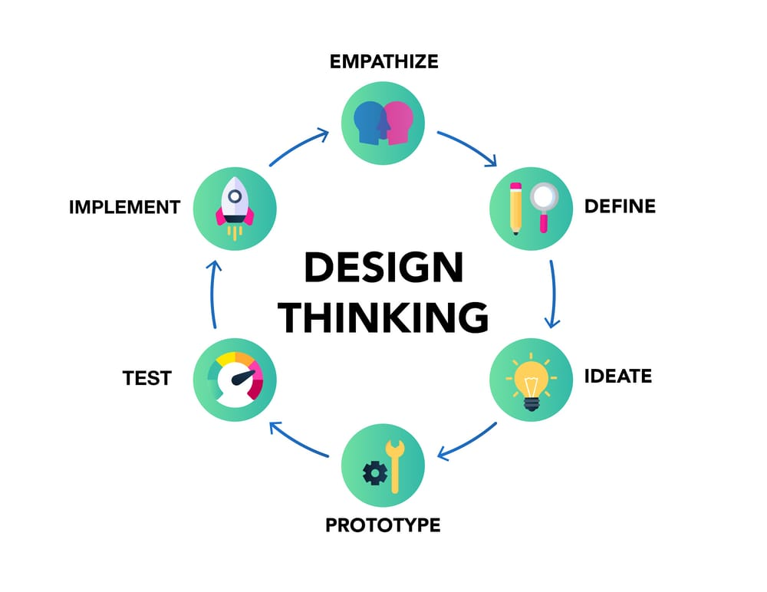
What is thinking and innovation??
Design thinking a human-centered, iterative, and non-linear problem-solving methodology designed to foster innovation by deeply understanding user needs, re-defining problems, and testing practical solutions.

Slide 5
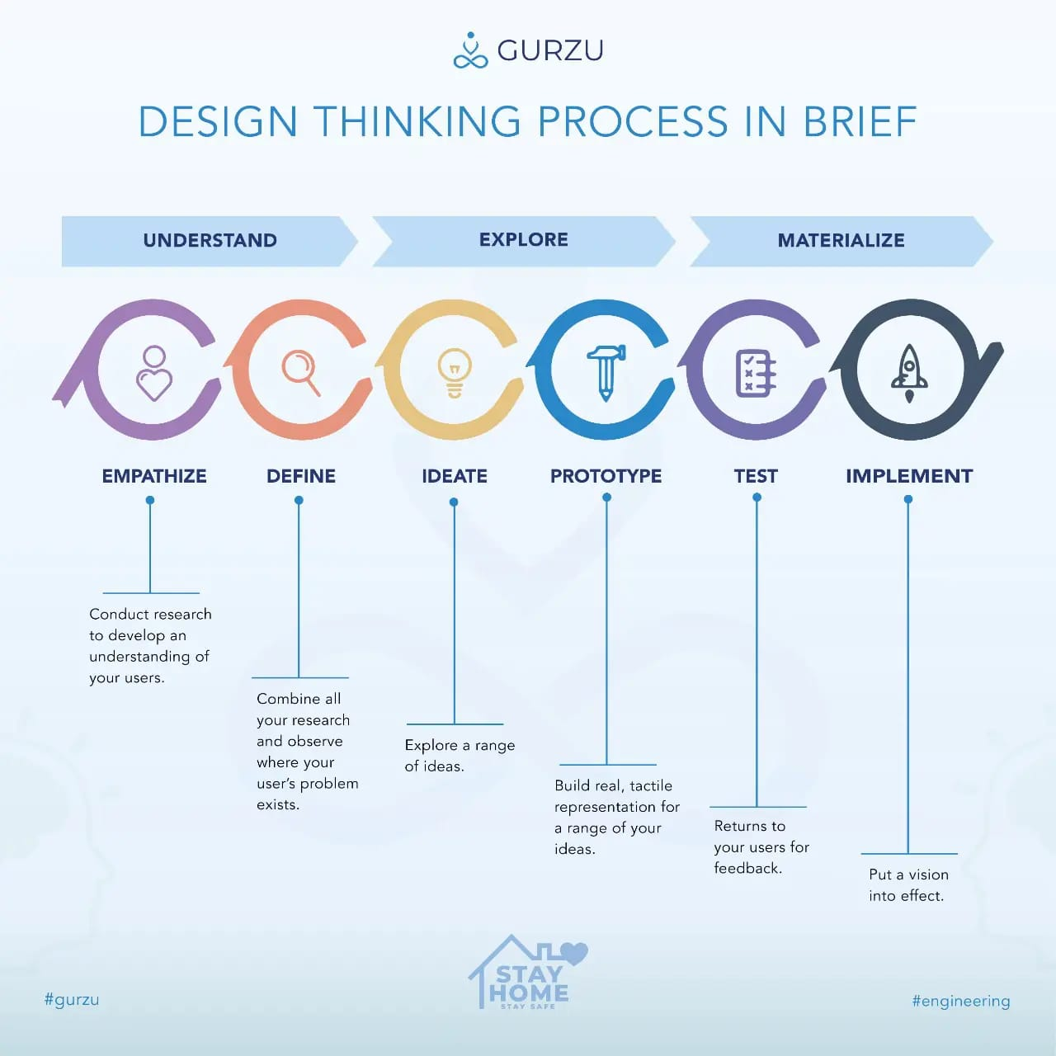
Design thinking Process

Slide 6
Problem statement
In emergency situations such as accidents, health issues, or unsafe environments, individuals often face delays in accessing immediate help due to panic, lack of quick communication tools, and unawareness of nearby emergency services. Existing solutions are either fragmented, slow, or require multiple steps, which reduces their effectiveness during critical moments. There is a need for a simple, fast, and integrated system that enables users to instantly contact emergency services, share real-time location with trusted contacts, and access nearby help resources, ensuring timely response and improved personal safety.

Slide 7
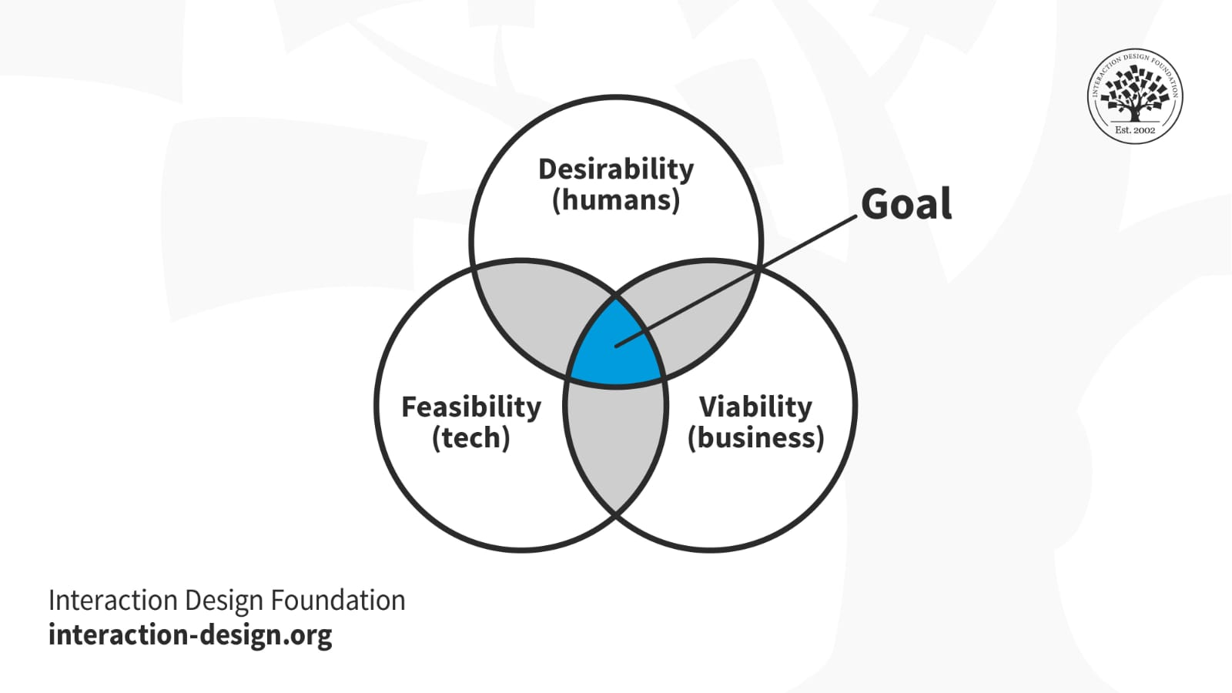
empathy
5 why’s
Persona’s
Interview question
Empathy map
Experience map

Slide 8
Empathy’s level
5why’s
Why are users unable to get quick help during emergencies?
| (why?)
Because they don’t know whom to contact immediately
|(why)
Why don’t they know whom to contact?
|(why)
Because emergency options are scattered and not instantly accessible
|(why)
Why are these options not easily accessible ?
|(why)
Because current systems require multiple steps like unlocking, searching contacts

Slide 9
Our tonughts on 5 whys
m.dinesh
m.lokesh
Why are users unable to get quick help during emergencies?
Ans: Because they are often unsure where to seek help or which service to contact.
Why are they unsure where to seek help?
Ans: Because there is a lack of public awareness about the most efficient emergency channels.
Why is there a lack of public awareness?
Ans: Because emergency information is not effectively communicated through public campaigns.
Why is emergency information not effectively communicated?
Ans: Because there is no centralized, easily accessible platform for emergency awareness.
Why is there no centralized platform?
Ans: Because emergency response systems are fragmented across different agencies and don’t integrate their communication channels.
Why are users unable to get quick help during emergencies?
Ans: because they don’t have immediate access to emergency services
Why don’t they have immediate access to emergency services?
Ans: Because emergency actions require multiple steps.
Why do emergency actions require multiple steps?
Ans: Because the systems are not designed for panic situations.
Why are systems not designed for panic situations?
Ans: Because they assume users can act normally during emergencies.
Why do systems assume users can act normally during emergencies?
Ans: Because there is a lack of empathy and real-world testing in the design process.

Slide 10
Interview question’s
Have you ever been in an emergency situation? What happened?
How did you try to get help at that time?
What was the most difficult part during that situation?
What would you do if you suddenly needed help right now?
Do you know emergency numbers like police or ambulance?
How quickly do you think you can contact help in a crisis?
What problems do you face while contacting help?

Slide 11
Answer’s
Yes, once I saw a road accident. I felt confused and didn’t know whom to call immediately.
I used my phone to call someone I knew and asked them what to do, then called an ambulance.
The main problem was panic. I couldn’t think clearly and wasted time figuring out what to do.
I would try to call a family member first and then search for emergency numbers.
I know some numbers, but I’m not fully sure about all of them.
It may take some time because I have to unlock the phone, find contacts, and call.
Finding the right number quickly and explaining my location is difficult.

Slide 12
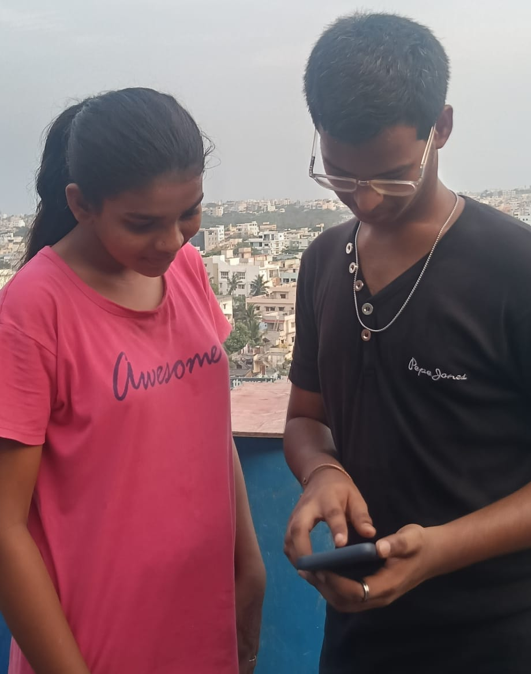
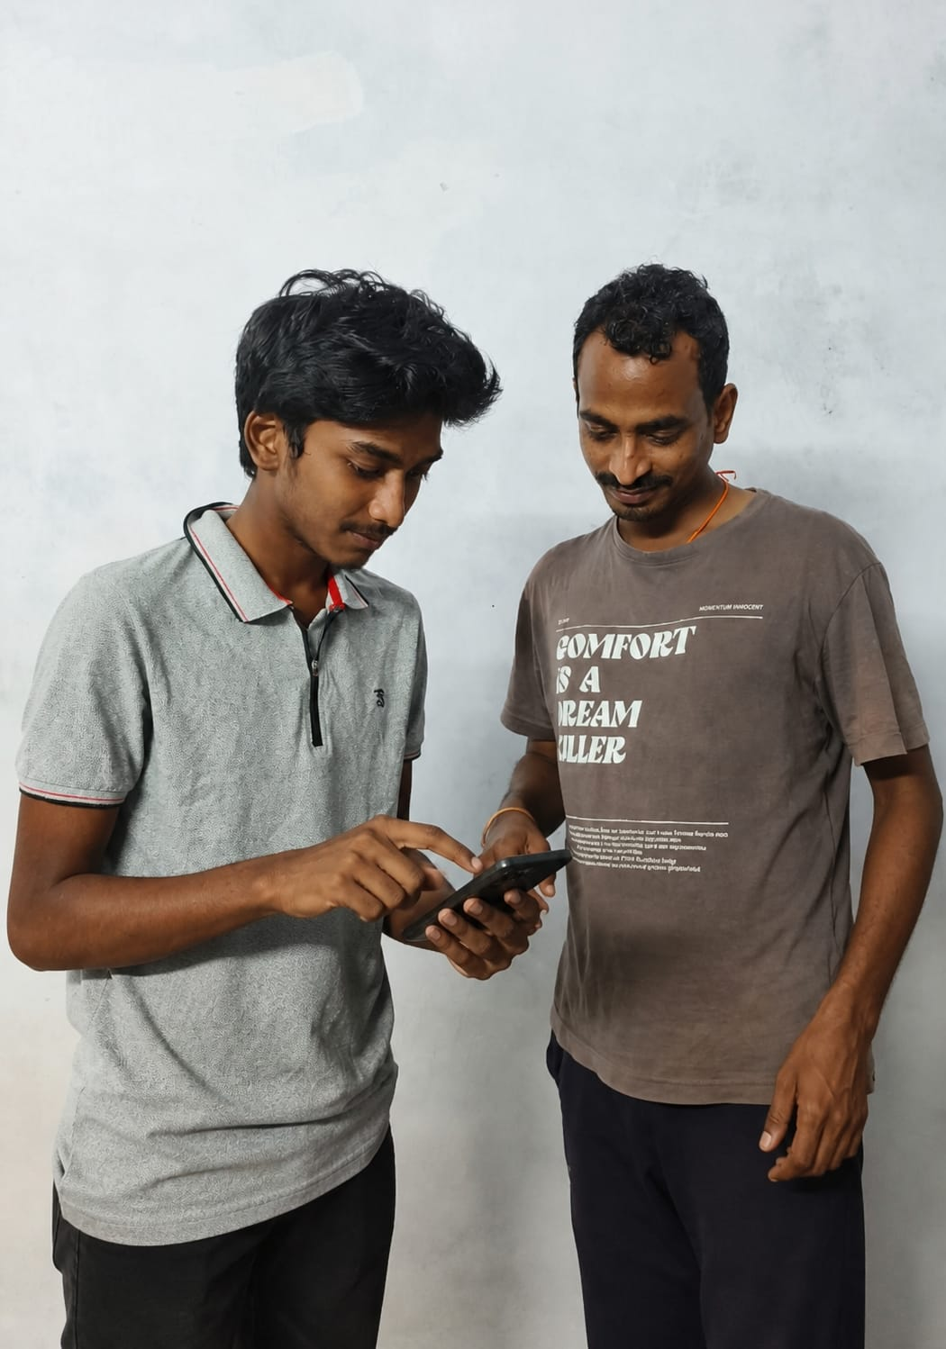
Persona’s
Person 1:
Name: Priya
Age: 20
Job: College Student
Hobbies: Watching movies, chatting with friends, traveling
Problem Facing:
Feels unsafe while traveling alone at night and cannot quickly send emergency alerts.
Person 2:
Name: Rahul
Age: 28
Job: Software Engineer
Hobbies: Gaming, gym, listening to music
Problem Facing:
Faces difficulty in getting quick emergency help during late-night office travel.

Slide 13
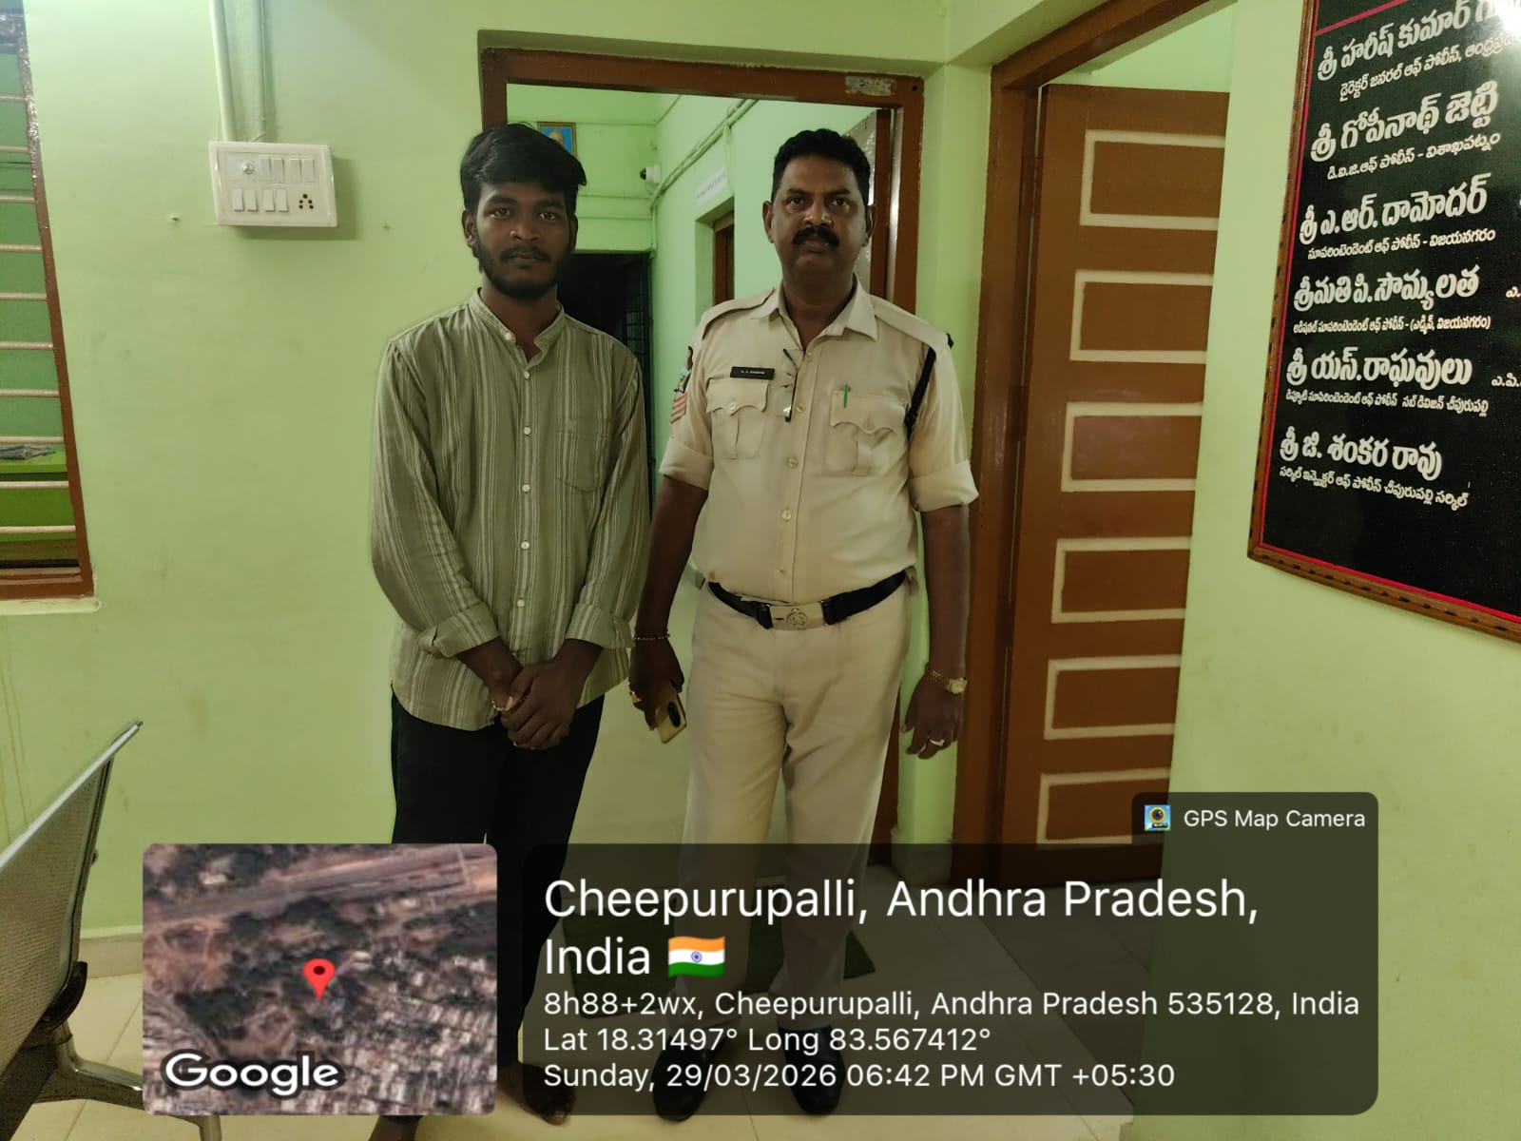
person 3:
Name: Ramesh
Age: 65
Job: Retired Person
Hobbies: Walking, reading newspaper, watching TV
Problem Facing:
Struggles to use complex mobile apps and cannot easily call for help in emergencies.

Slide 14
empathy map
Says:(why they express)
Thinks:(what’s on their mind)
“Help! Someone please help me!”
“I need an ambulance quickly!”
“I don’t know who to call!”
“There is no time, it’s urgent!”
FEELS :(User emotions)
Panic
Fear
Stress
Confusion
Anxiety
“Which number should I dial?”
“Will help reach me on time?”
“What if I press the wrong option?”
“Why is this taking so long?”
DOES :(user actions)
Tries to unlock phone quickly
Opens multiple apps or contacts
Calls random numbers
Shouts for help nearby
May freeze or act irrationally

Slide 15
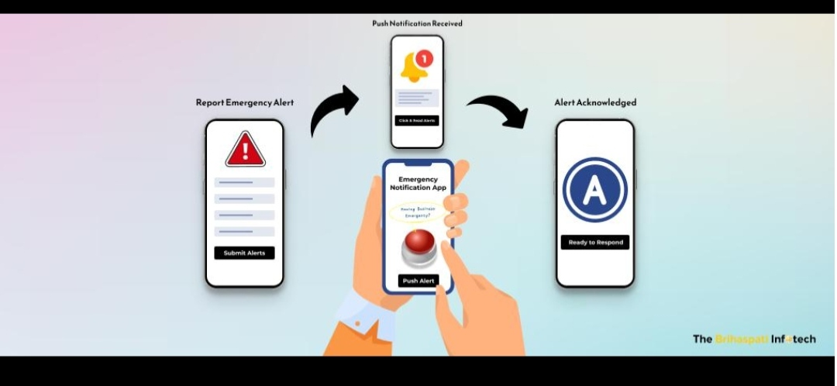
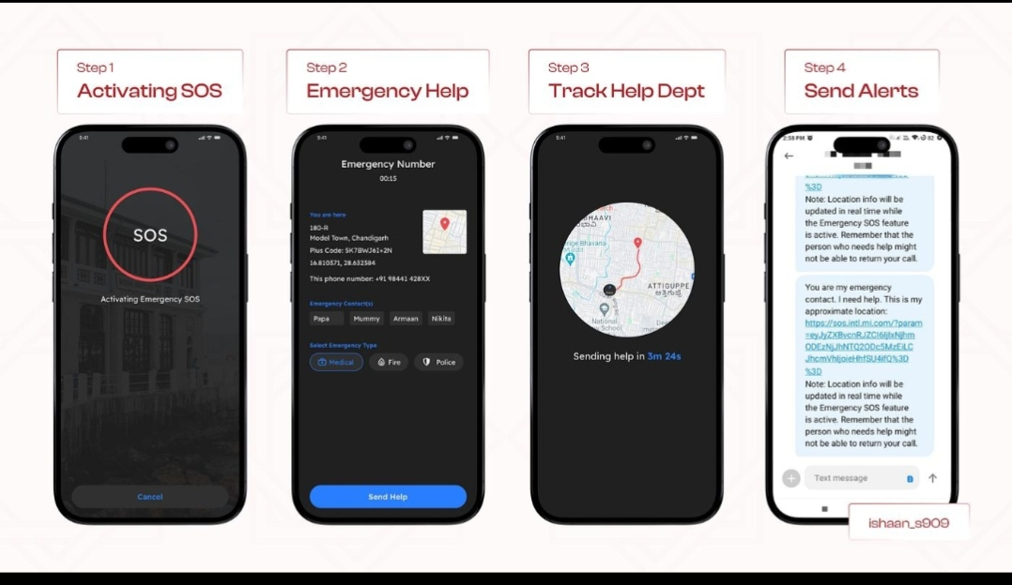
Experience Map

Slide 16
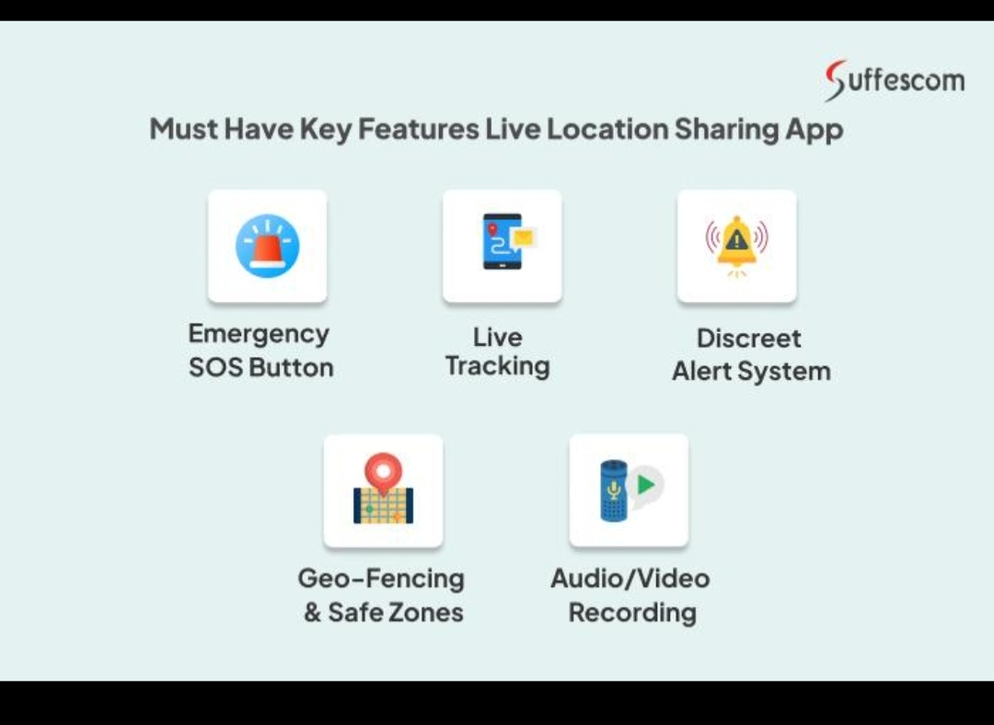
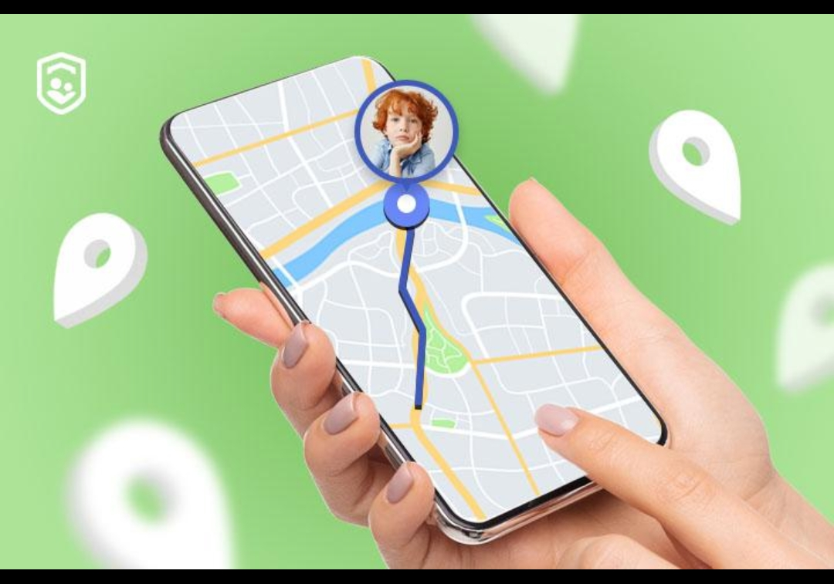

Slide 17
Survey analysis
The survey analysis for the ResQux app shows that most users feel unsafe during emergencies due to confusion, delay in contacting help, and difficulty in sharing their location quickly. A majority of users prefer a simple, one-tap solution that can instantly alert family members and emergency services without multiple steps. Many respondents also highlighted the need for features like live location sharing, nearby emergency services, and a fake call option for unsafe situations. At the same time, some users expressed concerns about privacy and data security, indicating that the app must be trustworthy and easy to use under stress. Overall, the analysis makes it clear that users are not lacking help, but they are lacking a fast and reliable way to access it, which directly supports the purpose of the ResQux app.

Slide 18
define
Q1: What is the main problem?
👉 Users are unable to get quick help during emergencies.
Q2: Why is this a problem?
👉 Because users feel panic and cannot follow complex steps.
Q3: What do users need?
👉 Users need a fast and simple way to access emergency services.
Q4: When does this problem occur?
👉 During critical situations like accidents or medical emergencies.
Q5: What is the impact of this problem?
👉 Delay in help can lead to serious consequences or loss of life.
Final Define Statement (from above answers)
👉 Users need a quick and easy way to access emergency help during panic situations because current systems are slow and complex.

Slide 19
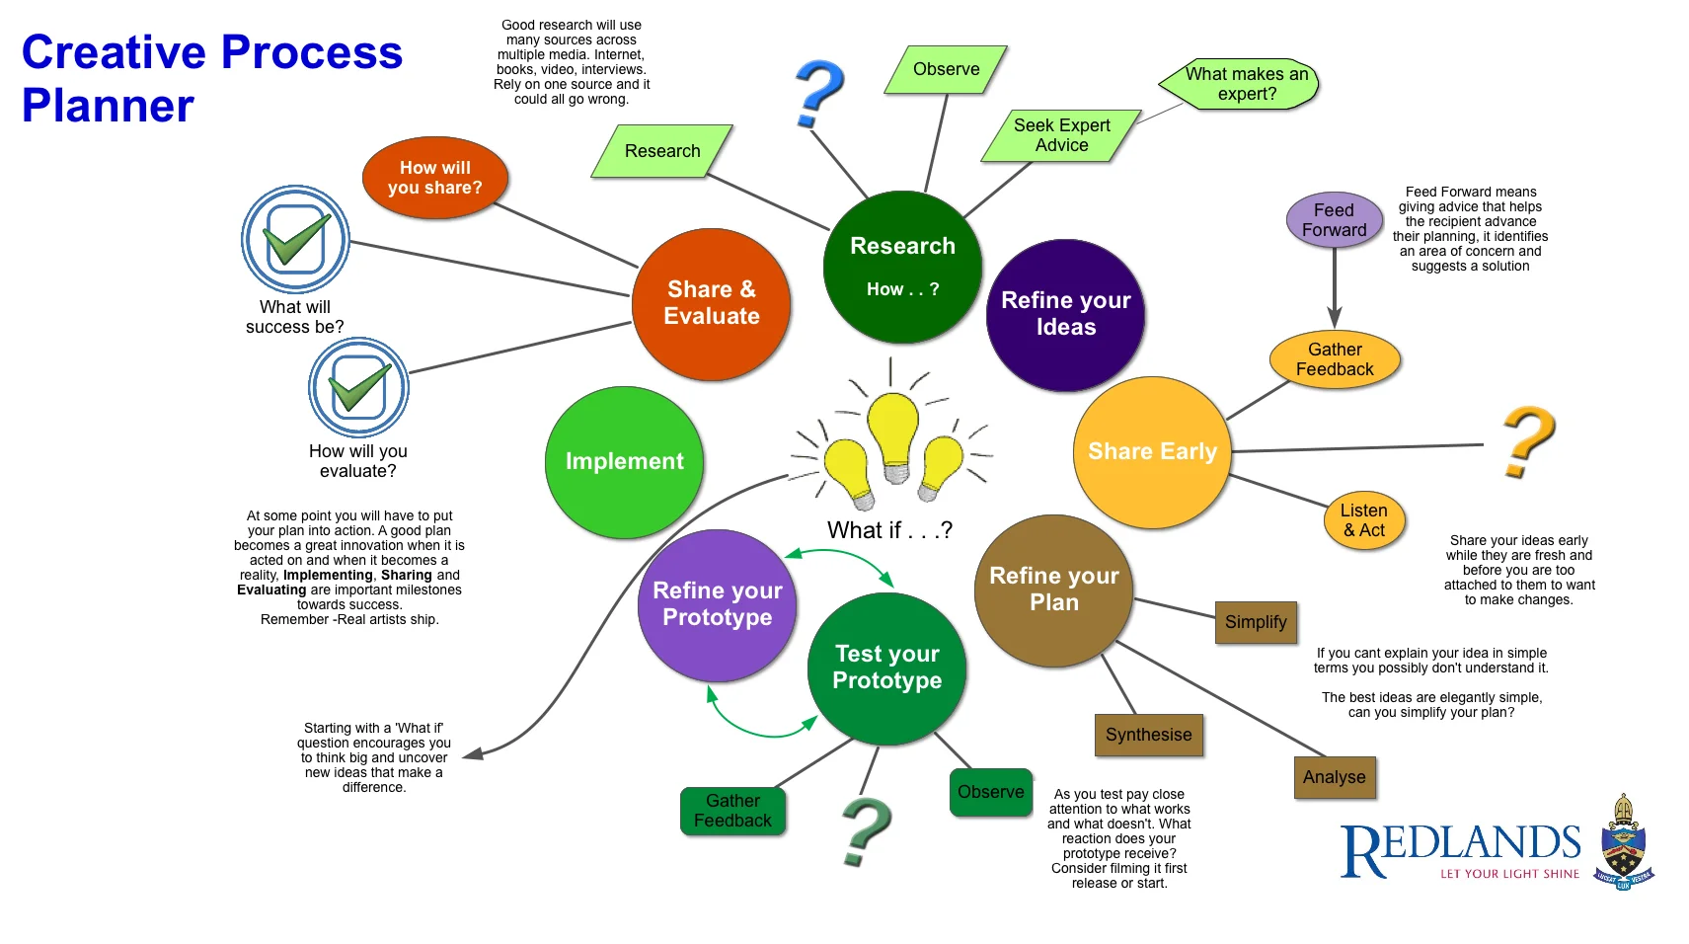
ideation
Brain writing
Brain storming
Dot voting

Slide 20
Brain writing
Brainwriting is a technique where ideas are written instead of spoken.
Each person writes their ideas and passes them to others for improvement.
It ensures equal participation from all members.
In this project, we used it to collect more unique and thoughtful ideas.
BRAIN STORMING
Brainstorming is a method where team members openly share ideas in a group.
Everyone is free to speak without fear of criticism.
It helps generate a large number of creative solutions quickly.
In this project, we discussed different ways to provide quick emergency help.

Slide 21
Dot voting
Dot voting is used to select the best ideas from a list.
Each member gets a limited number of votes (dots).
Ideas with the most votes are chosen as final solutions.
In this project, we selected the most effective emergency solution using this method.

Slide 22
ideation
The solution:
Ideation for the ResQux app focuses on generating practical solutions to reduce response time and simplify user actions during emergencies. Based on user needs, the idea is to create a one-tap system that instantly connects users to emergency services while simultaneously sending live location and alerts to trusted contacts. Additional features like a fake call option, nearby services (hospitals, police, fire stations), voice activation, and automatic alert triggers are considered to handle different real-life situations. The goal of ideation is not to add too many features, but to prioritize speed, simplicity, and reliability, ensuring that even in panic situations, the user can take action within seconds without confusion.

Slide 23
Feedback:
Feedback is the process of collecting users’ opinions after testing the solution.
It helps to understand whether the system is useful and easy to use.
Users share their problems, suggestions, and experiences.
Based on feedback, improvements are made to the system.
It ensures the final product meets user needs effectively.

Slide 24
conclusion
Design Thinking helps to understand user problems and create effective solutions.
By using empathy, we understood the difficulties faced during emergencies.
Define stage helped us clearly identify the problem.
Ideate methods like brainstorming, brainwriting, and dot voting helped generate and select the best idea.
Feedback helped us improve the solution based on user experience.
Overall, this approach leads to a simple, fast, and user-friendly emergency help system.

Slide 25
Thank
you!!

